Slide 1


16- 24 Training Provider Network
Youth Unemployment Updates – February 2022

Slide 2

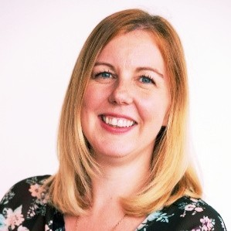
Dan White
Head of Health & Targeted Services
Youth Services
Cheryl Plant
Pathways & Progressions Manager
Lifelong Learning

Slide 3
Sheffield City Council Youth Service Updates
Community Youth Teams
To intervene early to give young people who need help most, the opportunities and support to help them realise their potential.
Community Youth Teams provide a specialist youth support service for older children and young people disengaged or at risk of disengagement from education, training and employment – as well as those at risk of becoming involved in crime, anti-social behaviour, or gangs. The teams also provide a wide range of positive youth work activity with a focus on communities which need it most.
Priorities
To reduce first time entrants to the criminal justice system
To reduce youth-related anti-social behaviour
To reduce the number of young people who are not engaged in education, employment or training (NEET)
SEND Careers Team
Provide personal careers guidance for students within Special Schools.
And offers support for students with an EHCP in Mainstream.

Slide 4
What do we do?
Prevention Workers & Youth Workers
Targeted Youth Support (TYS) Advisors & Assistants / Learning Difficulties & Disabilities Targeted Youth Services Advisors – work to support young people from becoming NEET by providing targeted 1-1 support and careers guidance into positive progression – college, apprenticeships, work and engaging with parents and families.

Slide 5
Operating Model
Identification of vulnerable young people needing support with risk-taking behaviour or evidence based ‘triggers’
Self: young people, parents, carers
Data / information: community, police & ASB data & reports, tensions reports, RONI, NEET, school exclusions,
Professional: CYT staff, Police, Schools, MAST, Learning Providers, Housing, A&E, Support Agencies
Referral
Specialist Young People
Interventions
Triage
Impact & Outcomes
Specialist Interventions
Assessment of need
Key worker allocation
Needs led individual intervention plan
1-1 interventions
Targeted group work intervention
Signposting/referral into other services
Access to in-house assessment of unmet health need
Bridged into community youth work
Positive activities and involvement opportunities
Youth crime prevention
Anti-social behaviour and victim awareness
Careers, education and post-16 advice and support
Gangs, youth violence & weapons prevention
Healthy relationships
Sexting/sexually harmful behaviour
Emotional health and well-being
Community Cohesion
Targeted youth work, engagement and curriculum delivery
Online safety
Young people moved from NEET to EET
Reduced risk-taking behaviour:
Young people who offend for the first time
Young people involved in ASB
Young people at risk of sexual and criminal exploitation
  Improved positive behaviour, youth resilience, aspiration, self-belief and emotional wellbeing
  Improved school engagement
  Successful transition to adulthood
  Signposting and referral to other services
Performance management, quality assurance, monitoring and review

Slide 6
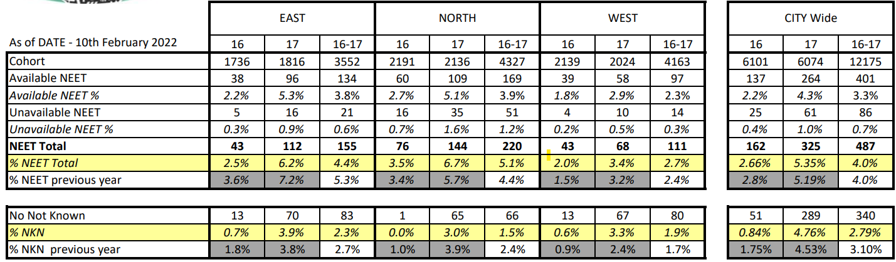
NEETs & Not Known
Academic Age 16 & 17 in Sheffield by Community Youth Team

Slide 7
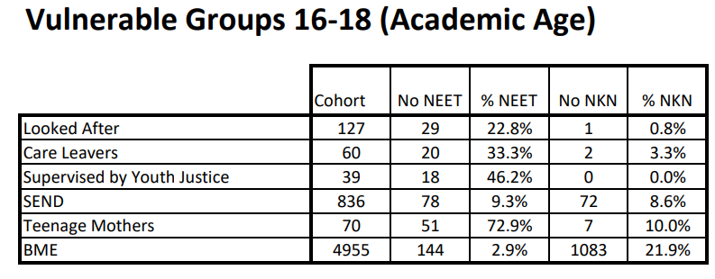

Slide 8
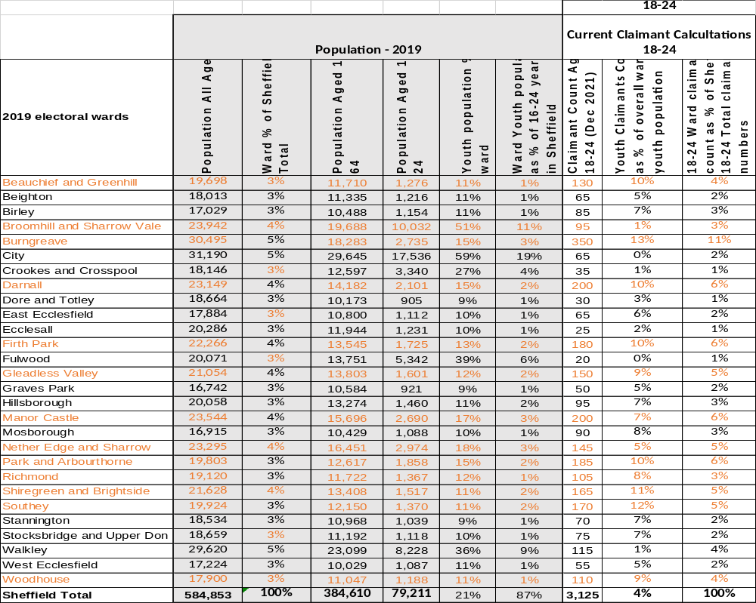
Youth Universal Credit Claimant Data shown is from December 2021
We expect to see a natural increase in unemployment numbers again as temporary employment over the festive period reduces
The areas highlighted in orange are the wards that fall into scope for the Local Area Committee locations where Community Youth Hubs will be active

Slide 9


Slide 10
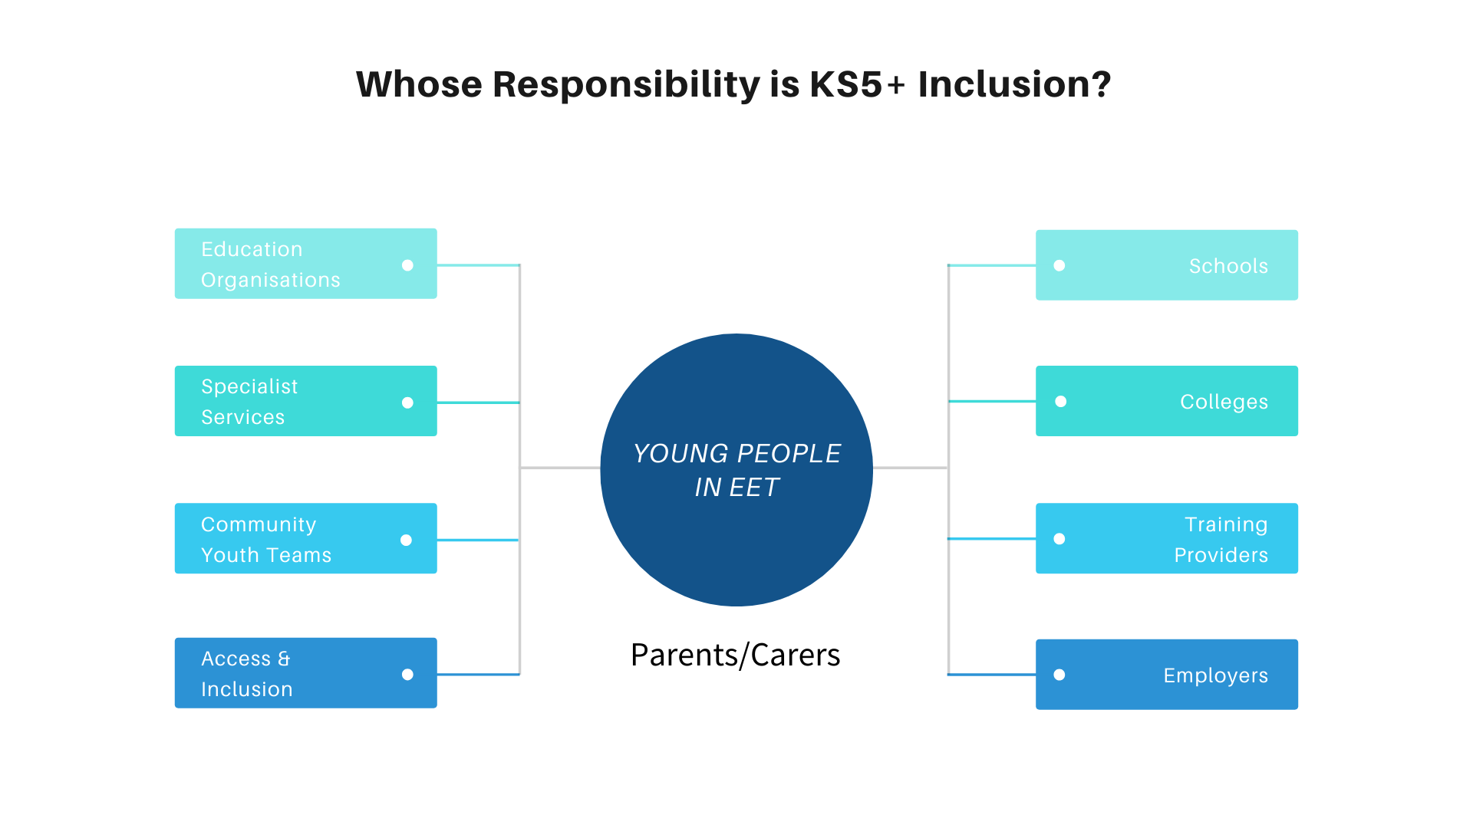
Support to Progress
Pathways

Slide 11
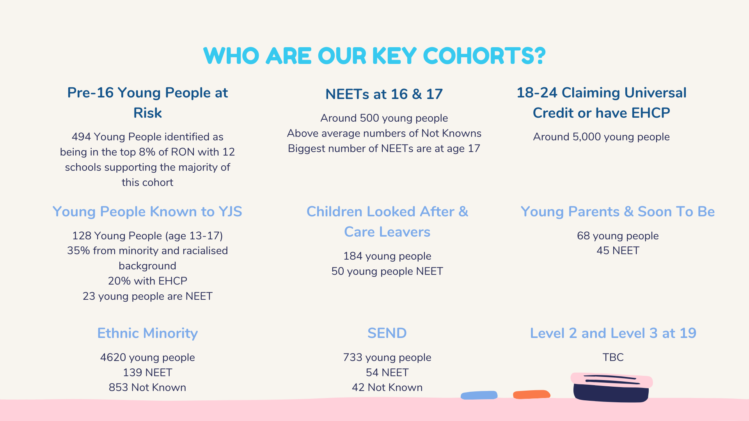
Nb figures shown are a moment in time and for demonstration purposes

Slide 12
We need your help, please
Lifelong Learning will be imminently setting a series of dates to bring people together in these themed discussions with an ambition to:
Share baseline data in relation to EET/NEET status, achievements and experiences
Share current experiences/feedback from support organisations working with each cohort to outline what common barriers to participation are
Help education/training providers understand what LA/Statutory support is available to providers when working with specific vulnerable cohorts
Identify specialist support and provision for each cohort and identify gaps in provision/support – this information will form the basis of an action plan that will be progressed across the academic year
Children looked after/care leavers | Young parents and those soon to be
Young people known to Youth Justice Service | Young people from ethnic minorities
Young people with special educational needs and disabilities (will be progressed through existing groups) | Technical & Vocational Education
Dates will be circulated imminently and all themed discussions will take place before the end of March – please get involved/contribute ❤

Slide 13
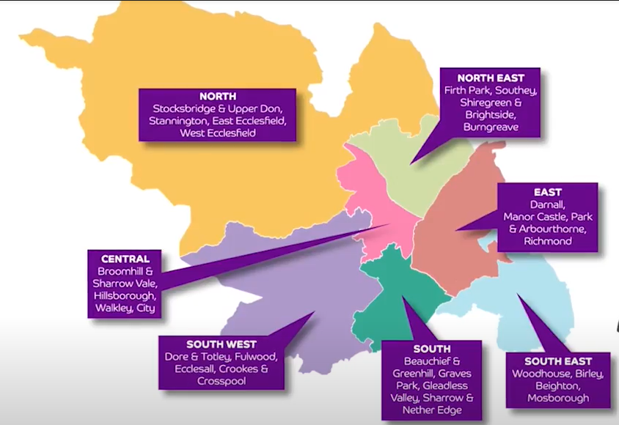
Community Youth Hubs in Sheffield
6 Hubs in Sheffield in total:
1 City Centre – The Sheffield College
4 in Local Area Committee Localities (North East, East, South East & South)
1 Specialist Hub supporting UC claimants with Learning Disabilities
April 2022 Launch

Slide 14
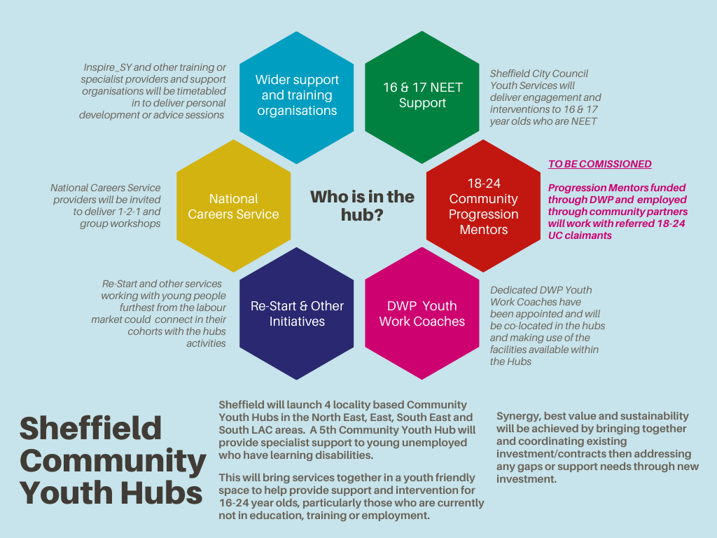

Slide 15
How Providers Can Get Involved
To give the Community Youth Hubs a real buzz of activity and to help connect young people to the great range of brilliant provision and opportunities we have in the city, we invite you to get involved by:
Thinking of taster/personal development/careers awareness/employability sessions that your organisation could deliver in one of the Hub locations
Short sessions up to 1 hour normally
Use this as an engagement activity to support our young people in the city and a chance to connect your offer with future learners
Complete the activity form here: https://forms.gle/5b38XnPNVmmpvo7L9

Slide 16



South Yorkshire Labour Market Information & Progression Pathways

Slide 17
What is START South Yorkshire?
Free to access Labour Market Information platform showing the key sectors for South Yorkshire
Section for 16 - 24 Year Olds: https://southyorkshire.startprofile.com/page/home-page
Section for adults 18+: South Yorkshire Careers | Local Jobs & Career Advice (startprofile.com)2
Here’s the Sheffield specific page: https://sheffield.startprofile.com (This page is in development!)
Tools for learners to develop their own portfolios/CVs/Skills
Industry Insights
Local jobs, local employers, local training and support organisations
If you want to sign up as an education organisation to use the full programme, here’s the detail and link: Start – Careers Platform (startprofile.com)

Slide 18
Actions for Providers
Check if your organisation is listed on the young person section Post 16 Options Section for Sheffield
https://southyorkshire.startprofile.com/page/post16-sheffield
Please note:
If you are based predominantly in another LA area, your offer should be shown in that area. Only organisations with a registered Sheffield base will be shown on the Sheffield page
Definition of a Training Provider in this instance is someone with a mainstream offer that would be promoted to Y11+. Organisations with NEETs response activities/provision should be listed under extra support
SEND Provision is specifically for organisations with learning places that are majority for young people with Education Health & Care Plans. The wording in this section will be updated to encourage young people with SEND to consider all mainstream options as well as the specialist provision.
If you are not listed or you are listed incorrectly, please let us know by sending the provided table back to Tracey.Lovell@sheffield.gov.uk

