Slide 1
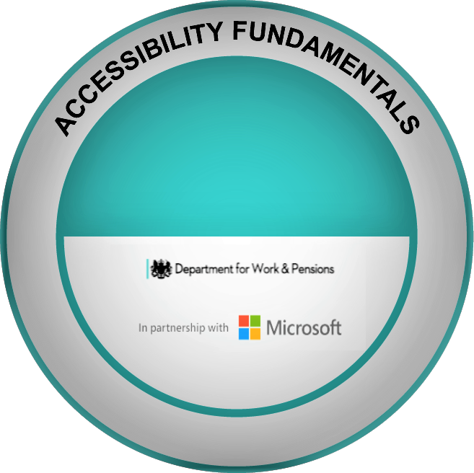
Microsoft and DWP - Accessibility Fundaments
Awareness for External Partners and Employers
November 2021
v1.0

Slide 2
Background and context
Around one in five working-age adults report having a disability, therefore health and disability issues are affecting the working lives of millions of people.
The Accessibility Fundamentals learning aims to support the government’s commitment to getting one million more disabled people into work by 2027.
It is critical that people with disabilities get the right advice and support to secure or retain employment.
The Accessibility Fundamentals learning aims to upskill work coaches in the Department for Work and Pensions (DWP) to support jobseekers with disabilities in using accessibility tools.

Slide 3
What is the Accessibility Fundamentals project?
On 28 April 2021, Microsoft announced that it was partnering with the Department for Work and Pensions (DWP) to help jobseekers with disabilities better use technology to help them gain and retain employment in an increasingly digital workplace.
The learning is called Accessibility Fundamentals and is a one-hour learning product that will be completed by all DWP colleagues in work coach roles along with their line managers.
The learning aims to ensure that all DWP work coaches understand how Microsoft tools such as immersive reader, magnifier and automated captions can help them create and design accessible experiences for jobseekers in securing and retaining work - as well as making a difference to their everyday lives.
Our ambition is for the majority of colleagues in work coach roles to have completed the learning by June 2022.

Slide 4
Resources
Access to Work
Access to Work is referenced in the learning. Support through the Access to Work scheme can help people get or stay in work if they have a physical or mental health condition or disability. The Access to Work scheme can help cover the costs of workplace adaptations, special equipment and travel. Further information is available on the Gov.uk website: Access to Work guide for employers
Microsoft resources
Microsoft are a Disability Confident Leader (level 3) and have produced lots of material about accessibility. You may want to watch some of the videos that are available: YouTube playlist
There is also additional information on Microsoft features on their website: Accessibility Features
For the most up to date information you can obtain access to Microsoft’s twitter page via the attached link: MSFT Accessibility Twitter
A link to other Microsoft learning resources: microsoft.com Learn

Slide 5
Resources (continued)
Other Resources
Huffington Post: “Nothing About Us Without Us” - this mantra “reinforces the role of people without disabilities as strong allies and partners who share the role towards inclusivity and accessibility”
A digital world accessible to all. | AbilityNet - supports anyone living with any disability or impairment to use technology to achieve their goals at home, at work and in education. - Request Free IT Support At Home | AbilityNet
Also, did you know that Microsoft, Google and Apple all have help desks to help people with disabilities access their products. You may also find these useful as well as sharing details with your customers.
Microsoft - Disability Answer Desk
Google - Support.google.com/accessibility
Apple - Accessibility Support - Official Apple Support

Slide 6
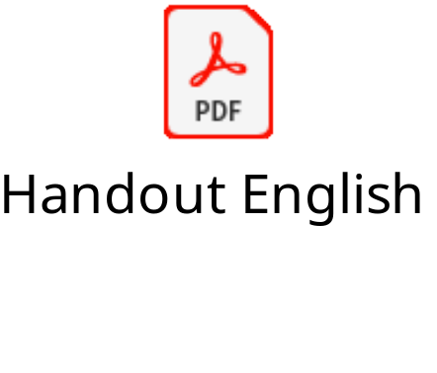
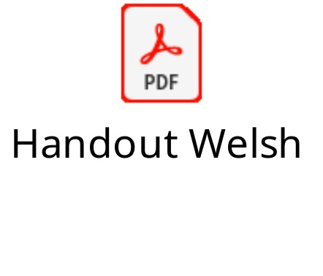
Handout for jobseekers
A handout is also available for sharing information with jobseekers to improve their knowledge of what features exist that will make it easier for them to use technology. The handout can be shared via e-mail and it contains some useful links to resources.
  Handout for jobseekers (English version)
  Handout for jobseekers (Welsh version)

