Slide 1
South Yorkshire Ownership Hub
Employee and worker ownership
Colette Harvey
Colette.Harvey@southyorkshire-ca.gov.uk
Notes:
Hello

Slide 2

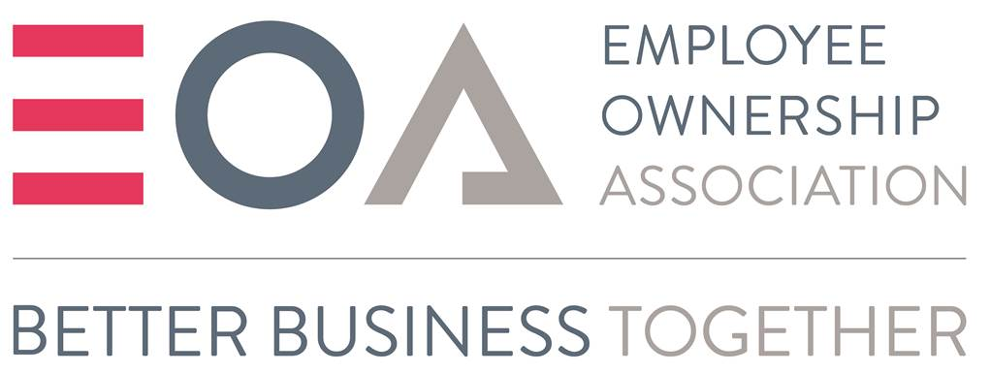

What is the Ownership Hub?
The Ownership Hub aims to
raise awareness, knowledge and capacity
among entrepreneurs, business owners and business advisors
to grow employee and worker ownership.
Notes:
The Ownership Hub is a partnership initiative between the Employee Ownership Association and Cooperatives UK
We’re working with the South Yorkshire Mayoral Combined authority to grow worker and employee ownership across the region
We’re doing this by offering training and running events, like this one, to raise awareness and knowledge of alternative forms of business ownership among entrepreneurs, business owners and business advisors.
We’re supporting 2 different types of businesses – employee owned businesses and worker co-operatives.

Slide 3
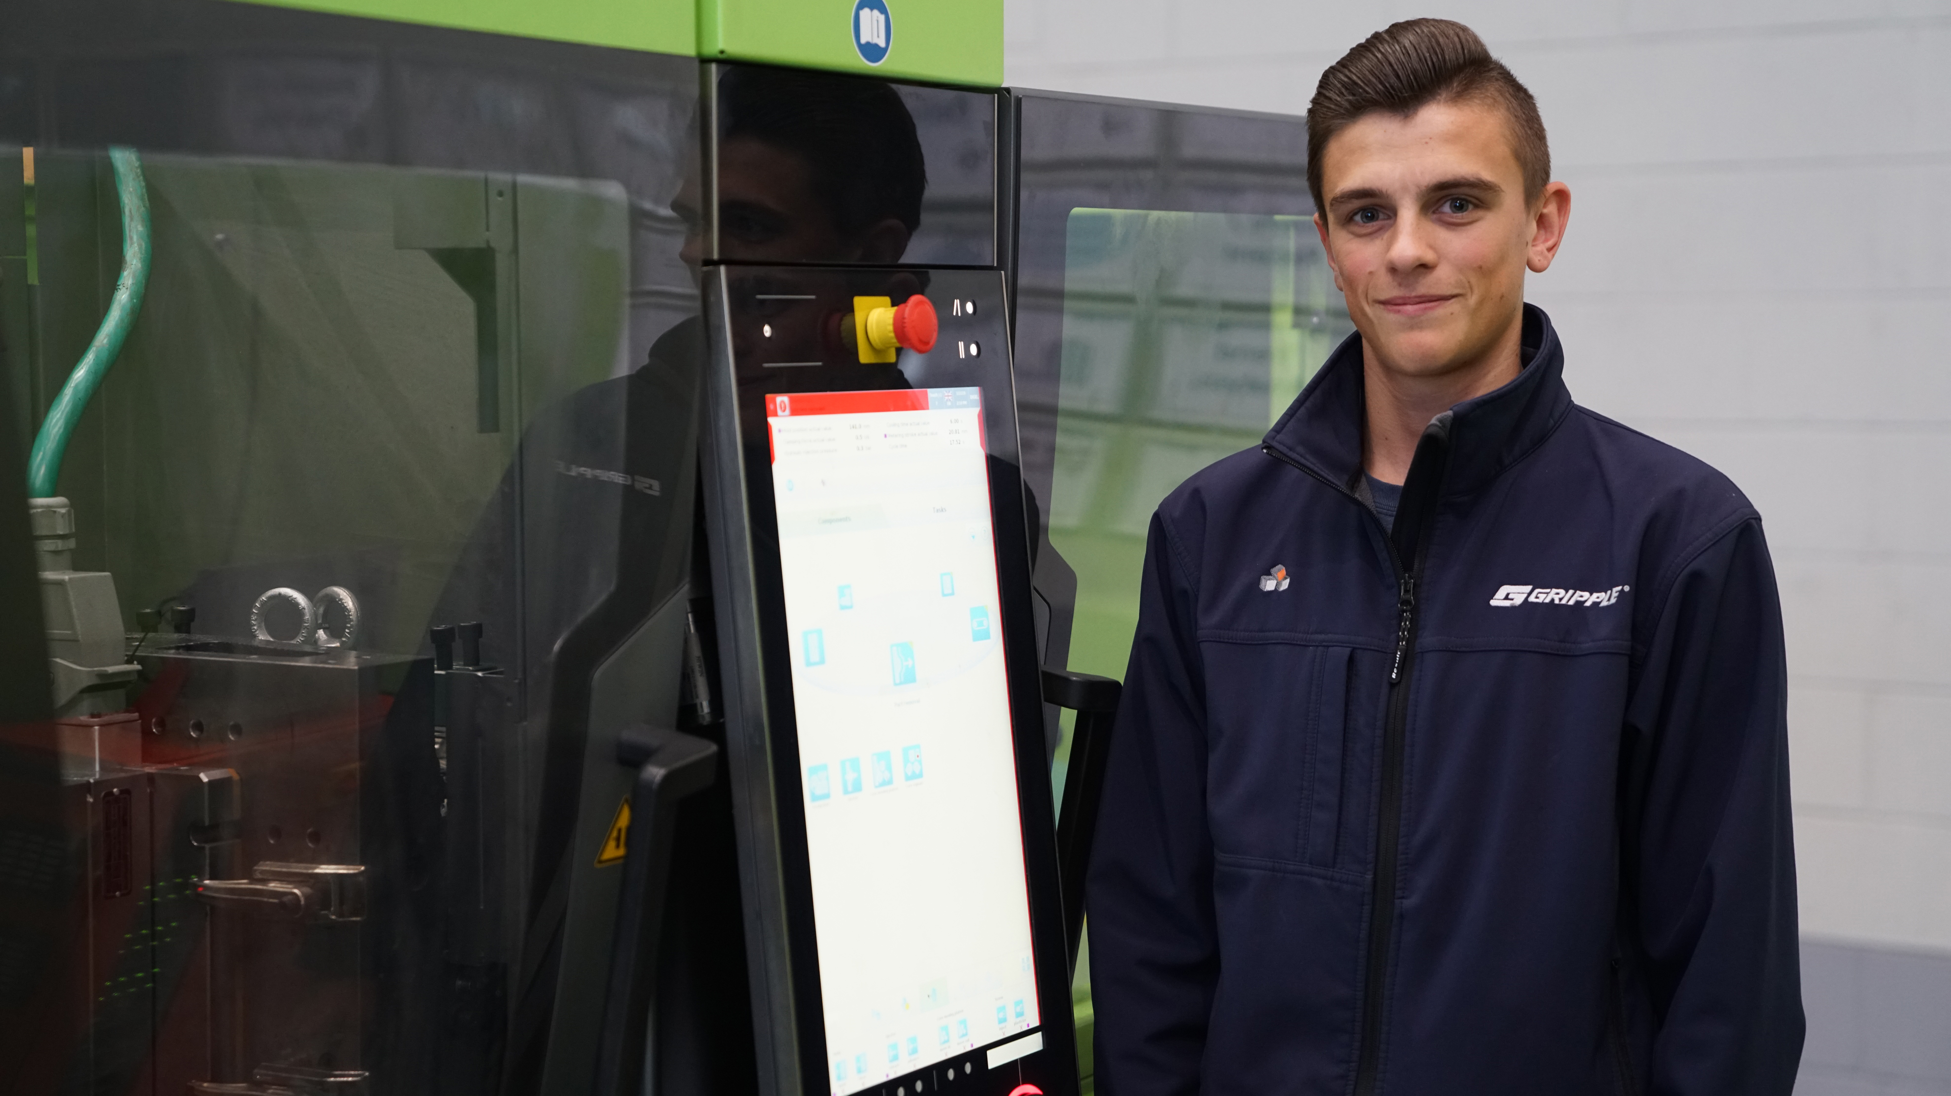
Employee Ownership
Employee ownership is when more than 25% of a business is in the hands of the employees, through direct or indirect share ownership.
Employee voice is represented in the operational and strategic direction of the business.
Notes:
Employee ownership is defined as a business that ‘offers a meaningful stake and a say for all employees’ (Nutall Review 2012)
A meaningful stake means that more than 25% of the businesses has to be in the hands of employees. Most employee owned businesses have a majority stake of more than 51% or are 100% employee owned.
A meaningful say means that there needs to be representation of employee voice in the operational and strategic direction of the business.

Slide 4
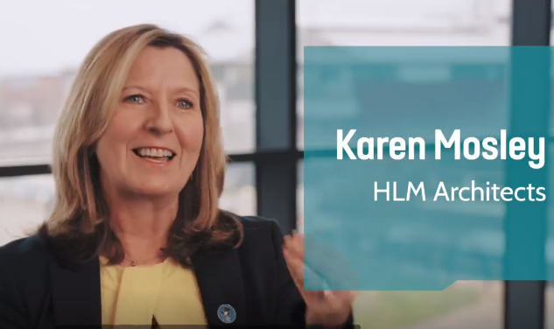
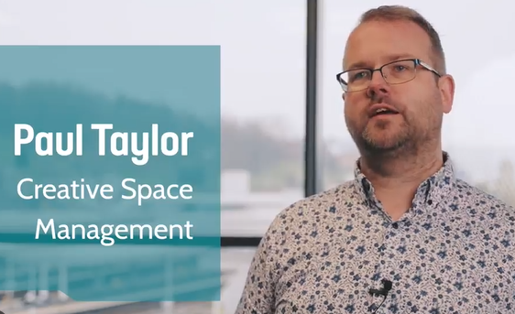
What do local businesses think?
“It’s like a post-pandemic model, it’s ideal for that. Our staff had been really creative and really innovative during that time…and so it was a real natural step for us.”
Click on photo to watch short video clip
Click on photo to watch short video clip
“We’re a service business, so our assets are our employees and we didn’t feel like in a traditional business model that they would be adequately rewarded.”
Notes:
We made some video case studies of local employee owned businesses – they’re in the pre-read information which was sent out to you. The case studies highlight some of the benefits of becoming employee owned.
Karen Mosley, from HLM Architects, explains she views employee ownership as a post-pandemic model as it increases employee engagement.
Paul from Creative Space Management, which manage buildings in Sheffield and Rotherham explains that they became employee owned to better reward their employees.
*need an internet connection to watch video clips

Slide 5
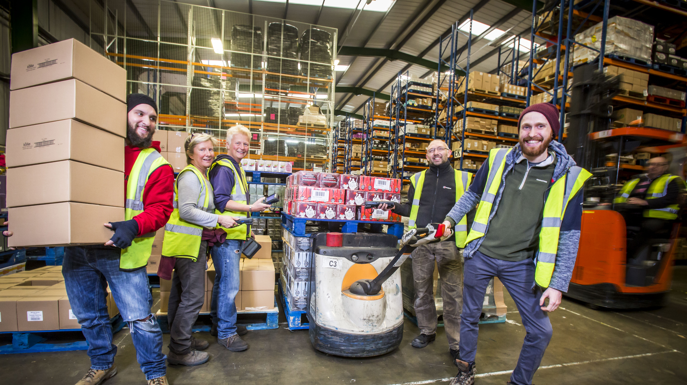
Worker
Co-operatives
Worker co-operatives are values-driven businesses which are democratically owned and run by the people who work in them through a membership model.
All workers have an equal say in what the business does (one member, one vote), and an equitable share in the surplus created.
Notes:
Moving on to co-operatives
Co-operatives are businesses which are owned, controlled and run by and for their members. They can have different types of members – customers, service users, community, residents and workers. And it’s that last membership group we’re interested in.
Worker co-operatives are trading businesses, owned and run by the people who work in them. The workers have an equal say in what the business does, and an equitable share in the wealth the business creates.
Sometimes businesses are not exclusively owned by workers. Sometimes workers share ownership and control with other stakeholders, like the local community, or customers in a co-ownership model.

Slide 6
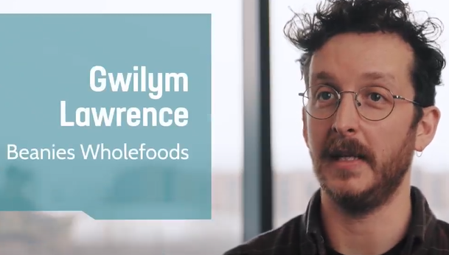
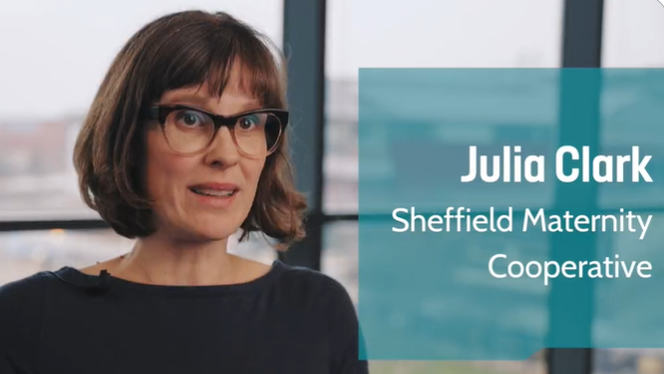

What do local businesses think?
“Anyone can benefit from working in a worker’s co-op because it means you have a connection to what you’re doing”.
Click on photo to watch short video clip
Click on photo to watch short video clip
“We've had people contact us from around the country saying they're interested in running something similar to what we do.”
Notes:
We made some video case studies of local worker controlled co-operatives.
Beanies Wholefoods in Sheffield is fully owned by the workers and Gwilym explains how this can give you a greater connection to your work, making it more enjoyable.
Sheffield Maternity Co-operative is a collective of midwives and birth workers, who provide care, support and advocacy services. It is co-owned by the workers and the community. Julia explains how their co-operative is the first offering these services in the UK and it is thriving. People from other places have been in touch asking how they can set up a similar model.
*need an internet connection to watch video clips

Slide 7
What is the difference between employee owned businesses and worker co-operatives?
Employee Owned Businesses
Owned by the employees via a company shares model. Shares are often held in a Trust on behalf of the employees.
There’s a minimum of one employee trustee on the Trust Board to represent the views of the employees. The employees have a say in the business governance via the employee trustee/s.
Worker Co-operatives
Owned by the workers via a democratic membership model. Co-operatives follow the co-operative principles and values.
Each member has an equal say in the running of the business – one member, one vote. Worker members will usually vote on big decisions which affect the co-operative and their working conditions.
Notes:
Speak to notes on slide and…
EOBs:
Likely to be of interest to:
- existing, successful small or medium businesses which have a “family” culture.
- family or founder business owners who are wanting to pass the business on to
Worker co-operatives:
Likely to be of interest to new or early-stage businesses which are values led.
Also suitable for:
- existing businesses looking to transfer ownership to their workers.
- a collective of freelancers or sole traders who are looking to formalize their collaborative working

Slide 8

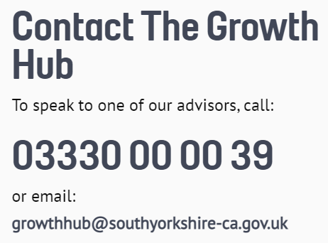
What’s on offer for entrepreneurs & businesses?
For new and emerging co-operatives
  Co-operatives UK business support programme is currently accepting applications.
  Contact the Growth Hub to access start-up and early stage support from a Launchpad business advisor
  Contact the Growth Hub to access Skillsbank or Advance for skills support and subsidised or free training
  Contact Sheffield Co-operative Development Group.
For conversion to employee ownership:
  Contact the Growth Hub to access confidential support from a business advisor about succession planning
  Contact the Growth Hub to access Skillsbank or Advance for skills support and subsidised or free training
All Ownership Hub support is accessed via the SY Business Support Growth Hub:
Notes:
What support is on offer for entrepreneurs and businesses through the Ownership Hub?
First it is important to note that all Ownership Hub services are accessed via the South Yorkshire Business Support Growth Hub.
People can access confidential business advice for start-ups, early stage and established businesses. You can also access free and subsidised skills development support for your staff to provide them with employee and worker ownership related skills.
So if you want to speak further about the support on offer through the Ownership Hub, do get in touch with the Growth Hub.

Slide 9
What events are coming up?
Mayoral breakfast. Thurs 10 Nov, 10am-12 noon in Doncaster at Danum Gallery. Book your place here.
Business Advisor training.
  How to spot and support a new worker co-operative. Tues 18 Oct, 10am to 11.30am. Book your place here.
  How to spot and support employee ownership conversions. Tues 22 Nov, 10am to 11.30am. Book your place here.
Training workshops for entrepreneurs, sole traders and groups who want to find out more about co-operatives. Sign up to the Co-operatives UK newsletter to receive updates on these 3 in-person workshops, which will be held in South Yorkshire, as well as to hear about co-operative news, advice and opportunities.
  Is starting a co-op right for you?
  Freelancers Unite! The power of co-ops and joint working
  Own your job: How starting a co-operative can empower you and your co-workers
An introduction to Employee Ownership webinar. Weds 2 Nov, 11am-12.30pm. Book your place here.
Notes:
We also have some events coming up in the next few months
Talk to events on slide and invite people along.
I can send out the slide pack afterwards with the sign up links.
If you want to talk with me further about worker co-operatives or the Ownership Hub, please get in touch.
Thanks!
How to spot and support a new worker co-operative – click the link to book a place – Tues 18 Oct, 10am to 11.30am
This free 90-minute training session aims to provide business advisors with the information and resources they need to understand co-operative business models, when they would suit a start-up or early-stage business, how to support and advise these types of businesses, and when to signpost on to more specialist forms of support. We’ll be joined on the day by a specialist co-operative advisor and a member of a local co-operative.
How to spot and support employee ownership conversions – click the link to book a place Tues 22 Nov, 10am to 11.30am
This free 90-minute training session aims to provide business advisors with the information and resources they need to understand employee ownership business models, when they would suit an established business (particularly those exploring succession planning), how to support and advise these types of businesses, and when to signpost on to more specialist forms of support. We’ll be joined on the day by a specialist employee ownership business advisor and a representative from an employee owned business.

