Slide 1


Slide 2








Who We Are
Training Provider:
Sheffield
Derby
Manchester
Birmingham
Recruitment Agency:

Slide 3
Our Vision
Breaking Down Barriers to Learning & Employment
Referral Partners – lots of them!
Thorough IAG process
Right Person Right Course
Incentives
Employer Interviews

Slide 4

Our Offer - Construction
Introduction to Construction
Health & Safety in a Construction Environment
CSCS Test + 1 Resit
CSCS Card
" I am very grateful for all the support Momentum has given me. Coming on the course was one of the best decisions I've ever made, as it has renewed my confidence and rekindled my passion for construction, with Momentum's help I have successfully managed to obtain my CSCS card and gain employment as a site supervisor. Thank you for all your help, I would recommend Momentum to anyone wanting to get back into work "
Upcoming Start Dates:
10th October

Slide 5
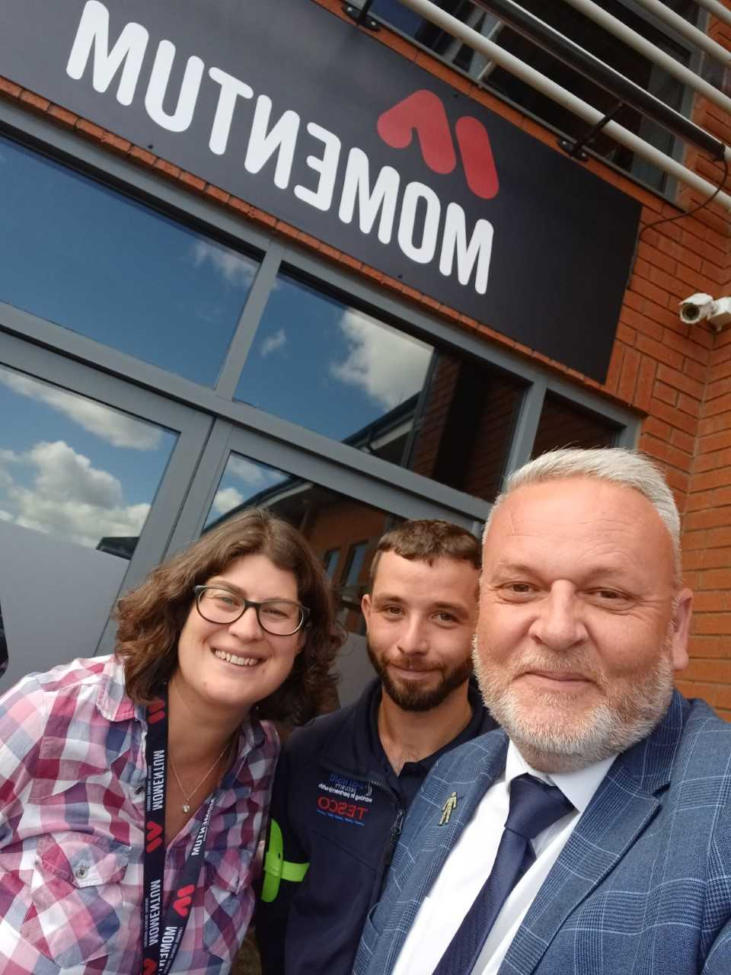
Our Offer - Security
Employability Skills i.e. team leading skills
Stewarding Step Off Point
First Aid & Door Supervisor
2 x Resits
SIA Badge
Employer Interviews & Application Support
Josh completed his SIA course and got his interview with Carlisle Support Services. He has been working as a security guard for Tescos for past 6 months. He recently came to talk to new learners about how they could follow his example!
Upcoming Start Dates:
10th October

Slide 6

Our Offer - Warehousing
Employability Skills i.e. team leading skills
Sector Specific Qualification in Warehousing
Counterbalance & Reach FLT Licence
Employer Interviews
Upcoming Start Dates:
10th October

Slide 7
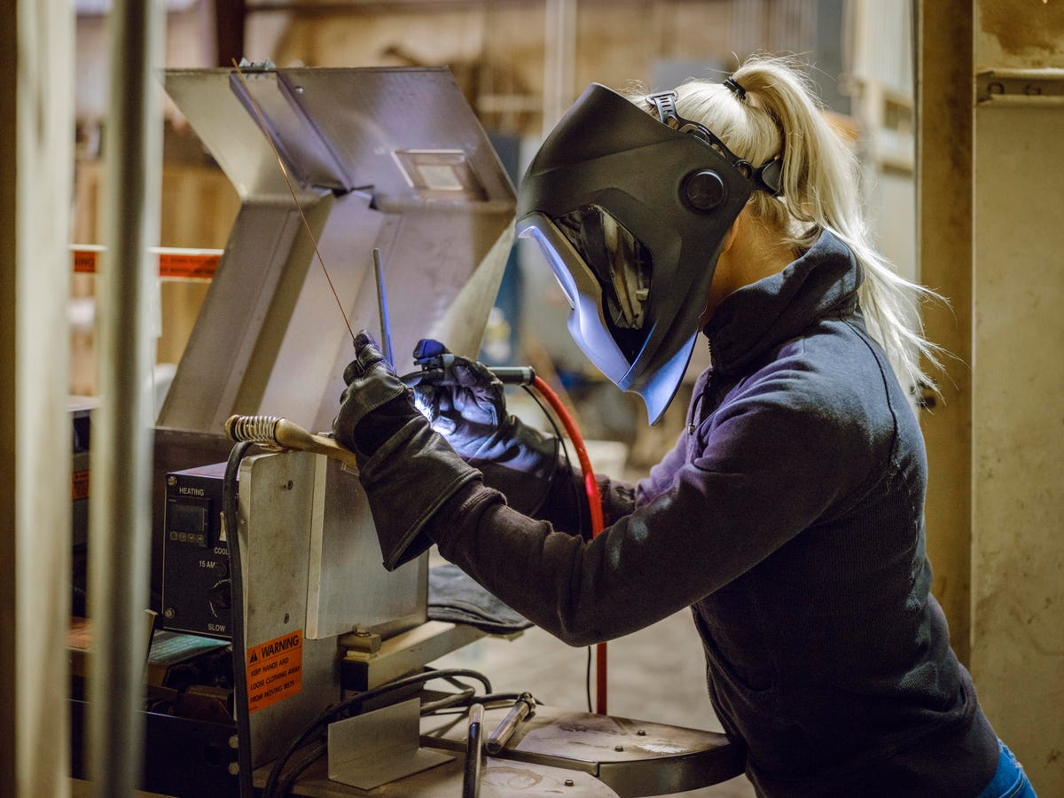
Our Offer - Welding
Specialised Welding Techniques
TIG, MIG, MMA & Fabrication
Bespoke Welding Unit
Virtual Welding Machines
Guaranteed Employer Interviews
Upcoming Start Dates:
24th October

Slide 8
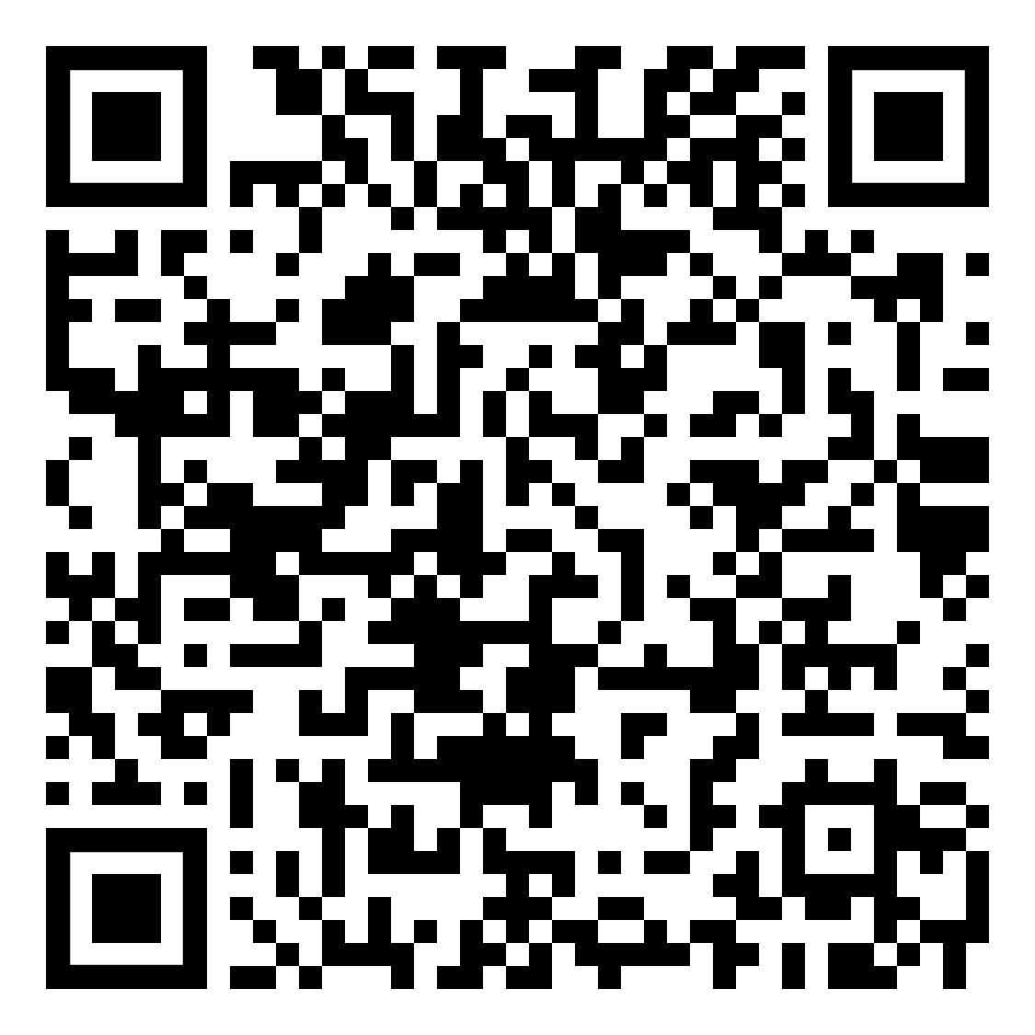
How to Apply
EASY!
Just scan the QR Code and complete the Application Form!

Slide 9
What’s Next?
Employer Interviews for Skills Bootcamp Learners
Commercial Courses
Skills Bootcamps in Welding & Engineering
Embedding more digital skills

