Slide 1




Teacake Club Spring Meeting 2023
Cost of living special
Part-funded by the European Social Fund

Slide 2
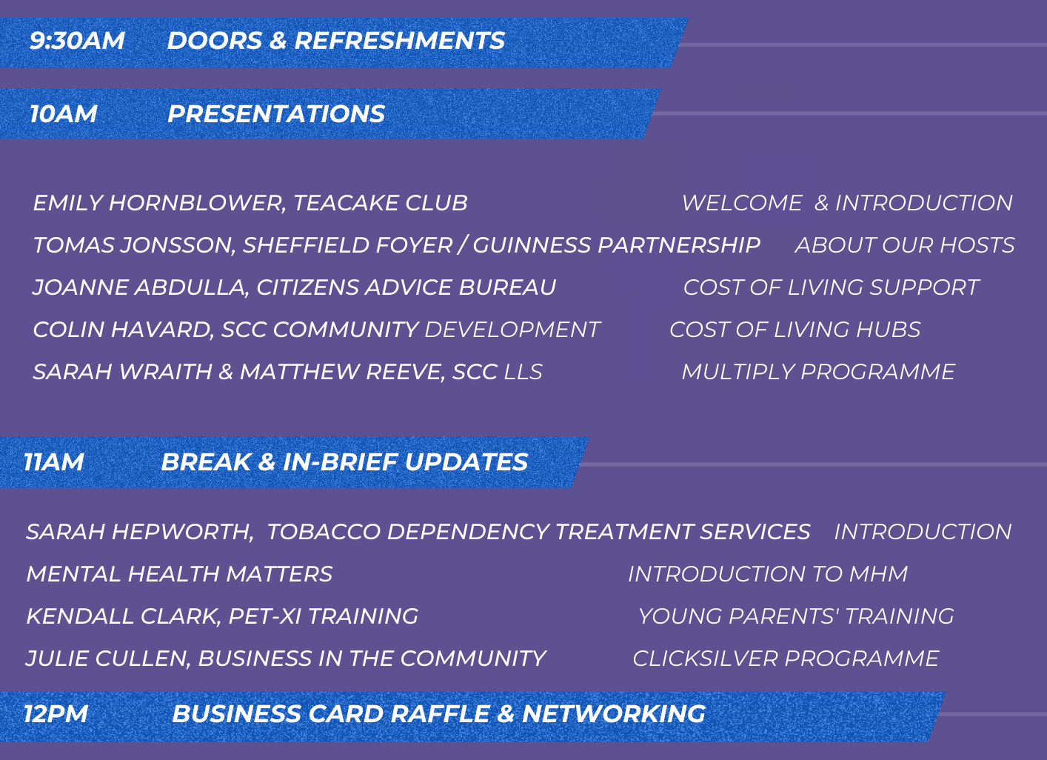

Slide 3


Our impact in 2021/2022
The difference our advice service makes to Sheffield

Slide 4
We are Citizens Advice Sheffield
Every year thousands of people come to us for help solving their problems.
This means we’re an important part of the community, with a credible understanding of local needs.
We use this to tailor our services and help improve local policies and practices.

Slide 5




Our 4 service commitments:
Our services are accessible and available when needed
We support prevention and early intervention
We help people achieve the outcomes they want and which will have the greatest impact on their lives
We make the best use of our resources to make the greatest difference

Slide 6

Our advice
Our services
We deliver this advice through a wide range of services to reach as many people as possible
We provide free advice on the 5 main areas of law
Welfare Benefits
Immigration
Debt
Employment
Housing
Adviceline
Help to Claim
Deaf Advice
Mental Health
Law Centre
Hospital-based support
Advocacy Hub
Consumer
Foodbanks
Pensionwise
And much more…

Slide 7

How we help
Dana’s story
Dana lives alone on a limited income.
She is unable to work due to multiple physical health issues including COPD, Muscular Dystrophy, Fibromyalgia, Osteoarthritis and mental health problems.
As a result she struggles to leave her home.
Many of our clients are vulnerable, for example due to their health or living arrangements, and facing really difficult situations.
Dana* is one of the people who turned to us last year.
Her story shows how we help people solve their problems and the positive impact this has on their lives.
*name changed for anonymity

Slide 8
Dana’s Story
The adviser helped Dana to submit a new claim but she was not awarded enough points in the assessment. The mandatory reconsideration was also unsuccessful so the adviser proceeded to appeal.
Dana had to rely on food banks throughout this time, she also faced challenges with her own mental health, had surgery and had to deal with her brother’s funeral.
Dana initially contacted Citizens Advice Sheffield in January 2021 for help getting a food parcel.
During her appointment, she mentioned a concern about her Personal Independence Payment (PIP) renewal.
CAS supported Dana to renew her PIP claim but her form went missing and her claim was closed.

Slide 9
Dana’s Story
As Dana’s story demonstrates, people often come to us with multiple or complex problems.
We aim to provide a holistic service and can deal with most of the issues people come to us with, tailoring our advice to their needs.
We provide follow up support, including complex casework if it’s needed to help people resolve their problems.
Wherever possible, we aim to empower people to find and use the resources to help solve their problems independently.
After a further 6 months’ of waiting for the tribunal hearing Dana won her appeal in April 2022 and was awarded around £4,300 in backdated PIP.
This outcome is a huge success for Dana. She is finally given the money she was entitled to and no longer faces the enormous stress that comes with a benefits appeal.

Slide 10

The difference this makes
“It's taken a long time and hard work to resolve this issue and we would not have been able to do it without your expertise. It really has made a profound difference to the lives of X and X’s family, including us. I can't thank you enough.”
- Client feedback
The impact of our advice goes far beyond the financial outcomes.
The toll that living in debt or poverty can take on physical and mental health has been heavily evidenced.
The processes to resolve these problems are often lengthy and complicated, which can further add to the client’s stress.
When a client’s debts are cleared or their benefits appeal is successful, a weight is taken off their shoulders.
“[I] can't express how much relief and support I felt being able to access the service and make [an] active decision on the best way forward for me. Exceptional service and very much appreciated.”
- Client feedback
Sources: JRF analysis of HBAI and FRS; Jenkins et al 2009; Lai ETC, Wickham S, Law C, et al 2019

Slide 11

Our team
Volunteering at CAS
Citizens Advice Sheffield is made up of 169 paid staff and 51 volunteers, including trustees.
Our volunteers have dedicated almost 7,600 hours this year to helping our clients.
Volunteers contribute to many aspects of our service, including advice work, support services and research and campaigns.
“There is always something to learn and I love learning”
Feedback from volunteer interviews, March 2022

Slide 12

What our volunteers have to say
“It makes you happy, the feeling that you helped someone, you can’t compare that to anything else”
“When the pandemic hit and we all went into lockdown, volunteering with CA changed overnight…
Many clients suffered all sorts of additional difficulties in coping with everyday life. The DWP were faced with a massive backlog of appeals to process and naturally started conducting these over the phone as well. Suddenly, it became possible to attend appeal hearings by joining in on a conference call.
[This] certainly adds to the job satisfaction of the volunteer, to follow the process through to its conclusion. Previously, we would submit our arguments on paper and wait for the result, but now we can join in and see how the written submission affects the course of the appeal hearing.”

Slide 13
The impact our volunteers have
John came to Citizens Advice Sheffield for help appealing this decision. He has severe mobility problems and he believed that the DWP failed to recognise this.
Our volunteer helped John to submit his appeal.
Although John had applied for PIP in October 2019, he didn’t receive the original decision for 6 months. The appeal stage also faced several delays and didn’t go to hearing until April 2021. As a result, John and his wife had gone 18 months without any DLA or PIP income and his Motability car had been taken away.
“The task before the tribunal was then to consider the state of the client’s disabilities on the date of the original assessment almost 18 months before, and to do this over the phone without seeing the client. The evidence I had submitted would be crucial in assisting the tribunal to come to their decision. “
John was awarded the mobility component as an outcome of the appeal and was satisfied with the result. As he is now past retirement age, his only alternative for a new claim would have been Attendance Allowance which doesn’t include a mobility component. He now has the option of applying for a review of his daily living if his condition further deteriorates.
John* is a pensioner with rheumatoid arthritis. He lives with his wife and relies on her for help as he struggles to walk moderate distances. With a progressive disease, he finds day-to-day life increasingly difficult.
John had been getting Disability Living Allowance (DLA) which included the use of a Motability car. However, when he converted to Personal Independence Payment (PIP) his claim was declined.
He submitted a mandatory reconsideration but this was unsuccessful.
“I find one of the most satisfying aspects of volunteering with Citizens Advice is when you can make a case for a client to successfully appeal an incorrect decision on a disability benefit.”
*name has been changed

Slide 14



Headlines: our advice services in 21/22
We have helped over 27,000 people
Over a quarter of the problems people came to us with were considered ‘urgent’
We have helped with over 74,000 different issues

Slide 15



People access us in different ways
67%
by telephone
25%
by email
8%
by other channels,
including webchat and targeted face-to-face

Slide 16





Who used our services in 21/22?
29% of our clients are from ethnic minority backgrounds
41% of our clients have a long-term illness or disability
57% identified as female
43% identified as male
Mental heath was the number one health condition affecting our clients
86% of our clients are in the age range 25-64

Slide 17


Measuring our impact
Welfare benefits remains our largest issue, accounting for almost 57% of issues
Debt was the second most common concern, accounting for over 12% of issues
Over £11 million
gained for our clients through unclaimed benefits
Over £850,000
of debts written-off

Slide 18
Our service is responsive
The Household Support Fund was announced by the Government on 1 October 2021 to support vulnerable households to meet daily needs such as food, clothing, and utilities.
Sheffield City Council (SCC) were allocated over £5million to be distributed through small payments via an on-line application process.
As Trusted Assessors, volunteers from Citizens Advice Sheffield were able to support 454 digitally excluded clients to successfully apply for this fund, achieving a total award income of £250,000 with an average award of £550*.
We also worked with SCC to implement a process for emergency applications, where clients were facing immediate crisis.
*figures reported cover the period 1 Nov 2021 to 13 May 2022.

Slide 19


Our advice is effective
3 in 4 people
Found it easy or very easy to access our services
More than 8 out of 10 people
Were satisfied or very satisfied with how we handled their query and with the information and assistance they received
Nearly 9 in 10 people
Would recommend our services to others
Client feedback for Adviceline
Notes:
More than 83% of benefit clients reported their problem as completely, mostly, or partly solved
79% of debt clients reported their problem as solved - 89% reported as resolved with attribution

Slide 20

“I rate your services 5*. I will always recommend your services to anyone who needs it. Many thanks for helping our community access services.”
Client feedback

Slide 21
Our advice is accessible
“100% service from CAB for deaf Sheffield”
We continue to focus on how to reach people who face additional barriers.
We run a Deaf Advice service for BSL users and the Deaf community by video conferencing and face to face
We deliver advice in community languages through bilingual advisers and extensive use of Language Line interpreters.
We have introduced additional dedicated lines for people who speak Urdu/Punjabi, Arabic and Somali.
We are in the process of introducing an additional Cantonese/Mandarin line for the Chinese community.
Client feedback for Deaf Advice service

Slide 22
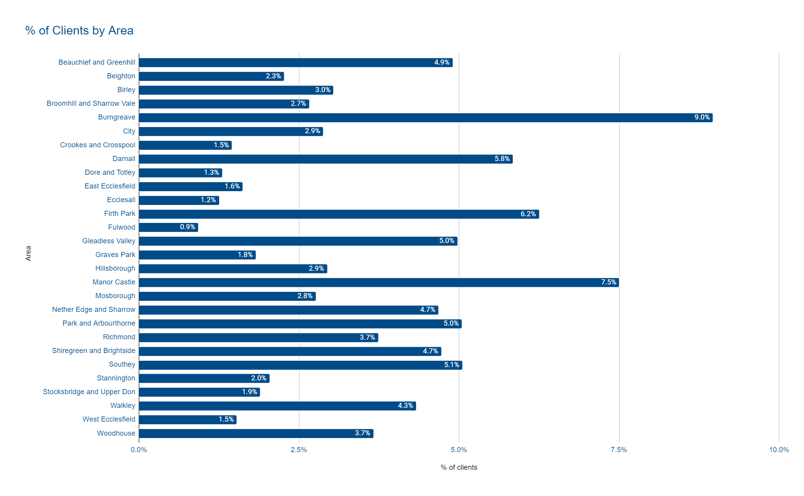

Slide 23
Our value to society
For every £1 invested in our advice service in 2021/2022, we generated:
£2.51
in savings to government and public services (fiscal benefits)
Total: £8,557,933
£20.64
in wider economic and social benefits (public value)
Total: £70,357,412
£13.49
in financial value to the people we help (specific outcomes to individuals)
Total: £45,978,452
Maximising the income for those we help prevents more costly intervention.
This helps reduce financial difficulty, promotes inclusion and benefits the economy.
Technical Annex: Financial modelling our value to society in 2019/20
Notes:
Our financial value is credible
We know this because we use a set of calculations, or methodology, that has been developed by an organisation called the New Economy. Their model is approved by the economists in the Treasury who are experts in financial value. By using a methodology they approve, we are “appealing to their authority” in this area.
The figures in our model come from the latest evidence and data. Our evidence comes from experts: such as an University who provide an in-depth analysis of how much homelessness costs a local authority. By referring to expert opinions and using up-to-date research we know that our model is as correct as it can be.
Our financial value is conservative
We only calculate financial value where we have credible evidence. Even when we do have that evidence, the calculations we make, especially the deadweight and the optimism bias provides us with a conservative estimate. It is likely that our financial value is much higher. Taking a conservative approach to our financial value helps us to provide credible figures.
Our financial value is a minimum return on the value of Citizens Advice
Because our model of financial value is conservative, we can provide a figure to our funders that is a ‘minimum return’. This means that our calculations of our financial value is the lowest that it can be. It is likely that we produce much more financial value. Once again we are being very conservative with our approach to produce figures that are credible.

Slide 24

Our value to the city
Our savings to the public purse include:
£688,278
saved by local government, through preventing homelessness and evictions
£1,666,863
saved by the NHS, through reducing use of mental health and GP services, and keeping people in work
This is only one fraction of our true value. We also:
help clients negotiate local processes, such as welfare reform changes
help local authority rent and council tax arrears to be rescheduled, and reduce the associated administrative costs
work with the local authority to help improve their systems and processes, such as the One Route In project
Technical Annex: Financial modelling our value to society in 2019/20

Slide 25

Impact of Covid-19
Throughout 2021-22, Covid-19 caused ongoing disruption and challenges for our service and the people we help.
Our phone, webchat and online channels have proved to be an efficient and effective way to deliver quality advice to thousands of people.
We introduced Community Access Points and resumed targeted face-to-face appointments for our most vulnerable clients.
We have worked closely with new and existing partners to develop new ways to ensure those who need us the most can access our services.
£[insert number]
number] for every £[insert number] invested in our service.

Slide 26


Impact of Covid-19
Community Access Points (CAPs) are now live in four venues in the city - touch screen video screens with the facility to share documents.
CAPs provide the opportunity for digitally-excluded people to meet remotely with an adviser. They require no special digital skills or know-how from the client.
CAPs are located in private spaces within familiar community venues.
The Department for Work and Pensions (DWP) and Sheffield City Council, via its COVID response line, direct people in food hunger to us so we can assess the causes of their food hunger.
Our close working history with food banks makes us the best placed to make the most effective referrals to one of the city’s many food banks.

Slide 27

Phone and Digital Advice
We now deliver the majority of our support via telephone and digital platforms, including email and webchat. This change, while initially prompted by the pandemic, has enabled us to dramatically increase the numbers of people we support and gives people in the city more flexibility over when and where they use our services. We deliver face to face services in a targeted way for those who need to access our support in this way, often working with partners.
Our clients are able to choose when, where, and how they contact us.
Our advisers can assist more people.
18,140 calls answered through Adviceline

Slide 28

Local Delivery
We continue to see clients who need face to face support all across the community and have developed new partnerships to increase our reach.
Advice in Refuges and the Independent Domestic Abuse Service
Specialist Housing Advice for people eligible for Legal Aid
Specialist immigration advice as part of the SPRING Project and for people applying for EUSS
Generalist and debt advice in-person through partnerships with local Food Banks (independent and Trussell Trust)
Mental Health Service based at Longley Centre and Michael Carlisle Centre
Hospital based support eg Weston Park Cancer Charity, Cystic Fibrosis Unit, Spinal injuries
Face to face support in British Sign Language through the Deaf Advice Service
Specialist debt advice, funded by Money and Pension Service
In-branch appointments with our advisers in partnership with Yorkshire Building Society

Slide 29

Research and campaigns
We continue to use our voice to raise awareness of the issues facing our clients and propose practical, evidence-based solutions.
Our work in 2021/22 includes:
Submitting a consultation response to the Health & Disability Green Paper
Raising the issue of unacceptable delays to Work Capability Assessments in Parliament through Paul Blomfield MP
Supporting the #KeepTheLifeline campaign and continuing to call for an uplift in benefits to help mitigate the rising cost of living
One of our immigration advisers was instrumental in producing a national report into the hardships caused by ‘No Recourse to Public Funds’, a visa condition which prevents people subject to immigration control (including long-term residents) from receiving state benefits and housing assistance. This research was presented in Parliament to the Work & Pensions Committee.

Slide 30

Not just advice
As the lead provider for Sheffield Advocacy Hub, we are now one of the biggest advocacy providers in the country and together deliver all the statutory advocacy for Sheffield.
We successfully completed the Quality Performance Mark assessment process and have been re-awarded the Advocacy QPM for three years
We provided in-depth casework to over 1,600 clients
We have successfully implemented a new Independent Case Review process
Our Advocacy Impact Report 2021/2022 is available as a separate document

Slide 31

Citizens Advice Sheffield
All of our telephone services operate Monday-Friday (times vary).
Most of our numbers are free to call (local call charge rates apply to the language lines).
Sheffield Advice Line: 0808 278 7820 - 10am to 4pm
Help to Claim: 0800 144 8144 - 8am to 6pm
Consumer Line: 0808 223 1133 - 9am to 5pm
Sheffield Advocacy Hub: 0800 035 0396 - 9am to 5pm
Leave a message for a callback from our bilingual advisers
Somali Line: 0114 700 6896
Urdu/Punjabi Line: 0114 700 6881
Arabic Line: 0114 700 2345
@SheffieldAdvice

Slide 32


Citizens Advice Sheffield
getintouch@citizensadvicesheffield.org.uk
www.citizensadvicesheffield.org.uk
www.sheffieldadvocacyhub.org.uk
@SheffieldAdvice

Slide 33
Supporting Sheffielders through the cost-of-living crisis
Teacake Club

Slide 34
Reminder of our overall aim
The overall aim is to work with the people and communities of Sheffield through the Cost of Living crisis to help mitigate the significant challenges they will be facing, with a particular focus on those who are struggling the most.

Slide 35
Link to the Cost of Living strategy
Outcomes that are most relevant to this area are in bold:
Support people to make the best possible choices about how they use the income they have
Help people maximise their income further (including but not limited to benefits maximisation)
Provide a central place to gather information about the scale and nature of the crisis, especially how it is developing over time, in order to prioritise actions and to amplify personal stories
Do what we can to ensure that emergency support is available when people are in financial crisis
Co-ordinate support for the people and communities that need it the most
Put people experiencing the cost of living crisis at the heart of Sheffield’s approach to recovery and delivering clean, inclusive growth including supporting people to respond to rising fuel prices, while preparing the whole city for long-term trends

Slide 36
Shared Prosperity Fund update
Three year programme funded by central govt, handled by SYMCA
Focus for “Communities” element is to support the VCF, as they support the people in need.
Communities plan has 4 elements:
  Adding funds to the Cost of Living fund held by SYCF
  Invest in volunteer support to build skills in communities
  Support organisations experiencing barriers to accessing funding
  Create team of cost of living link workers and community development workers
Sheffield Cost of Living fund launched by SYCF on 22nd March
Recruitment for other elements will start in March, now that Y2 confirmed
Working on best method for integrating SCC & VCF approaches

Slide 37
Wider work going on
As well as supporting the VCF to play their role as first line engagement and support for people through SPF much wider work is also going on:
A Food Access Plan has been delivering food for emergency food providers whilst building the resilience of this network and focussing on #cashfirst activities
Work to ensure everyone who is eligible has access to Household Support Fund by an operational team that runs Community Support Helpline, HSF and LAS crisis grants, alongside guidance on benefits maximisation
Cost of Living information circulated across the city including a toolkit to help front line workers find the info they need to support people
Cost of Living dashboard created to highlight where need is so we can target services

Slide 38
Wider work going on 2
170+ Welcome Places across Sheffield providing somewhere for people to go to get support.
A “frontline toolkit” has been produced to share info on what support is available: https://www.sheffield.gov.uk/utilities/cost-of-living

Slide 39
Where does the Teacake Club come into this?
So how can you support this work?
The link to the COL e-leaflet is available to share via social media https://bit.ly/COLeleaflet
There’s also a 2nd Cost of Living newsletter coming next week – if anyone wishes to receive this, please can they share their email addresses to be added to the distribution list.

Slide 40
Sarah Wraith – Multiply Operations and Partnerships Manager

Slide 41
Multiply is a new 3 year project, funded by DfE (Department for Education) and is the first priority of the UK Shared Prosperity Fund (replacing ESF)
17million adults have maths skills similar to a primary child aged 7-9 years old
Part of the approach to ‘Levelling Up ’ initiatives
Nationally up to £559 million is available over the three years.
SYMCA has been allocated the funding for South Yorkshire which is approximately £7.5 million over the 3 years.
The project runs to end of March 2025

Slide 42
Skills Mission
Multiply contributes to the Skills Mission for the United Kingdom which has never been more critical as we recover from the effects of the worst pandemic in over a century.
Talent is everywhere across the United Kingdom, but opportunity is not.
Levelling Up is designed to reverse this unfairness by spreading opportunity more equally across the country.
Multiply will help to fulfil the ambitions and the objectives of Levelling Up.
Specifically, The Skills Mission from the Levelling Up White Paper, February 2022: “By 2030, the number of people successfully completing high-quality skills training will have significantly increased in every area of the UK.
Notes:
Where people live unfairly affects their chances of getting on in life.
In England, this will lead to 200,000 more people successfully completing high-quality skills training annually, driven by 80,000 more people completing courses in the lowest skilled areas.”

Slide 43
What is the purpose of Multiply?
To reach adults aged 19+ to raise awareness of the benefits of understanding numeracy and regenerate people’s interest in maths.
It will support people to overcome their barriers to maths and enable them to be more functional with numeracy in everyday life
Enable progression on a pathway to gain a qualification up to level 2 in maths
Equipping with skills that will enable people to progress in life, work and their career
To help people improve their ability to understand and use maths in daily life, home, and work.
Themes and topics such as: household finances, helping children with homework, making more sense of the facts in the media, or improving numeracy skills specific to a key sector or specific line of work.

Slide 44
What types of activity we will need to develop
There will be a three-stage programme of delivery:
1. Engagement activity - intensive period of engagement, motivation and confidence building
2. Intensity of support - Progress to appropriate intensive Multiply activities that includes unintrusive discrete assessment to maintain engagement
3. Assessment & Progression - Establish further content that develops style of engagement and assessment. Information, Advice and Guidance to increase and aid progression to a sustained destination

Slide 45
Who we want to work in partnership with
Schools to support parental engagement, areas where GCSE attainment is particularly low or school attendance will impact their child’s successful outcome
VCF partners able to engage with the most vulnerable and are unlikely to have a maths level 2 / be unemployed / need everyday numeracy support
Employers to upskill their workforce and succession planning, ensuring they have a workforce fit for the future
Providers who can develop sector specific learning delivery to enable employers to develop their workforce
Notes:
RS

Slide 46
Branding

Slide 47
Success so far
Since 6th January 2023
We have engaged over 300 people in the Multiply project
Of these 180 participants have moved on to courses

Slide 48
Success so far

Slide 50
References
Counting on the recovery: The role for numeracy skills in ‘levelling up’ the UK, April 2021 , National Numeracy Counting on the Recovery (compressed) FINAL.pdf (nationalnumeracy.org.uk)
Levelling up the United Kingdom, 2022, Levelling Up the United Kingdom - GOV.UK (www.gov.uk)
Skills for Life, Multiply Multiply - Skills for Life
UK Shared Prosperity Funding, 2022, UK Shared Prosperity Fund: prospectus - GOV.UK (www.gov.uk)
What the UK thinks about numbers, 2019, National Numeracy national_numeracy_day_2019.pdf (nationalnumeracy.org.uk)

Slide 51
Sheffield Tobacco Control Strategy and Model 2022-2027
Sarah Hepworth
Health Improvement Principal
www.SmokefreeSheffield.org

Slide 52
Sheffield lead the way in tobacco control – there is a lot to be proud of
Since 2017 we have reduced smoking prevalence in Adults by 4.3% (20,000 fewer smokers) and smoking has reduced across all social groups. Current rates 13.3%
We are the 6th best in Yorkshire and Humber – competing with more affluent areas
One of the most proactive Tobacco Control programmes in the country and highest preforming Local authorities

Slide 53
However…….
Around 60,000 adults still smoke in Sheffield (13.3%)
Almost 5,200 people are admitted to hospital because of smoking each year
Tobacco kills around 1000 people each year (more than covid per year to date)
5% of 15 year olds smoke regularly, around 940 children start smoking each year
A quarter of people working in routine and manual occupations smoke
1 in 9 pregnant women are smokers at the time their baby is born
People with mental health problems are 3-4 times more likely to smoke
1 in 3 people who live in social housing smoke
Smoking is linked to almost every indicator of disadvantage and there is a clear gradient, the more disadvantaged you are the more likely you are to smoke and least likely to be able to afford it.
Overall smoking costs local economy in Sheffield £193 million each year including costs of healthcare, social care, productivity, and fire costs

Slide 54
Health inequalities in smoking in Sheffield

Slide 55
Health harms, social care and disadvantage
Long-term smokers die on average 10 years earlier, but before this many will spend years in poor health living with a serious smoking-related illness.
Smokers need social care support ten years earlier than never smokers this accounts for 8% of local authority spending on adult social care.
Smoking is a driver of inequalities in health and is responsible for half of the difference in life expectancy between the richest and poorest in UK and Sheffield.

Slide 56
Poverty, worklessness and economic impact
The average smoker is spending between £2,000 to £5000 a year on tobacco costing Sheffield smokers £122m- £305m per year. This could be spent on other items in the local economy
Each year in Sheffield when income and smoking costs are taken into account 14,189 households are driven into poverty. The residents of these households include:
  23,759 adults working age,
  4130 pension age adults
  11,240 dependent children.
Smokers’ employment chances and average earnings are also damaged by smoking. In Sheffield 4130 people are economically inactive due to smoking and smokers earn 6.8% less than non-smokers.
The underemployment of smokers is likely due to higher levels of ill health which make it more difficult for them to maintain full employment to state pension age

Slide 57
Economic and environmental impacts
When the costs, and the loss to society of people dying while still of working age are taken into account smoking in Sheffield is estimated to cost £159 million in lost productivity
It is not just its effects on health which make tobacco an unethical product:
Smoking is not a personal lifestyle choice, as the public have been led to believe, it’s a lethal addiction, usually beginning in childhood.
Tobacco is a commercial determinant of health that impacts negatively on peoples lives for the profits of a few large tobacco companies and their shareholders
Tobacco production occurs mostly in low- and middle-income countries, contributes to climate change, drives deforestation and often relies on child labour

Slide 58
Our vision and goal
Our Vision - we wish to eliminate the harm smoked tobacco products cause our communities by transforming Sheffield to a smokefree city by 2030 in which to live, work and play. We want to create a smokefree generation. Sheffield people live longer and healthier lives, smokefree. Sheffield children will grow up in a city where smoking is unusual.
Our Goal -The primary aim of the Sheffield tobacco control strategy is to achieve the governments smokefree ambition - make smoking obsolete or getting to 5% or less smoking prevalence, as quickly as possible and accelerating rates in decline compared to the current trends across all groups.
We aim to get to 5% by 2027.

Slide 59
Our three aims:
1. Increase the number of smokers who attempt to quit and achieve success each year
Make it easier for people who smoke to quit.
2. Create a smokefree generation by increasing the number of children and young people who never smoke
Smoking harms children and young people and most smokers start in childhood. We need to prevent children and young people from starting to smoke and we need to help their parents and the adults around them to quit smoking.
3. Eliminate inequities in smoking rates and smoking-related illnesses
Smoking impoverishes, amplifies, and drives inequalities harming some people more than others. We need to remove these inequities and prioritise action amongst these groups.

Slide 60
Health and Wellbeing Board
Tobacco Control Strategy
2022-2027
Annual budget
£3,325,000
(split £977 (SCC)
and £688k ICB Sheffield PLACE)
QUIT £1.66m (NHS,ICS/YCR)
Tobacco Control Board
Tobacco Control Strategy
Led & cordinated by Public Health Place Team
Ambition: Smokefree Generation by 2030 (<5% prevalence) Make Smoking Obsolete
Model: WHO MPOWER interventions, policy and services
Aims: Prevent tobacco related harm by stopping children starting, supporting adults to quit and harm reduction.
Evaluation
How will we know this is working?
Research and evaluation through SCHARR/NIHR/CLAHRD/local surveys/ clinical audit/PHOF/TC profile.
Tobacco Dependency Treatment Service for adults, families and C&YP £1,248 000
Motivating and assisting smokers to quit tobacco and Smokeless tobacco
Universal service offering 12 weeks of behavioral support and stop smoking medications or an e-cigarette. Support via face to face, telephone, online text support instant chat and stop smoking medicines and e-cigarettes
Priority groups with the highest smoking prevalence - routine and manual, areas of high deprivation, Black, Asian and Ethnic Minorities, people with mental health conditions, homeless, people with long term conditions
12 week quit as a success metric
Specialist Midwifery Tobacco Treatment Service
£60k (SCC)
£90k (CCG)
Sheffield Teaching Hospitals Jessop Wing – Developing A Smokefree Generation
Citywide service supporting pregnant women and their families to quit smoking during pregnancy
Measured via 4 week quit
Delivering an evidenced based incentive to quit scheme (£60k SCC)
Wider Tobacco Control:
nicotine management,
-Smokefree sites,
Communication campaigns,
Smokefree Homes
QUIT in Secondary Care (£1.66m via ICS/YCR)
(Budget embedded in Stop Smoking Service) potential annual £600k investment to SCC via CCG/ICS
Embedding the treatment of tobacco dependency into secondary care pathways
Systematic identification of smokers at every healthcare interaction
Treat tobacco dependency as a chronic relapsing condition: timely provision of
pharmacotherapy and behavioural support
Seamless transition to Community Stop Smoking Service
Bespoke inhouse service in SHSC for patients
Staff tobacco treatment
Smoke-free champions across the Trust to support the programme
Very Brief Advice training for to promote supportive conversations
Harm Reduction
(Budget embedded in Stop Smoking Service)
Clear consistent advice about NRT and e-cigarettes via the Stop Smoking Service, QUIT in Secondary Care and marketing and communications activities.
Voucher scheme provision of NRT as part of the Stop Smoking Service offer and voucher scheme or direct supply of e-cigarettes
Surveillance and enforcement action on age of sale of e-cigs
Cheap and Illicit Tobacco
£159k
Tackle Suppliers of Cheap Counterfeit & Illicit (C&I) Tobacco
Trading Standards enforcement to reduce availability of cheap and illicit tobacco, targeting suppliers undermining tobacco taxation strategies and allow children to buy cigarettes at pocket money prices.
Uses ‘Systems Thinking’ measures of success, not arbitrary targets
Prioritising safeguarding vulnerable adults & children, from organised criminals looking to exploit them
Smokefree Spaces
(Budget embedded with SCC £8k staff investment)
De-normalising tobacco use and protecting from second-hand exposure
Targeted work in workplaces and public open spaces
Extending and maintaining smokefree public spaces - SCC, hospitals, CCG, University campuses, transport hubs and large workspaces/public spaces e.g. The Peace Gardens
Smokefree School Sites
Smokefree City events
Survey and consultation to understand behaviours, attitudes, public opinion and programme evaluation
Marketing and Communications
£100k
Increase mass media and marketing campaigns to change attitudes & social norms around smoking and increase quit attempts
Targeted communications campaigns to high prevalence groups;
De-normalise smoking and communicate/ engender hope, self compassion
Educate re. impact of C&I on communities
Smokefree C&YP prevention
E-cig harm reduction for adults
Smokefree homes
Mental health and pregnancy
Disadvantaged groups via Housing and Social Care
Smokefree Sheffield Website

Slide 61
Why comprehensive tobacco control?
The community dividends of a fully-fledged tobacco control strategy are huge as the effects of smoking on communities are so great. Tackle smoking effectively will:
lift thousands of households out of poverty
increase local productivity (due to reduced loss of workforce)
boost economic prosperity with money spent on other items rather than tobacco
protect children from harm
reduce inequalities
improve quality of life in our communities
save thousands of lives
Save the NHS, SCC, the benefit system and social care a fortune
Impact positively on climate change
Improve local neighbourhoods (reduced crime)
To achieve this multicomponent approach is required to meet the needs of the whole smoking population not just to those who attend CSSS.
It is difficult to quantify or isolate the exact contribution of each individual intervention in reducing smoking prevalence. If you remove one component this undermines the effectiveness of the whole approach as they are interdependent
Notes:
Comprehensive tobacco control programmes aim to involve a mix of coordinated interventions that complement each other at both a city, regional and international level. One intervention cannot achieve the required reductions in isolation as smoking is a system wide, global epidemic that requires a multicomponent approach in order to be effective; this approach must prevents children from starting smoking, support adults to quit, addresses the supply and demand of cheap and illicit, educates tobacco users of the harm and encourages quitting and change social norms around smoking and increase smokefree environments, in addition to this a range of national fiscal and policy measures are required. If you remove one component this undermines the effectiveness of the whole approach as they are interdependent.
Comprehensive tobacco control includes a range of interventions which are designed to achieve two goals - stopping people (particularly children and young people) from starting to smoke and getting those that are smoking to quit.
There are six strands within the MPOWER model, and our approach is based on these:
stopping the promotion of tobacco;
making tobacco less affordable;
effective regulation of tobacco products;
helping tobacco users to quit;
reducing exposure to second-hand smoke;
effective communications for tobacco control.

Slide 62
Communicate Hope
When smokers try to quit and fail, they may be discouraged from trying again. They know they should quit, they want to quit, but many have such poor expectations that they don’t try to quit. it can take over 30 x for a smoker to quit for good.
Communicate hope, be compassionate and inspire smokers to try once more
Compassion should be a common thread of delivery – smokers already feel judged and stigmatised – shame does not illicit quit attempts/behaviour change, compassion, kindness and understanding does - when combined with meeting needs in line with Capability, Opportunity and Motivation
The-End-of-Smoking_final.pdf (ash.org.uk)

Slide 63
Smoking doesn’t care about you - YouTube
Smokefree Sheffield 'Closer Each Time' TV Advert - Subtitled - YouTube

Slide 64
New Sheffield Smokefree Service (April 2023)
Quit, Switch or Cut Down - Adults 18+
Children (11-17)
12 weeks of free behavioural support and stop smoking medicines or vapes (adults) voucher scheme
8 weeks support for children (+NRT for those over 12 years) direct supply to reduce barriers
Harm reduction – switch or cut down to quit (6 weeks support prior to setting Quit date)
Stress management/coping skills – critical component re cost of living crisis
Smokeless tobacco/Shisha – support to QUIT
Nicotine cessation offer – vapes or NRT
Holistic support and strong links with VCF sector (link workers, social prescribers) – embed in VCF and PCN
Range of support – always on service, face to face, telephone, text and online support

Slide 65
https://youtu.be/rod4d4yFeaE

Slide 66
What can you do?
Identify smokers and refer to the Smokefree Sheffield Service
Access training Brief intervention training for all frontline staff
Promote the new service offer for adults and children
Promote smokefree homes
Given evidenced based information on vaping – children and adults
Promote the tobacco/smokefree Sheffield communication campaigns – via your social media, websites via text message and across the practices
Go Smokefree across all your buildings and grounds
Report illegal sales of illicit tobacco and vapes and underage. Contact Sheffield Trading Standards at trading.standards@sheffield.gov.uk or call the consumer direct helpline run by Citizens Advice who will pass your intelligence to Trading Standards. Telephone: 0808 223 1133 Mon to Fri 9am to 5pm.
www.smokefreesheffield.org

Slide 67


ClickSilver
BRIDGING THE DIGITAL DIVIDE
March 2023
“Proficiency in digital skills is now considered a necessity not a desirable”
Verity Davidge, Director of Central Policy at Make UK, 2021

Slide 68
40 YEARS OF PARTNERING WITH COMMUNITIES
Business in the Community (BITC) and our network of business members are leading a movement to create a fair and sustainable world in which to live and work.
Formed in 1982, with His Majesty King Charles III as our Royal Founding Patron, we are the largest and longest-established membership organisation dedicated to responsible business.
We work and campaign with more than 600 members to continually grow their responsible business practices, uniting our efforts for greater social and environmental impact in our communities.

Slide 69
10 MILLION PEOPLE IN THE UK LACK THE VERY BASIC FOUNDATION SKILLS NEEDED FOR OUR DIGITAL World!
DIGITAL INCLUSION
AN AGEING WORKFORCE
DIGITAL SKILLS FOR WORK
With so many elements of our daily lives being managed online – such as finding work, internet banking and staying in touch with family – having the confidence and skills to understand and efficiently use digital technology is more important than ever before.
Older people are being left behind as digital skills become essential. The 4.8 million people over the age of 55 not online are finding it increasingly difficult to access essential goods and services as provision goes digital.
‘Digital Skills for Work’ are now a fundamental requirement for almost all job roles, with 92% of businesses stating that a basic level of digital skills is important for employees in their organisation, and jobs vacancy data showing that four in five (82%) job vacancies require digital skills.

Slide 70
Businesses and PARTICIPANTS working together
ClickSilver provides one-to-one support to individuals to develop digital skills and increase confidence in the use of technology.
BITC trains volunteers from its business membership to become ClickSilver mentors. We match mentors with individuals from across the UK who need support to develop digital skills and get online.
During sessions mentors share the skills and knowledge built during their time in employment to help increase beneficiaries’ confidence in using essential workplace digital tools.

Slide 71
MORE THAN 400 INDIVIDUALS SUPPORTED EACH YEAR
Tried and Tested – With over 10 years of delivery, ClickSilver is able to demonstrate real and meaningful impact for hundreds of individuals across the UK
Easy to Engage – BITC provides everything your clients need to develop effective digital skills, from comprehensive volunteer training and custom matching to providing updates on progress and impact
Open to All – Providing an accessible and engaging opportunity for individuals at all levels to make a positive difference to life
90% of participants report feeling less lonely
90% of participants said they would recommend ClickSilver
85% of participants now feel confident using technology
“I felt stupid, I had tried everything but there were so many things I couldn’t do...
Now my confidence has improved 100%. ClickSilver has helped so much; it gave me the confidence to face things head on.”

Slide 72

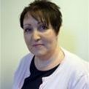
For more information, please contact:
TOGETHER, WE CAN MAKE A DIFFERENCE
ANDREEA TUDOR
Operations Manager
andreea.tudor@bitc.org.uk
JULIE CULLEN
Programme Manager
julie.cullen@bitc.org.uk

Slide 73
Bitc National business response network
March 2023

Slide 74
Our Needs Analysis research revealed community organisations needed the most support:
National Business Response Network
The NBRN has been developed to connect community organisations with the expertise and experience of skilled business volunteers from BITC’s membership of over 600 businesses.
With stronger community organisations, we can address key issues within communities focusing on:
Inequality
Mental Health and Wellbeing
Climate Action
MARKETING
Digital proficiency
PR/marketing
Social media
Storytelling
STRATEGIC SCALE-UP
Business planning
Resource planning
Financial management
Project management
HR/PEOPLE SKILLS
Leadership styles
Mentoring
Diversity and inclusion
Strategy
Employee wellbeing
REACH & IMPACT
Fundraising
Bid writing
Business partnerships
Tracking impact
Notes:
Through this programme We facilitate change across the UK by brokering and nurturing connections between our members and community organisations.
The Skills Exchange programme provides community organisations with free one-to-one support, consultancy, pro-bono services and skills training (webinars) through the support of skilled volunteers
All too frequently these small organisations lack the budget, time and resources needed to deliver services efficiently and at scale. That’s why volunteers like you are so important in helping these organisations to scale their reach and impact.
What is Skills Exchange?
BITC’s Skills Exchange volunteering programme has been developed to connect the experience and expertise of skilled business volunteers with community organisations like yourselves.
Through Skills Exchange, community organisations, CIC’s, CIO’s and charities can access free one-to-one support and consultancy from a business volunteer
It could be a short engagement such as a one-off meeting or telephone conversation or a larger piece of work, such support with a project over a period of time

Slide 75
National Business Response Network Update :
We have reactivated this important network to provide much-needed assistance during
the cost-of-living crisis.
Through business support, we will focus on providing five much-needed items and five vital skills:
FIVE TIME/SKILLS
Job coaching
Wellbeing mentorship
Marketing advice
Sales/fundraising advice
Operational/scale-up advice
FIVE ITEMS
Laptops and smartphones
Warm clothing and bedding
Food packaging
Energy-efficient products
Kitchen equipment

Slide 76
Your nbrn journey
LOGGING YOUR REQUEST
MATCH
CHECK IN AND FEEDBACK
Log your request
A Programme Manager will contact you to learn more about your organisation and context of your needs.
We will share your needs with our business members.
Business volunteers selects the opportunity.
Once we have an offer of support from our member businesses, a Programme Manager will contact you.
A Programme Manager will help to facilitate an initial meeting to discuss the scope, discuss rough timelines and how the support will be provided.
A Programme Manager will check in at week 2 and 5 to see how the partnership is progressing.
Week 8: we will ask for your feedback on the partnership and outcomes.
If the business does not have the right skillset to support, please inform us at any point.
Any questions or concerns, please contact your Programme Manager.

Slide 77
NBRN platform

Slide 78
CONTACT
To find out more about how your community organisation can access free one-to-one support, consultancy, pro-bono services and skills training from Business in the Community's network of business members email us at:
Michelle Brannen
Programme Manager, North & Midlands
Michelle.brannen@bitc.org.uk
“As a standalone charity, gaining advice on our operations from a major corporate like Sodexo has been invaluable.”
CEO, The Bread and Butter Thing, Manchester
Julie Cullen
Programme Manager
Julie.cullen@bitc.org.uk

