Slide 1
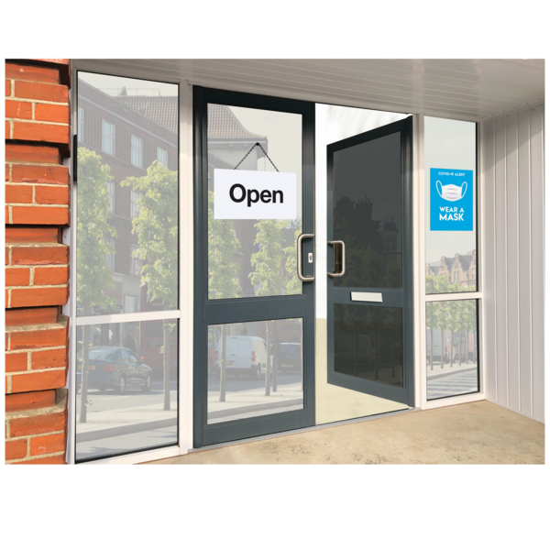


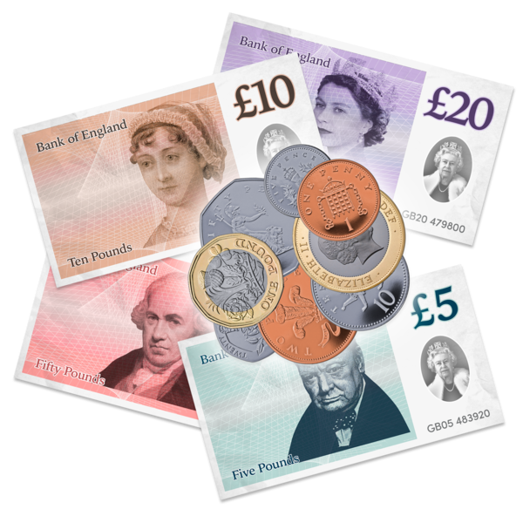


Are you interested in becoming a quality Inspector for SDB Apparel?
The Company
SBD is a global sportswear brand that designs and makes market-leading performance products for strength sports. Our team is proud to make all our products in the United Kingdom, with the majority made at our headquarters. Our commitment to quality has seen our products become the standard among strength athletes in gyms across the world.
The Skills
We invite applications from candidates who can show:
Skill and accuracy in machine processes, including work handling work and health and safety.
Excellent communication, teamwork and computer skills.
Ability to share ideas and make suggestions for improvement.
Meet deadlines and targets.
The Benefits
Some of the benefits include:
Free onsite parking and gym access.
Complimentary breakfast and lunch.
Company pension scheme.
33 Days’ holiday including bank holidays.
40% staff discount and limited edition clothing.
Company sick pay allowance.
Company saving schemes.
Salary:
£10.85 - £11.55 per hour
Hours:
40 hours per week. Monday – Friday
Location:
Unit 2b Lanchester Way, Advanced Manufacturing Park, Waverley, S60 5FX
*Infographics created by photosymbols*

