Slide 1


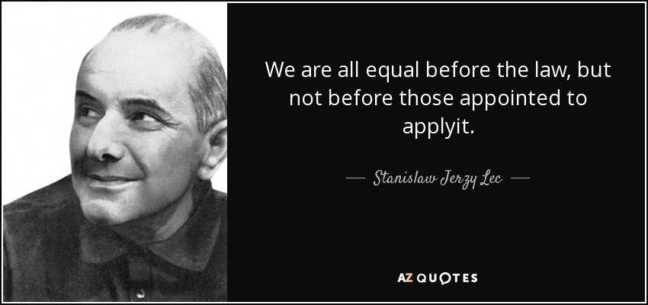
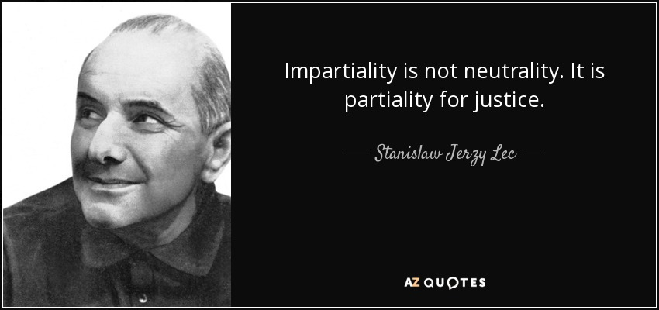






Let’s talk about
Building Alliances between women networks
Ensuring legal and policy standards are applied for Roma women and girls”
Stanisław Jerzy Lec was a Polish aphorist and poet. Among the greatest writers of post-war Poland.
Terezia Rostas Roma Educational Consultant and advocate
Founder of Care for Young People’s Future
www.cypf.org.uk
Twitter @Terezia Rostas or @CareCYPF
Linkedin Terezia Rostas

Slide 2
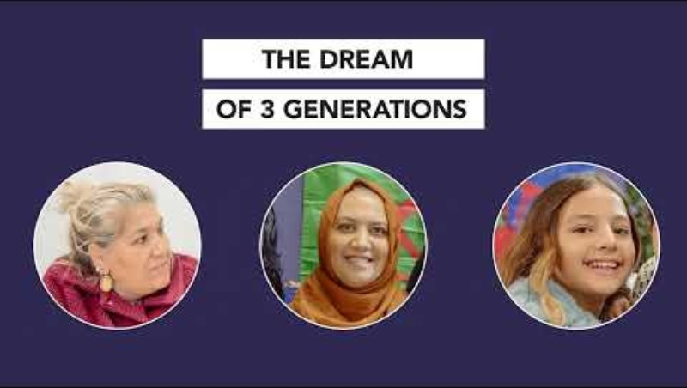


Roma Women transforming the educational systems around Europe through their social and political mobilizations continuing with Opportunity Sheffield in the UK

Slide 3
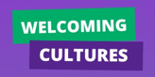
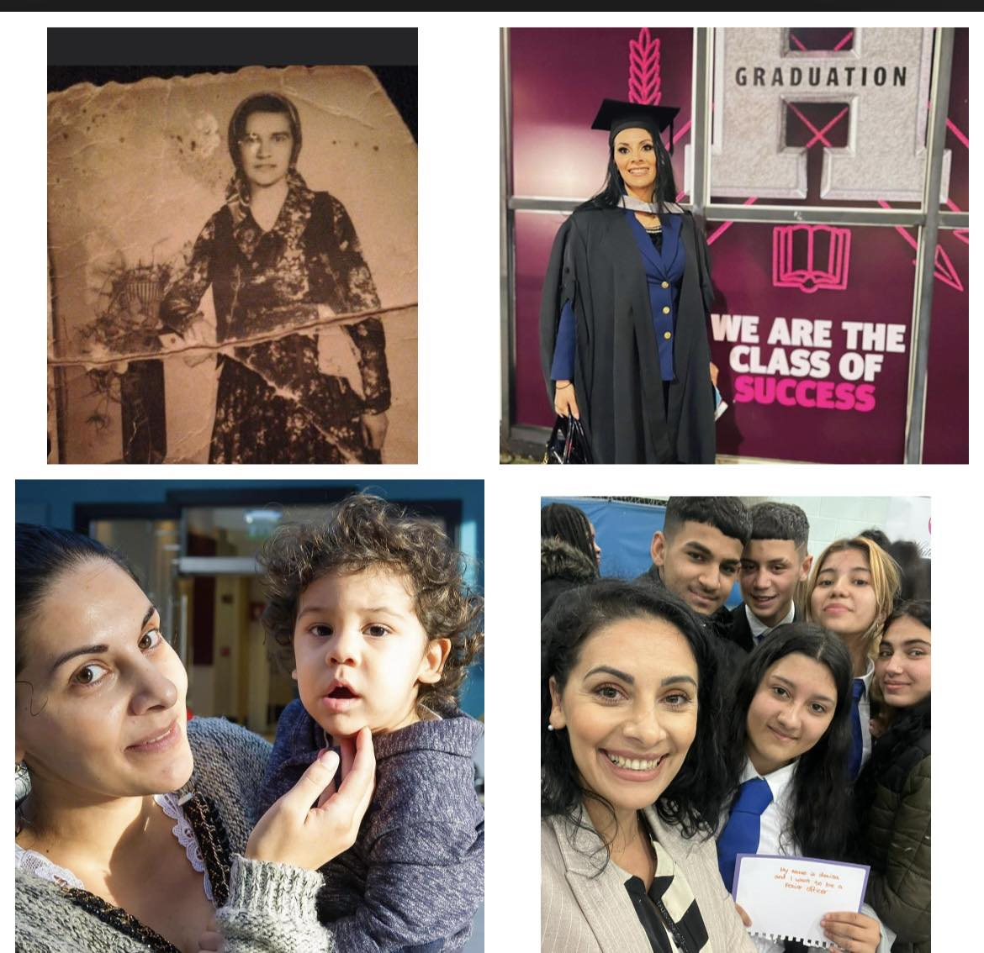


Building Alliances between women networks
Ensuring legal and policy standards are applied for Roma women and girls”
Where you come from affects where you can go!
Terezia Rostas –Cultural Consultant , RA and founder of Welcoming Cultures UK and Care for young People’s Future @Welcoming CulturesUK

Slide 4
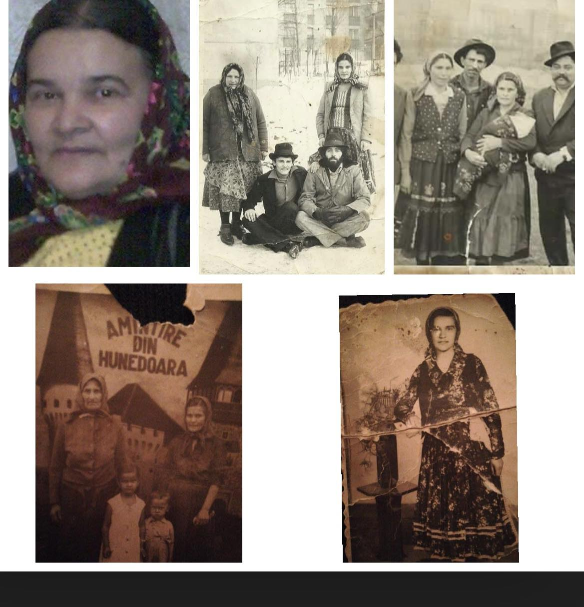

Slide 5
Intersection of institutions and grassroot Roma women
Building alliances between political partners and grassroots Roma women is essential to ensure legal and policy standards are effectively applied for the benefit of Roma women and girls. This collaboration is pivotal in addressing the unique needs of the Roma community, particularly women, and integrating their perspectives into policies for a more inclusive society.

Slide 6
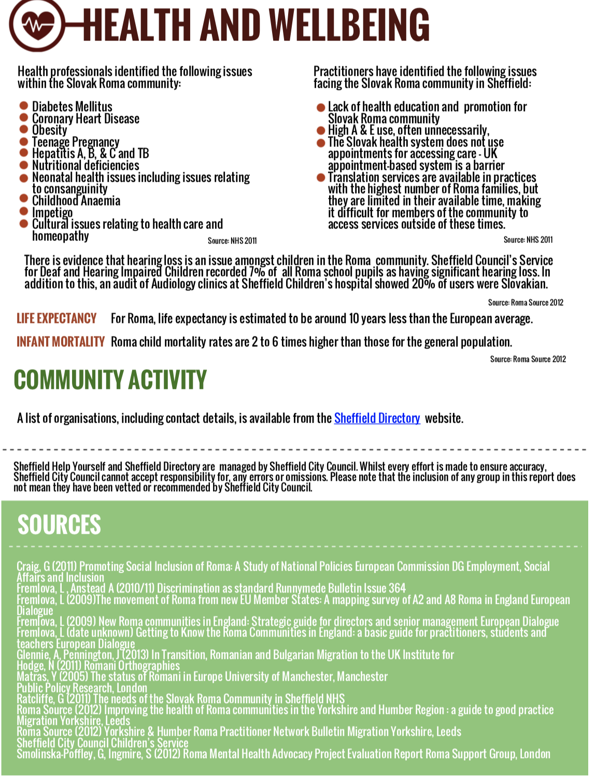
Inequalities/Health/Education/Employment
Life expectancy
Mental Health

Slide 7
Power dynamics/ exposure to discriminatory listening
People who hold positions of power or privilege, such as those in leadership roles, those with higher socioeconomic status, or those who belong to dominant cultural groups, may be more likely to be listened to without discrimination.
Individuals or groups who are marginalized or underrepresented may be more likely to face discriminatory listening.

Slide 8
Barriers ,challenges, impact , faced by the community and services
(short presentation and group work on related topics)
In a society where losing your identity or traditions is seems to be more encouraged, the identity of being traditional Roma seems to be less encouraged , by the society that we live in .
Saying it , out loud or stating the fact that you are part of a community ,which is often seen as negative with stereotypes and prejudice , it becomes to look more like a brave act rather than a normal fact .
Barriers faced by the community
Language barrier
Lack of trust
Discrimination
Lack of understanding
Maltreatment
Lack of system knowledge and available services
Denied access to basic human rights
Forming new relationships with other people
Low aspirations
Marginalisation
Barriers faced by services
Lack of understanding and acknowledging the real needs of the Roma community
Low engagement
Language barrier, lack of Roma interpreter
Lack of knowledge of the Roma culture and history
Assumptions
Stereotypes
Low attendance
Poor relationships
Low achievement or slow progress

Slide 9
Recognition of Roma Women's Needs in Policies:
  Prioritize understanding and acknowledging the specific challenges faced by Roma women and girls in education, healthcare, employment, and societal integration.
  Ensure policies are formulated with a gender-sensitive approach that accounts for the diverse experiences and requirements within the Roma community.
Co-Creation and Inclusive Decision-Making:
  Facilitate co-creation processes where Roma women actively participate in shaping policies that directly impact them.
  Organize inclusive forums, dialogues, and workshops that enable open discussions and contributions from Roma women, ensuring their voices are heard and valued.
Capacity Building and Education:
  Promote educational opportunities for Roma women, offering access to learning platforms, vocational training, and skill-building programs.
  Encourage partnerships with educational institutions and organizations to provide mentorship and support networks for Roma women seeking to engage in politics and governance.
.
Discrimination and Stereotypes:
Roma individuals face pervasive discrimination, judgments, and enduring stereotypes that further exacerbate the reluctance to seek mental health support.
Political Inclusion and Representation:
Foster an environment conducive to Roma women's participation in political spheres by creating mentorship programs, leadership training, and avenues for political engagement.
Advocate for increased representation of Roma women in decision-making bodies, ensuring their perspectives are integrated into policy formulation.

Slide 10
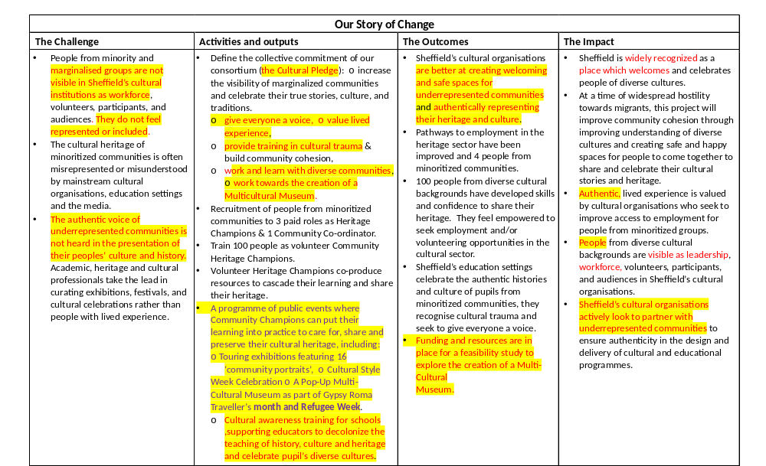

Slide 11
Listening types /stages
Discriminative listening is a type of listening that focuses on understanding specific sounds in a message, while discriminatory listening is a negative behaviour where a person selectively listens to information based on their biases, prejudices, or stereotypes.
Discriminatory listening is a form of discrimination that can lead to misunderstandings, hurt feelings, and even discrimination.
Similar to a poem – both require the right timing , the right words and the right image . Only when this elements align something meaningful will happen.

Slide 12
Working together impact
Benefits to political partners Benefits to Roma women
• The project has empowered Roma women by increasing their visibility and ensuring their voices are heard.
• Their needs and recommendations have been taken into account and have influenced policy changes.
• This empowerment and recognition are likely to lead to improved outcomes and opportunities for the Roma women.
Building Trust and Relationships
Capacity building
Accountability and increased Roma women presence in decision making
• The project has resulted in the review and adaptation of existing policies and programs to better accommodate the needs and presence of the Roma community.
• Increased visibility of the voice and needs of Roma women.
• Enhanced inclusion of Roma women into policies and programs.
• Gratitude from various official institutions and leaders, including Sheffield Museums,
Sheffield Council, Sheffield Teaching Hospital, Job Centre, Hallam University, University of Sheffield, Yorkshire Sport Foundation, local councillors, and police leaders.
• Collaboration and ongoing contact with these partners have led to co-creation of events and discussions around addressing the challenges faced by the Roma women.

Slide 13
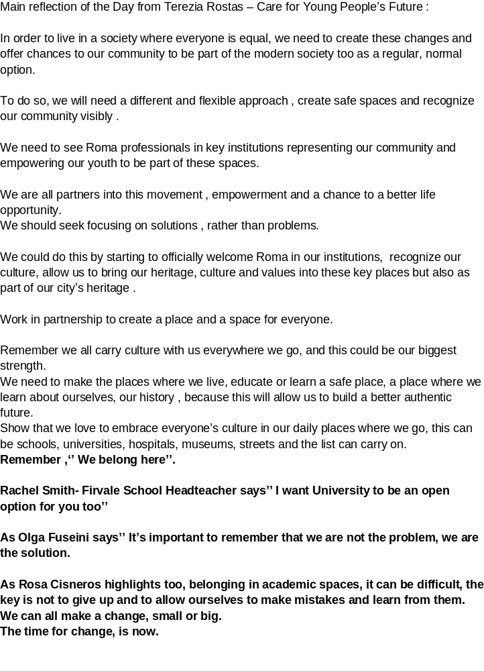
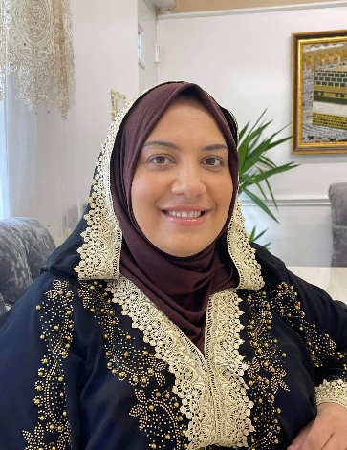
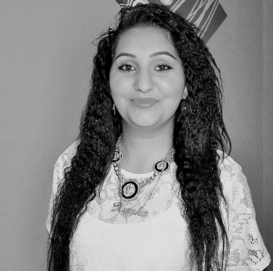
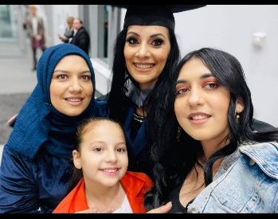
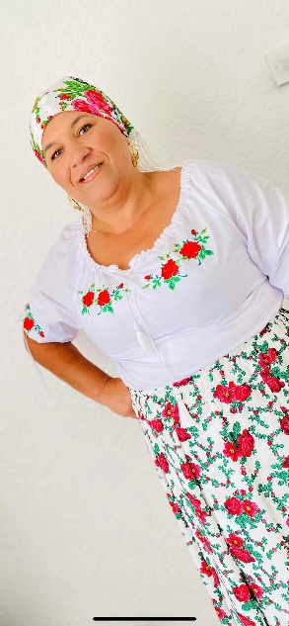
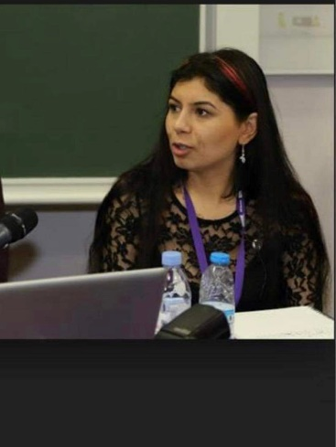
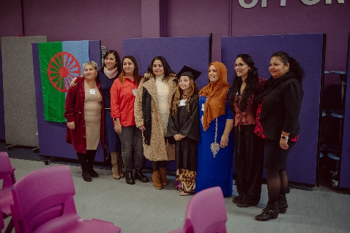
Some reflections

Slide 14
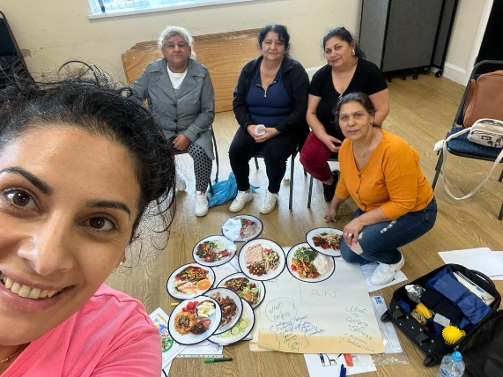

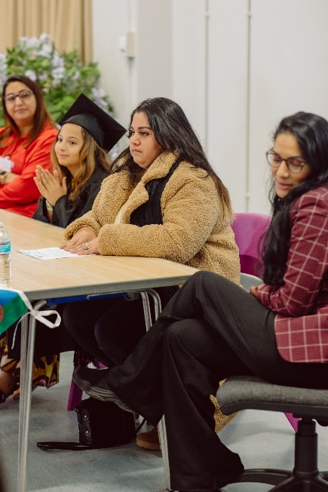
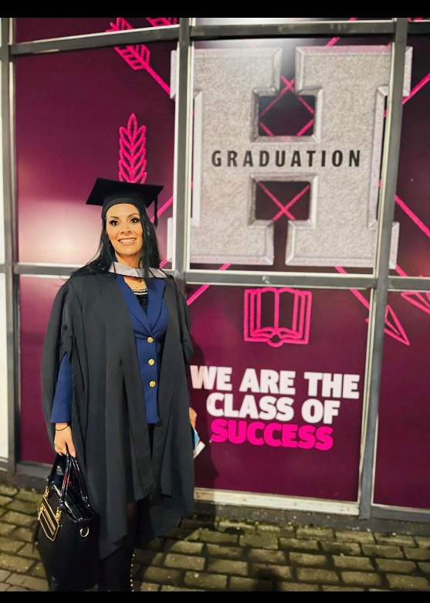
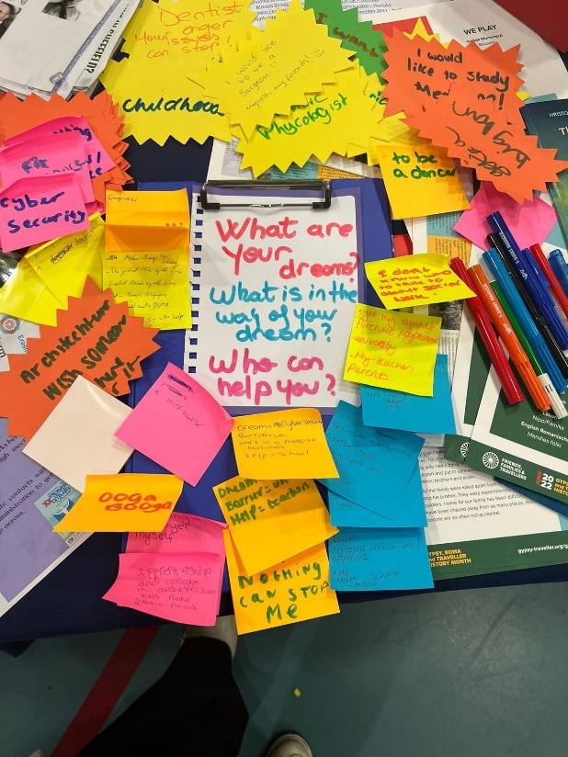
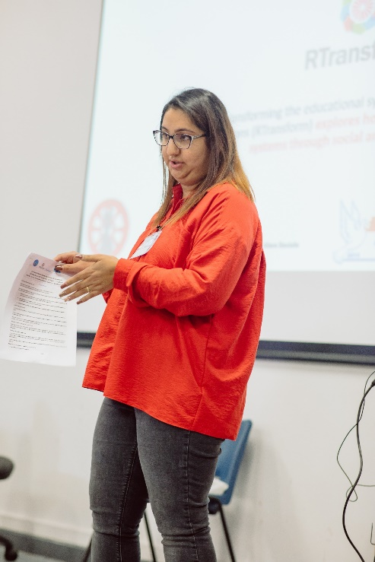

Slide 15
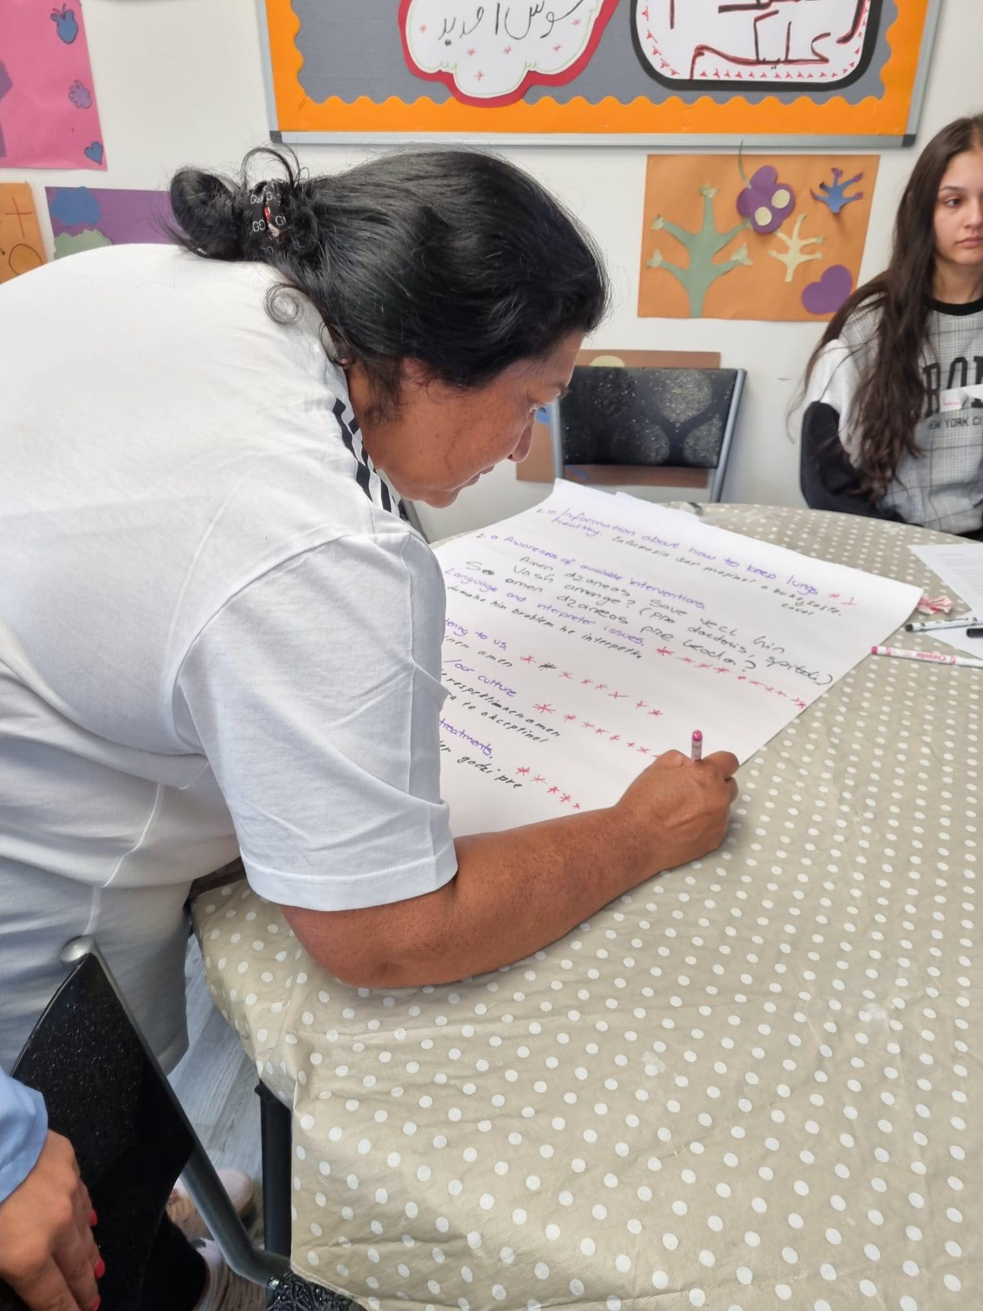
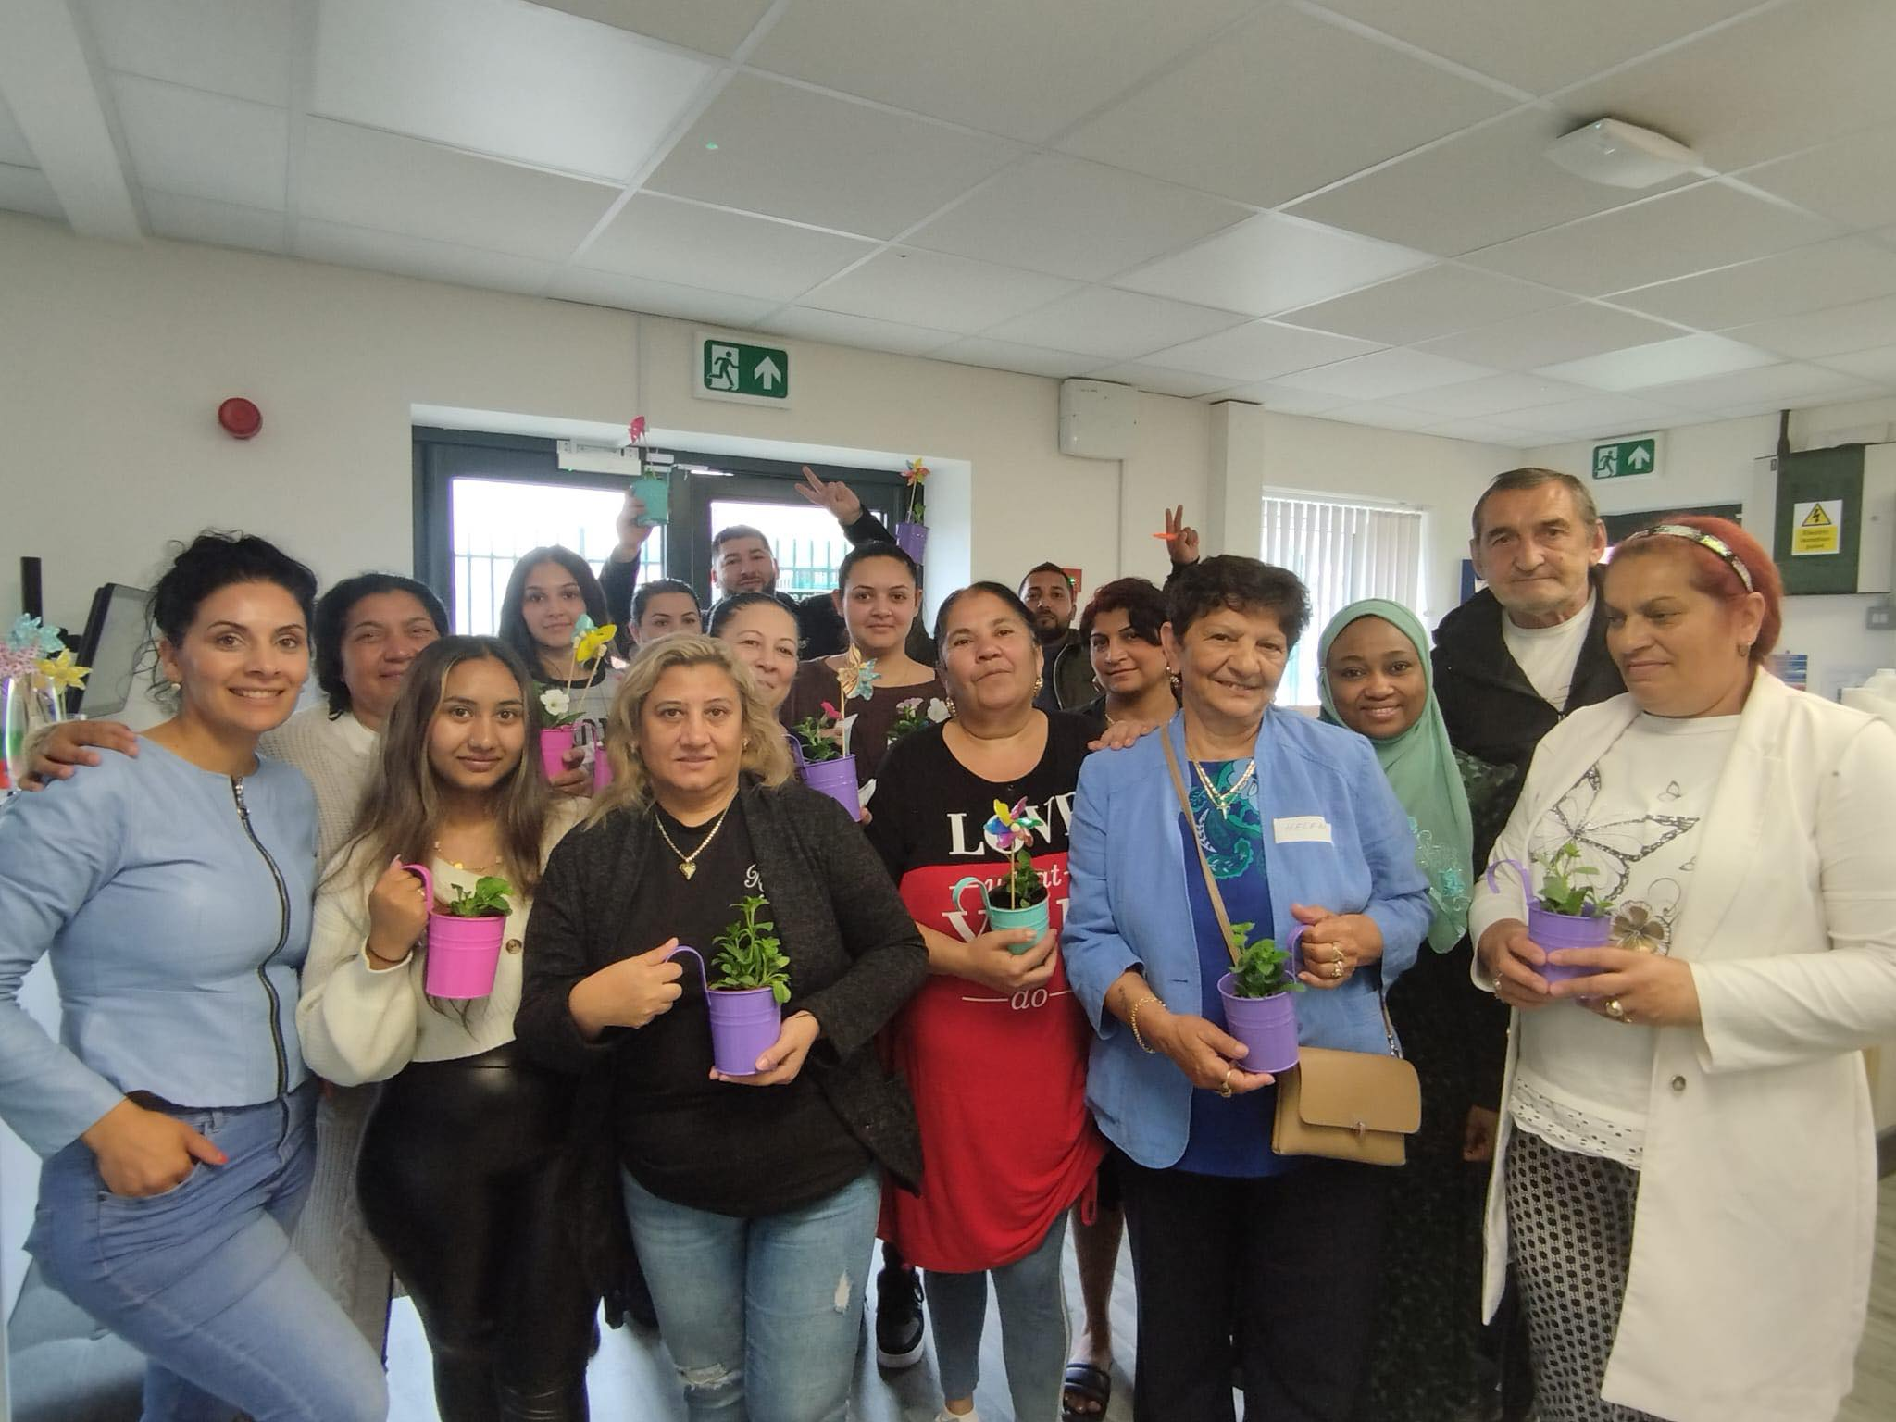
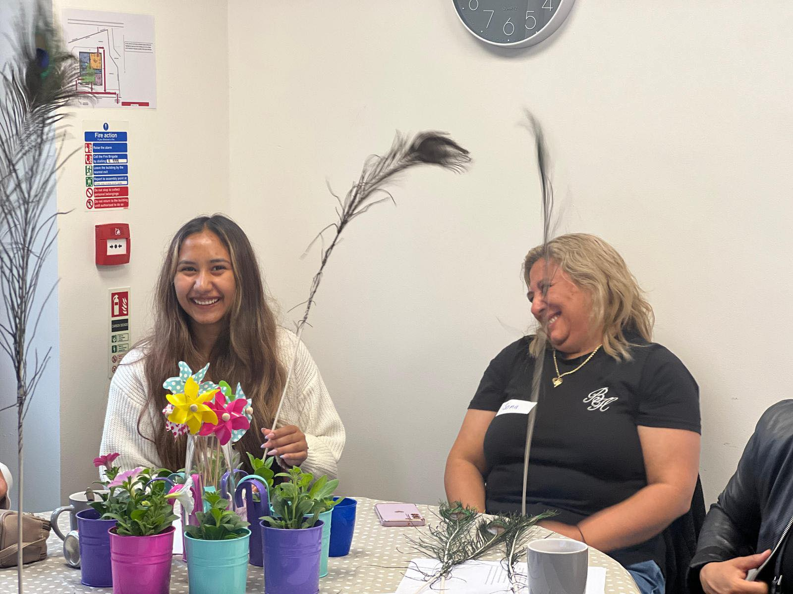
Addressing mental health as a wellbeing coach
Education
Reconnection with nature
Reconnection with professionals
Raising aspirations
Dialogues about women’s struggles
Supporting each other
Improving our literacy /knowledge on mental health
Small changes

Slide 16
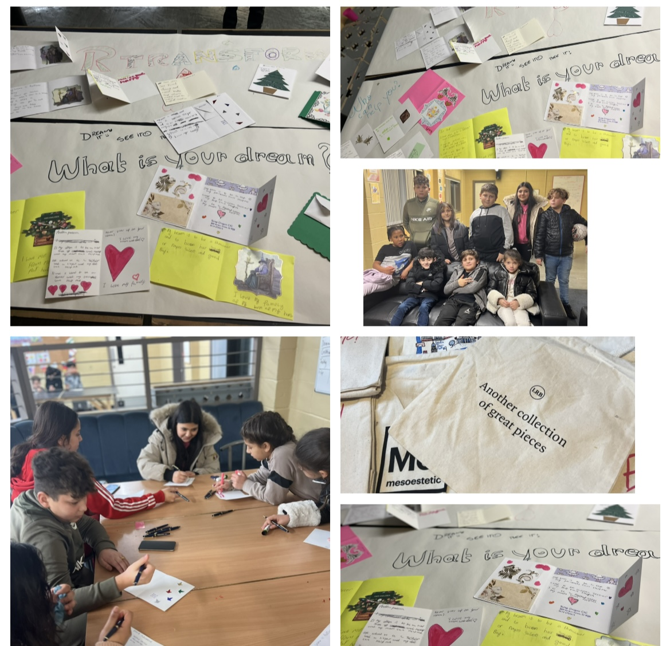
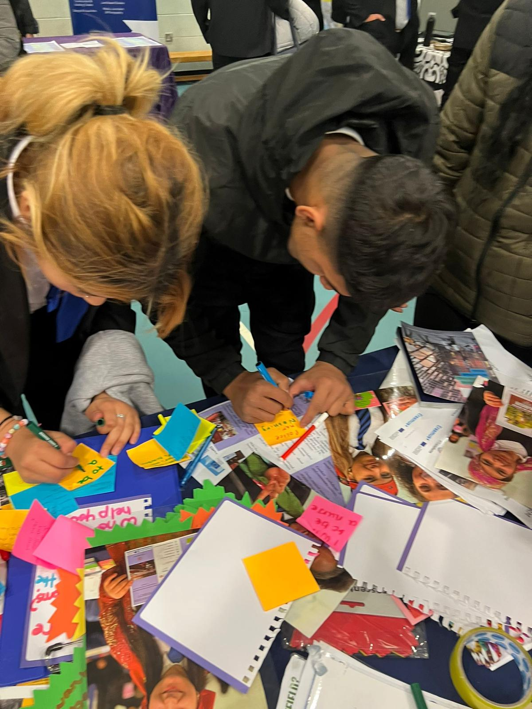

Slide 17
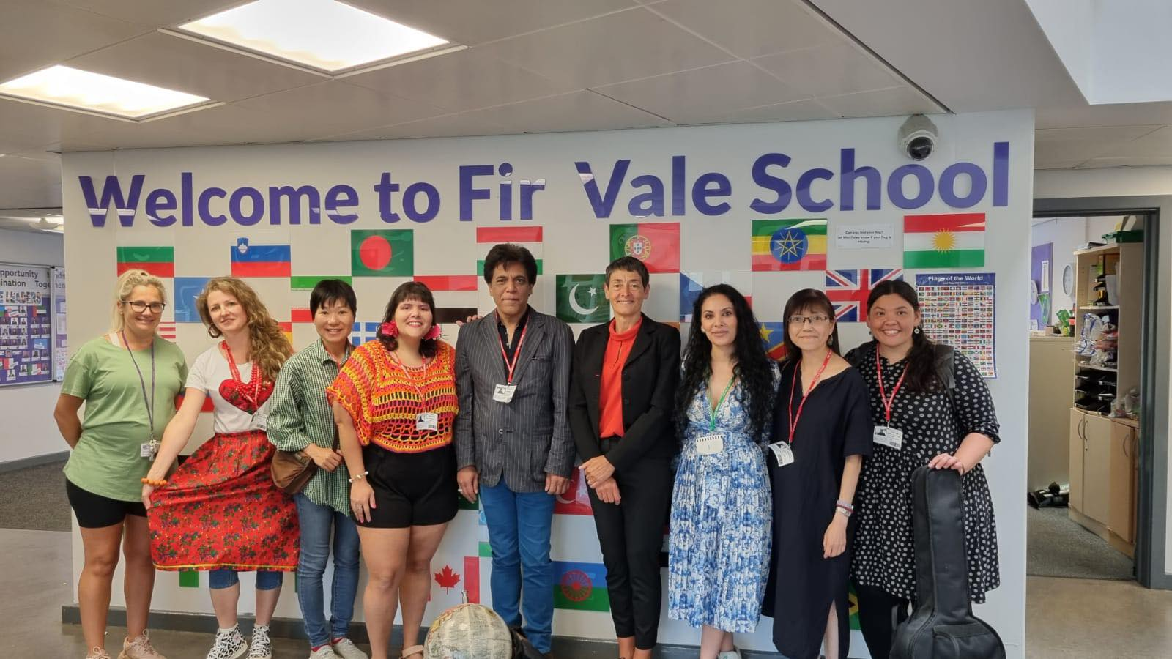
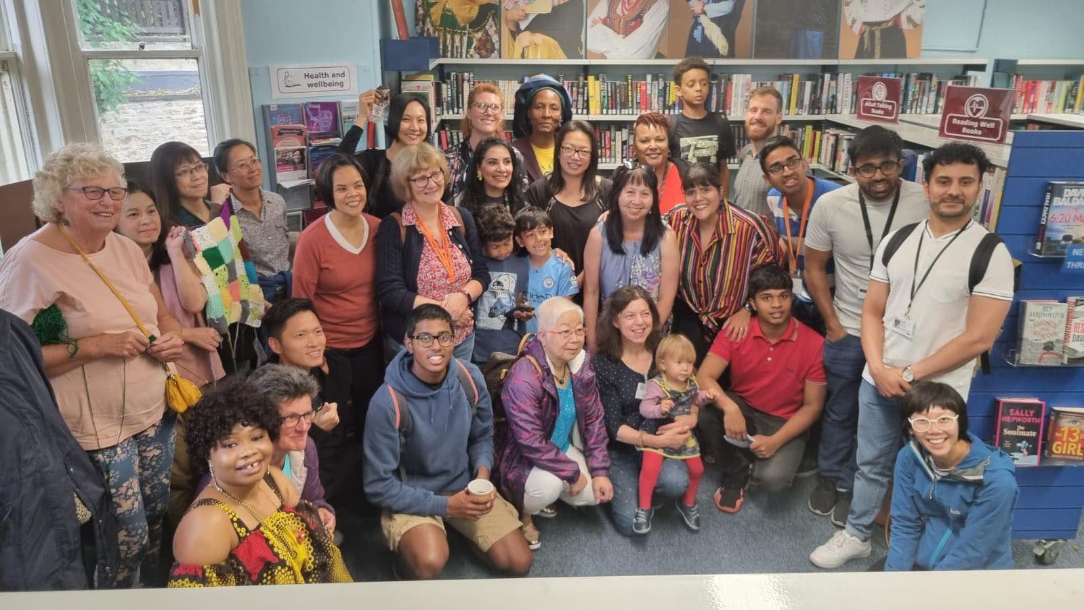
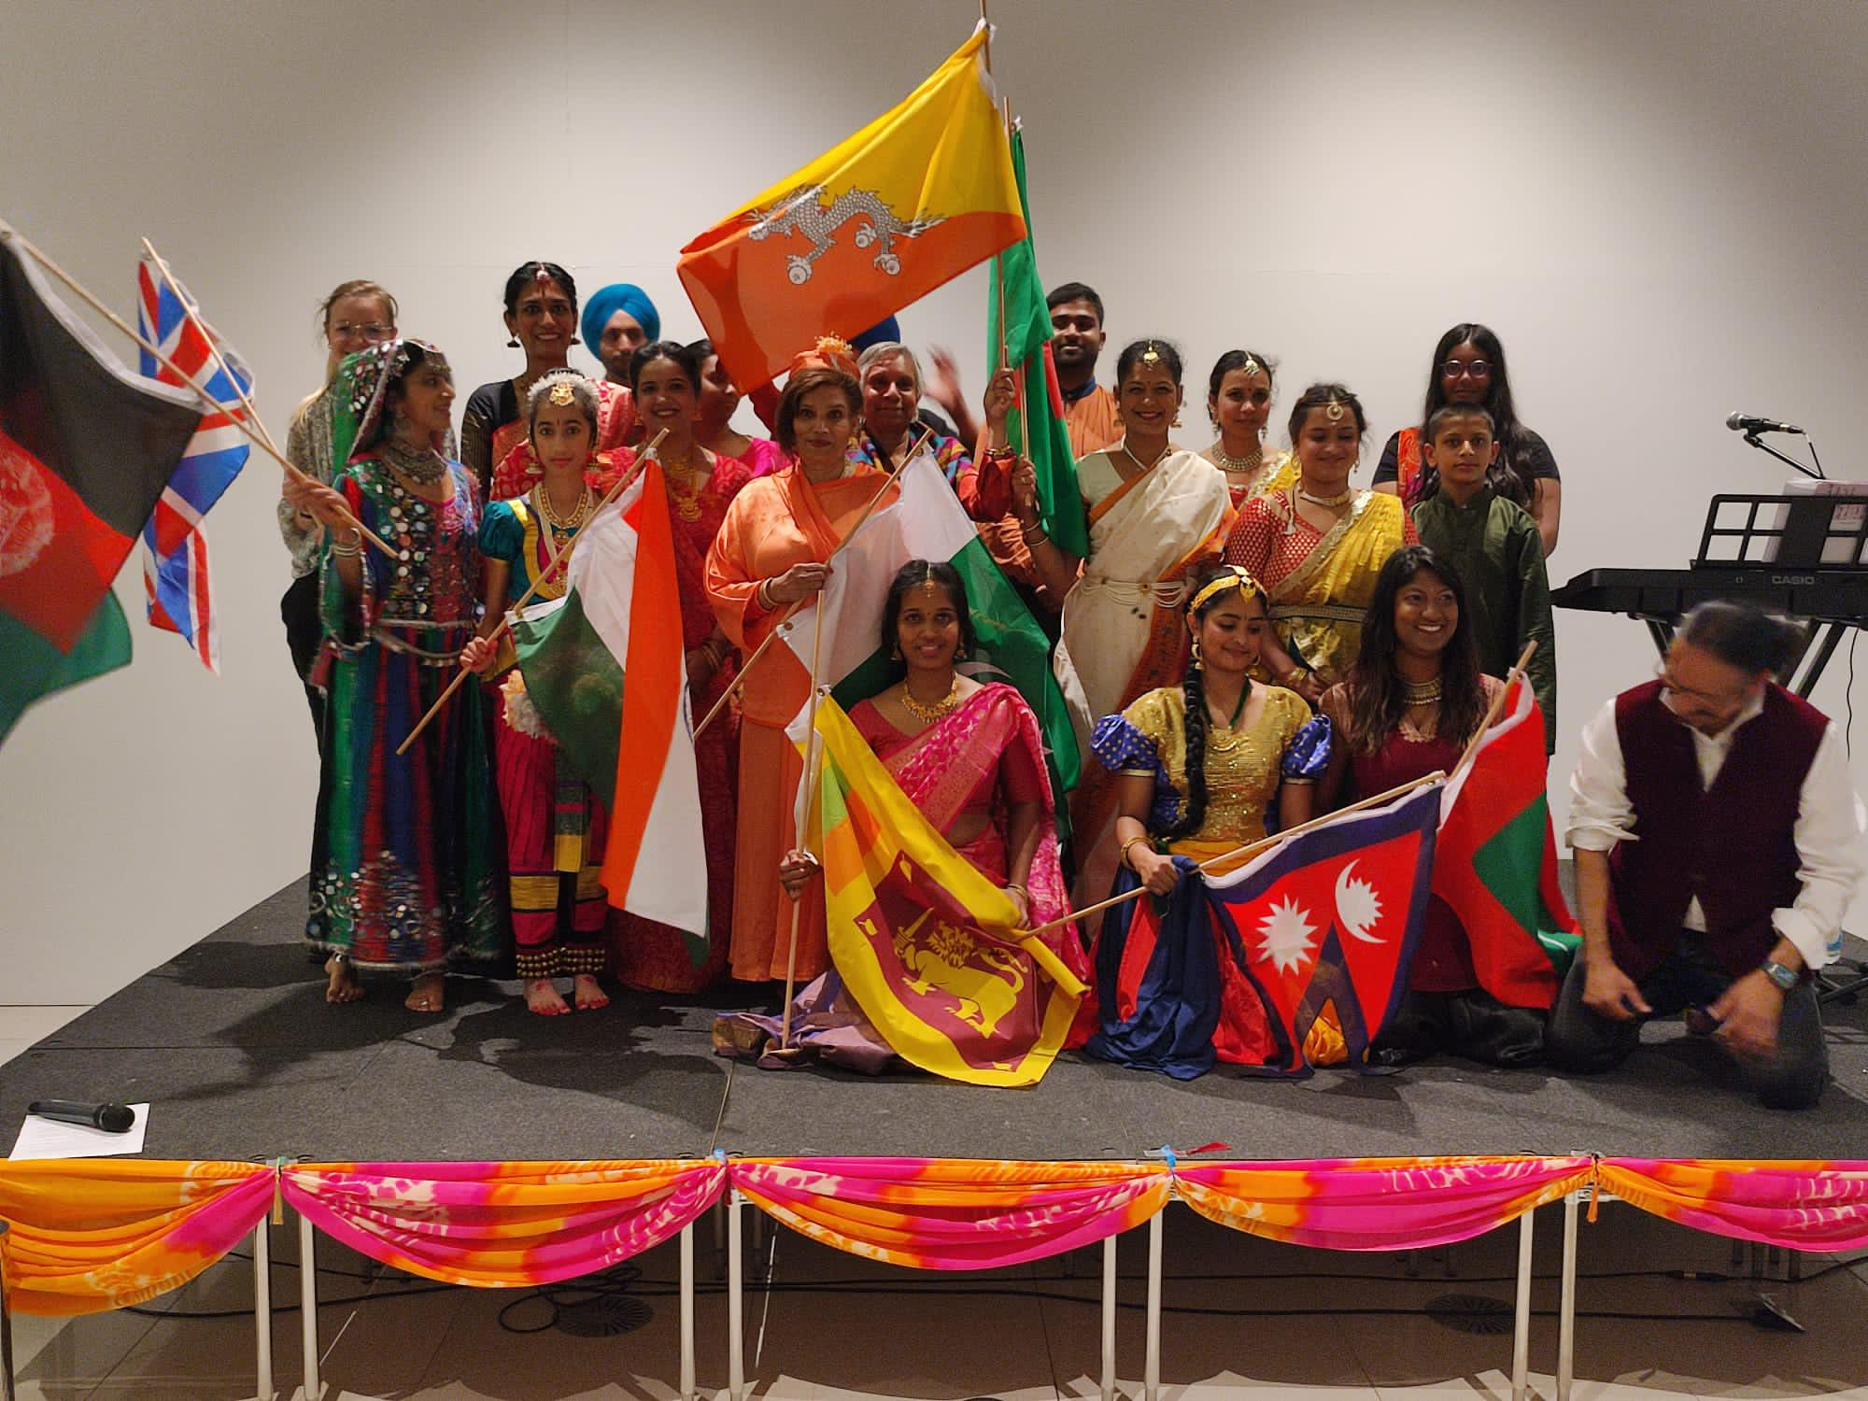
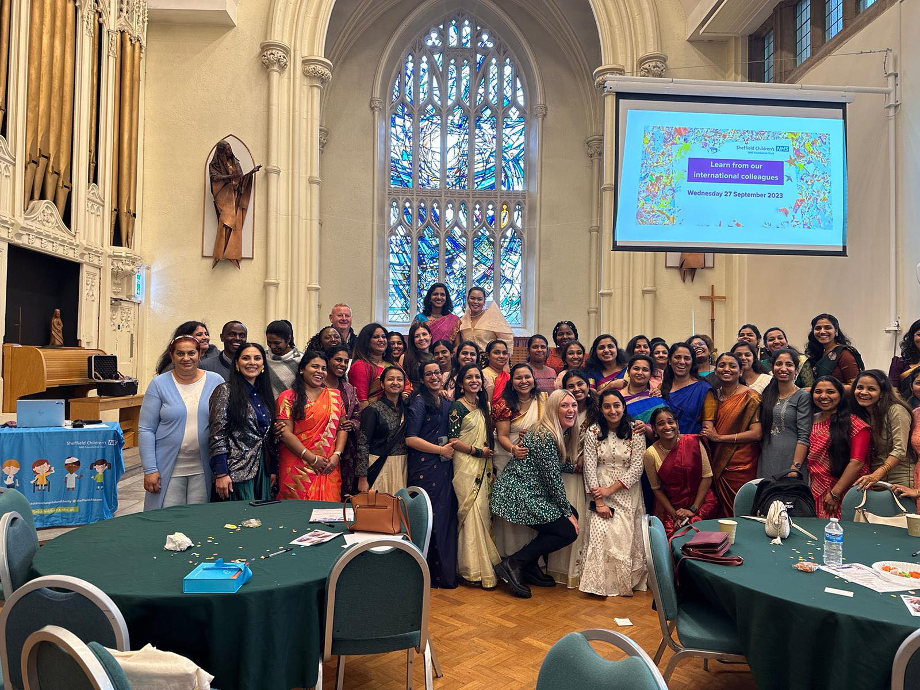
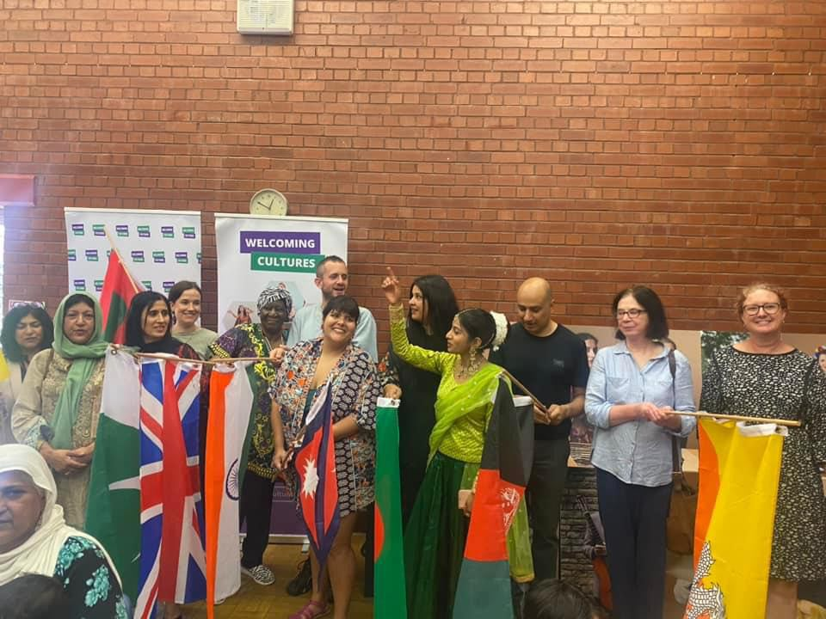
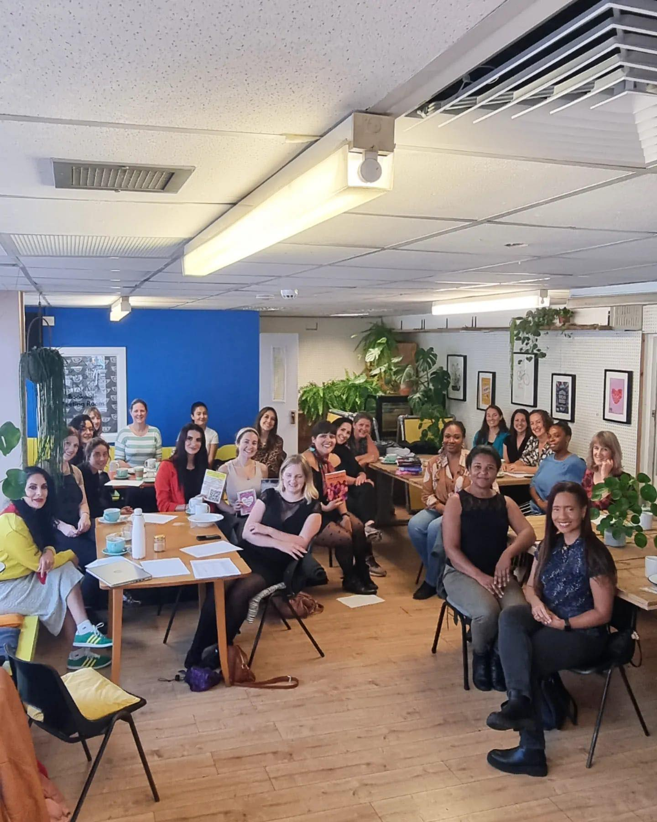
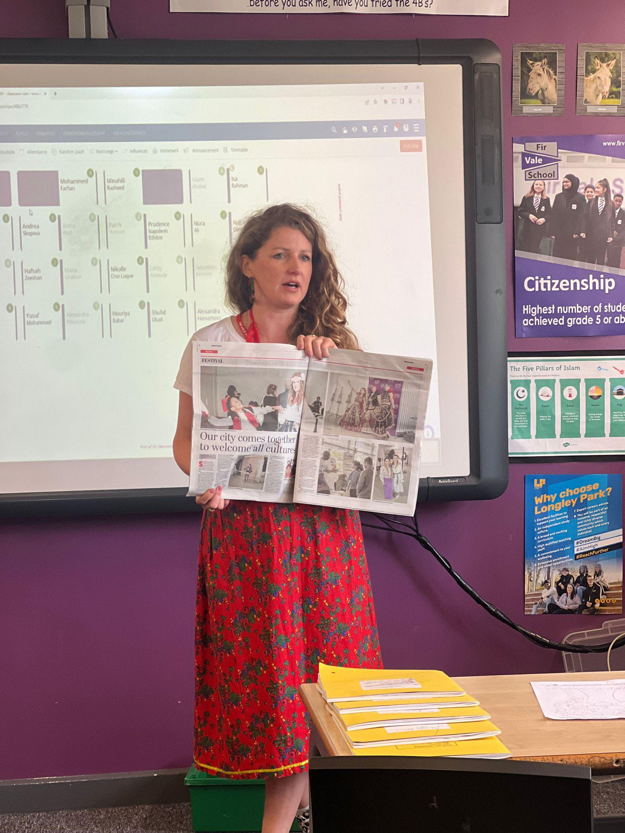
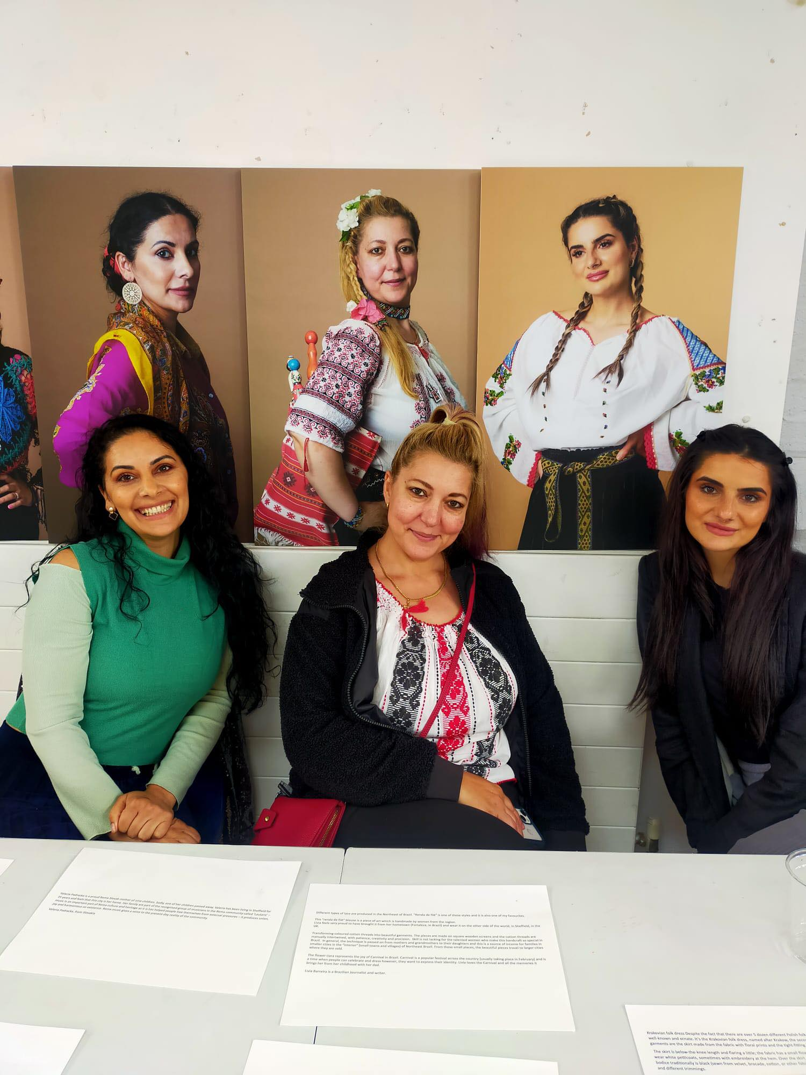
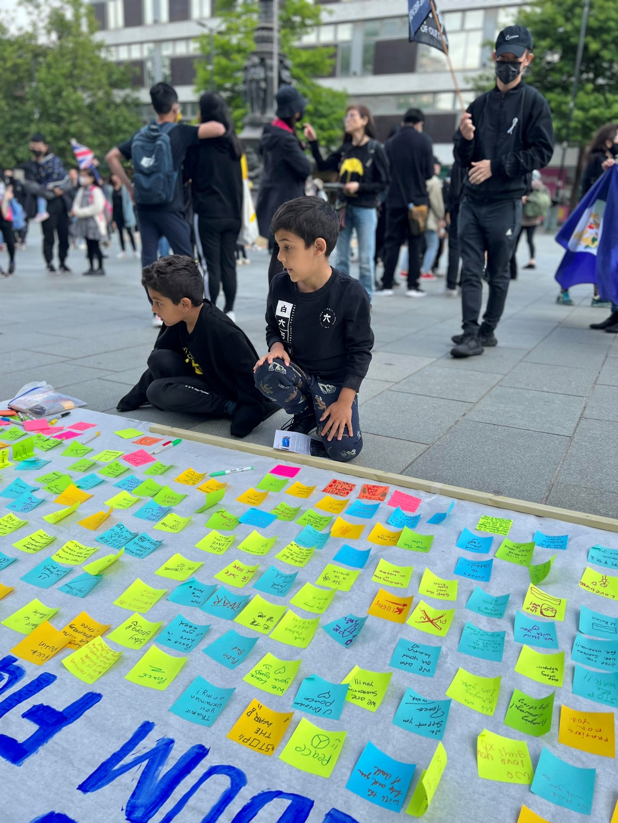
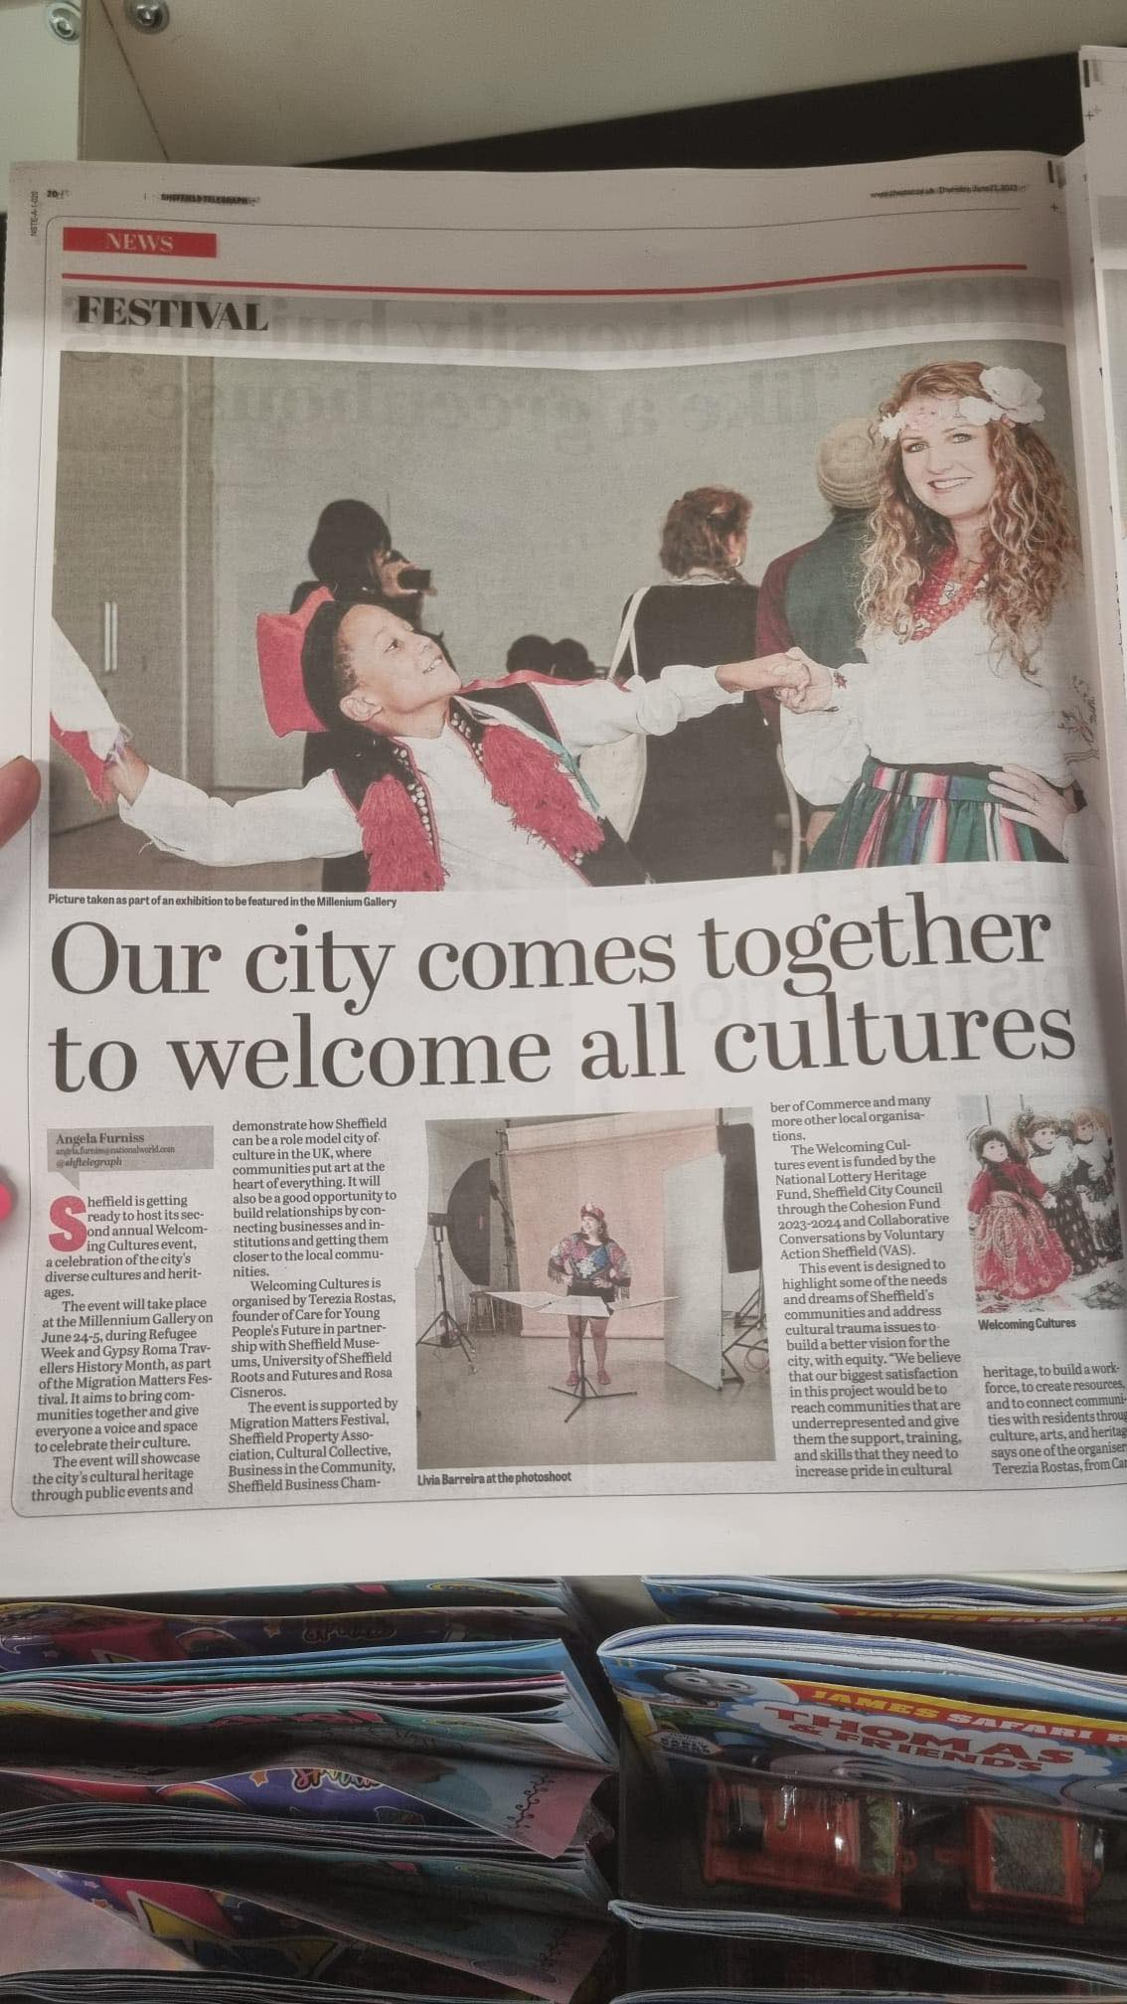
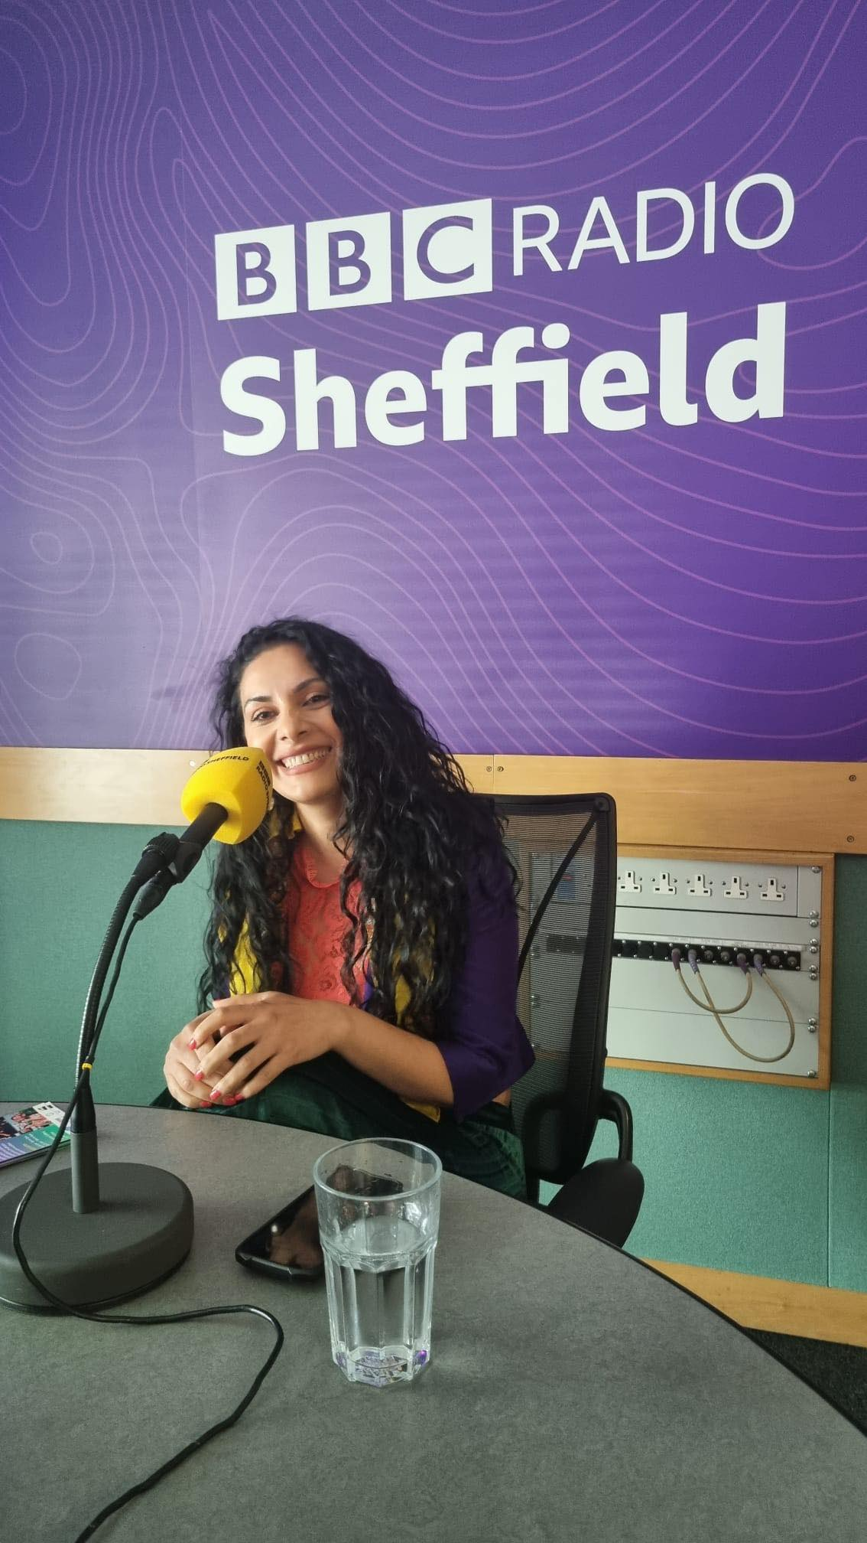
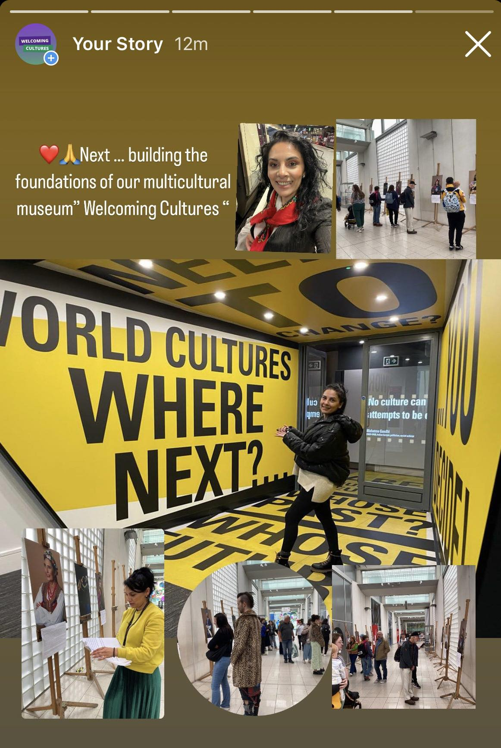
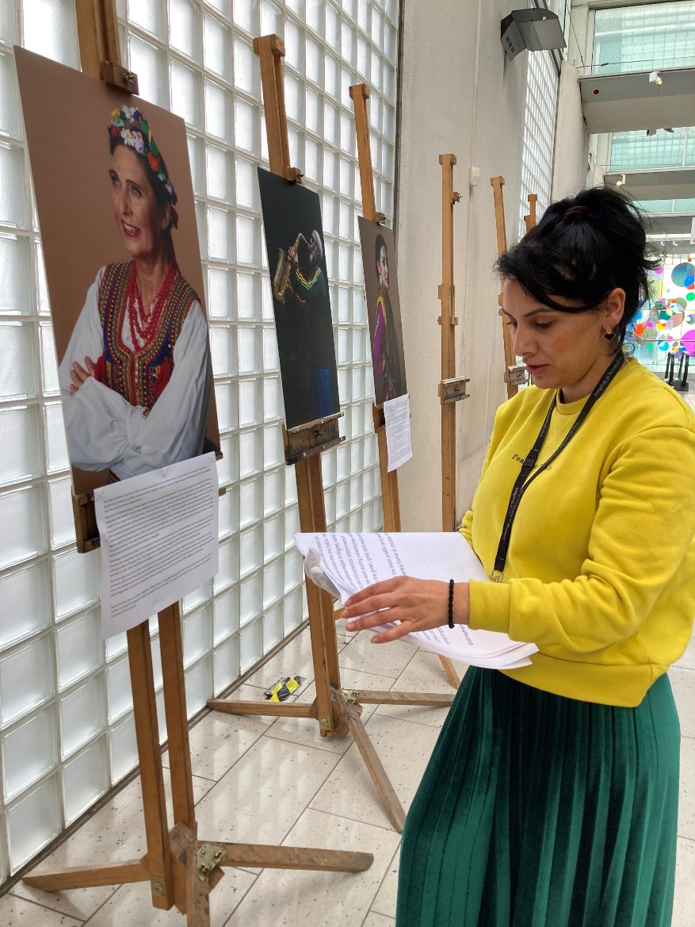
Welcoming Cultures

Slide 18
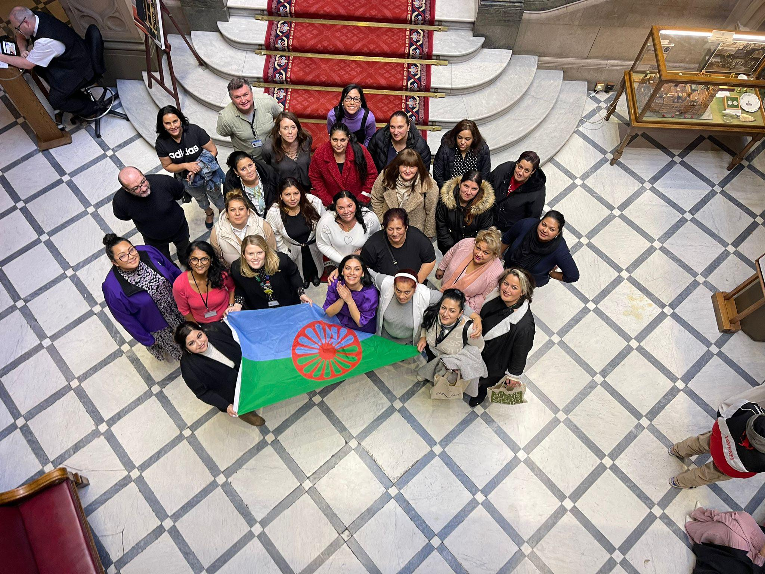

Slide 19


Thankyou

Slide 20
Roma Women transforming the educational systems around Europe through their social and political mobilizations (RTransform)
It is a three year project in partnership with 5 countries : UK, Spain, Hungary, Greece and Bulgaria.
Each partner will aim to deliver :
20 educational workshops
1 Roma women gathering/year – which will address education, raising aspirations and empowerment .
1 training /year for each organisation to exchange/learn good practice from each partner
Find us on : Facebook :Rtranform.eu Twitter and Instagram : @Rtranformeu
Email: info@rtransform.eu
Website : www.rtranform.eu

Slide 21
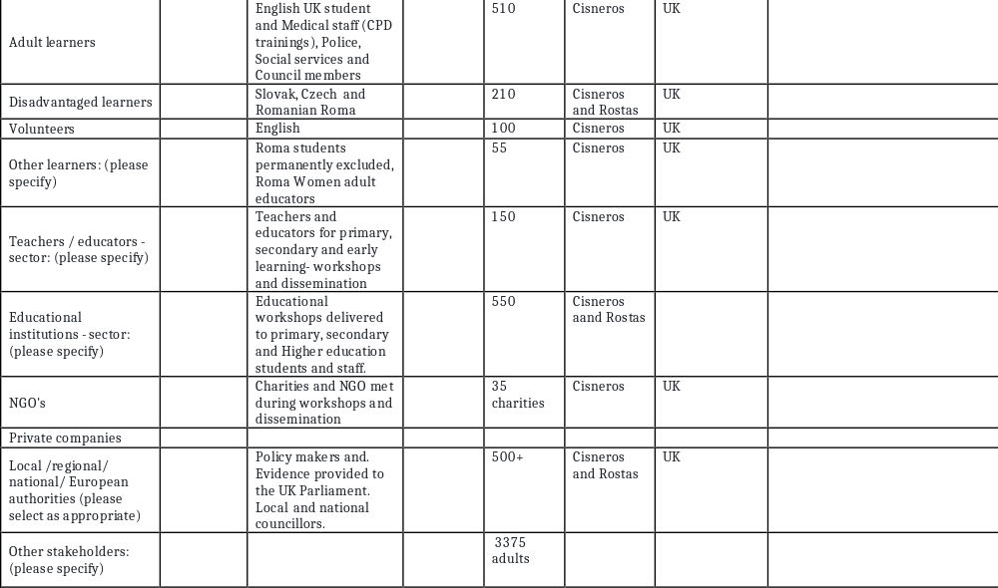
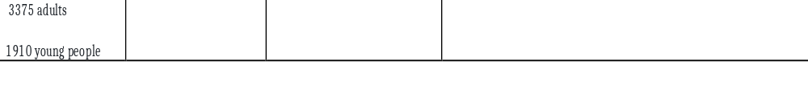

Slide 22
How we will continue to make an impact
We are currently working closely with all our partners to review their existing services and identify strengths and challenges.
Decolonising existing educational programmes that are not currently inclusive and recognising the Roma community’s history.
Bring more visual and representation from the Roma community by presenting our recommendations to Sheffield City Partnership and official institutions across the UK.
Our 2 universities in Sheffield are currently looking at co creating Community and cultural courses that will empower the Roma women to apply and be part of the university life.
Department from Education- GRT Stakeholder group and Our University of Sheffield we are creating a multicultural curriculum for our schools hosted by trusted websites.
Recognise lived experience by treating our Roma women as experts , increase the access to employment, education and decision making
Ensuring our founder is representing the Roma community’s needs at high-level decision-making meetings
We are on the Steering group for the Cultural Strategy of the city, CITY GOALS. CITY’S GROWTH , Business

Slide 23
What do our Roma Women want?
Representation and visibility, resources and support and inclusive curriculum and training.
1: Representation and Visibility
Ensure clear and visible Roma role models in various positions, including senior leadership spaces, to make education more accessible and visible to Gypsy, Roma, and Traveller (GRT) children and young people.
Improve visual and in-person representation of Roma women in educational settings, cultural institutions, and the health sector.
Recognize and incorporate Roma history and language into educational institutions to make them visible, accessible, and recognized.
Create Romani Studies Programs to increase Roma students' access to higher education and promote inclusivity.
2: Resources and Support
Provide financial support and mentoring opportunities, such as bursaries, to support Roma students, women, and girls in their educational journeys.
Establish partnerships with colleges, universities, museums, and arts institutions to foster collaboration and create opportunities for Roma community members to attend and engage with these spaces.
Offer mentoring and needed support for Roma individuals to access and feel welcomed in educational and cultural settings.
Ensure financial assistance programs, such as the Roma Education Fund and bursaries, to address existing inequalities and barriers for Roma individuals in higher education.

Slide 24
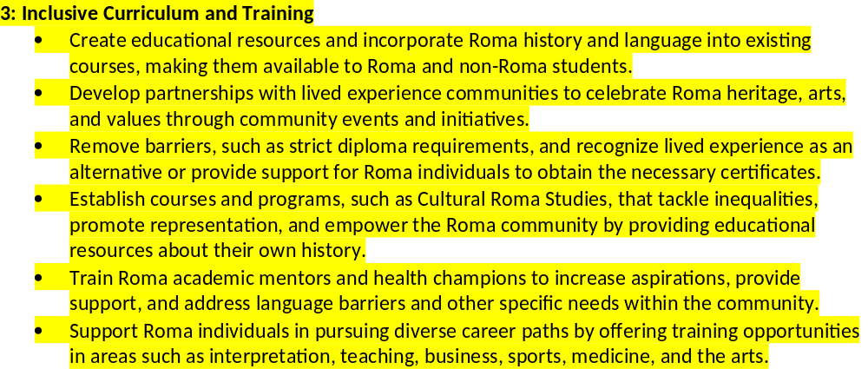
These recommendations aim to address the educational challenges faced by the Roma Women and girls. It aims to improve representation and visibility, foster inclusive and culturally responsive educational environments. By implementing these recommendations, political partners and policymakers can make significant strides in promoting equality of educational opportunities and empowering the Roma Women in having equal chances for her health and in accessing education arts and culture .

Slide 25
Race and mental health intersection unseen factors
Constant family worries
Silenced
Stressful environment
Large families- low level of empathy
Racism
No real support,language needs, learning difficulties
Judgements
Policies not recognising their needs
Constant sacrifice , health,finance ,housing
Migrants, refugees
Responsibility
Brave, starting from zero
Putting themselves last
Not feeling valued

Slide 26
Race and mental health intersection helping factors
Unity/togetherness
Understanding
Teamwork
Empathy
Collaboration
Engagement
Solidarity
Trust
Knowledge
Policy making
Communication
Creativity
Inclusivity
Respect

Slide 27
Importance of Including Roma Women's Needs into Policies:
Holistic Development: Recognizing and addressing the specific needs of Roma women leads to more comprehensive and effective policies that contribute to the overall development of the community.
Equitable Opportunities: Inclusion in policy-making ensures equitable access to resources, services, and opportunities for Roma women, contributing to their empowerment and socio-economic upliftment.
Cultural Sensitivity: Policies that consider Roma women's perspectives respect their cultural values, traditions, and lived experiences, fostering a sense of belonging and social cohesion within the community.
Conclusion: Building alliances between political partners and grassroots Roma women requires a concerted effort to bridge the gap between policy formulation and the needs of the community. By prioritizing co-creation, inclusive education, and political participation, we can create a more equitable and inclusive society that uplifts and empowers Roma women and girls.

Slide 28

What’s next ?
The UK branch of the consortium found that the following was key:
Acknowledging and strengthening the Roma Women's Movement is important;
Improving educational expectations for our Roma women and girls is vital;
Making the voice of Roma Women heard through understanding that they are part of the solution;
Creating space for the needs of the Roma Women by including them in the policy-making processes and following up with the implementation and evaluation of those policies.

