Slide 1

City of Sanctuary Sheffield
Creating a Culture of Welcome
Blessan Babu

Slide 2



Our Vision
For all new refugees in Sheffield to lead full lives
For Sheffield to be a safe and welcoming city for all

Slide 3
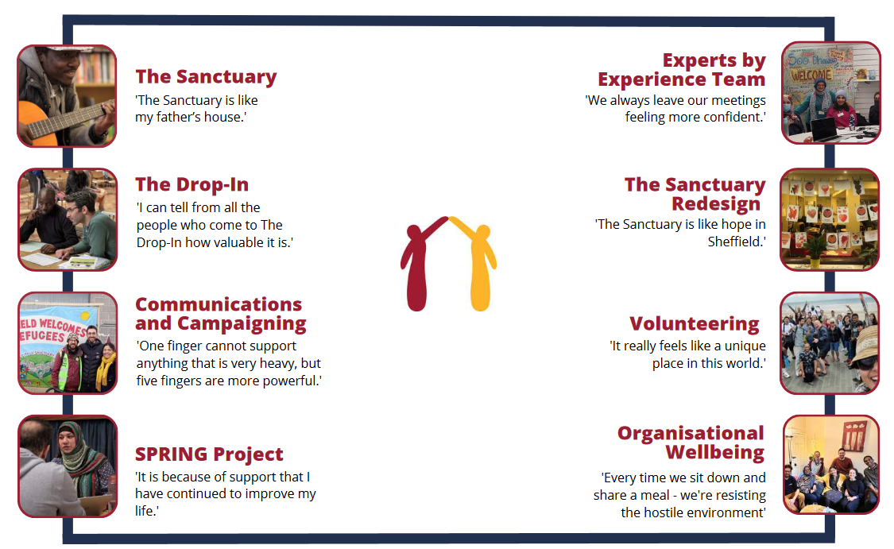
What We Do

Slide 4
What We Do: The Sanctuary
A place of Safety and Welcome
A warm welcome with a hot drink and calm place to sit.
Opportunities for participation in conversation groups and many more social activities.

Slide 5
What We Do: The Drop-In
Crucial FACE to FACE support
Bringing partners together in one space
Health and wellbeing, English language classes, signposting to food banks… and much more

Slide 6
What We Do: SPRING
Sheffield Project for Refugee Integration and Growth
URGENT needs: housing, benefits, immigration advice…
LONG-TERM integration and empowerment: education/employment, language classes, mental health support…

Slide 7
What We Do: Experts by Experience
Voices of those with LIVED EXPERIENCE seeking sanctuary in Sheffield
Inform all our work at the Sanctuary
Members can access training and develop skills

Slide 8
What We’ve Achieved
Prevented multiple homeless cases
Supported over 1500 new refugees
2019
NOW
Made numerous referrals to our partners
Creation of Sheffield Lift the Ban Coalition

Slide 9
Volunteering breakdown
Total Number of Current Volunteers at COSS: 135
Average number of volunteer hours worked per week per volunteer: 2.97 hours
Percentage of volunteers with lived experience of seeking sanctuary: 38.52%

Slide 10
What We’re Working On
Advocacy and System Change Team
Lift the Ban Strategy 2024: the right to WORK
Concessionary FREE TRAVEL passes in Sheffield
Access to good quality LEGAL HELP and REPRESENTATION

Slide 11
Some of Our Partners
Sheffield City Council
SOLACE
SAVTE
Citizens Advice Sheffield
New Beginnings

Slide 12




Any Questions?
https://sheffield.cityofsanctuary.org
City of Sanctuary Sheffield
City of Sanctuary Sheffield

