Slide 1


Slide 2
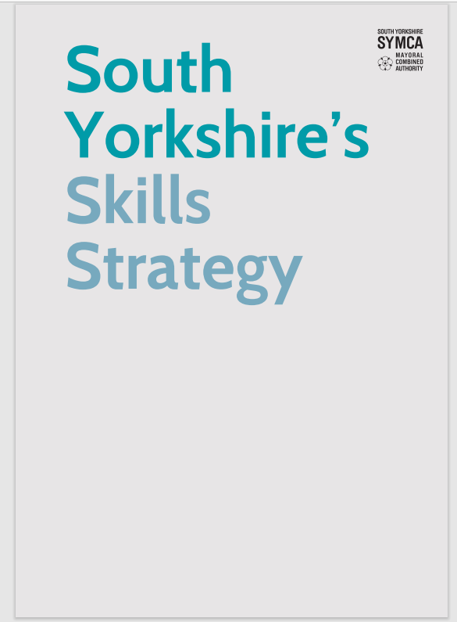
Regional Skills Strategy
Desk-based research & consultation in 2022-23
Published by SYMCA in March 2024
Outlines South Yorkshire priorities for employment & skills
Mission Areas
To structure skills activity and discussions across the region.
1. Move those far from the labour market into work or ready for work
2. Raise attainment of core knowledge and skills
3. Increase the supply of a high-skilled workforce

Slide 3
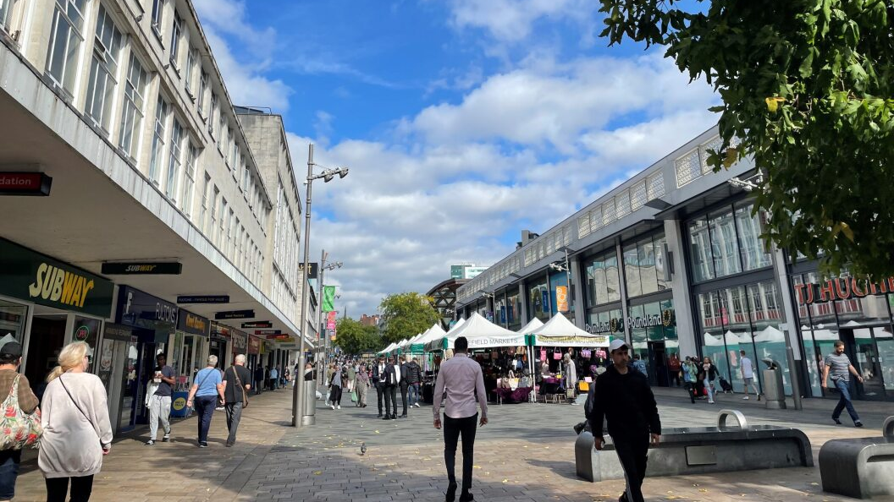
The need for a local strategy
Sheffield has not renewed an Employment & Skills Strategy in the last ten years.
The city benefits from a wide range of employment and skills activity – Council, colleges, universities, schools, training providers, employers, health sector, voluntary and community sector etc
Stakeholders agree that whilst there is some strong partnership working, there is a need to set an ambitious vision for Sheffield:
to provide a framework within which the wide range of partners and activities will operate
to provide additional co-ordination and ensure programmes are complementary
to align with the mission areas and themes of SYMCA’s regional strategy

Slide 4













SESAB partners
Since March 2023, Sheffield Employment & Skills Advisory Board (SESAB) – a partnership of anchor stakeholders within the city – has been working towards a new Employment & Skills Strategy.
Sheffield City Council – Employment & Skills
The Sheffield College
Sheffield City Council – Public Health
Sheffield Hallam University
NHS South Yorkshire Integrated Care Board
The University of Sheffield
South Yorkshire Mayoral Combined Authority
Sheffield Health & Care Partnership
Department for Work & Pensions
Voluntary Action Sheffield
Sheffield Chamber of Commerce
VCS Employment & Skills Group & BAMER 5 sub-group

Slide 5
Strategy origins
In March 2023, the Councils’ Economic Development and Skills Committee (EDSC) tasked SESAB with delivering a new Employment & Skills Strategy for the city.
The ask is for an ambitious, citywide strategy that all key stakeholders can sign up to.
With SYMCA’s regional strategy set for publication, the project to deliver the local equivalent for Sheffield can now commence.
The Sheffield Employment & Skills Strategy will align with the Regional Strategy’s three Mission Areas, but with detail specific to our city:
Opportunities
Challenges
Unique strengths
Residents
Communities
Anchor organisations
Employers
Sectors
Economy
Skills
Jobs
Inclusion

Slide 6

What will the strategy deliver?
The Sheffield Employment & Skills Strategy will deliver:
A long-term, clear vision which acknowledges the major challenges we face now and are likely to face in the future. To include longer-terms aims and objectives, with milestones
A detailed 5-year roadmap which states priorities, outlines actions assigned to stakeholders and sets SMART targets as the first step towards delivering on the vision
A ‘live’ dashboard from the baseline work to monitor the delivery of the strategy and achievements against project objectives.

Slide 7


Commissioning
SCC, working on behalf of SESAB, has recently commissioned a partnership of consultants to develop the strategy:
Kada Research is a Sheffield-based economic development consultancy – recent commissions include research work on the Regional Skills Strategy, Local Skills Improvement Plan, and Sheffield Economic Evidence Base
Ekosgen is a Manchester-based economic and social research, analysis and consultant.
SCC’s EDSC has appointed a Task and Finish Group of cross-party Members to guide the development of the strategy.

Slide 8
Consultation (1)
Extensive consultation was undertaken by Kada Research for the Regional Skills Strategy – the Sheffield strategy will draw on this evidence base.
We are eager not to repeat work already undertaken, input already provided, and intelligence already gained.
There will be opportunities to input for all stakeholders, including those who didn’t participate in earlier consultation.
Kada will be convening themed groups, consulting with representative bodies and established networks - this will draw upon feedback from the regional skills strategy and seek to advance the conversation.
“You told us this…
“Here are our thoughts…
“What do you think?...

Slide 9
Consultation (2)
APRIL: Desk-based research / evidence base
JUNE: The first round of consultation activity will move straight to the discussion of missions (objectives, outcomes, parts and roles, indicators, broad areas of activity).
JULY: The second round of consultation in July will focus on action development to populate the roadmap.
AUGUST: Draft report
SEPTEMBER: Publication of the strategy
STAY TUNED FOR MORE INFORMATION!

