Slide 1

Sheffield Programmes
Gary Drake - Head of Operations

Slide 2
What PET-Xi’s Ignite Programme offers:
Our free programme is designed to help young jobseekers develop entrepreneurial skills and support starting their own business within 10 days! We believe in the power of entrepreneurship and want to help them turn their business ideas into reality!
Entrepreneurship Training: Our comprehensive programme focuses on developing entrepreneurial skills. From idea generation to business planning, we cover all the essentials you need to start your
own business.
Mentoring and Support: You won’t be alone on this journey. Our team of experienced entrepreneurs will provide guidance and support, helping you navigate through the challenges of starting a business.
£50 Start-Up Business Grant: To help you get started, every individual completing our programme will receive a £50 start-up business grant. Plus, support to apply for £1000 Sheffield New Business start-up Grant!
Eligibility: Must be 19-24 (born before 31.08.04) and not in education.

Slide 3






Slide 4



Slide 5
What PET-Xi’s Introduction to Coaching Football offers:
Our free programme is designed to help young jobseekers start a Football Coaching career with Sheffield United Community Foundation.
Role: Football Coach Term: Casual Hours
Salary: £11 – £15 p/h dependent on qualifications
If you have a passion for coaching and developing players to help them understand more about the game and embrace a love for football, the FREE Introduction to Coaching Football Course is the
perfect place to start.
Plus, gain the Introduction to Coaching Football Qualification (Previously FA Level 1 Coaching Badge).
With the opportunity to progress onto UEFA C Coaching License with SUFC Community Foundation if successful.
Eligibility: Must be 19-24 (born before 31.08.04) and not in education.

Slide 6


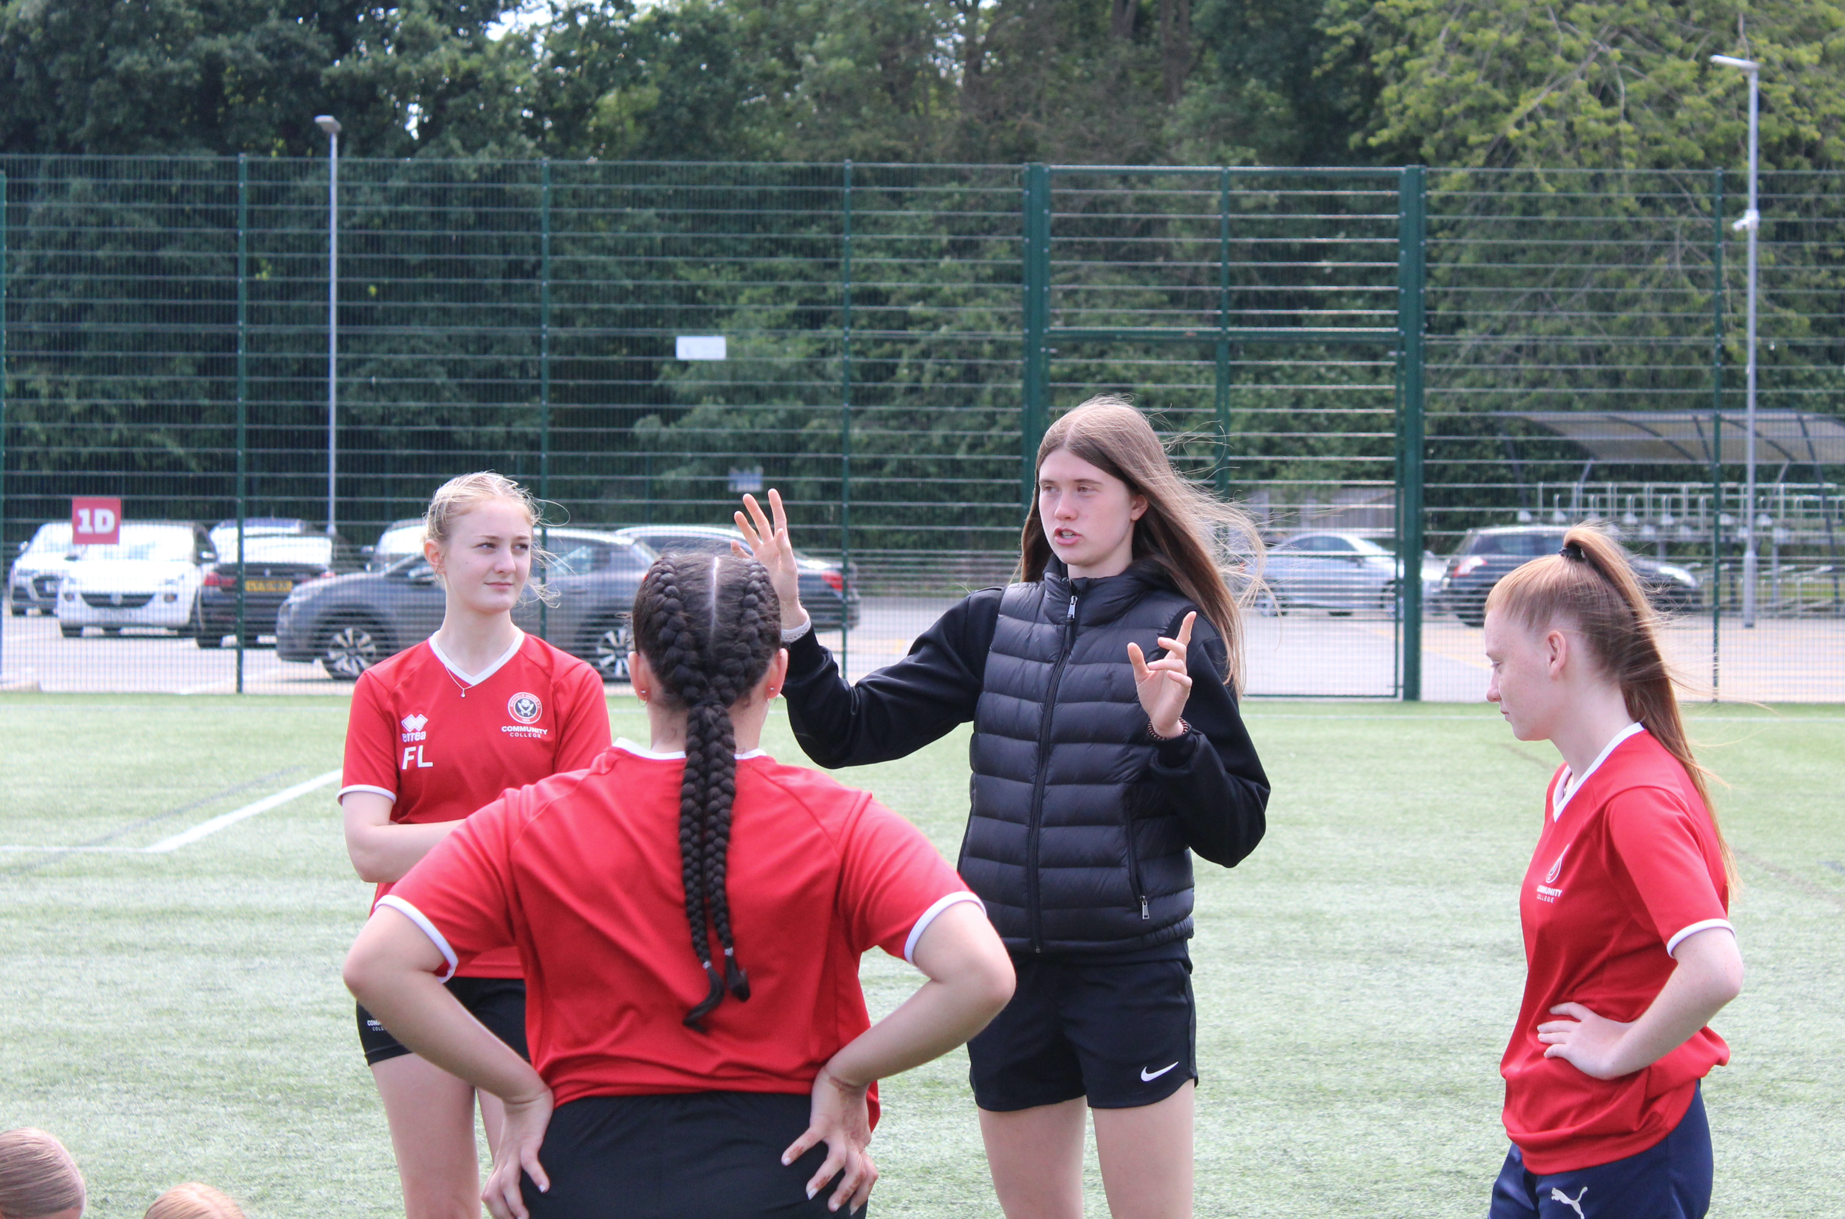
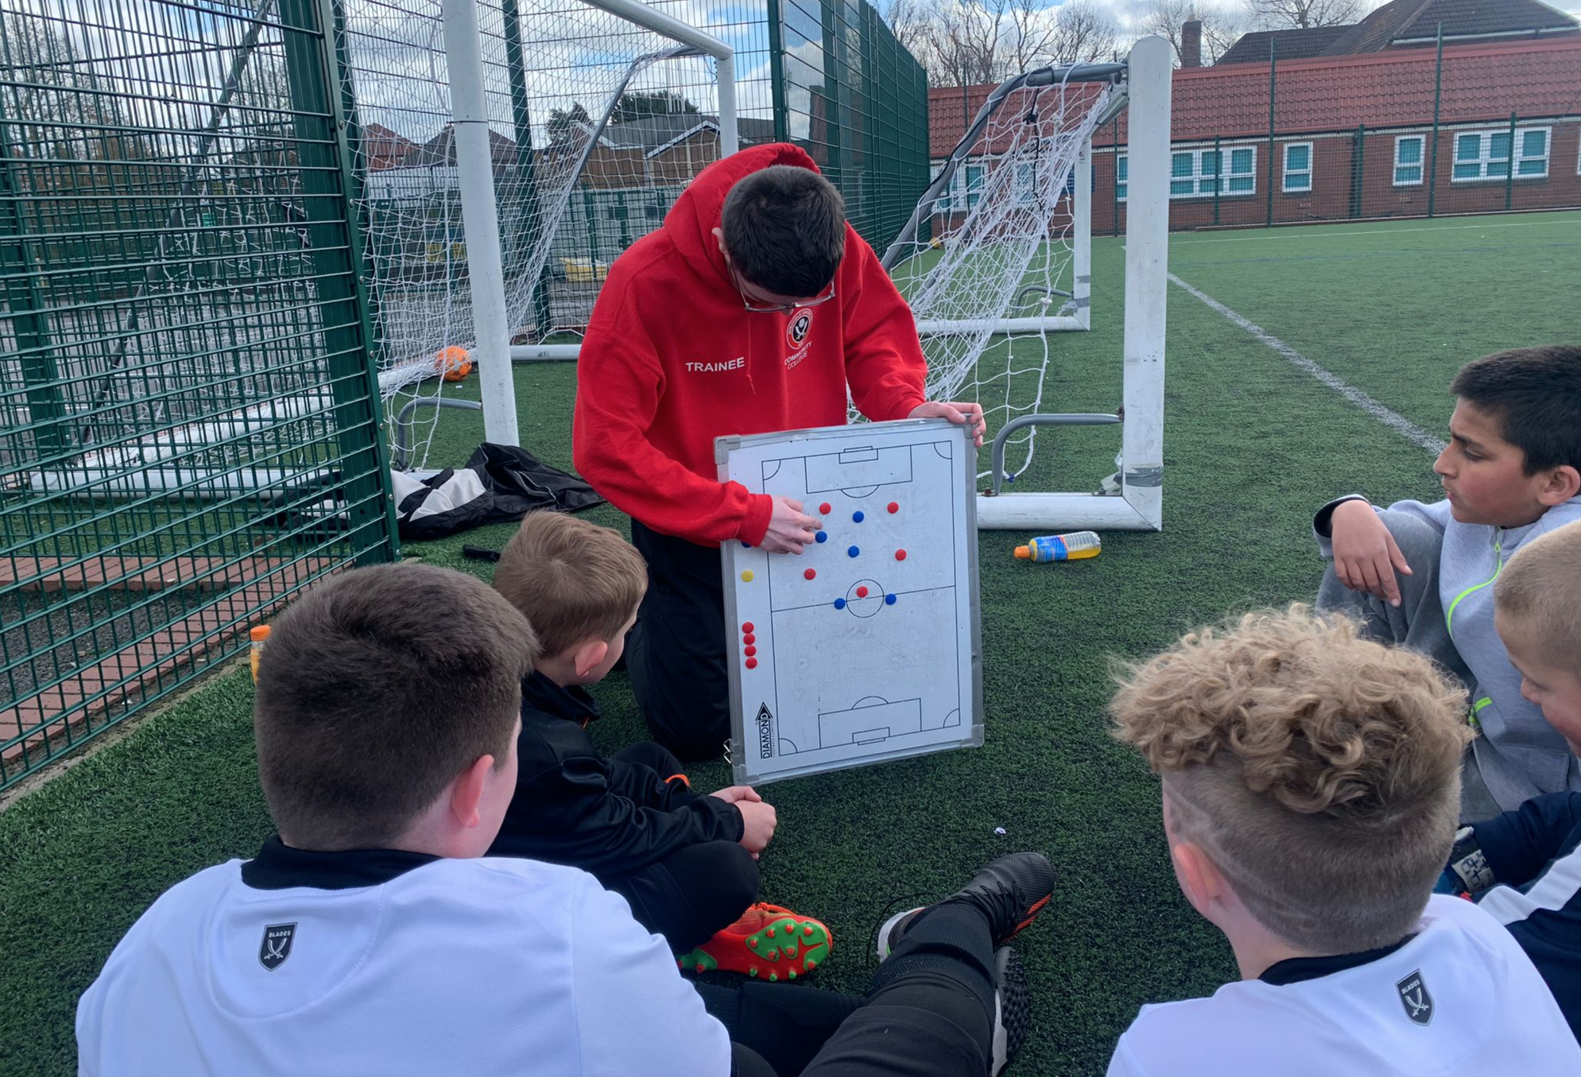
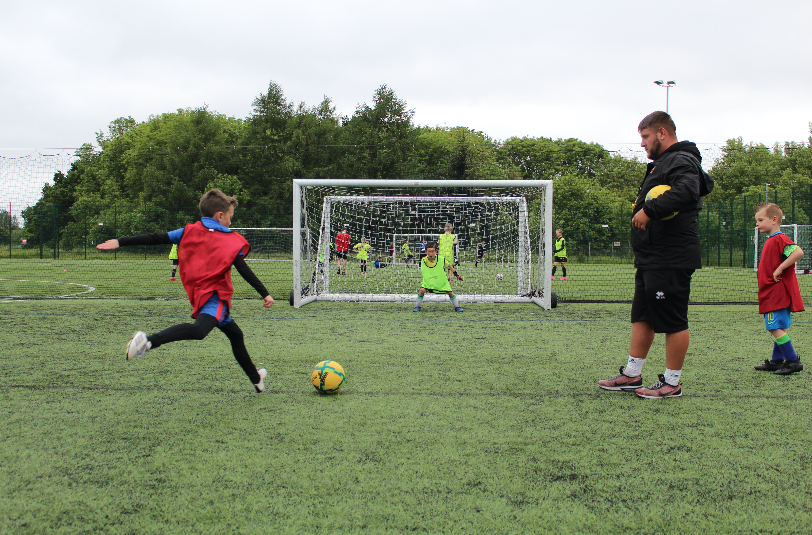

Slide 7
What PET-Xi’s Exemplar Health Care Programme offers:
Our free programme is designed to help young jobseekers start a career in the care sector with Exemplar Health Care.
Role: Health Care Assistant Term: Full-time
Salary: £11.94 /ph Location: S4 8AR
(Must be flexible days and nights)
We’re working with Exemplar Health Care to offer guaranteed interviews for their Health Care Assistant roles, upon completion of our FREE training programme.
Eligibility: Must be 19-24 (born before 31.08.04) and not in education.

Slide 8


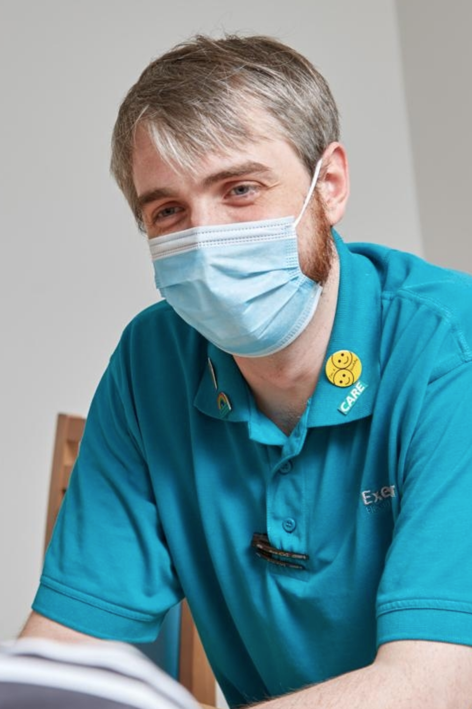


Slide 9
What PET-Xi’s Daisy Communications Programme offers:
Our free programme is designed to help job seekers 19+ start a career with Daisy Communications
the largest independent specialist telecommunications business in the UK.
Role: Customer Loyalty Advisor Term: Office based full-time
Salary: £22,308 with realistic commission of £1000 per month.
Mon to Fri working between: 9:00 - 18:00 (37.5 hours per week).
Our FREE training course will help prepare jobseekers for their guaranteed interview with Daisy Communication.
Eligibility: Sheffield residents 19+, currently not in education or in full-time employment.

Slide 10






Slide 11
PET-Xi Sheffield would like to invite you to come along and meet the team!
Matching your participants to the right support can be a tricky business, with ever changing barriers & needs of young people, and the local labour market, the network can feel overwhelming.
At PET-Xi we pride ourselves on providing a welcoming, non-judgmental setting where young people can not only grow, but thrive and realise their potential. With non-bias IAG, Interactive Level 2 Vocational Certificates and flexible, bespoke careers support, and our Multiply Cooking Counts Programme, our team are here to empower and inspire!
We’d love for Work Coaches, Advisors, PAs and Partners to meet the team, check
out the setting and find out more about how we can support your participants.

Slide 12


