Slide 1


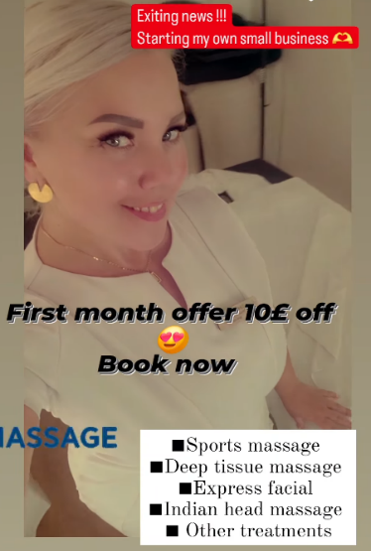
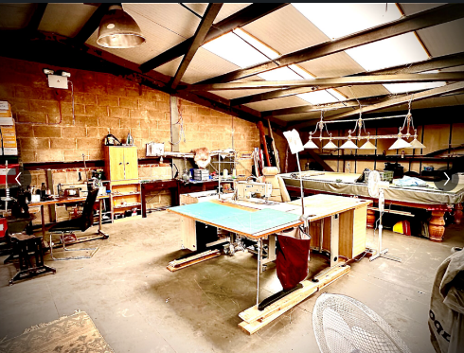

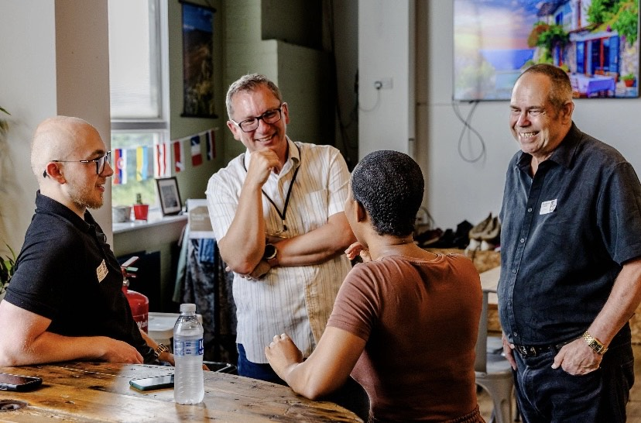
Newsletter
Citadel Business Academy
Client Success Stories
Jack (right) has set up his leather bag making workshop after making the first four sales in his new venture, he is making travel kits for classic car owners and also instrument bags for musicians. https://justthehide.co.uk/
Sintija (left) has started doing massages such as sport massage and deep tissue massage as a sole trader, you can book on to find her services using the link below: https://made2move.co.uk/book-now/
Business Startup Programme
Introducing our new business startup programme, a six- session programme that is designed to get you from having a business idea, to having a fully functioning and
profitable business within the six sessions.
We still have our one-to-one business startup coaching, however this is an alternative method to get you started up in a structured and organised manner.
Find necessary details here: https://citadelbusinessacademy.org/programmes/business-startup-programme
The Business Colab
A monthly informal network held by the Hope Community Foundation in partnership with us, this is an opportunity for all business owners in and around Sheffield to connect and collaborate with fellow local entrepreneurs. This is held on the 3rd Thursday of every month, meaning this event will be held on Thursday 17th October between 12pm and 2pm. Find more details below:
https://citadelbusinessacademy.org/business-colab
Upcoming Events and Projects
Business Exploration Drop-In Session – Friday 1st November
https://citadelbusinessacademy.org/events/business-drop-in-session
The Business Colab – Thursday 17th October
https://citadelbusinessacademy.org/business-colab
LinkedIn – Citadel Business Academy
Instagram - _citadelbusinessacademy
Email – citadelbusinesstraining@gmail.com
Telephone – 0114 312 4024

