Slide 1




Teacake Club
Winter 2025

Slide 2
Welcome !
First of 2025

Slide 3

Chloe Janes
Events and Engagement Manager
Opp

Slide 4

Sian Waddell
Employability Lead &
Learning and Development Facilitator
Opp

Slide 5




Employability at Sheffield Teaching Hospitals
Sian Waddell
Employability Lead

Slide 6

Sheffield Teaching Hospitals
One of the largest employers in Sheffield, with around 20,000 employees
Spread across 5 sites;
  Northern General
  Royal Hallamshire
  Weston Park
  Jessop Wing
  Charles Clifford Dental Hospital
  + Integrated Community Services
We actively recruit people of all ages, backgrounds and levels of experience.
We have clinical & non-clinical roles, ranging from apprenticeships & entry-level to senior and more niche opportunities.
Employability – widening participation through IAG & Training/Programmes…
PROUD TO MAKE A DIFFERENCE
SHEFFIELD TEACHING HOSPITALS NHS FOUNDATION TRUST

Slide 7


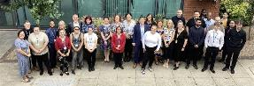

2024 Activity
The PROUD Apprenticeship – Launched February ‘24
Level 2 Customer Service role within NHS Admin areas
Entry Level – built into our admin career pathway
Widening Participation at the heart: employability IAG sessions, King’s Trust programmes & Values-based Assessment Day
Cohort 1 started in July with 14 apprentices; 50% declared a learning difficulty/neurodiversity or disability, 43% live in areas of higher deprivation
We’ve since hired another 13 to start in February this year
PROUD TO MAKE A DIFFERENCE
SHEFFIELD TEACHING HOSPITALS NHS FOUNDATION TRUST

Slide 8
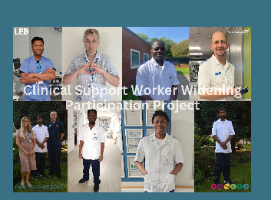
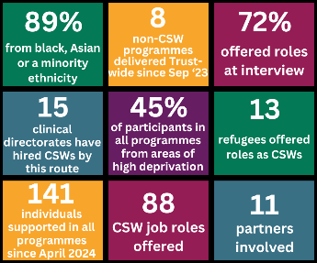
2024 Activity
Clinical Support Worker Widening Access Project
Working with partners to attract & support hard-to-reach communities/individuals with employment barriers.
Using STH resource more efficiently, focusing on quality over quantity.
Employability IAG Sessions followed by a hidden advert for partners to share with suitable customers.
Interview support and face to face interviews.
Nominated for the Best Social Responsibility category at the Nursing Times Workforce Awards.
Amazing outcomes…
PROUD TO MAKE A DIFFERENCE
SHEFFIELD TEACHING HOSPITALS NHS FOUNDATION TRUST

Slide 9




2024 Activity
King’s Trust &
Street League
1 week programmes for young people to introduce them to job roles and support them to apply.
4 x King’s Trust programmes and 1 with Street League.
Ringfenced vacancies for each programme.
55% of participants received job offers overall.
Ongoing pastoral support provided by each organisation.
PROUD TO MAKE A DIFFERENCE
SHEFFIELD TEACHING HOSPITALS NHS FOUNDATION TRUST

Slide 10
2024 Activity
Sector-based Work Academy Programme (SWAP)
Providing job-specific & employability training and work placements within Domestics/Facilities roles.
Bespoke programme for refugees, referred by DWP, VAS & REP.
Co-delivered by STH & Sheffield College.
100% of candidates (7) who completed the programme were offered jobs.
PROUD TO MAKE A DIFFERENCE
SHEFFIELD TEACHING HOSPITALS NHS FOUNDATION TRUST

Slide 11
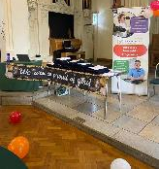
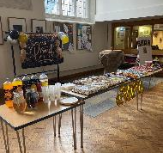
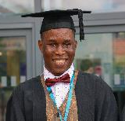
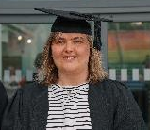
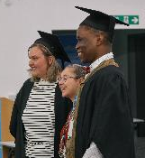
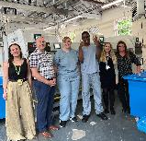
2024 Activity
Supported Internships
Hosted supported interns from Choices College & Sheffield College across our Trust.
Supporting all interns via employability workshops & hospital tours.
Providing career guidance and opportunities via bespoke recruitment opportunities including onto our PROUD apprenticeship (2 starts) and within Linen Services (2 starts).
PROUD TO MAKE A DIFFERENCE
SHEFFIELD TEACHING HOSPITALS NHS FOUNDATION TRUST

Slide 12




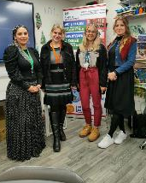

2024 Activity
Community Workshops
Application & Interview Skills Online Webinars – every 6 weeks, 273 bookings
In-person workshops
  Zest
  Growth (Refugee Employability Programme)
  Wybourn (Pat Midgley)
  Sharrow (Care Leavers)
  Oasis Community Hub (Roma Women Employment Project + local hub attendees)
    ~60 total attendees
PROUD TO MAKE A DIFFERENCE
SHEFFIELD TEACHING HOSPITALS NHS FOUNDATION TRUST

Slide 13
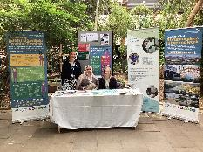
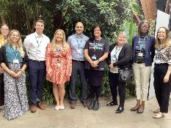
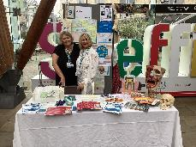
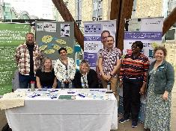
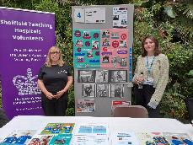
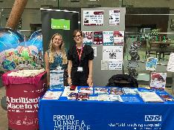
2024 Activity
World of Work Careers Fair
Ringfenced vacancies
Employability Zone
  CSW workshop & other employability support advertised
336 expressions of interest – 34% unemployed, 84% non-white ethnicity
PROUD TO MAKE A DIFFERENCE
SHEFFIELD TEACHING HOSPITALS NHS FOUNDATION TRUST

Slide 14
2024 Activity
Other Entry-Level Apprenticeships – Employability Focus
Recruitment into the following programmes:
Dental Nurse (L3)
Pharmacy Assistant (L2)
Pharmacy Tech (L3)
Healthcare Science Assistant (L2)
Installation & Maintenance Electrician (L3)
Building Services Engineering Installer (L2)
Carpentry & Joiners (L2)
Plumbing & Heating Technician (L3)
Early Years Educator (L3)
PROUD TO MAKE A DIFFERENCE
SHEFFIELD TEACHING HOSPITALS NHS FOUNDATION TRUST

Slide 15
2024 Stats
440 touchpoints
343 supported
221 interviewed
182 job offers
120 started employment (and still counting)
43% live in areas of high/above average deprivation
77% were non-white ethnicity
PROUD TO MAKE A DIFFERENCE
SHEFFIELD TEACHING HOSPITALS NHS FOUNDATION TRUST

Slide 16
This year
CSW – 4 x Widening Access recruitment (February, April, July, November)
Admin SWAP – Sector Routeways (February)
Ringfenced Domestics Vacancies – New Approach
Street League – April (various roles)
Facilities SWAP – June (Domestics)
King’s Trust – July (Roles TBC)
PROUD Apprenticeship Cohort 3 (Date TBC)
Supported Internships
PROUD TO MAKE A DIFFERENCE
SHEFFIELD TEACHING HOSPITALS NHS FOUNDATION TRUST

Slide 17

Get in touch!
Any Questions?
Sian Waddell
Learning and Development Facilitator & Employability Lead (Healthcare Careers)
Sheffield Teaching Hospitals NHS Foundation Trust
Rivermead Training Centre | Northern General Hospital | Herries Road | Sheffield S5 7AU
Email: sian.waddell@nhs.net or sth.employability@nhs.net
Call: 0114 271 5755
Follow us on Twitter to keep up to date with our news:

Slide 18

SANJAY NIJHAWAN
WORKING WIN TEAM LEADER

Slide 19

Charly Crump
Training Manager

Slide 21
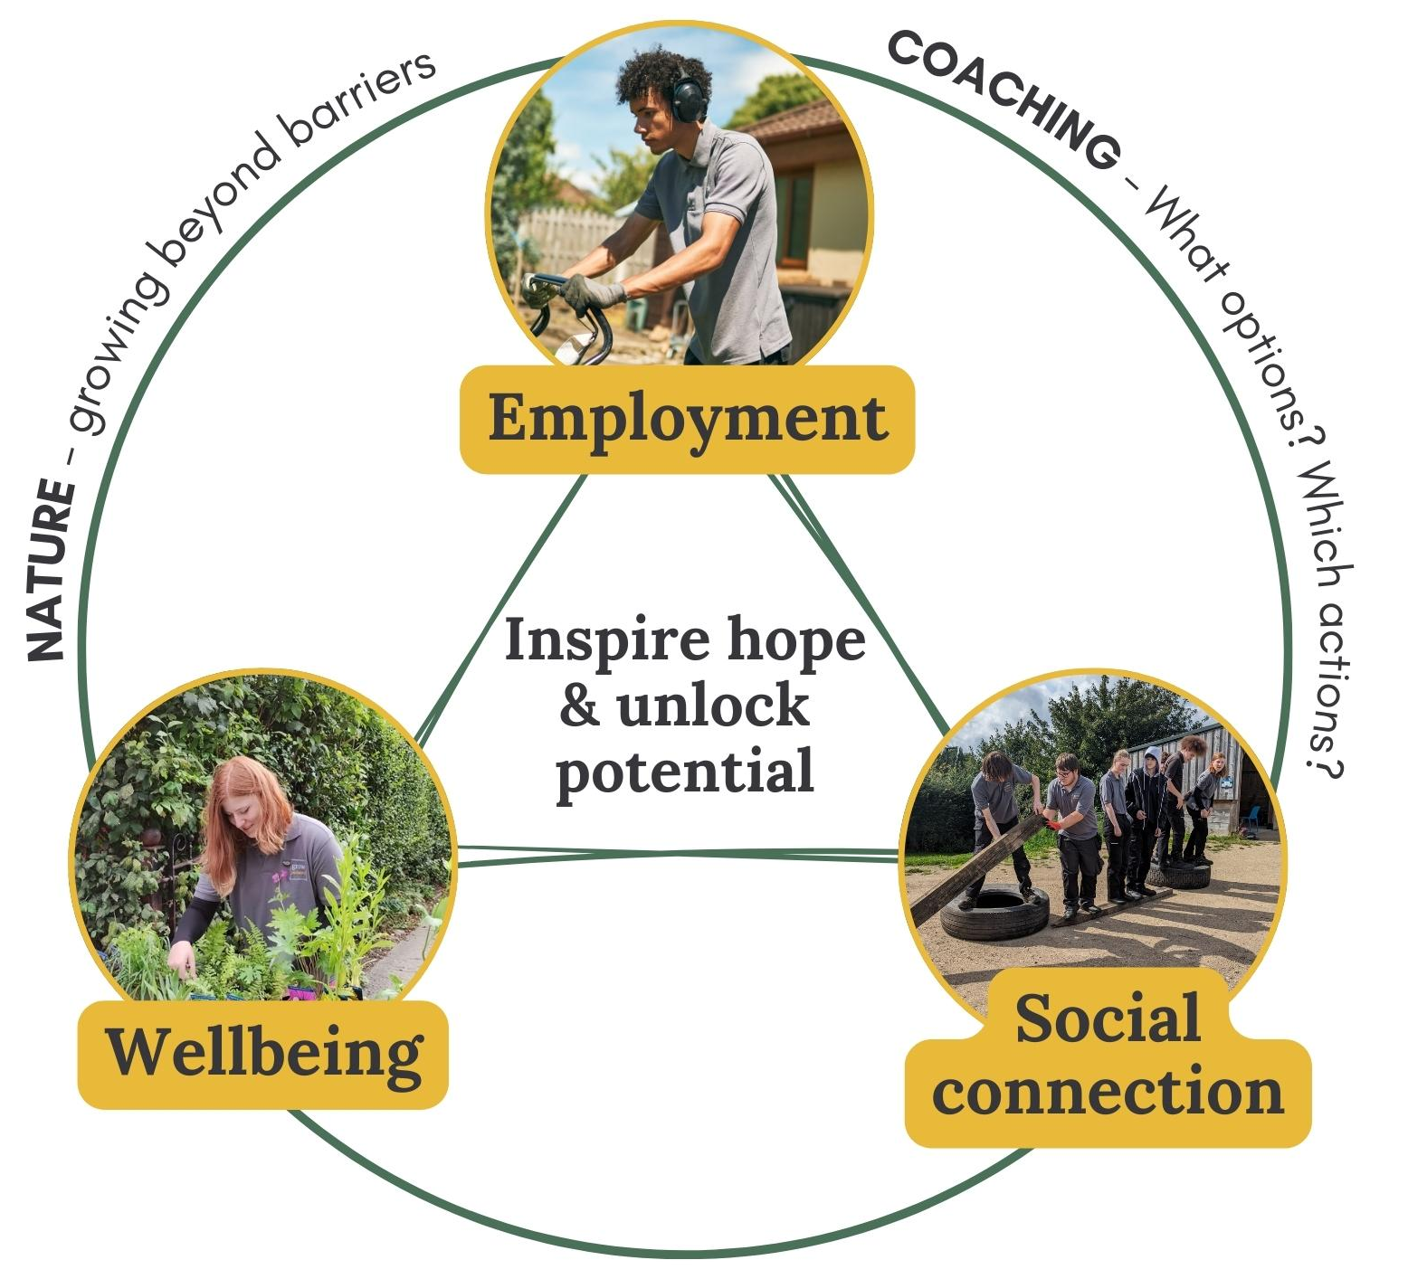
Grow’s mission
Our mission:
Inspiring hope and unlocking potential in young people (16-24 NEETS) through nature
Our work cultivates holistic impact by focusing in three key areas:
Employment (Meaningful Activity)
Wellbeing (Mental & Physical)
Social connection

Slide 22

Grow Programme to Grow Gardeners Employment
Our solution helps young people overcome two critical barriers:

Slide 23
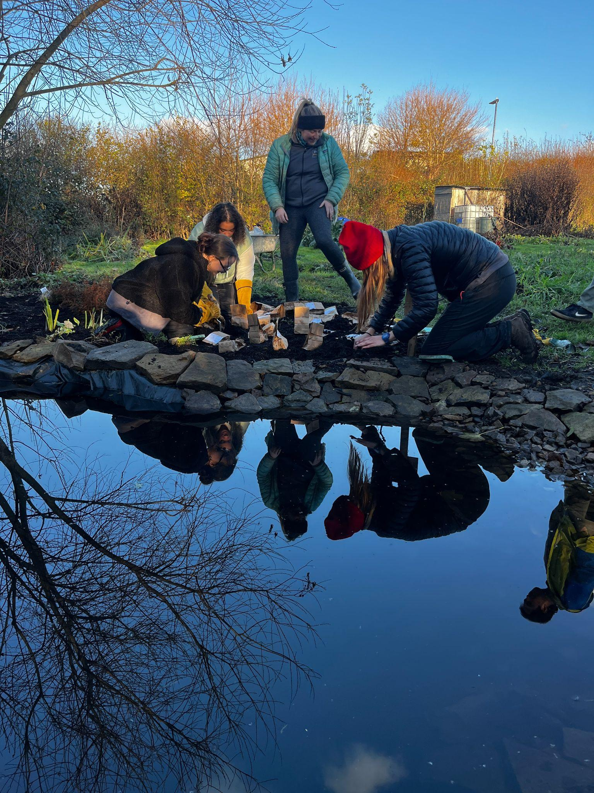
Grow Programme
Open to 16-24 year olds who are not in employment, education or training
4 week unpaid work experience programme
Mondays, Tuesdays and Wednesdays 1-3:30pm
Group coaching to develop employability skills
Working outside in a team to learn practical skills on our farm
Weekly 1-to-1 with a coach
Guaranteed interview at the end of the 4 weeks
PPE provided

Slide 24
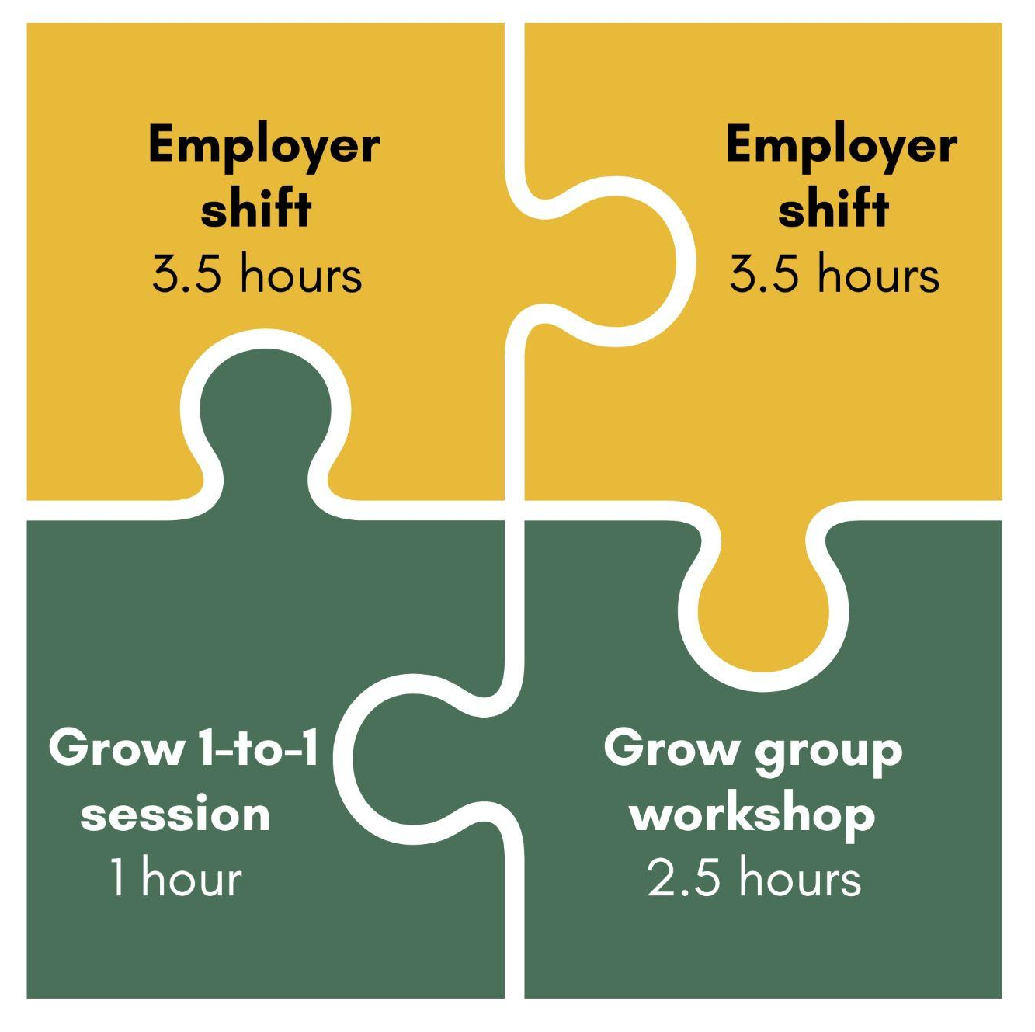
Grow Gardeners
10 week paid work experience programme
10.5 hours in total per week
2.5hs Grow Group Workshop - Tuesday afternoons
1hr 1-to-1 coaching session
7hrs with one of Grow’s Partner Employers
Support towards the end of the programme to find work or continue with our partner.

Slide 25

Kendal’s Story

Slide 26

Thank you
Any questions?

Slide 27

Tea & Coffee
20 minutes

Slide 28

In Brief
Your turn to share

Slide 29
John Powell
Partnership Manager

Slide 30

Pathways to Work

Slide 31
12-month Economic Inactivity Trailblazer
Funded by DWP for 2025-26
£3m programme in Sheffield
To form part of the Pathways to Work ‘system’ in South Yorkshire
2,000 economically active residents supported
900 economically inactive job outcomes
Other targets
Work placements / volunteering
Basic Skills registrations / achieved
Qualifications started / achieved
Vocational Licences gained
Health support
Childcare support
Transport support

Slide 32
UKSPF
Funded by the Ministry of Housing, Communities & Local Government
£2.2m programme in Sheffield for 2025-26
Economically inactive and socially excluded unemployed
Estimated 1,200 residents supported, 400 into employment
Other targets
TBD
SCC intention, if we can, is to significantly reduce the variety of outputs and outcomes from the current programme – to refocus on the key outputs and outcomes

Slide 33
Key considerations for SCC
The desire to sustain and increase VCS capacity to deliver employment support – for both the economically inactive and higher-needs unemployed – and keep things simple for residents
The need for coverage across Sheffield, including in areas where we have low presence – maximising open doors. To include new delivery sites and outreach
The need to engage those furthest from the labour market – including those who historically have not engaged with ESF / UKSPF – to enable a scaled-up programme
The need to achieve large numbers of job outcomes, while keeping targets realistic – scaling up what we currently do well and identifying new approaches to do even more
The desire for more evening & weekend engagement activity
The need to wrap around other community delivery (e.g. FACES, Multiply, PKW) more effectively
Commissioning in a way that gives VCS providers a strong opportunity to successfully bid for funding
The need for contracts to be financially viable for VCS providers
The need to manage programme-level risks – cost, staffing capacity, under-delivery
The desire to plan for a longer term programme and the launch of Connect to Work (IPS / Supported Employment)

Slide 34
Commissioning methodology
Evidence-led approach – economically inactive & cohort data from the Census, deprivation data etc to identify areas of high demand. Understanding the breakdown of economically inactive residents in Sheffield – reasons they are inactive and types of interventions they may need
Assessing demand for services in geographic areas and devising an approach for ensuring coverage exists in the areas we aren’t reaching - i.e. focusing on smaller geographic areas
Identifying cohorts which would benefit from targeted support – based upon data, experience and other activity being delivered by the market
Allocating outputs and outcomes based upon perceived demand and the need for SCC intervention, and modelling targets based upon realistic caseloads and costing activity accordingly
Assessing where additional support may be needed to ensure the market delivers a successful bidder, who can deliver the required outputs / outcomes. Including direct delivery options
Dividing into lots and sub-lots and capping the number of awards per provider, to minimise risk
Ensuring a minimum number of providers across a minimum number of geographies, to avoid duplication of area focus.

Slide 35
Proposed approach
Combined commissioning of Economic Inactivity Trailblazer and UKSPF activity – with the focus on economically inactive residents but with scope to deliver some unemployed outcomes
Lots and sub-lots for tender responses – with ringfenced funding for areas and cohorts
Revised geographic target areas, from 6 to 10 – minimum 75% of participants to be residents in from specified areas, to retain some flexibility for participant choice. TBC.
Cohort specific activity also to be commissioned – cohorts still to be finalised but will include specialist Ethnic Minorities contracts
Providers can over-deliver on economically inactive participant outcomes (at the expense of those for unemployed residents), but not the other way round.
Budgeting for performance-related add-ons for providers who over-deliver on EI job outcomes

Slide 36

Matt Slonskyj
Work & Wellbeing Team Leader

Slide 37
IPS-Homelessness
Homelessness – Including:
No Fixed Abode
Sofa Surfing
Rough Sleeping
Temporary Accommodation
Supported Accommodation
A randomised control trial aiming at testing the effectiveness of IPS when supporting individuals coping with homelessness and looking to secure employment

Slide 38
What is IPS

Slide 39

Individual Placement & Support: Originally developed as a method of employment support for individuals struggling with mental health – rolled out to help other barriers
Governs how we work with clients
8 Principles covered by 25 Fidelity points
Can learn more information at:
https://ipsgrow.org.uk/about/what-is-ips/
https://www.centreformentalhealth.org.uk/what-ips/

Slide 40
How we work with People

Slide 41
Meet and complete a Vocational Profile (a strengths based document that focuses on what people can and want to do as well as their transferable skills)
Regular meetings with a rapid approach to job search and wrap around support
Link up with CAB for benefits and better off calculations to ensure people aren’t worse off
Motivational interviewing
Active listening
Identifying skills
Goal setting and development
Support with CV’s, Applications and Searching
Interview preparation and support
Employer engagement

Slide 42

Why are we doing this

Slide 43
This is a Trial at 3 sites across England (South Yorkshire, West Yorkshire and Shropshire) to see if IPS can be adapted to provide consistent and similar benefits when applied to individuals facing homelessness (as well as coach surfing etc)
Introducing a new model of employment support to help affected individuals find more stability
See if this helps provide evidence of the impact this holistic approach can have for the better
Randomised Control Trial
Individuals meet their coach and go through a randomisation tool
Half the participants get 1-1 support from ES (Trial Group)
Half the participants receive signposting and direction to other services that the individual may require (Control Group)

Slide 44
How to Refer

Slide 45
Certain information is required as this is a trial but you can refer individuals by speaking with the employment specialist in your area, emailing details across to them for them to process or by accessing the Find Good Work referral website (to the right).
If referring via website: please select other for your organisation and then prefix the name of your organisation in the next box with “IPS-H” – you can then complete the remaining details and provide further information and your phone number in the “Referral notes” box
Referral Window is open from 4th November 2024 – 30th June 2025
Chris Ducker (Sheffield ES): C.Ducker@syha.co.uk
Louise Edwards & Evie Starikova (Barnsley ES’s): L.Edwards@syha.co.uk & E.Starikova@syha.co.uk
Cheryl Turner (Rotherham ES): C.Turner@syha.co.uk
Matt Slonskyj (Team Leader): M.Slonskyj@syha.co.uk
https://www.findgoodwork.co.uk/refer/

Slide 46
What can you Expect

Slide 47
12 months of support around employment
Employment continues after finding work to provide IWS and help with reasonable adjustments, WRAP etc
Individuals on both sides of the trial (Control and IPS Support) will be contacted by research team for baseline assessment then at midline (6mths) and endline (12mths) surveys: Participants will receive a £20 e-voucher for each survey completed

Slide 48
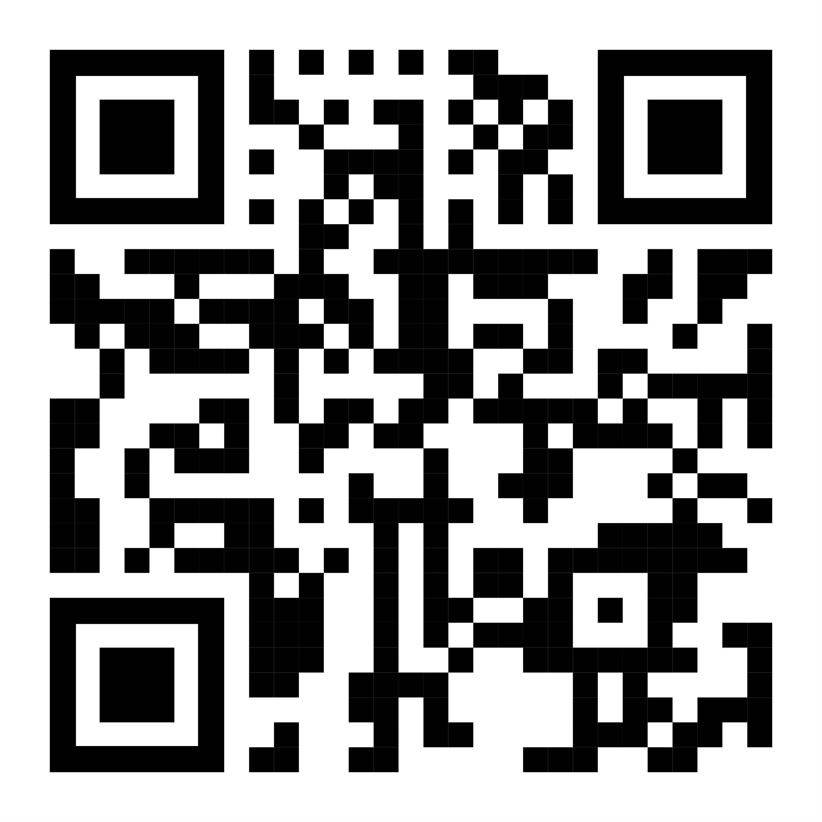
Thank you for your time
Matt Slonskyj – Work & Wellbeing Team Leader: M.slonskyj@syha.co.uk
Good Work Referral Website

Slide 49
Business Card Raffle
Will you win?

Slide 50
Thank you!
If you are interested in speaking at or hosting the next Teacake Club come let me know !

