Slide 1



Sheffield City Council’s Employment and Skills through Planning and Procurement Report
Quarter 4
2024-2025

Slide 2
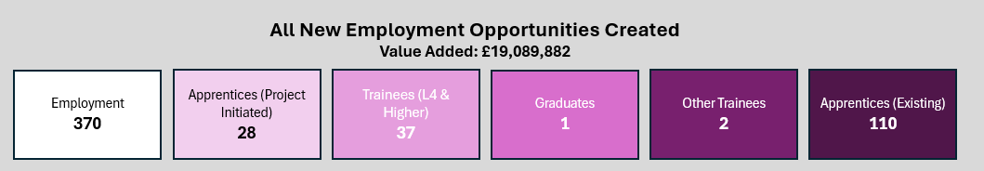
1. Employment and Skills Through Procurement and Planning Monitoring Quarter 4 and Overall 2024 - 2025
Quarter 4 Highlights
Employment
New employment and apprenticeship opportunities are regularly shared with job seekers living within Sheffield.
McLaughlin and Harvey, the principle contractor for Forgemasters Machine Shop Enabling site, has created 75 new employment opportunities.
Due to an increase in demand, Wates (Aids and Adaptations contract) have offered a further 21 employment opportunities during Quarter 4.
Reed (Sheffield City Council Temporary Work Contract) have place 19 Sheffield residents, who had previously been unemployed for 3 months or longer, into work.
Apprenticeships
Jewson Partnership Solutions (General Building Supplies Contract) have reportedd that an employee has commenced a L6 Leadership and Management Apprenticeship this Quarter.
Several contractors including, Galliford Try, McLaughlin and Harvey, Vinci Building and Wates, attended Opportunity Sheffield’s Apprenticeships: Be Inspired event on 6th March. On the day over 800 pupils received bespoke advice and guidance on apprenticeships available.

Slide 3
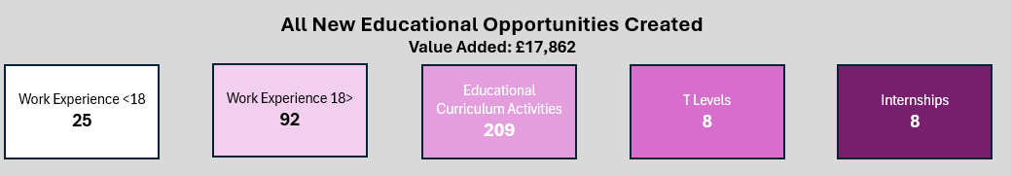
Educational Curriculum Activities
Representatives from the construction sector have worked with over 23 schools across Sheffield including primary, secondary SEND and post-16 , to run construction themed workshops and employability sessions as well as showcase the diverse range of careers that are available to school leavers.
During Quarter 4, Amey (Streets Ahead Contract) and Aureos, formerly known as Keltbray, (Castelgate Regeneration scheme) have both delivered 15 educational curriculum activities respectively.
T-Levels
Construction employers continue to support T Level placements. Thank you to the following contractors for hosting T Level students this year: Aureos, Axtec Construction, Vinci and Wates
Work Experience Placement
Employers are offering work experience placements to school age students and 16+ candidates looking for a pathway into construction.
Amey’s Environment Stewardship programme has enrolled a further 13 work experience placements during Quarter 4.
Keepmoat’s Sheffield Housing Company sites have hosted 8 Sector Routeways work experience placements throughout the year.

Slide 4
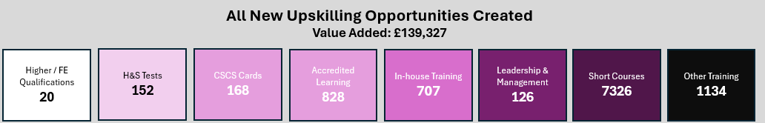
Upskilling and Further Training
Toolbox Talks are used effectively to upskill construction employees across a range of sites. HEC (Electrical Upgrade contract) have covered a range of topics including, winter working and Asbestos awareness which has directly supported employees working in residential properties.
RLB offered 104 training opportunities for their employees during Quarter 4.
CGL’s Young Persons’ Substance Misuse Support contract, has offered employees a total of 168 training places across a wide range of topics including Trauma Informed Care, Motivational Interviewing and Mental Health First Aid training during the year.

Slide 5
Additional Social Value, Community and Charity Support
The Built Environment for Good meeting on 22nd January, hosted at SADACCA, enabled attendees, including representatives from Henry Boot, Amey, McLaughlin and Harvey, Fortem, Harmony Fire and BDP Architects, to hear first hand the challenges faced by community groups.
In response, the next meeting in May will be hosted in Fir Vale so attendees can increase their understanding of the needs within the community.
Fortem (Elementals contract) responded to a significant challenge which was highlighted to them by Heeley City Farm Youth Hub. Many of the young people they support do not have access to basic hygiene products. For those striving to enter the workforce, being able to afford essential items such as body wash, deodorant, and toothpaste can be a major barrier to confidence and employability. Fortem’s supply chain partners donated £300 to the Youth Hub which will be used to purchase hygiene products.
Non- Construction Social Value Update
During Quarter 4, introductory meetings with Taylor Shaw (School Meals contract), Everyone Active (Leisure contract) and ASM Global (Sheffield Arena / Sheffield City Hall) have taken place. These suppliers will begin to report their social value outputs from Quarter 1 2025.
Quarter 4
Wider Social Value

Slide 6

Social Value Portal Summary
SCC utilises the Social Value Portal (SVP) as a resource to provide us with an accurate and quantifiable social, fiscal and economic impact measurement tool for social value activities undertaken throughout the delivery lifespan our procured major services. Our suppliers register with SVP and commit to a suite of social value outcomes to be delivered in line with the city’s priorities. These measurements, or TOMs (Themes, Measures, Outcomes), can include local job opportunities, environmental outcomes and community wellbeing, particularly in areas such as construction. Each TOM has a proxy value determined by multiple socio-economic datasets, including HM Treasury Green Book impact metrics (guidance on how to appraise and evaluate policies and programmes, and advanced analytics to ascribe a social value to social initiatives.)
There are currently 28 live projects on the portal. During this quarter, our suppliers have delivered £807,057 worth of Social Value into Sheffield’s economy.
Delivered Social Value
£18,040,338
Committed Social Value
£62,597,225
% Commitments delivered
28.84%

Slide 7
3. Appendix: Further Employment & Skills Information
Page 8: Employment and Skills through Construction Projects
Page 9: Employment and Skills through Planning
Page 10: Employment and Skills through Housing
Page 11: Employment and Skills through Other

Slide 8
New Employment Opportunities Created - Construction
Value Added: £11,871,262
Employment
230
Apprentices (Project Initiated)
25
Trainees (L4 & Higher)
37
Graduates
1
Other Trainees
2
Apprentices (Existing)
108
New Educational Opportunities Created - Construction
Value Added: £17,514
Work Experience <18
25
Work Experience 18>
92
Educational Curriculum Activities
185
T Levels
8
Internships
8
New Upskilling Opportunities Created - Construction
Value Added: £131,996
Higher / FE Qualifications
20
H&S Tests
27
CSCS Cards
163
Accredited Learning
658
In-house Training
465
Leadership & Management
117
Short Courses
7326
Other Training
1122

Slide 9
New Employment Opportunities Created - Housing
Value Added: £5,157,672
Employment
100
Apprentices (Project Initiated)
4
Apprentices (Existing)
11
New Educational Opportunities Created - Housing
Value Added: £6,238
Work Experience <18
4
Work Experience 18>
1
Educational Curriculum Activities
21
T Levels
3
Internships
13
New Upskilling Opportunities Created - Housing
Value Added: £3,489
H&S Tests
13
CSCS Cards
13
Accredited Learning
2
Leadership & Management
19
Short Courses
83
Other Training
138

Slide 10
New Employment Opportunities Created - Planning
Value Added: £6,294,477
Employment
122
Apprentices (Project Initiated)
5
Trainees (L4 & Higher)
6
Other Trainees
1
Apprentices (Existing)
75
New Educational Opportunities Created - Planning
Value Added: £2,726
Work Experience 18>
18
Educational Curriculum Activities
62
T Levels
3
New Upskilling Opportunities Created - Planning
Value Added: £11,783
H&S Tests
2
CSCS Cards
55
Accredited Learning
5
In-house Training
40
Leadership & Management
12
Short Courses
253
Other Training
538

Slide 11
New Employment Opportunities Created - Other
Value Added: £7,167,349
Employment
139
Apprentices (Project Initiated)
1
Other Trainees
1
Apprentices (Existing)
1
New Educational Opportunities Created - Other
Value Added: £7,479
Work Experience <18
7
Work Experience 18>
36
Educational Curriculum Activities
59
Internships
6
New Upskilling Opportunities Created - Other
Value Added: £7,629
H&S Tests
58
CSCS Cards
3
Accredited Learning
169
In-house Training
341
Leadership & Management
10
Short Courses
0
Other Training
5

