Slide 1




Teacake Club
Spring 2025

Slide 2
Welcome !

Slide 3

Emma Billingham
Team Leader
Ebillingham@adullam.org.uk
0800 2545 248

Slide 4

Julia Ertl
Employment Specialist

Slide 5
Likewise Sheffield – Drug and Alcohol Recovery Service
Julia Ertl – Employment Specialist
Notes:
I work as an Employment Specialist for Likewise Sheffield drug and alcohol recovery service. I am here today to introduce the services of Likewise including the IPS Employability Support Programme that helps clients find meaningful employment as a part of their recovery journey.

Slide 6

What we offer:
Our experienced and professional teams work with individuals to plan their own recovery journey from drugs and/or alcohol.
This might be fast track or longer-term recovery work.
Everyone is allocated a dedicated key worker to support them throughout their treatment.
The services we offer people coming into treatment include:
One-to-one support in recovery when appropriate
Health and wellbeing checks, health screenings, blood testing and vaccinations from our medical team
Support for family members and friends with our weekly Concerned Others Drop-in
Support with reducing the harm of drugs and overdose prevention
Substitute medication for certain drugs
Detox within the community/at home or at a rehab centre
Notes:
At Likewise our professional teams follow a person-centred approach to work with clients to plan their own recovery journey from drugs and/or alcohol. Depending on the client’s need, we offer fast track or longer-term support. We also have teams who work with clients who are rough-sleepers and difficult to engage due to other personal circumstances.
Every client works with a dedicated recovery navigator and can access one-to-one support, health & wellbeing checks and support, harm reduction advice, substitute medication for certain substances, and detox either within the community or at a rehabilitation centre.
We also offer support for family members and friends of our clients.

Slide 7
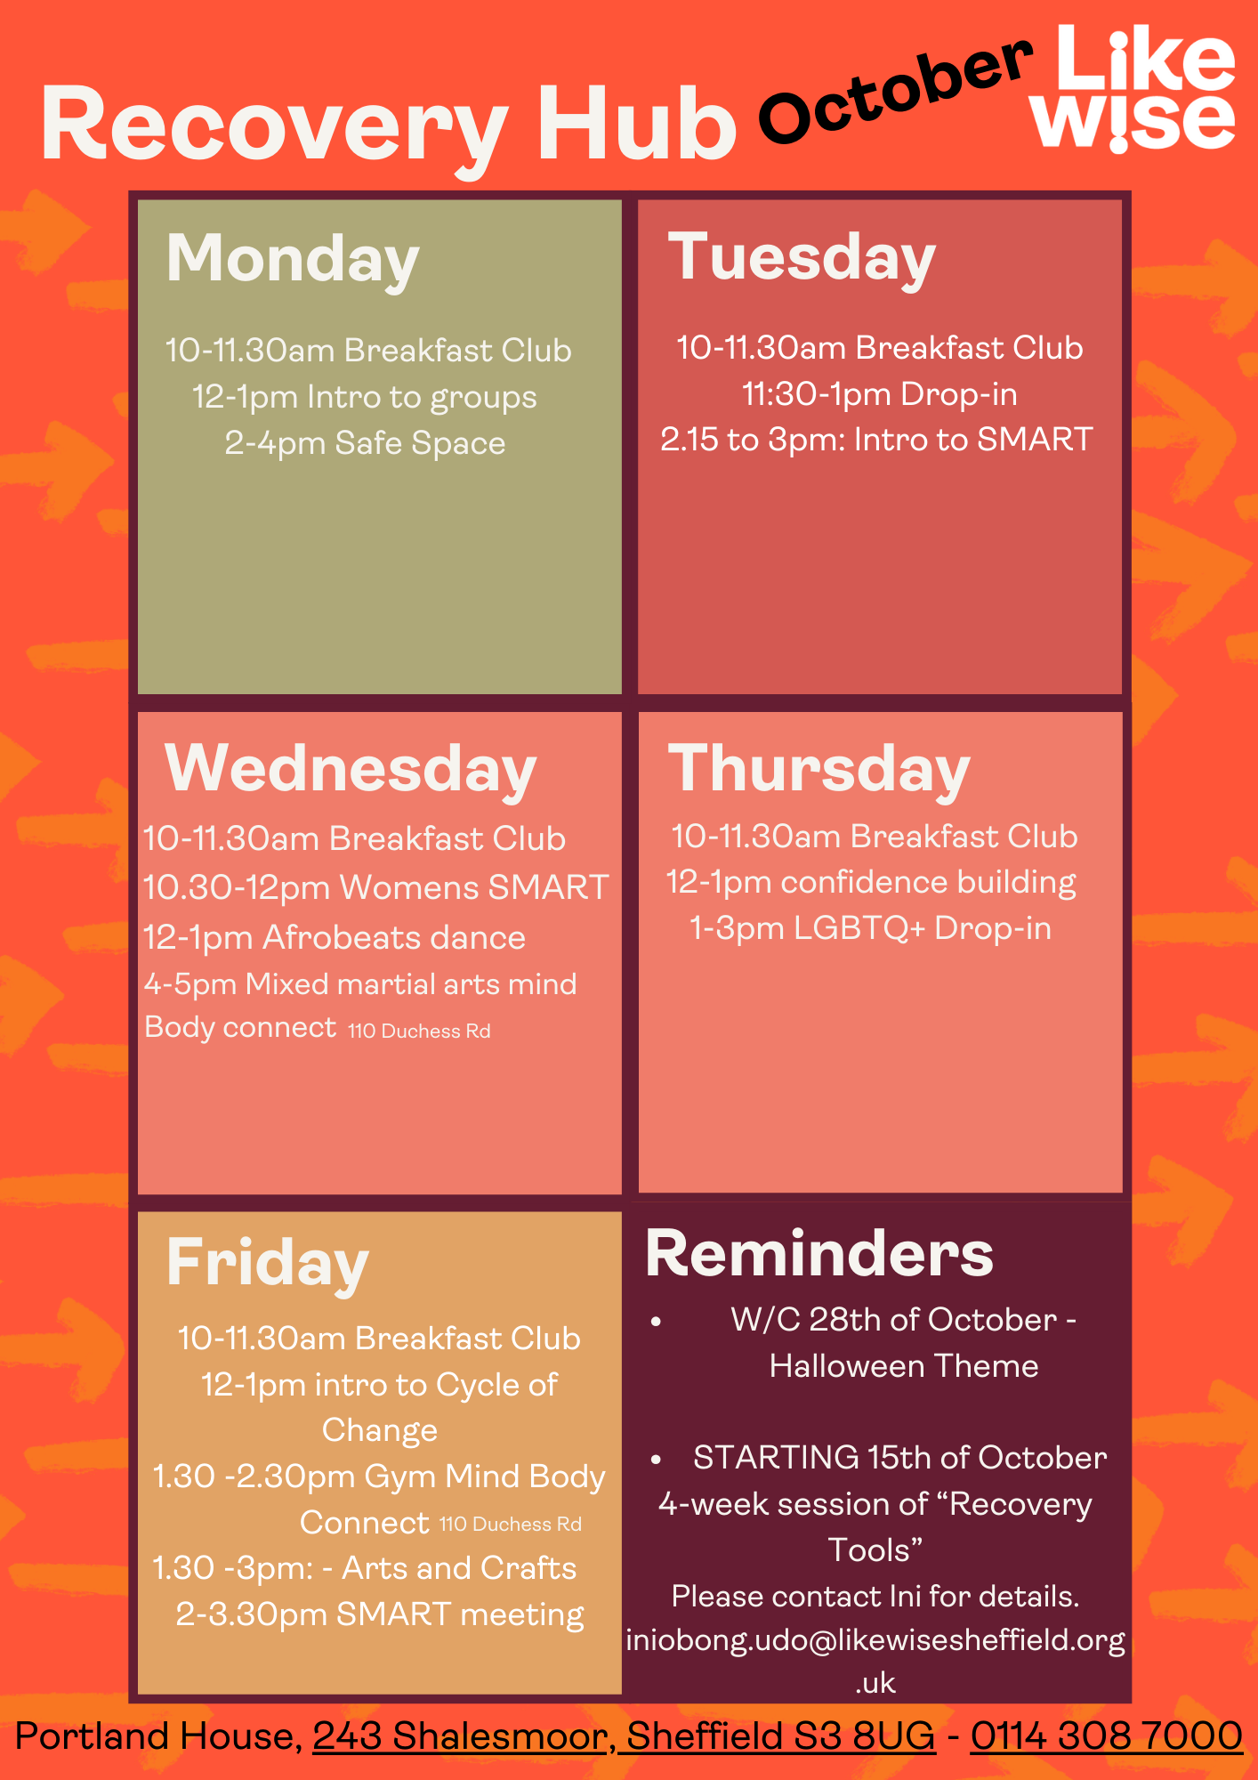
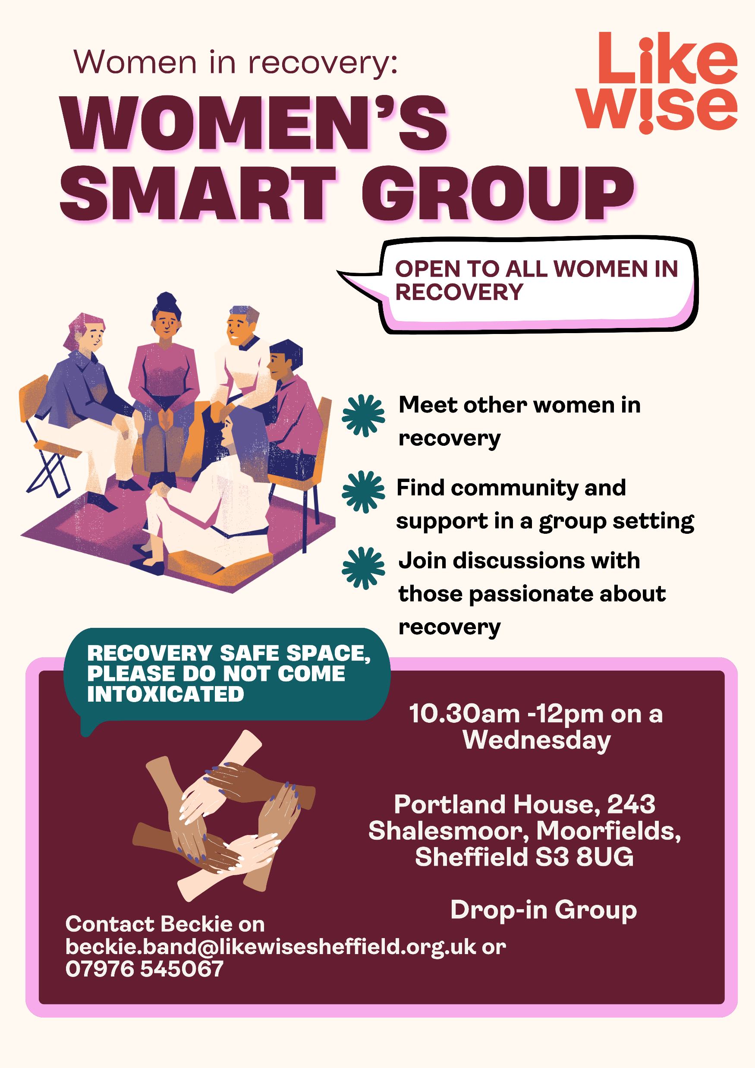
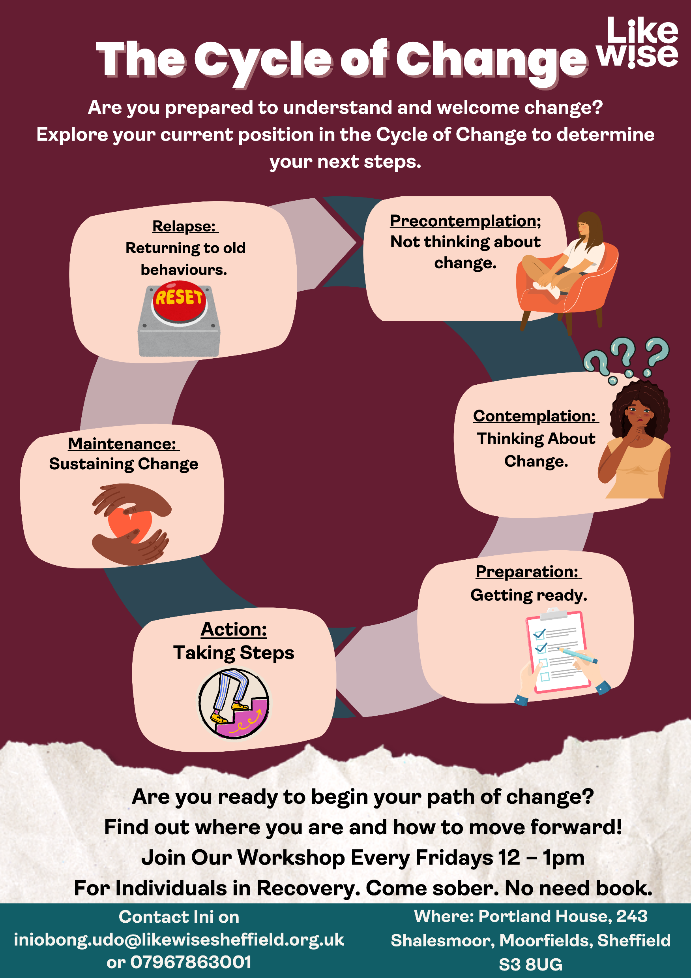
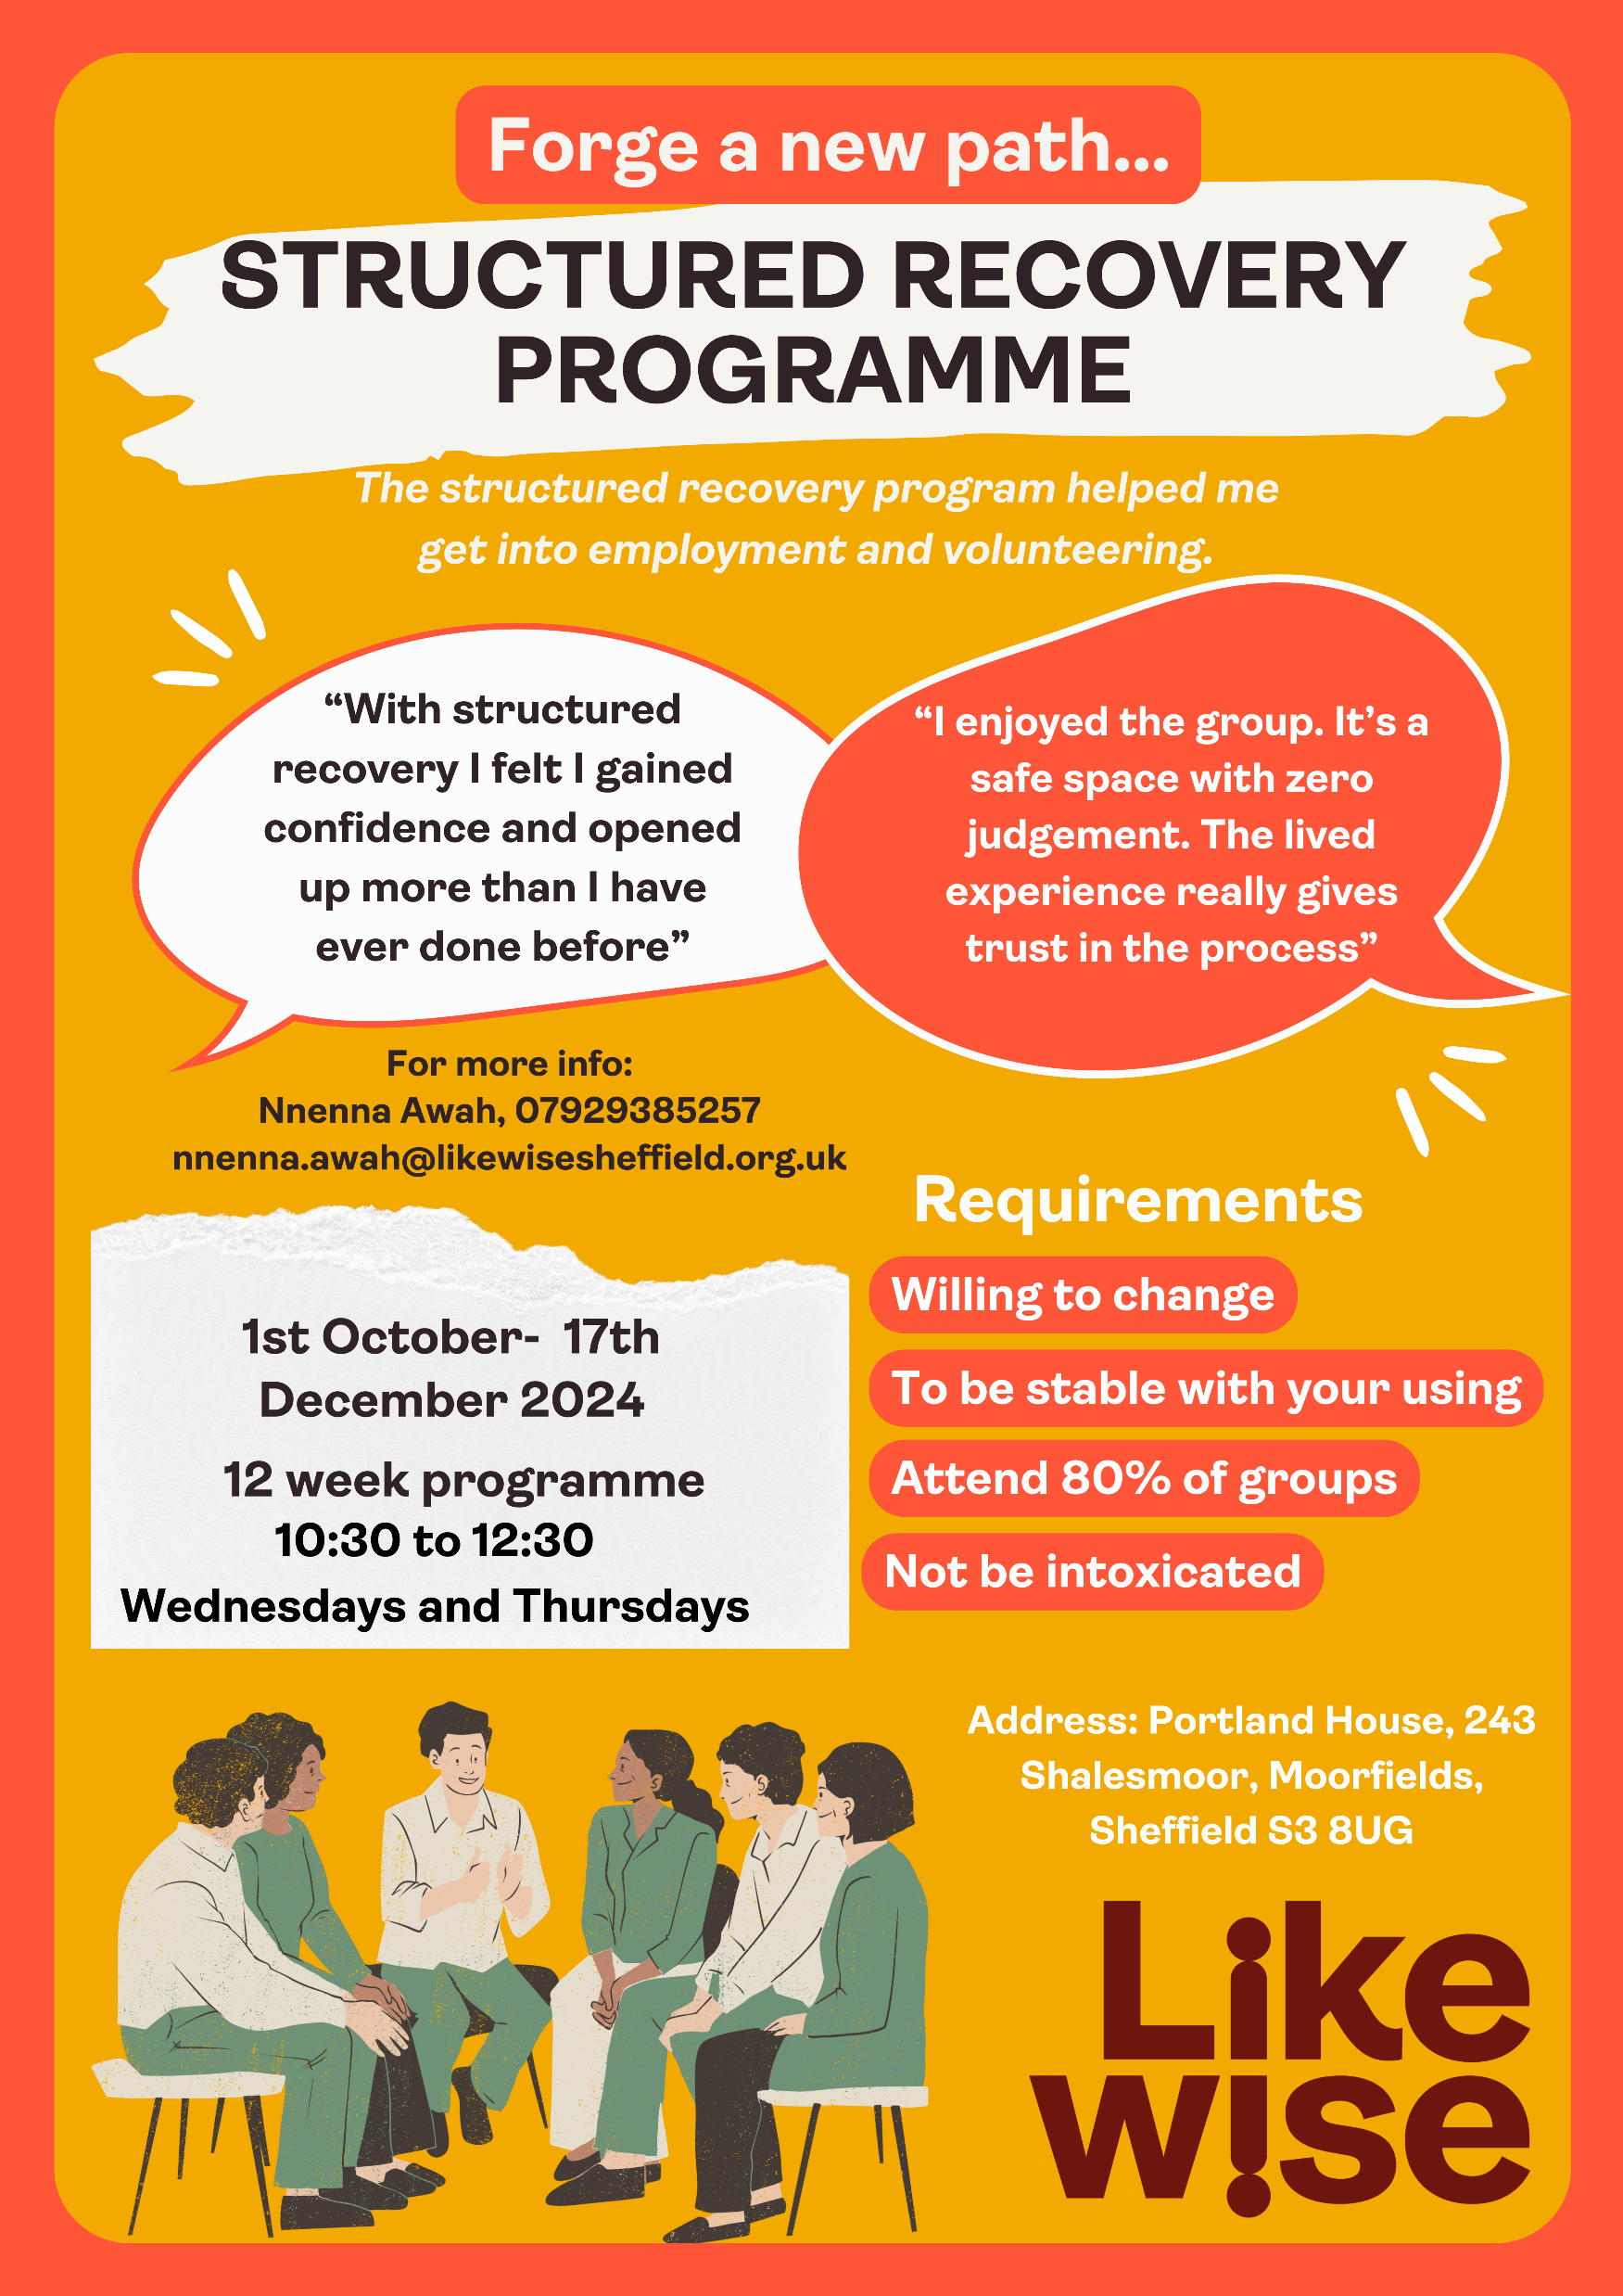
What we offer: Recovery Hub
With our partner, Project 6, we offer a diverse daily timetable of groups, classes and activities for those who are newly in recovery.
Structured Recovery Programme and other type of recovery groups
Wellbeing groups and activities from arts and crafts to outdoor activities
Build connections within a supportive recovery community
Volunteering and Ambassador’s Programme
Notes:
With our partner Project 6, we offer group sessions at our Recovery Hub. There is a diverse daily timetable of groups, classes, and activities for those who are newly in recovery. This way our service-users can build connections with a supportive recovery community.
The Recovery Hub also offers Structured Recovery Programme, opportunities for volunteering and the Ambassador’s Programme. Participating in this programme often leads to securing employment at Likewise. Many of my colleagues have joined the organisation this way and bring invaluable lived experience which allows us all to provide better support for our clients.

Slide 8

What we offer: IPS
What is IPS?
A supported employment model that helps people with substance misuse disorder to seek and retain competitive employment​
Based on the philosophy that employment is treatment and a huge step towards sustaining recovery​
Integrates Employment Specialists into clinical teams​
Uses a tailored approach to support individuals overcome their barriers to employment​
Notes:
IPS stands for Individual Placement Support. It is a supported employment model that helps people for whom substance misuse presents a barrier to employment.
The core idea of IPS is that employment is treatment and a huge step towards recovery. The IPS model uses a tailored approach to support clients overcome their barriers to employment.
It does this by multidisciplinary work and support, where Employment Specialists are integrated into the clinical teams.
Appointments can take place at our office at Shalesmoor or out in the community.

Slide 9

What we offer: IPS
The 8 principles of IPS
1. Competitive employment is the primary goal.
2. Everyone who wants it is eligible for employment support.
3. Job search is in line with individual preferences and strengths.
4. Job search is rapid – it begins within four weeks.
5. Employment specialist and clinical teams work and are located together.
6. Support is time-unlimited and individualised to both the employee and the employer.
7. Welfare benefits advice and information is available.
8. Jobs are developed with local employers.
Notes:
IPS is built on 8 principles. In line with these 8 principles, we help clients find competitive, paid employment. We do this by building on existing skills and short qualifications where necessary.
We can support clients who are already accessing our recovery services. This is the only piece of eligibility criteria we have. Other than that, everyone who wants our support is eligible.
As Employment Specialists, we find out about each of our clients’ strengths, passions and work preferences, and we do the job search in line with these, rather than what is easily available.
The IPS service is a place and train model, meaning that the job search is rapid, we aim to place our clients into work as soon as possible and focus on the training later, as a part of the in-work support. This way, we can keep up the motivation of our clients to get back into employment and continue their recovery journey.
Our IPS team is located with the clinical and recovery teams at Portland House, we work as a multidisciplinary team allowing our clients to receive specialist advice regarding health, recovery and employment.
Once our clients start working, we offer individualised in-work support to both employee and employer. This way we can ensure that our clients sustain employment and that any employer concerns are resolved.
As a part of our support service, we complete better off calculations, discuss with clients how working affects their benefits and signpost to specialist benefits advice. We work closely with the JobCentre. We have a work coach on our premises every Tuesday, he sees clients who need further advice, and I deliver a drop-in session at Cavendish Court every other Wednesday, where I engage with people who want to get back into work, but substance misuse presents a barrier to employment.
And lastly, we work with local employers, conduct employer engagement to learn more about local recruitment needs and create suitable job matches.

Slide 10

What we offer: IPS
Evidence
Twice as likely to secure employment (55%-28%) and work for significantly longer
Individuals who gained employment experience are less likely to get hospitalised
Individuals who secured employment have less dependency on services, showed improvement in mental wellbeing, and a reduction in substance misuse
Costs less than other employment approaches
Notes:
Studies have shown that clients who have been supported on an IPS programme are twice as likely to secure employment and work as other people.
IPS clients also stay in work for significantly longer.
IPS costs less than other employment approaches.
Individuals who gained employment experience are less likely to get hospitalised, have less dependency on services and showed improvement in mental wellbeing as well as a reduction in substance use.

Slide 11

What we offer: IPS
The IPS Process
Referrals, Outreach
Benefits Advice
Vocational Profiling
Vocational Action Planning
Employer Engagement
Job Placement
Ongoing Support
Notes:
As Employment Specialists we work with small caseloads, a maximum of 20 people per E.S. so that we can focus on providing tailored support to our clients following the IPS Process.
We promote the IPS employability support within the service so that recovery navigators make referrals.
We complete better-off calculations and a vocational profile, based on which we make an action plan with the client.
We conduct employer engagement, place clients into preferred jobs and offer ongoing in-work support.

Slide 12

What we offer: IPS
Employer Engagement
Attending local job fairs to liaise with employers and understand immediate and long-term staffing needs
Tapping into the hidden job market
Finding supportive and understanding employers
Support with personal information disclosure, risk and trigger management
Providing education
Reducing stigma
Notes:
We work closely with local employers to create suitable job matches. We do this by prioritising face-to-face employer engagement. We attend local job fairs to liaise with employers and get a better understanding of their recruitment needs.
Due to the face-to-face engagement, we can also tap into the hidden job market and find vacancies for our clients that are not advertised online. As Employment Specialists, we offer tailored support for clients, place them into roles with supportive employers, assist with personal information such as criminal record and health condition disclosure, risk and trigger management.
We also support the employers, manage any concerns they may have, provide education, and ultimately reduce the stigma around substance misuse.

Slide 13

What we offer: IPS
In-work Support
Offered to both client & employer
Help settling in, and on-going support
Support with reasonable adjustments
Point of contact
Supporting employer how to deal with substance misuse at the workplace
Helping clients deal with challenging situations, support them to sustain employment
Notes:
As a part of the IPS employability support service, Employment Specialists provide in-work support for both employee and employer. The goal is to help our clients settle in at their new job, so that they can sustain employment.
We offer support with reasonable adjustments at the workplace, serve as a point of contact for both employers and clients in case of any concerns. We discuss potential triggers with clients and support them to manage these effectively without relapsing.
And as mentioned previously, we provide education and support to employers how to deal with substance misuse and how to support employees in recovery to stay in work.

Slide 14
Benefits of IPS
Challenges the stigma around substance misuse
Promotes an inclusive society
Purpose
Structure to the day
Reduces isolation
Promotes greater social contact
Gives hope and direction
Supports recovery journey
Identity
Financial independence
Improves the quality of life
Opportunity to change life
Notes:
And last but not least, some of the several benefits of IPS. This type of employability support challenges the stigma around substance misuse and mental health conditions and promotes a more inclusive society.
Employment gives purpose to clients and a structure to their day. It reduces isolation and promotes greater social contact.
It gives hope, direction and supports the person’s recovery journey.
It contributes to the identity of the client, it gives financial independence, improves the quality of life and ultimately gives the person an opportunity to change their lives.

Slide 15
How to Refer to Likewise
Individuals can self refer, or referrals can be made on behalf of someone.
For more information and for referrals, please contact us on:
0114 308 7000
www.likewisesheffield.org.uk
info@likewisesheffield.org.uk
Where to find us:
Portland House, 243 Moorfields, Shalesmoor, Sheffield S3 8UG
Closed bank holidays and weekends
Mon- Weds & Friday: 9am-5pm Thurs: 9am-7pm

Slide 16
Any Questions?
Julia Ertl
Employment Specialist
Julia.Ertl@likewisesheffield.org.uk – 07483 196519
Portland House, Sheffield, S3 8UG

Slide 17
Kingsley Paul
Service Manager

Slide 18

New Triage System
Opportunity Sheffield now has a dedicated triage team to speak to and direct incoming clients to the most appropriate service in Sheffield.
This won’t always be provision commissioned by SCC

Slide 19
Process
Incoming Call or E-mail will be handled by the triage team.
They will speak to the participant about barriers and goals and labour market status.
If being refereed to P2W provision the triage team will create a profile for the participant and a contract manager will assign it to a provider.
For external referrals the triage team will get verbal consent from the participant and get in touch with the partner.

Slide 20
What we need from you!
If you’re not a programme that’s commissioned by Opportunity Sheffield then we’d like you on our directory.
We will give referrals to you if your service is the most appropriate for the client; if you’re able to accept.
Please get in touch with Ross Brown with project name, aim, eligibility, locations, restrictions and referral pathway.

Slide 21

Tea & Coffee
20 minutes

Slide 22

In Brief
Your turn to share

Slide 23

John Joseph Bradley
Facilitator

Slide 24



Slide 25
Things preferable to public speaking
Death
Leg Eaten by Bears
Trump Foot Massage

Slide 26
Zero Practice
Lack of Feedback
Feeling Exposed
Unfamiliar People
Anxiety and Stress
Why?

Slide 27
Regular Practice
Structured Feedback
Feeling Supported
Familiar Group
Increased Confidence
Solution
Successful Outcomes!

Slide 28
Two Workshops Each Month
Impromptu and Prepared Speaking
Concise and Positive Feedback
121s and Further Coaching Available
Safe Friendly Environment
R.E.A.L Values

Slide 29
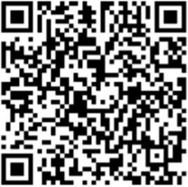
Register to attend as a free guest here:
See you there.

Slide 30

Gareth & Trevor

Slide 31
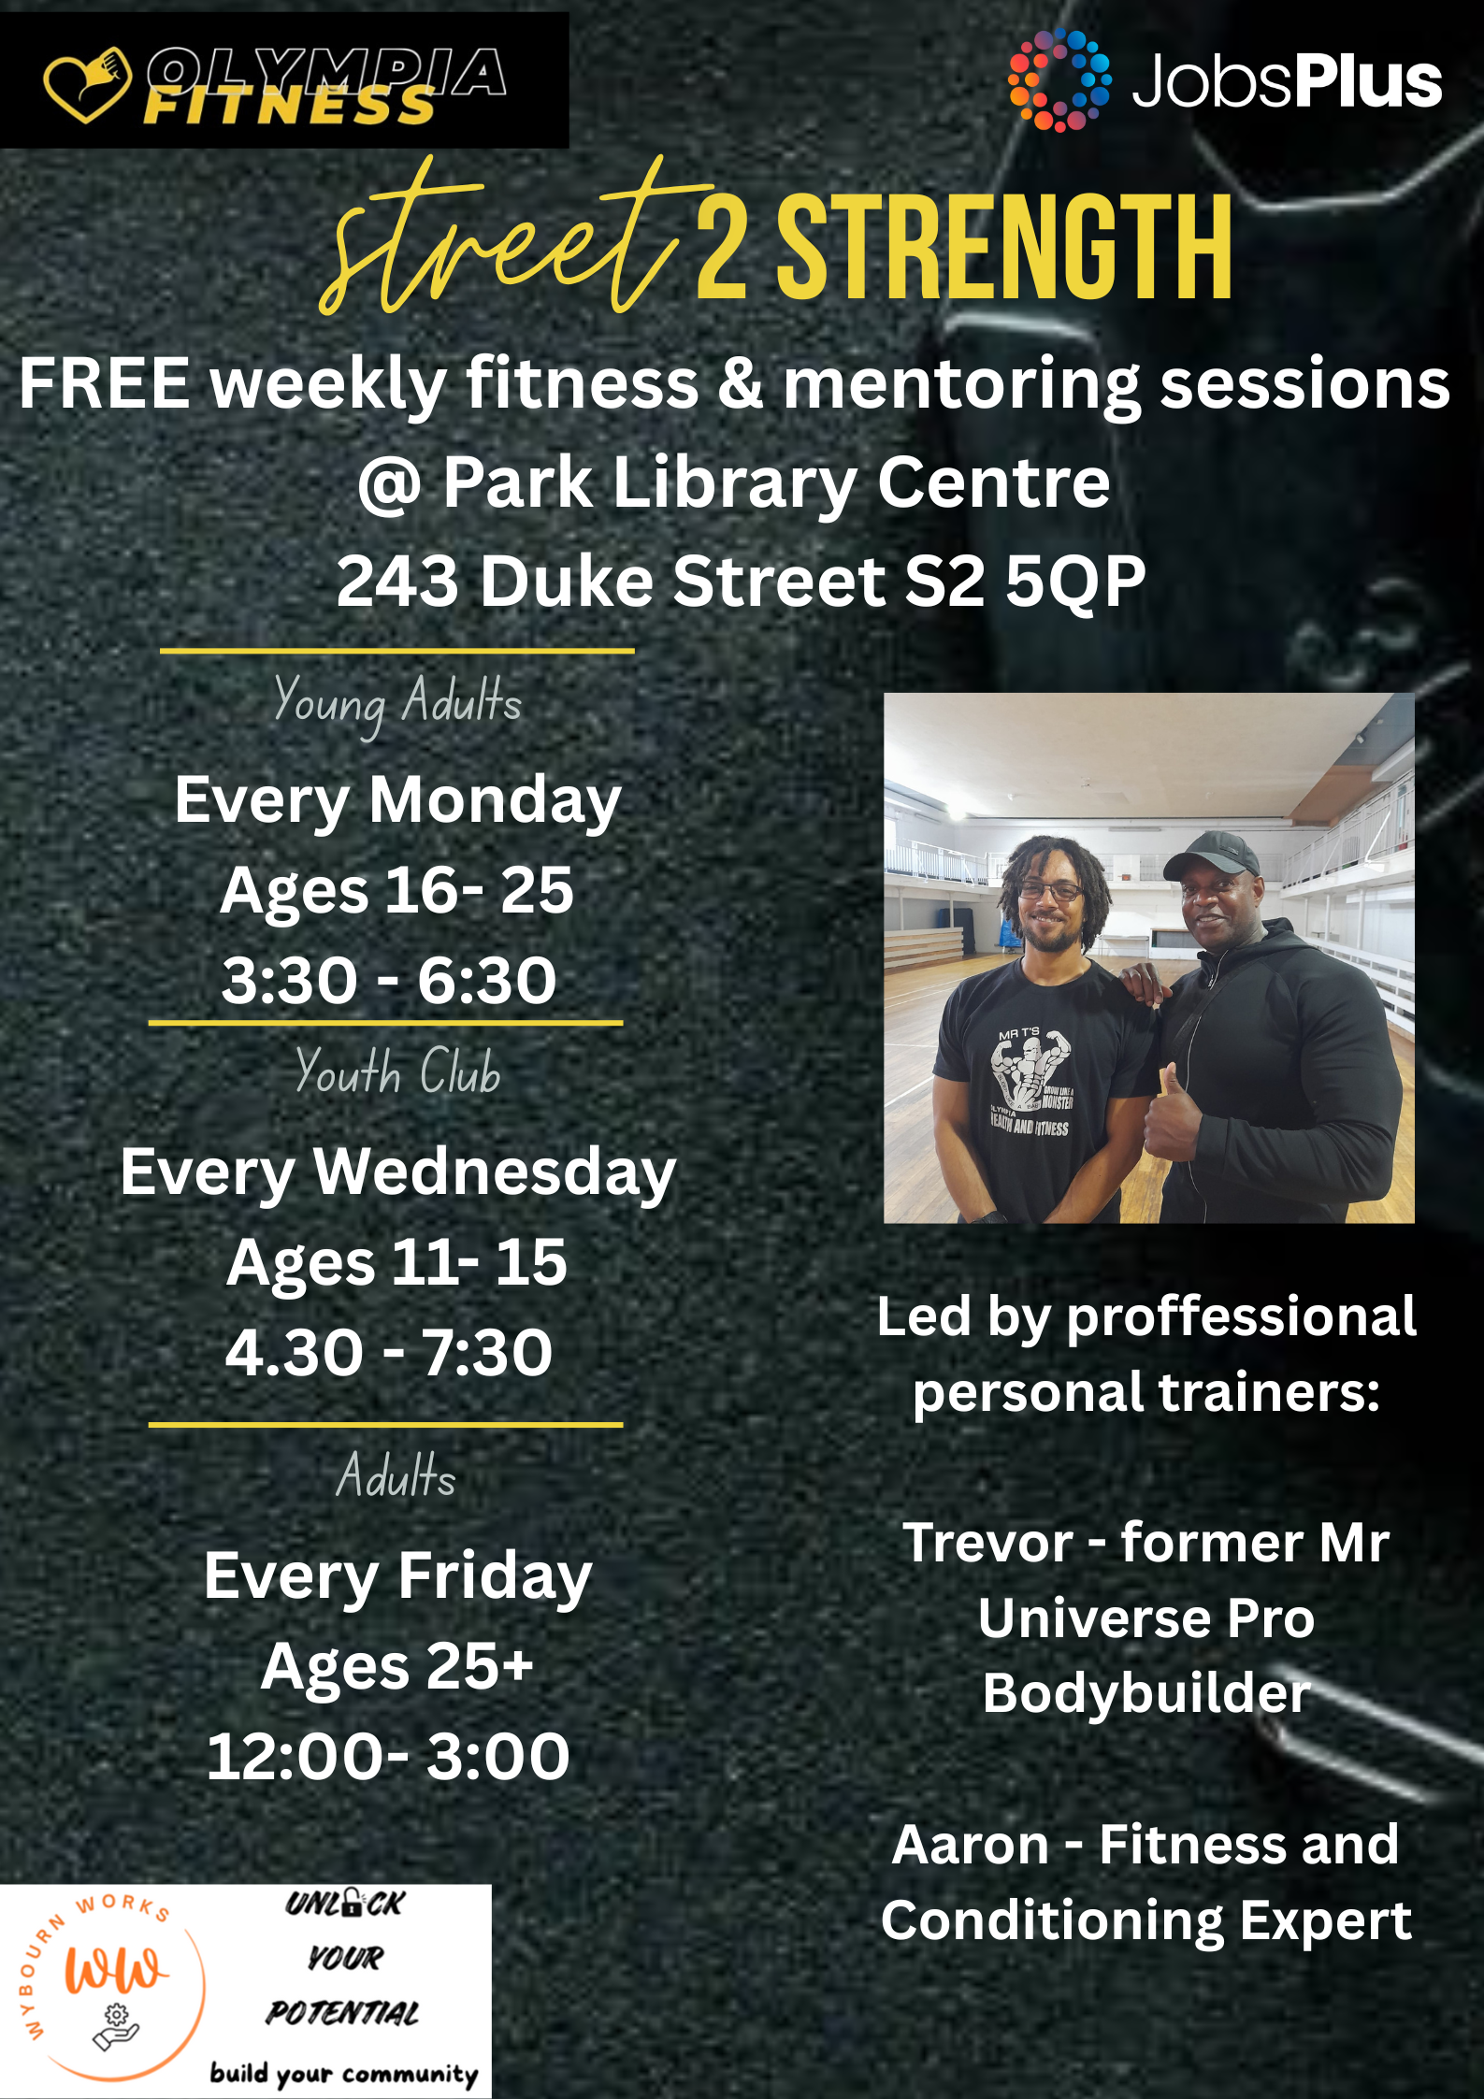


Slide 32

Amy & Vicky
Employment Advisors

Slide 33


Sheffield Talking Therapies
Employment Service
TeaCake Club Event
9th May 2025

Slide 34

Introductions!
Vicky Reynolds
Amy Cockbill

Slide 35
Talking Therapies and Employment Services
A brief history
Helping people retain or return to employment was one of the core objectives of IAPT when it was developed in 2008.
2017 a pilot was undertaken by Lets Talk-Wellbeing in Leicestershire County and Rutland with the aim to integrate IAPT, healthcare and employment support.
The objectives were to provide early intervention and timely support to help avoid long term unemployment for people.
Link between being in work and achieving improved health outcomes.
Current national integrated EA role out - nearly all NHS Talking Therapies services across the country are engaged with this
Notes:
Sheffield ‘buy in’ to the benefits of employment support since 2009 – the roll out gives an opportunity to hugely expand this - out of work support, wider/comprehensive service promotion, full integration.

Slide 36

Employment Team.
Currently 2 x SEAs
4 x WTE EA and 3 x PT EA.
Notes:
Include that Emma and Lydia started in Oct 23 – set the service up so it was integrated.
3 x EA’s started in March 24
5 x EA’s started in June 24

Slide 37
Our Service.
Employment Advisor are embedded in clinical teams.
Shared clinical data recording system.
Employment support is offered to all appropriate STT patients.
We aim to support patients with their employment needs at the same time as their psychological treatment.
We work to empower patients to establish and work towards their employment goals.
We offer wider signposting support.
Notes:
Set up of our service
Integrated within STT
Staff are part of clinical teams
Shared clinical data recording system
Regular conversations between therapists and EA’s

Slide 38
What can Employment Advisor’s support with?
What Can We help With? | What Can’t We help With?
Short term employment support​ Employer engagement​ Jobsearch, CVs, Applications Interviews Reasonable adjustments​ Money guidance and signposting​ Advice around return-to-work ​ Confidence building ​ Advice around policy and processes at work, including occupational health | Long term employment support​ Tribunals​ Legal advice​ Benefits​ Funding for courses, travel, interview clothes, work clothes​ Workplace qualifications.​ Attendance at Safeguarding meetings /MARAC​ Therapy

Slide 39



What is Sheffield Talking Therapies?
  18+ psychological therapy service for people with Sheffield GP or under consultant in Sheffield
  Mild-moderate common mental health problems e.g. stress, anxiety, low mood
  Short-term therapy (average 6-14 sessions)​
  See 16000+ people per year ​
  Face to face or remotely
  Sheffield Talking Therapies has 2 main arms: ​
  Core Talking Therapies (est 2008) – common mental health problems​
  Health & Wellbeing Service (est 2017) – Long Term Conditions (LTC) /Persistent Physical Symptoms (PPS)​
Notes:
Health and wellbeing pathways
Asthma
Cancer (following successful treatment)
Cardiac Conditions(i.e. stable angina; heart failure, atrial fibrillation, cardiac event 12 weeks post-event & following cardiac rehab)
CFS/ME and fatigue
Chronic pain (MSK)
COPD
Diabetes (Types 1 and 2)
Health anxiety (i.e. Hypochondriasis)
Irritable Bowel Syndrome
Long Covid*
PPS – common symptoms (eg: pain in the joints/ muscles/chest, tiredness/ fatigue, numbness and tingling sensations, headaches, heart palpitations, stomach problems including unexplained pain, feeling bloated).
Skin conditions
Tinnitus*
3

Slide 40
What is Sheffield Talking Therapies?
  Stepped care approach, least intrusive intervention first​
  Step 2 - Psychological Wellbeing Practitioners (PWPs) offer Courses, Online Programmes, 1:1 guided self-help
  Step 3 - Cognitive Behavioural Therapy (CBT) & Person-centred Experiential Counselling for Depression (PCE-CFD) ​
  Evidence based treatments - ​every session patients are asked to complete PHQ-9; GAD-7/Additional Disorder Specific Measure (ADSM)​
Notes:
Step 3 -Also some therapists are trained in Interpersonal Therapy (IPT), Eye Movement Desensitisation and Reprocessing (EMDR), Narrative Exposure Therapy (NET), Couples Therapy for Depression (CTfD)
4

Slide 41
Who can Talking Therapies help?
  Mild – moderate anxiety and depression
  Willing and able to attend and engage in regular appointments
  Not in crisis and requiring urgent help
  Not currently accessing or waiting for other mental health services
  Not diagnosed with Severe Mental Illness (SMI) Bi-polar, Personality disorders, Psychosis/Schizophrenia
Notes:
Previously known as IAPT
6

Slide 42

Achievements.
Silvercloud
Employment Advisor Service Wide Launch
Month on month increase in referrals.
Supported 865 patients since Feb 2024
A short wait for an assessment with an EA.

Slide 43
How to access the service?
Self-referral via:
•Website –SheffieldTalkingTherapies.nhs.uk
including online self-referral form
•Telephone – (0114) 226 4380
Assessment
Everyone is offered a telephone assessment with a Psychological Wellbeing Practitioner (PWP) to assess their psychological needs & goals, give information and discuss treatment options.
Once an assessment has happened and our service has been deemed suitable for the patient, they can then access our Employment Team via an internal referral.

Slide 44


Employment Service Patient Feedback
“My EA was supportive, understood my concerns & gave constructive advice. This has been such a valuable service, especially running alongside my therapy sessions.”
“Really helpful support and my EA also helped me to get some talking therapy. The two types of support were really impactful together. Thank you.”
“My EA was wonderfully supportive throughout our sessions and really helped me with the unique situation I was facing at work. Whilst the situation is not fully resolved the employment therapy has left me feeling a lot more confident and has provided me with the tools needed to help. Thank you so much for your help!”
Notes:
emma

Slide 45
Employment Service Therapist Feedback
As a Psychological Wellbeing Practitioner (PWP), I've worked with many patients who struggle with employment-based issues. Before we had the employment advisors, these issues could take up a lot of time in therapy sessions, unfortunately distracting from the core depression/anxiety work, which we have limited time for at step 2 anyway.
With the Employment Advisors working alongside us, my patients have expressed how much they appreciate having the time and space to talk about their employment issues, as well as practical advice and support to address these issues. I've seen how this can empower my patients.
“
Notes:
Emma?

Slide 46

Questions
Notes:
Final questions

Slide 47
Business Card Raffle
Will you win?

Slide 48
Thank you!

