Slide 1




Teacake Club

Slide 2
Welcome !

Slide 3
John Powell
Opportunity Sheffield
Opp

Slide 4






Employment & Skills Mapping & Triage Service Update

Slide 5
Overview of the Triage Service
Triage service connects participants to the right employment support.
Initial assessment, referral to providers, and data tracking.
Helps streamline access and improve service delivery.
Email: opportunity@sheffield.gov.uk​
Tel: 0114 229 6188

Slide 6
Benefits of the Triage Service
Improved referrals and participant outcomes.
Better tracking of triage routes and service usage.
Supports data-driven planning and gap analysis.
“One Front Door”
Email: opportunity@sheffield.gov.uk​
Tel: 0114 229 6188

Slide 7
Employment & Skills Mapping Survey
Purpose: Map employment and skills activity across Sheffield.
Importance: Strengthen triage service and identify service gaps.
Email: opportunity@sheffield.gov.uk​
Tel: 0114 229 6188

Slide 8
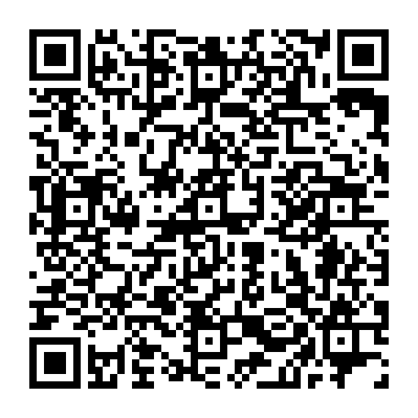
Call to Action
Encourage all organisations to complete the survey.
Share the link with partners and networks.
Help us build a stronger, more responsive triage system.
Email: opportunity@sheffield.gov.uk​
Tel: 0114 229 6188

Slide 9
Sheffield’s Employment and Skills Triage service
Call 0114 229 6188
Email: opportunity@sheffield.gov.uk

Slide 10
Clare Holdsworth & Clare O'Neill
Voice and Influence
Opp

Slide 11



Care Experienced Voice and Influence Team

Slide 12

https://youtu.be/gKhOdjPcAic?si=akxfTm5xgQZwGHnF

Slide 13



You’re Hired Toolkit research:
Focus groups and 1-1 interviews with
14 care experienced young people seeking work
Focus group with 15 employers from all sectors that are keen to employ care experienced young people
Focus group with 20 professionals that support care experienced young people

Slide 14

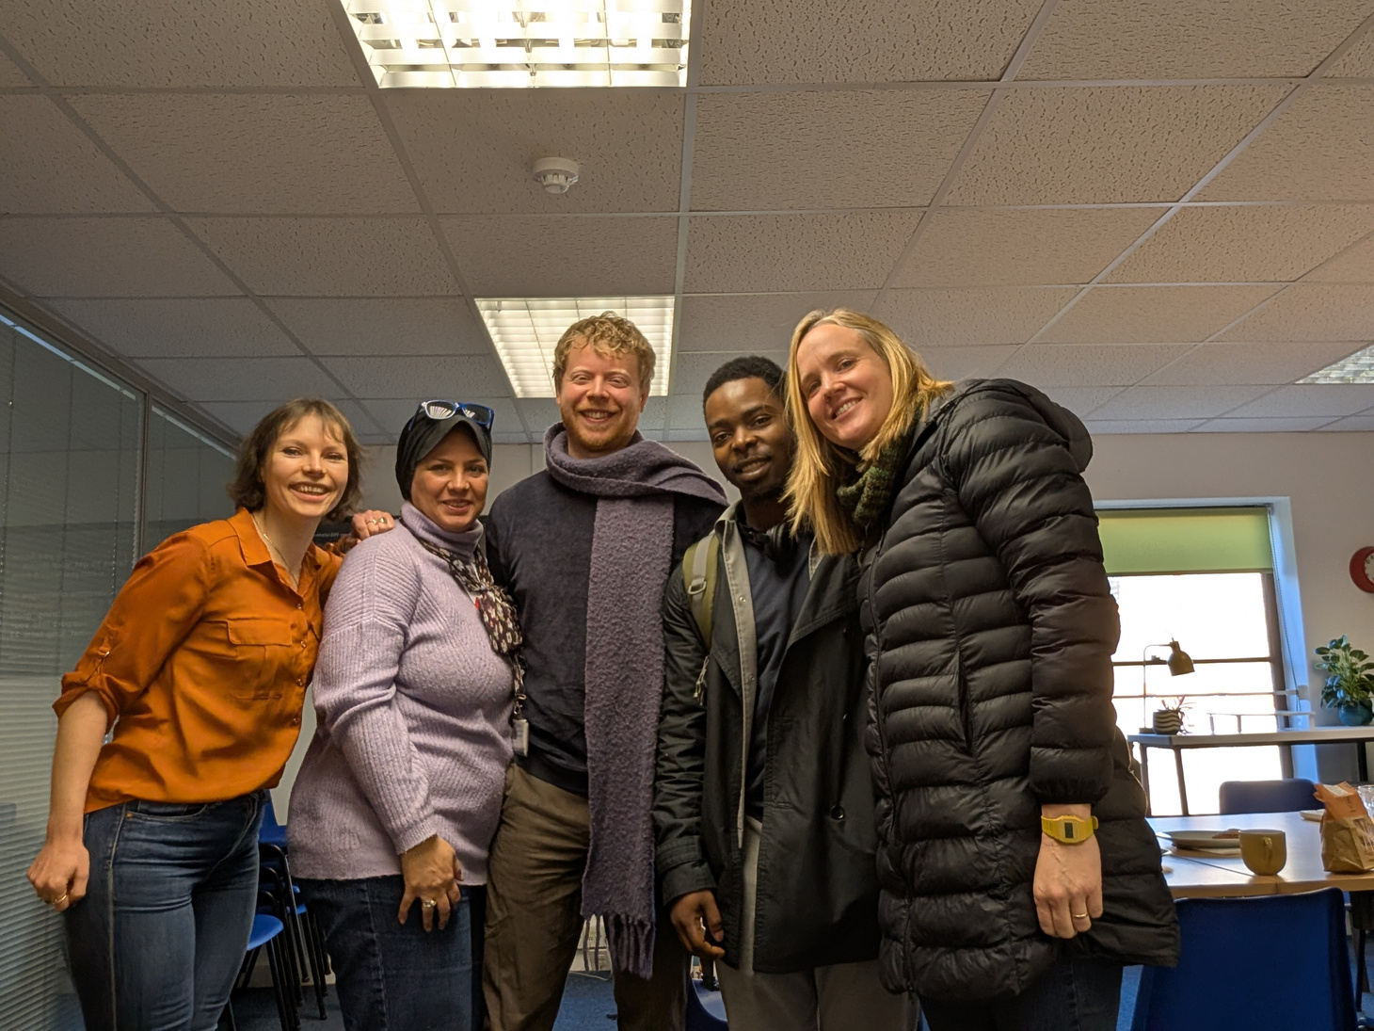
We did research
visits

Slide 15
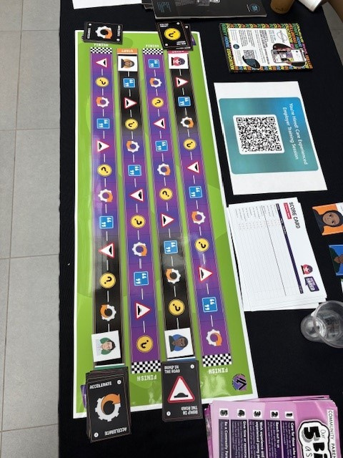

You’re Hired Training Toolkit
under construction:
Shared at Opening Doors Campaign
Piloted with 4 employers
Tweaks underway to launch Care leavers month

Slide 16


How can we work
together?

Slide 17
Lisa Webster
Education & Childcare Commissioning team

Slide 18



Childminding as a Career Option
Teacake Club
Oct 2025

Slide 19
Childcare Support for working parents
Parents requiring support to find a pre school childcare place
Parents wanting help to identify if they qualify for 15 or 30 hours of funded childcare
Parents needing before and/or after school childcare between 8am – 6pm
  For wraparound - First stop school – ask for wraparound and support to find if not available by the school
  Family Hubs can locate independent nurseries offering wraparound and any local childminders and support with a HMRC tool check to see what funding they qualify for.
Signpost to Local family hub – email, call, or visit - 7 round the city.
Phone: 0114 273 5665
Email: SheffieldFamilyHubs@sheffield.gov.uk
Website: Family Hubs | Sheffield City Council
19
Sheffield City Council

Slide 20
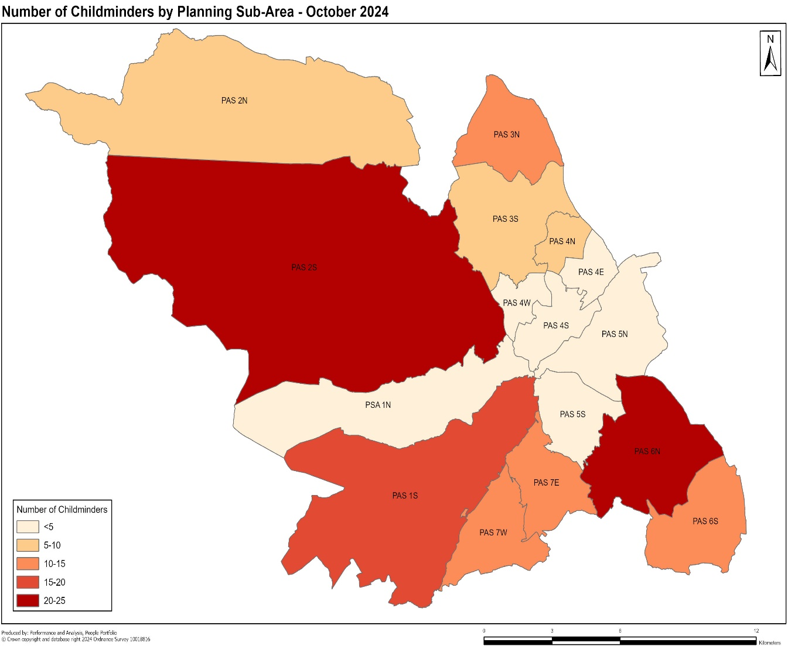
Childminders – Local Ambition
Childminder numbers have significantly decreased over the last few years reducing parental childcare options.
Childcare reforms extended entitlements final rollout September 2025 forecasting significant increased demand for childcare places for 2 year olds and under.
Local ambition is to increase numbers of Childminders to deliver support for 0-3 childcare places, plus wraparound support for primary school aged children Reception – Year 6.
Lighter areas lower numbers, darker larger numbers
20
Sheffield City Council

Slide 21
A Career in Childminding
Flexible, Fulfilling and Full of Opportunity
DfE have been running the ‘Do something big’ campaign nationally to promote careers in Early Years childcare to meet anticipated increased demand in childcare and the need for more Early Years staff.
Analysis shared shows there is a range of audiences (by occupation and social status) who are open to considering a role in Early Years, including males and mothers and ages ranging from 16-44.
Main motivations to work in early years are that EY careers are perceived as rewarding, joyful, impactful, making a difference, giving something back for future generations, and local.
Main barriers are perceived lack of qualifications/experience, low pay, lack or little progression, and lack of awareness/understanding of routes into the sector.
“Every day is different, exciting, challenging and rewarding”
“We often get muddy and wet … the children absolutely love it!”
“I just love children”
“My parents love that their children are out in the fresh air, learning about our environment“
“Love spending time with children”
21
Sheffield City Council

Slide 22
Core Skills and Values Required
Love Working with Children
Believe that all
children deserve the
best start in life
Dedicated to
providing high quality
learning and
development
opportunities
Committed to
providing quality care
Flexible and
adaptable
22
Sheffield City Council

Slide 23
Signposting - Routes into Childminding
  There are 2 routes into Childminding
      1) Ofsted Registration – to work as an independent childminder with training and support from the Local Authority
      2) Registration via a Childminding Agency – to work under the agencies Ofsted registration with support from the agency with training and set up.
  For more information on steps involved to become a childminder;
  Visit Sheffield Directory in formation page -
      Becoming a Registered Childminder in Sheffield | Sheffield
  Or - Register to attend a childminder briefing session –
      Expression of Interest for childminder briefing sessions
  Briefing sessions will be made available for all those who register their interest via the survey link. These sessions are a key first step for interested ones to find out more before making any decisions but are not essential to start the process in becoming a childminder for those who want to take the next step.
  Leaflets are available containing a link to registering interest in attending a briefing session.
23
Sheffield City Council

Slide 24


Childminding Promotional Leaflet
24
Sheffield City Council

Slide 25
FEL Childcare Ratios and Funding
  RATIOS
  Up to 6 children under the age of 8 can be cared for at any one time.
  Maximum of 3 under 5 years old
  Only 1 under 1 year old
  DELIVERY MODELS
  FEL is typically delivered as;
  15 hours per week for 38 weeks
  30 hours per week for eligible working parents
  Childcare can also be stretched over the year and not just term time
  May be spread over more than one provider
  FUNDING RATES 25/26
  9 months - 2 year olds = £10.73 per hour, maximum 30 hrs per week, 38 weeks (term time) for parents eligible for Working Parent Entitlement (WPE) - plus £0.44 deprivation per eligible child
  2 year olds (both eligible working parents and those receiving additional support): £7.88 per hour plus £0.44 deprivation per eligible child
  3 and 4 year olds (universal and extended entitlement): £5.32 per hour plus £0.44 deprivation per eligible child
  Additional charges for consumables such as nappies, meals etc can be applied providing these are not mandatory and parents have the option to provide themselves.
  Private funding rates vary and can range from £4 - £11 ph
25
Sheffield City Council

Slide 26
FEL Childcare: Potential Income via Childminder Agency (based on quote received)
  Example 1.
Looking after just three children receiving the under 2 year old funding, 30 hours a week during term time (38 weeks):
Income
Per Week: £621
Per Year: £32,293
  Example 2.
Looking after just three children receiving the 2 year old funding, 30 hours a week during term time (38 weeks):
Income
Per Week: £456
Per Year: £23,716
  Additional 3 places
An additional 3 children paying a private rate for example of £7 per child per hour approx. 15 hours per week during term time (38 weeks):
Income
Per Week: £204
Per Year : £10,584
Annual Figures are after agency fee deduction. Example 1 & 2 leave 3 places available for 5-8 year olds at a private rate.
26
Sheffield City Council

Slide 27
FEL Childcare: Potential Income via Ofsted Registration
  Example 1.
Looking after just three children receiving the under 2 year old funding, 30 hours a week during term time (38 weeks):
Income
Per Week: £705
Per Year: £36,700
  Example 2.
Looking after just three children receiving the 2-3 year old funding, 30 hours a week during term time (38 weeks):
Income
Per Week: £518
Per Year: £26,950
  Example 3.
Looking after just three children receiving the 3-5 years old funding, 30 hours a week during term time (38 weeks):
Income
Per week: £350
Per Year: £18,200
Examples 1-3 leaving 3 spaces for 5-8 year olds at a private rate. Private funding rates can vary ranging from £4-£11 per hour and are set by the childminder.
27
Sheffield City Council

Slide 28
Wraparound Childcare: Potential Income via
Ofsted Registration
  Wraparound
Before and after school childcare starting 8am before school and up to 6pm after school for reception to year 6 pupils to support working parents with stable and affordable childcare. Emphasis on schools to make arrangements for parents
Potential Income
Set up funding available to deliver wraparound of up to £6,000 as a one off payment for 3 full places wrapround places. (Limited time as programme ends March 26).
Hourly or session rate can be set by the childminder, and average charges range from £5-£7 per hour.
Example - Term time offer for 3 children attending 4 hours per day Mon-Fri at £7 per hour:
      Annual Income of £15,960
      Weekly income = £420 over 38 weeks, average over 52 weeks £307
      Additional costs for meals and snacks would be added
28
Sheffield City Council

Slide 29
How can we reach potential new childminders?
Promotion
Run a ‘become a childminder campaign’
Arrange a briefing session to a group of people you support
Display the leaflet on digital screens within reception, waiting areas
Job fairs/ career events/ network events – let us know so we can attend
Direct to Sheffield citizens:
Ask directly if it’s something they would consider, share information and signpost to webpage or briefing session
Ask if they know of anyone who might be interested
29
Sheffield City Council

Slide 30

Tea & Coffee
20 minutes

Slide 31

In Brief
Your turn to share

Slide 32
Annie Gale, Hannah Crossan Smith, Rachel Thompson
Royal Foundation – Homewards Project

Slide 33
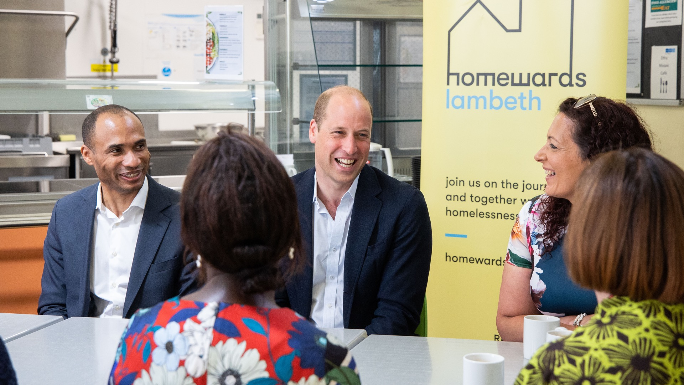



Making Homelessness Rare, Brief and unrepeated

Slide 34

“I refuse to believe that homelessness is an irrevocable fact of life....
If we really want to tackle homelessness, it can be done.
If we do it together and there’s a big team effort, it is possible.”
- Prince William

Slide 35

“Seldom have I seen a charity start and be so successful in such a short period of time and to galvanise so many people. I want to congratulate all the businesses, charities, NGOs, experts from the housing field and the local authorities that are involved.
You’ve given people hope.”
- Gordon Brown
Bringing together cross-sector partners is how systems change and how real impact can be made.
- Steven Bartlett

Slide 36

What IS HOMEWARDS?
Prince William and The Royal Foundation launched Homewards: a transformative five-year programme that aims to demonstrate that together, it’s possible to end homelessness – making it rare, brief and unrepeated.
By demonstrating
that homelessness
is not inevitable,
and is a solvable issue, Homewards is kickstarting an inspiring movement in the UK, and further afield, to end homelessness
for good.

Slide 37






Six flagship
Homewards locations

Slide 38
Homewards cohorts
Homewards Cohorts
(all at risk of homelessness)
Northern Ireland - Care Experienced Young People, women leaving prison
Aberdeen: Young People 16-24
Bournemouth, Christchurch & Poole: Young People
Lambeth: Lone Parents in Temporary Accommodation
Newport: Families; women experiencing mulptiple disadvantage
Sheffield: Families in Burngrave
Homewards has identified specific cohorts in each location so that we can develop tailored, local solutions. By understanding the unique needs and root causes of homelessness for these groups, Homewards can create and scale innovative approaches.
We are focusing on the following strategic initiatives across all 6 locations: employment, data, housing, funding and early interventions. This deck focusses on employment.

Slide 39
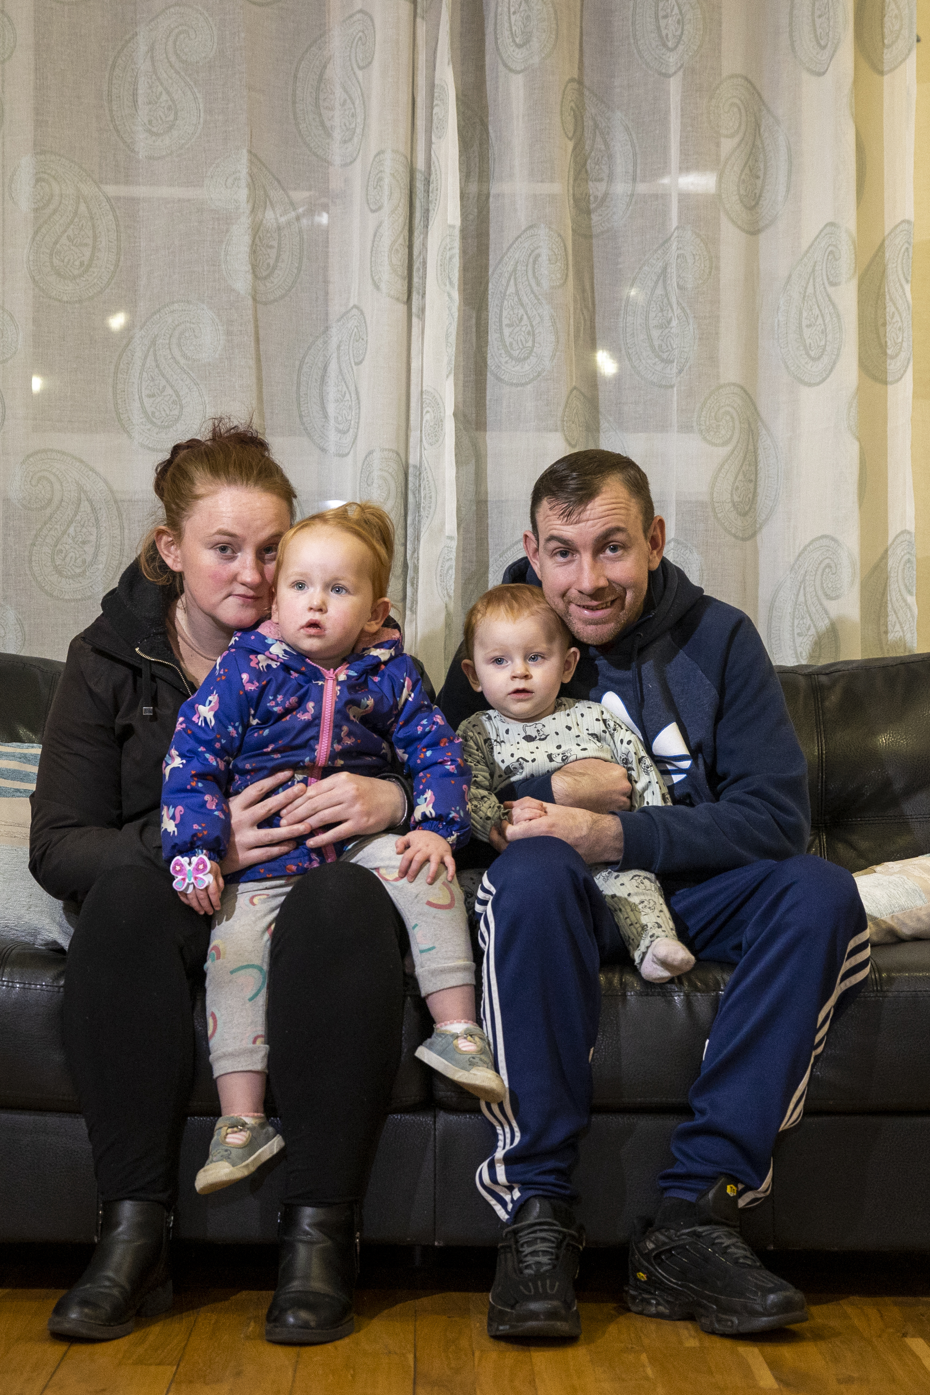

A major societal challenge
Homelessness is a complex issue, and its definition is broad – from rough-sleeping to living in temporary accommodation to sofa surfing.
It is now estimated that over 350,000 people – nearly half of whom are children – are sofa surfing, sleeping on the streets, staying in hostels, living in their cars or other forms of temporary accommodation.
And this is only the tip of the iceberg.
However, homelessness is not inevitable….
Centre for Homelessness Impact / Liam McBurney/PA

Slide 40

Ending the ‘No Job, No Home’ cycle
Homelessness is not inevitable
We have been inspired by international success stories, such as Finland, and examples set by pioneering projects here in the UK.
Employment is key
In Canada, a 1% increase in local employment rate led to a 9% reduction in homelessness duration*
* https://arxiv.org/ March 2025
Homelessness in Finland 1987 - 2022
Notes:
Employment = key driver re preventing homelessness; one of 5 strat initiatives (Homes, Data, Finance & Early interventions)
TRF – PW and GB reiterated at 2 yr event - committing to support by helping establish private-sector led groups focused on employment
In Finland, through innovative, cross sector partnerships – and creative ‘upstream’ solutions, there is evidence to show that ending homelessness is possible.
Challenge:
Scarcity of job opportunities, often insecure or low paid, for those at risk of homelessness​
Significant barriers to employment (including high degrees of stigma) ​
Opportunity:
Homewards’ cross-sector approach allows private, voluntary, and public sectors to collaborate to increase the quantity and quality of opportunities​
Spotlight success, tackling stigma​

Slide 41

Progress to date
In its first 2 years, Homewards has brought together partners from the private, public and non profit sectors to demonstrate it's possible to end homelessness – making it rare, brief and unrepeated. Projects include:
  Lloyd Banking Group committed an initial £50 million in new lending to support small and medium-sized housing providers and charities to deliver new homes across all the locations.
  Leading recruitment expert, Hays, is unlocking employment opportunities for young people across all six locations through partnerships employers including Specsavers and Altrad.
  Blue Light Card welcomed the UK homelessness sector to their list of recipients for the discount card, an estimated 60,000 people saving over half a million pounds since launch in September 2024.

Slide 42

Why employment?
    We know the power of a job to change life. It’s that simple.
Homelessness is always about housing. But it’s not just about housing…. It’s a team game. Nothing happens without us all working together and doing it properly.
- Prince William
Notes:
Terry & Del – D’s story
AG experience at COOK – RT prog, barriers, 10 yrs, 250+ people

Slide 43

Why employment?
Notes:
Terry & Del – D’s story
Has to be business-led. Aiming for BAU for UKplc.
3 qus: I understand the plan, I understand my role in it, I have committed to next steps.

Slide 44

Preventing homelessness by employment: supporting keen, job-ready candidates into Decent, Sustainable jobs

Slide 45


The vision
    Our vision is to prove that it is possible to end homelessness, making it rare, brief and unrepeated.
    Business – in partnership with public & third sector organisations - plays a key role. We would like the UK to be leading the way in inclusive, supportive employment to reduce homelessness.
    If someone can work, wants to
    work and is safe to work… they work.
Notes:
UK unemployment rate is 4.2%
Youth unemployment rate for 16-24 year olds is 14.2%
According to a report by Crisis (Dashed Hopes, 2013), people experiencing homelessness “want to work but often face multiple and complex barriers to finding and staying in employment”.
The number of vacancies fell in the last quarter and over the year to 831,000 in August to October 2024, but remains above pre-pandemic levels.

Slide 46




What does Success look like?
11
11
Increase in Employment Rate for our cohort of focus in each location
10 employers in each location begin hiring people facing homelessness (from our cohorts of focus), with 60% sustaining employment for 12 months+. (Metric tbc re % of cohort in work)
A measurable increase in employment rate for people in our cohort of focus vs societal context (metrics tbc – Homewards Data Partner).
Stronger Employability Pathways (new & existing/stronger)
Clear pathways to work for people facing homelessness in our 6 locations.
Strong wraparound support leading to and during early employment.
Cohort-Specific Job Broker (referrals; support - people & employers)
A dedicated broker matching the right people to the right support and the right jobs.
Notes:
Eg unemployment in hostels for 18-25s decreases by x%.
Need baseline data and a way of measuring success. CHI and ELP working with us to measure impact - data-led approach.

Slide 47
The plan
Develop sustainable structure
Agree on shared targets & measurement mechanic
Work with employability partners* to support people at risk of homelessness into work
Support business to hire people at risk of homelessness; and to lead the charge & light the way for others
*Charity and statutory bodies supporting people into work who are at risk of homelessness

Slide 48
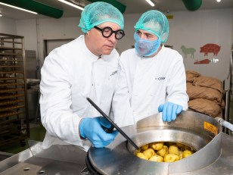

What is NEON?
NEON (New Employment Opportunities Network) is a Homewards initiative, led by business. NEON brings together business leaders, public services, and the voluntary sector in the location to find decent jobs and strengthen pathways into employment for those at risk of / experiencing homelessness.
NEON is built on the proven success of Employment Advisory Boards (EABs*), adapted for the homelessness context. Each NEON is locally led by an influential business leader and is supported by Homewards.
*In partnership with prisons, probation and DWP, Employment Advisory Boards have more than doubled employment on release from UK prisons from 14% in 20/21 to 31% in 23/24
‘Offenders who are in work six weeks after leaving prison reoffend at half the rate of those who are unemployed.’
Lord Timpson OBE, CEO,
UK Minister of State for Prisons, Parole & Probation

Slide 49

How does neon work?
Each NEON is led by a senior business leader from the private sector in partnership with:
Local employers
Individuals with lived experience of homelessness
Representatives from DWP / DfC / Jobcentre Plus / housing
Voluntary and community organisations
The Homewards team
Together, NEON:
Builds & strengthens routes into sustained work for local people at risk of homelessness
Builds support for both individuals and employers via charity and statutory agencies to ensure decent, sustained work
Tracks progress, adapts and shares learning based on what works

Slide 50

Homewards is looking for…
Pioneering Employers
Are you looking for loyal, diverse teams? Could you support someone into work who is at risk of / facing homelessness?
Business Leaders
If you are already hiring inclusively, could you light the way for others in your supply / contracting / client network and beyond?
Employability Partners
Could you refer and support people into work? Could you support hiring managers and candidates to ensure sustainable work?
Notes:
Looking for relevant sectors to lead the way by offering commitments to a certain number of jobs for our cohorts in NI & across our 6 locations

Slide 51

Partnership – What can you bring?
Employment Pathway
SUPPORT
for employer
SUPPORT
for individual
Strong team/culture
Flexible roles
Tailored onboarding
Counselling
Training
Education
Skills
Soft skills
Volunteering
Employability
Work Experience
Paid placement
Permanent Contract
Roles for cohort
Inclusive hiring
Mentor/buddy
CEYP or woman leaving prison
Loyal employee, progressing, mentoring others
REFERRAL
of individual into next step
Work Ready:
Can work
Wants to work
Safe to work
DATA
Collection / reporting
IMPACT
Measurement / reporting
Alongside PATHWAYs into home & support

Slide 52
Next steps
23 October – Employability Workshop
Gather and connect all those involved in supporting CEYP and female prison leavers towards work
Clear, effective, supportive pathways into sustainable employment for our cohorts
27 October – NEON Kick-off
Align on objectives
Agree on success measures
Roles & responsibilities
11 Nov – NEON mtg 2
- Understand baseline data
9 Dec – NEON mtg 3

Slide 53
THANK YOU
Rachel Thompson: rachel.thompson@royalfoundation.com

Slide 54

Appendices

Slide 55
Paul Harvey
VAS

Slide 56
Christos Louca
Sheffield Futures

Slide 57



Better futures start here

Slide 58




About Sheffield Futures
We are a local, independent youth charity that exists to support Sheffield’s young people to:
Feel well
Have a voice
Be active in their communities
Access the learning and employment opportunities that are right for them
For 30 years, we’ve been empowering Sheffield’s young people to build a positive future for themselves by providing youth-led, holistic and individualised support.

Slide 59





Hub-and-Spoke Model
Open Access One-Stop Shop
Targeted Outreach
Drop-in group sessions
Drop-in 1:1 support
Bookable appointments
Signposting to other services
Free space to relax or socialise
Games, books, WiFi
Group sessions in schools, colleges and clubs
1:1 support in schools, college and GP surgeries
Notes:
Key points
- services are free for all young people
- accessible to refugees, asylum seekers, and those with no fixed abode
- we take a young person-led approach, meeting them where they are on their journey
- fully accessible

Slide 60
Our Services in 2025
Door 43: Mental Health and Wellbeing
Careers Education, Information, Advice and Guidance
Employability support
Youth voice

Slide 61







Every young person deserves to:
Feel confident, happy and healthy
Be comfortable in themselves
Enjoy life
Health and Wellbeing
Early Support Hub
Counselling
Social Prescribing
Notes:
Key points:
- group and 1:1 provision available
- for ages 11-25 (some service-specific age restrictions apply)
- in person, remote, outreach
- delivered by qualified health and wellbeing practitioners, mental health workers, and counsellors

Slide 62


Careers Education, Information, Advice and Guidance
Independent, impartial guidance delivered in schools to support young people with their post-16 options
Localised and bespoke resources and guides
Notes:
Key points
- helping schools meet the Gatsby benchmarks
- largest independent careers provider in Sheffield
- 1:1 support

Slide 63





Employability
Supporting young people to find and enter the education, employment and training that is right for them
Notes:
Key points:
- bringing lived experience with care leavers
- employer encounters and personalised support
- award winning service (Project Apollo)

Slide 64

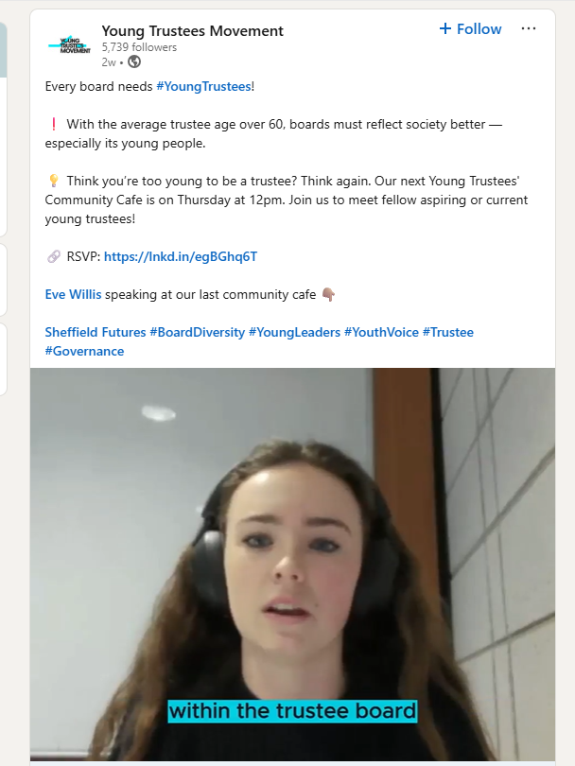


Youth voice
Providing young people with opportunities to:
Share their views
Influence change
Develop leadership skills
Deliver projects
Notes:
Key points:
- young Trustees
- consultation on hyper-local, local, regional and national issues

Slide 65


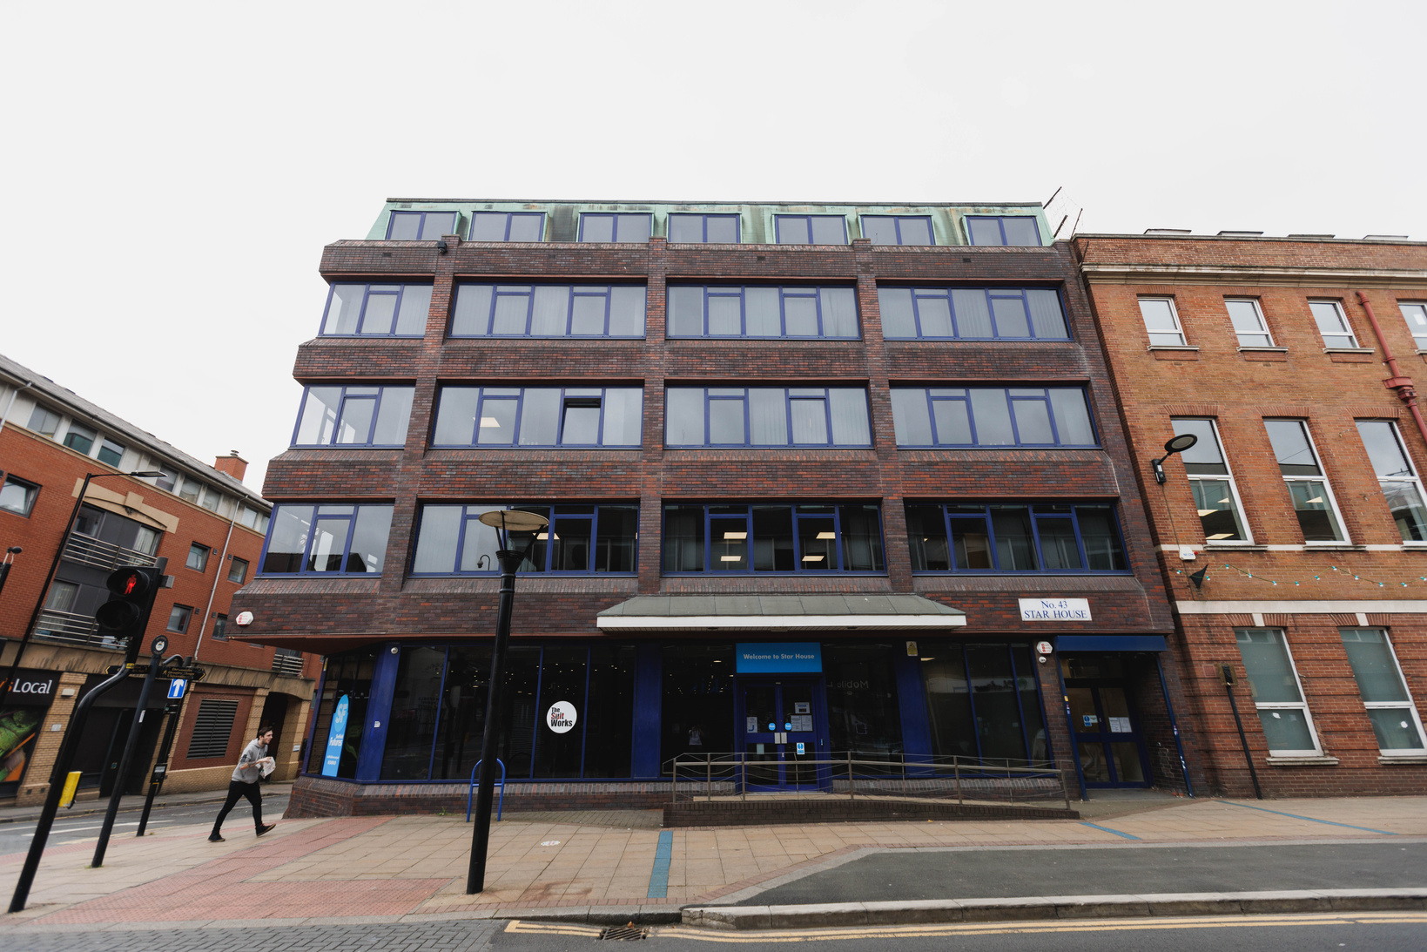
City Centre Youth Hub
Star House, our city centre home, is a welcoming hub for young people to engage with each other, in our services, and with the other for-good organisations based here.
The ground floor is open to young people from 9am – 5pm Monday to Friday, with communal space set up for activities, group sessions, doing independent work or just chilling out.
Star House
43 Division Street
S1 4GE

Slide 66

Together, we can do better for Sheffield’s young people

Slide 67
Business Card Raffle

Slide 68
Thank you!
If you are interested in speaking at or hosting the next Teacake Club come let me know !

