Slide 1
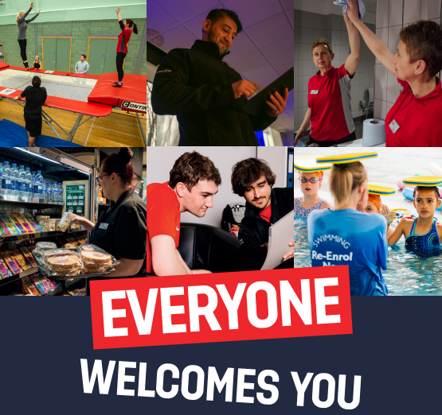

Slide 2

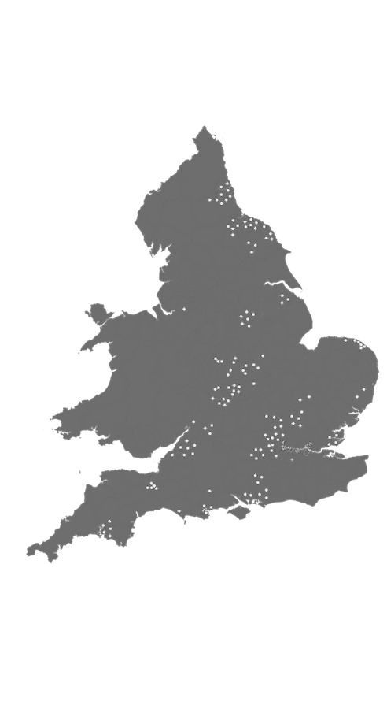



The Everyone Active Story So Far…
  Everyone Active is a part of Sports and Leisure Management Ltd, we are the longest-established leisure contractor in the UK, having been founded in 1987.
  ‘EVERYONE ACTIVE’ made it our mission to encourage everyone to participate in at least 30 minutes of moderate physical activity, either in one of our center's or via online training, five times per week.
  We are the fastest growing leisure management company in the UK. We have an established & respected track record and we manage over 240 sites nationally in partnership with over 70 local authorities.
  Employing over 15,000 colleagues

Slide 3
OUR EXCITING NEW
PARTNERSHIP
  Together we will achieve greatness!
  1. Colleagues
  2. Community
  3. Carbon reduction
  4. Commercial

Slide 4
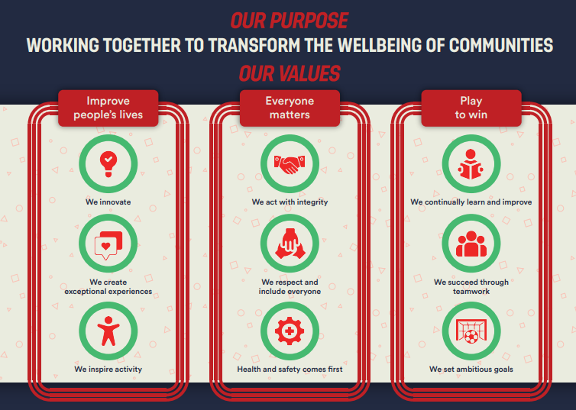

Slide 5

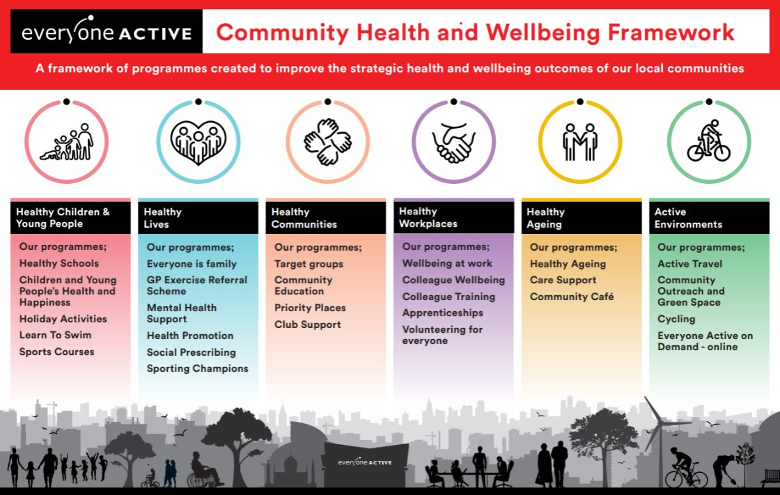

Slide 6


Slide 7
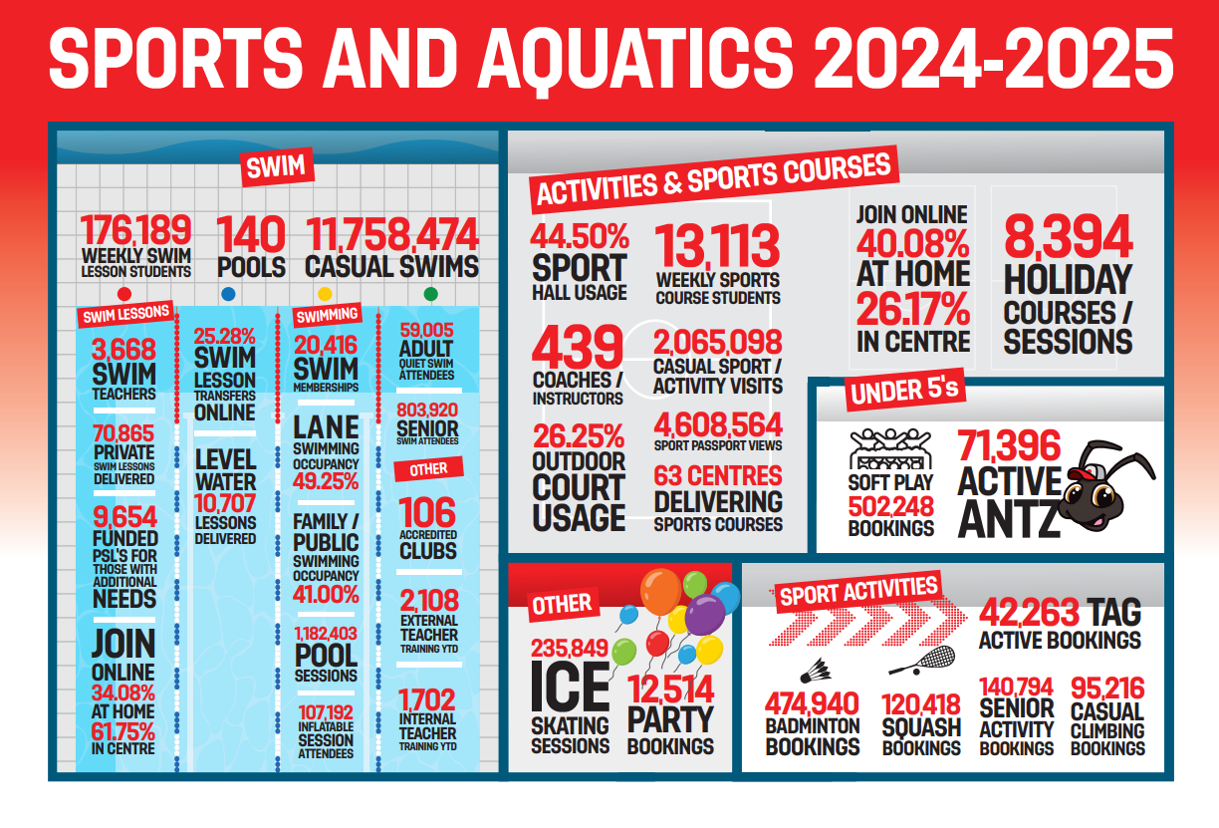

Slide 8




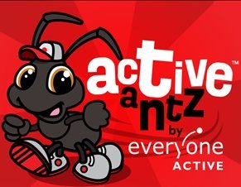












National Partnerships
Will introduce in Sheffield

Slide 9


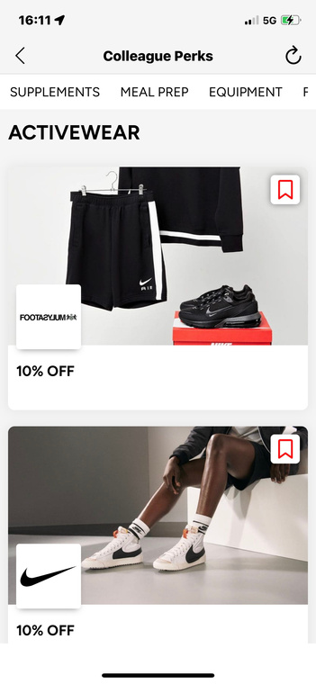
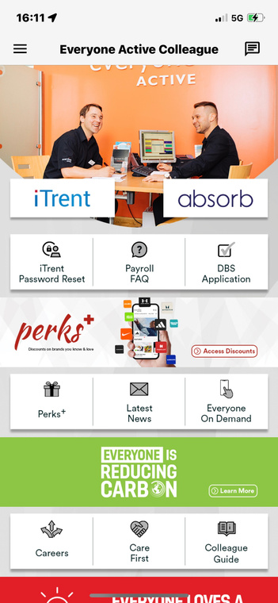
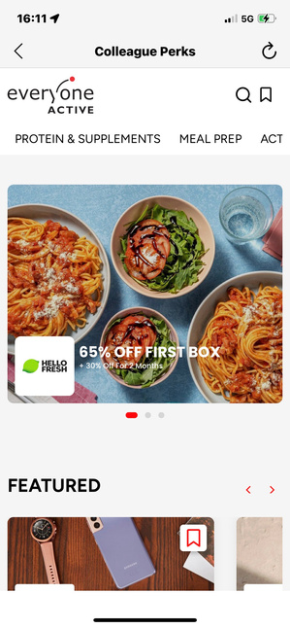
LOVES A DISCOUNT
CLUB PERKS
Discounts on activewear, nutrition, travel brands and much more!
Available via the Everyone Active Colleague App

Slide 10
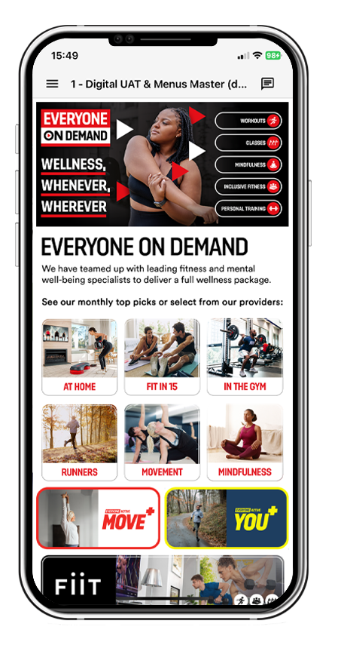
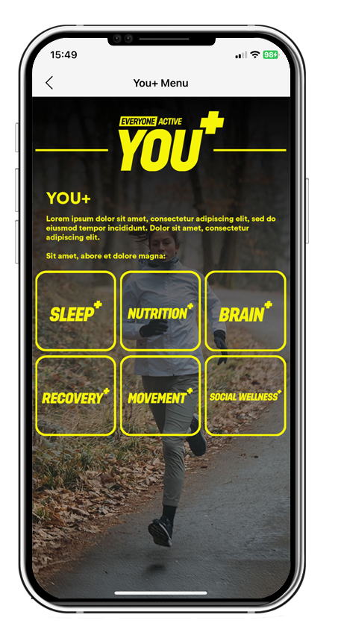
WE ARE PASSIONATE ABOUT DIGITAL
  Everyone Active App (Customer & Colleague)
  Virtual Membership Card
  Online Activity Hub
  Online induction
  Innovative, personalised & engaging member and acquisition campaigns
  Social media strategy, campaigns & engaging colleagues
  Updated website
  Join @ home
  Sport Passport
  Single Customer View
  EQMS

Slide 11








OUR CUSTOMER SERVICE ETHOS
EVERYONE GETS A FABULOUS WARM WELCOME
VALUE EVERYONE YOU MEET
EVERY TIME YOU WALK PAST A CUSTOMER SMILE AND INSPIRE THEM TO RETURN
REMEMBER TEAMWORK MAKES THE DREAM WORK
YOU ONLY GET ONE CHANCE TO MAKE A FIRST IMPRESSION
OUR AIM IS TO CONTINUALLY LEARN AND IMPROVE
NO ONE LEAVES WITHOUT A FOND FAREWELL
EMBRACE YOUR DISCRETION AND INTEGRITY

Slide 12


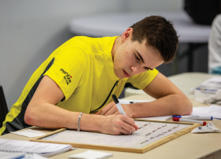
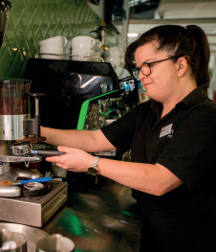
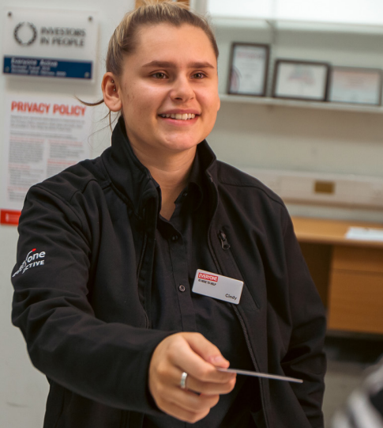
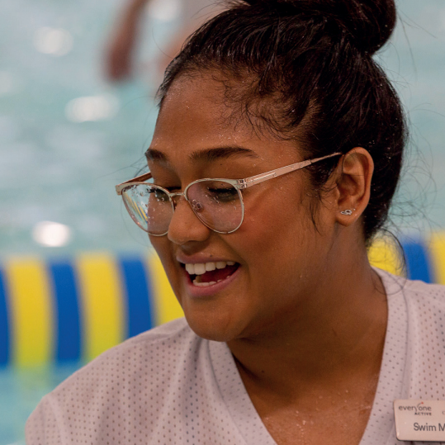
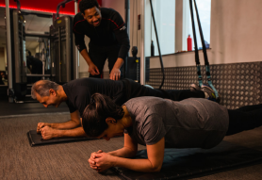
  We are as passionate about our people as we are about encouraging everyone to take part in activity. Employees are our greatest asset – they are a representation of our brand and are what help to drive our business forward.
  We refer to you as colleagues and its our aim to develop each individual to realise their potential

Slide 13
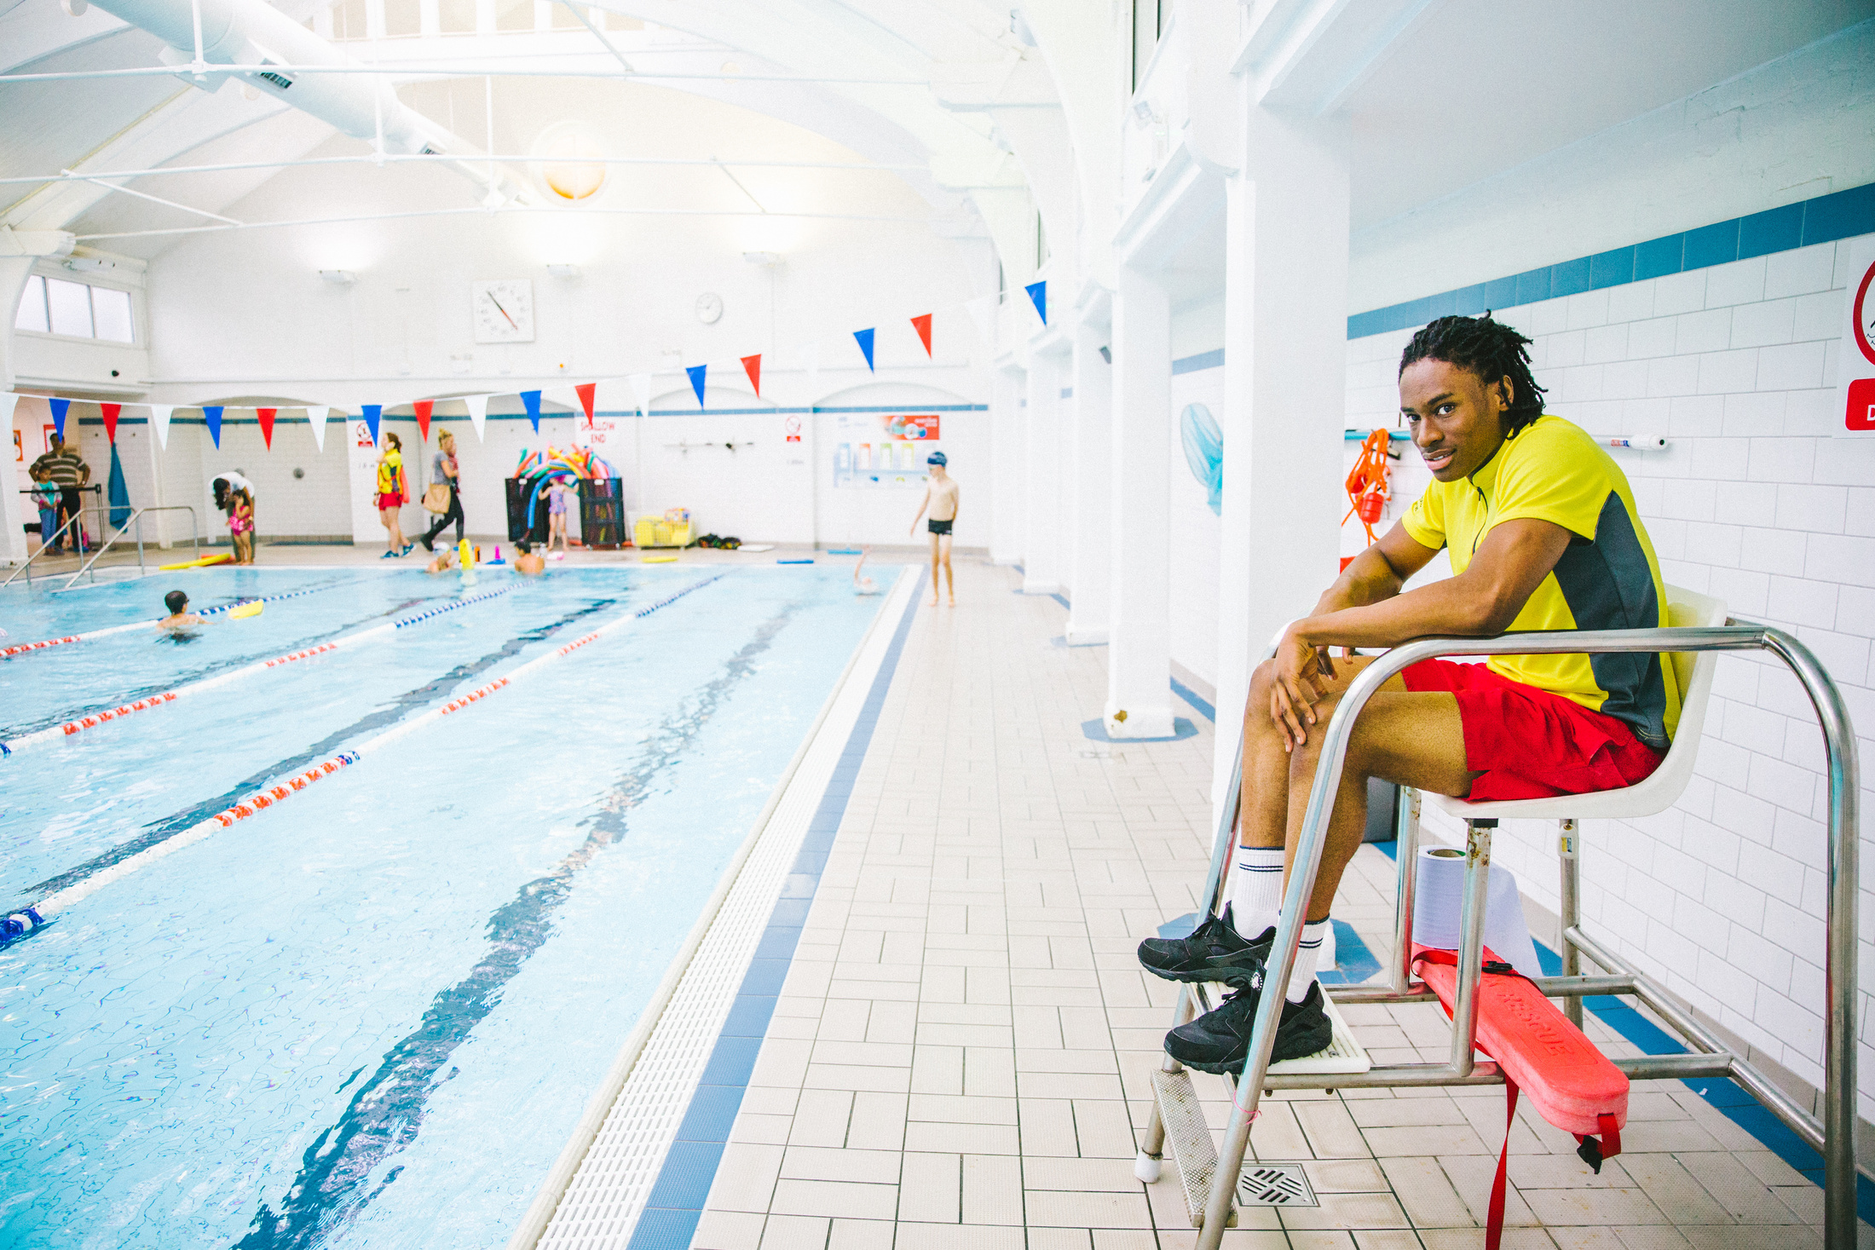
TRAINING, DEVELOPMENT
AND BENEFITS FOR
  Ongoing training and development
  Free YOU+ membership to our centres nationwide
  Free online access – to all classes, workouts
  25% off – sports coaching courses, swimming lessons, Group activity camps for our colleagues’ children during school holidays
  20% off – in centre café and retail products

Slide 14
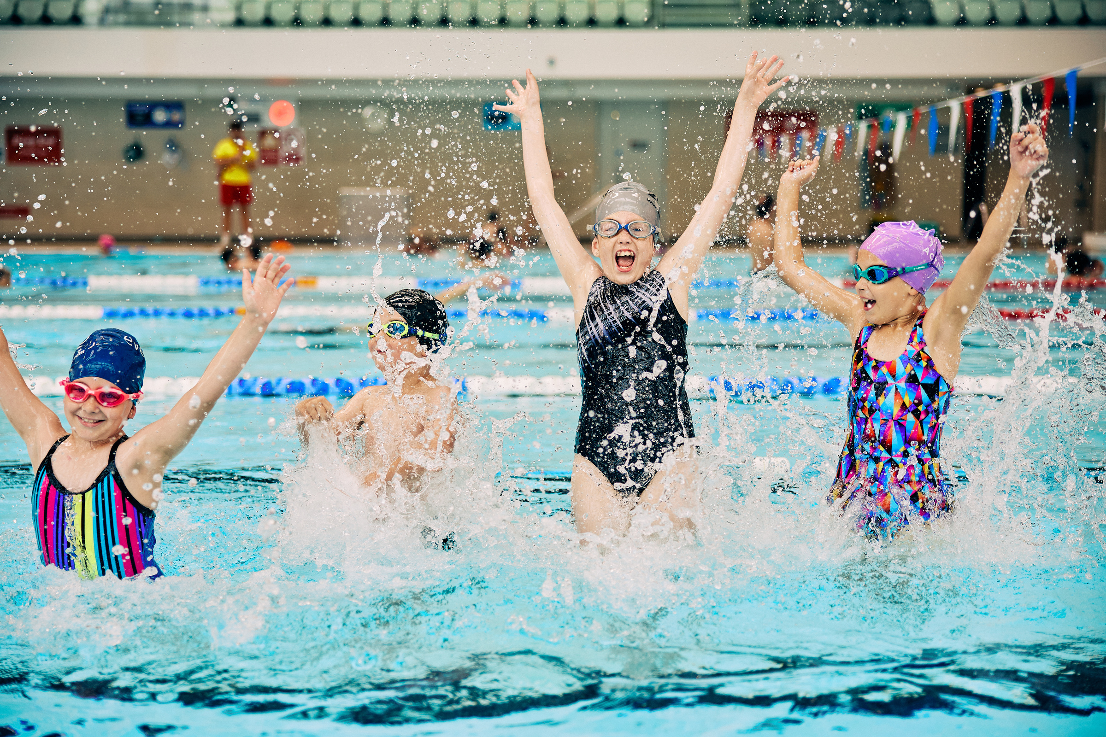
THANK YOU

