Slide 1
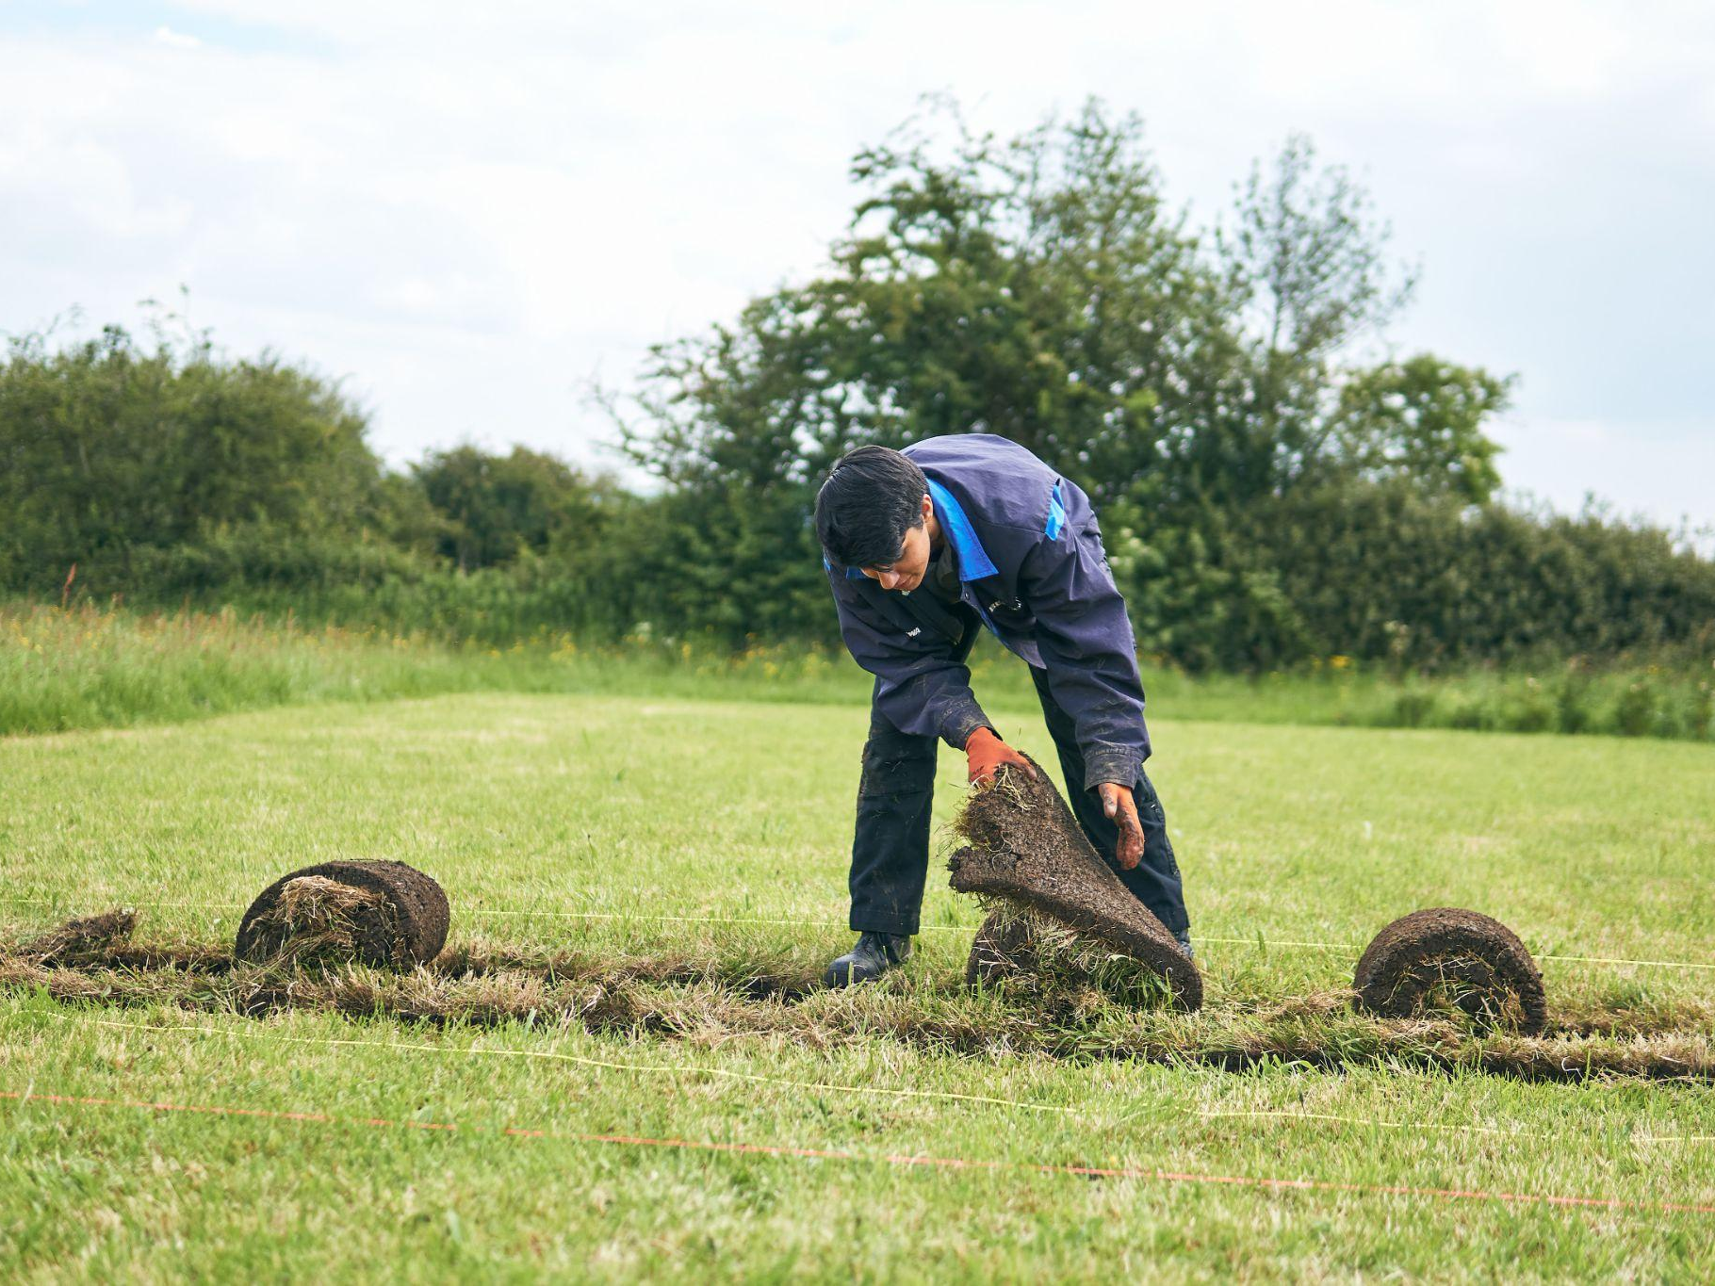
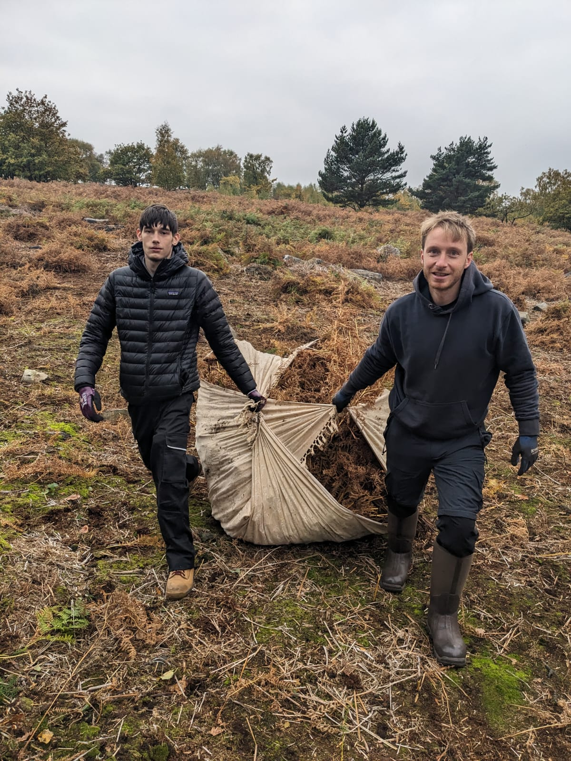

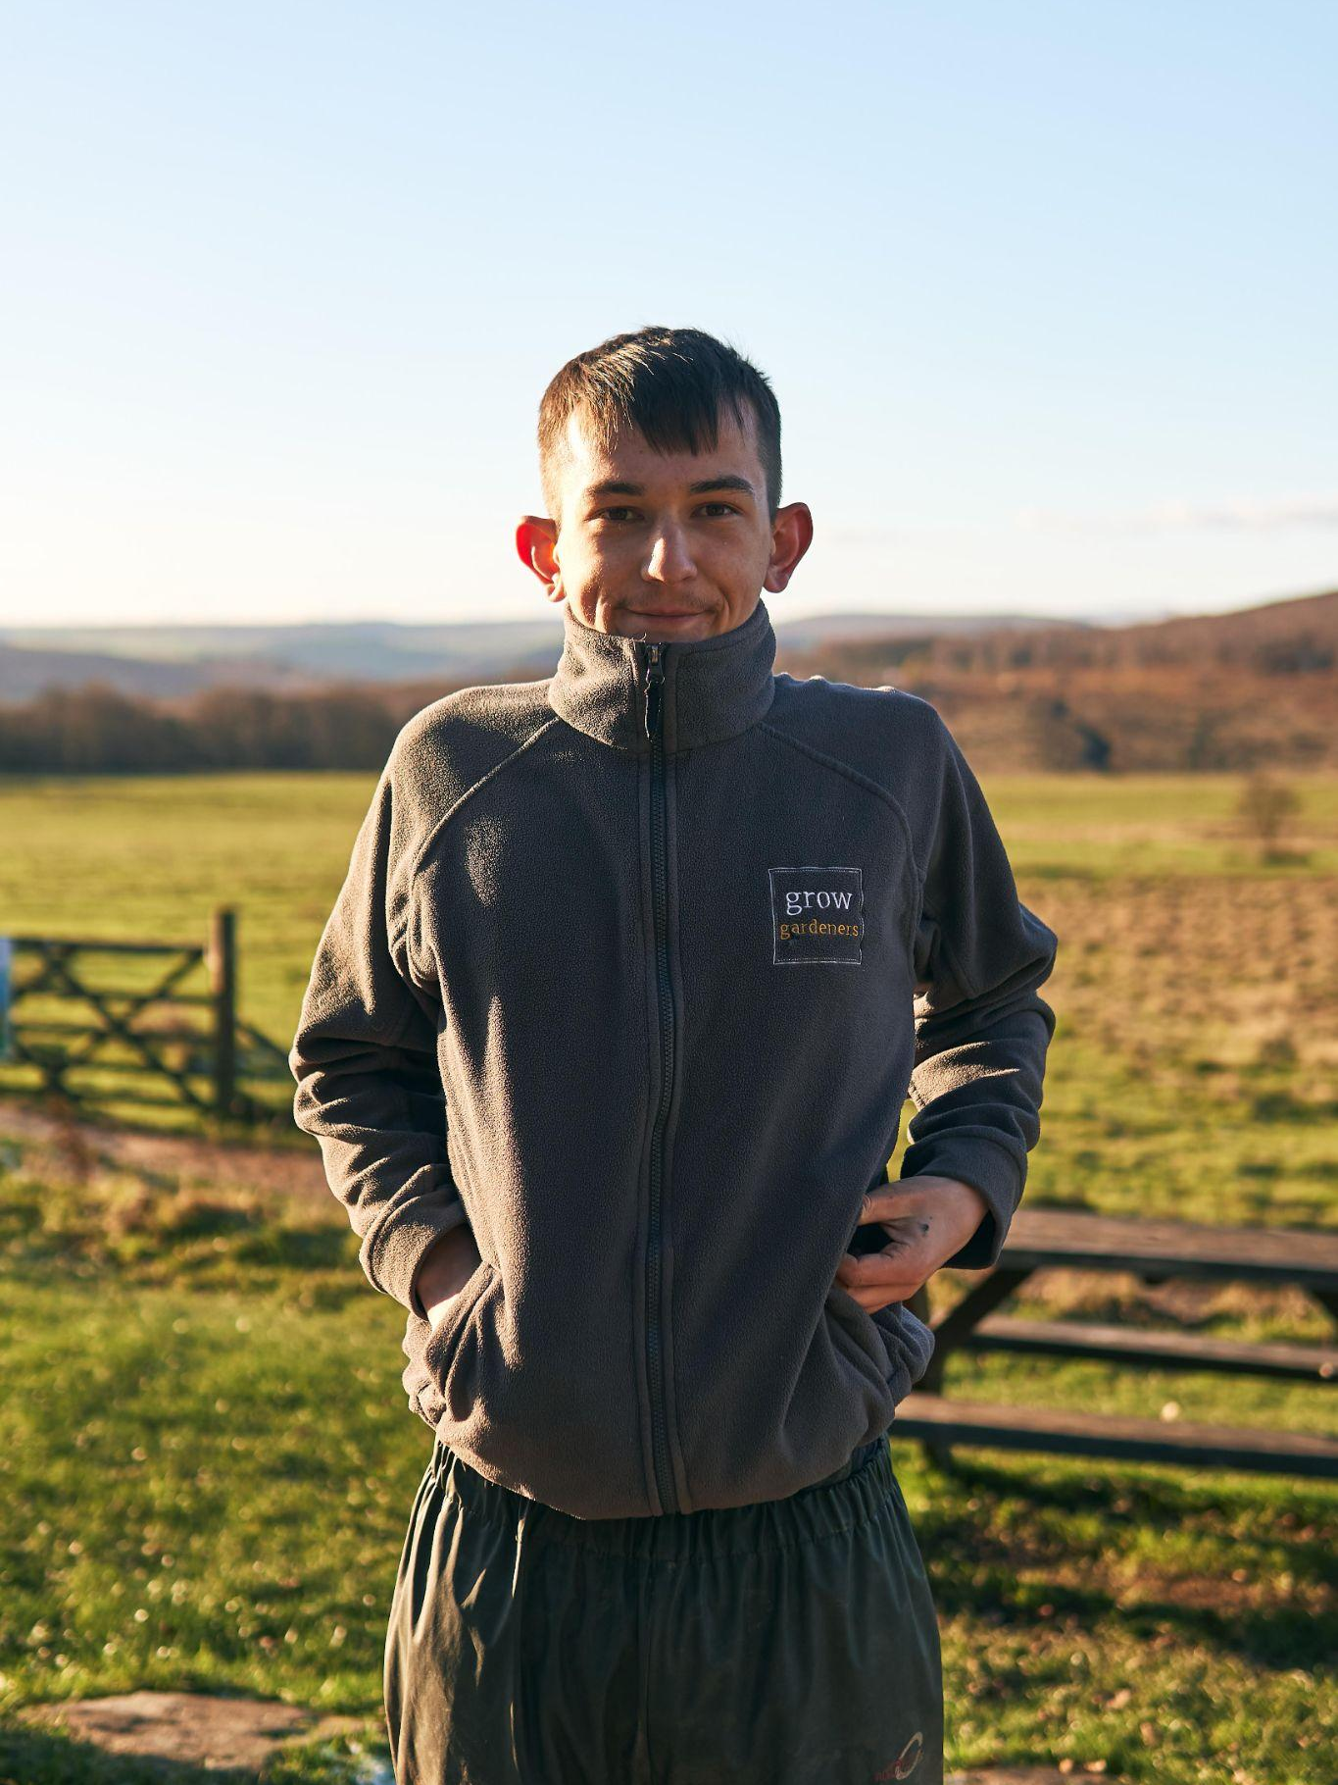
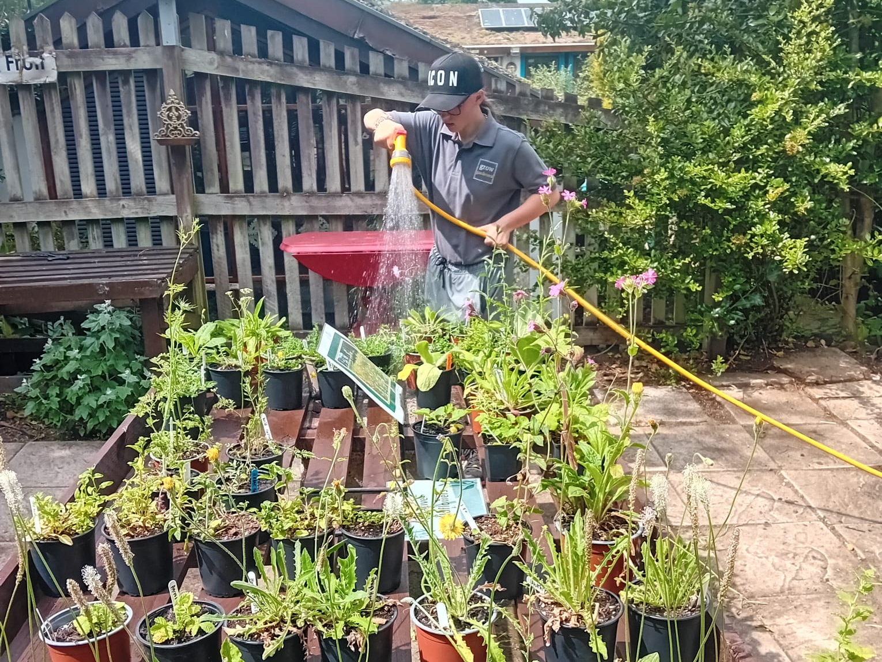
Inspiring hope and unlocking potential in young people through nature
charly.crump@growuk.org
Notes:
Welcome / plan for the afternoon / housekeeping

Slide 2
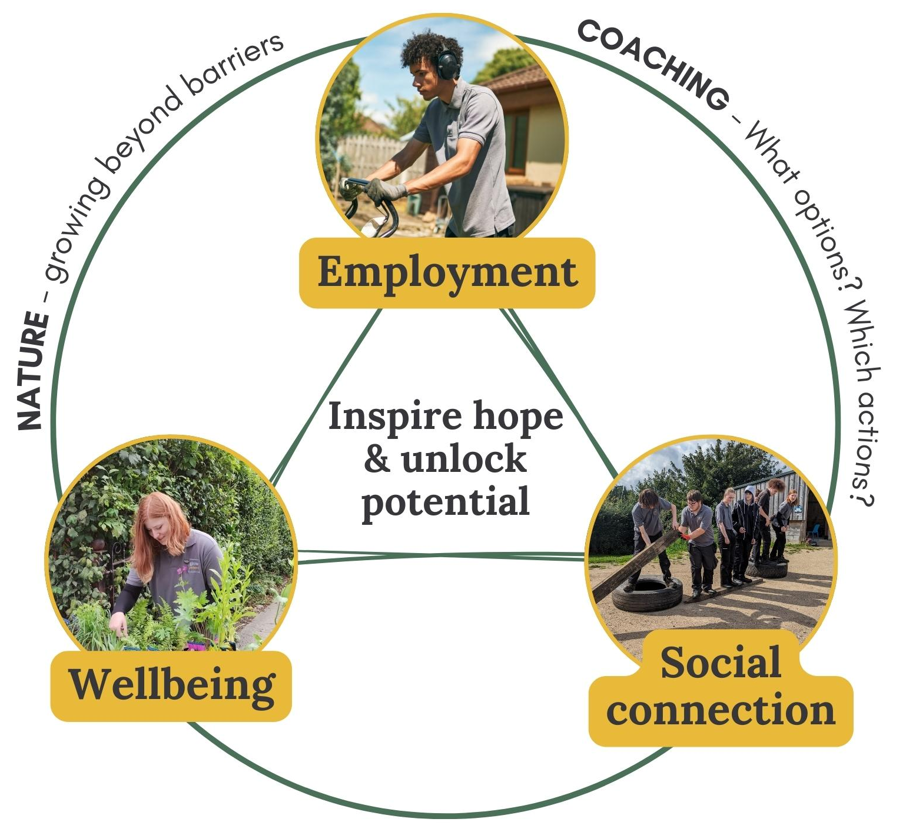
Grow’s mission
Our mission:
Inspiring hope and unlocking potential in young people (16-24 NEETS) through nature
Our work cultivates holistic impact by focusing in three key areas:
Employment (Meaningful Activity)
Wellbeing (Mental & Physical)
Social connection

Slide 3
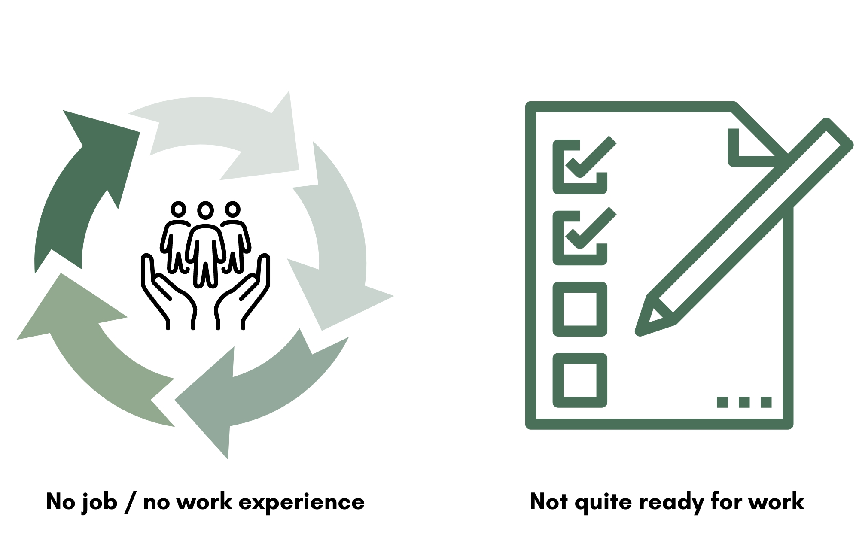
Grow Training to Grow Employment
Our solution helps young people overcome two critical barriers:

Slide 4
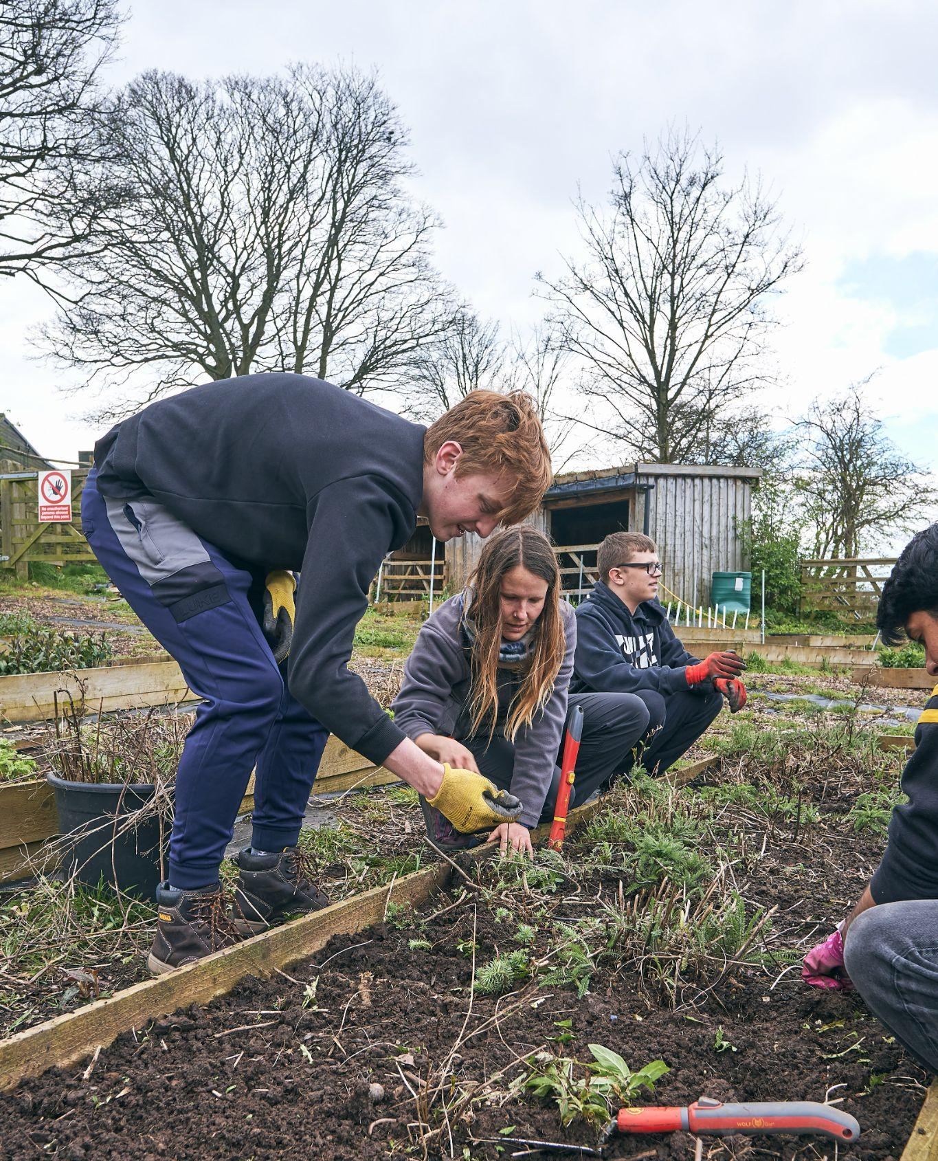
Grow Programme
Open to 16-24 year olds who are not in employment, education or training
4 week unpaid work experience programme
3 afternoons a week - all outdoors
Group coaching to develop employability skills
Working outside in a team to learn practical gardening skills
Weekly 1-to-1 with a coach
Guaranteed interview for a 10 week paid placement in week 4
PPE provided

Slide 5
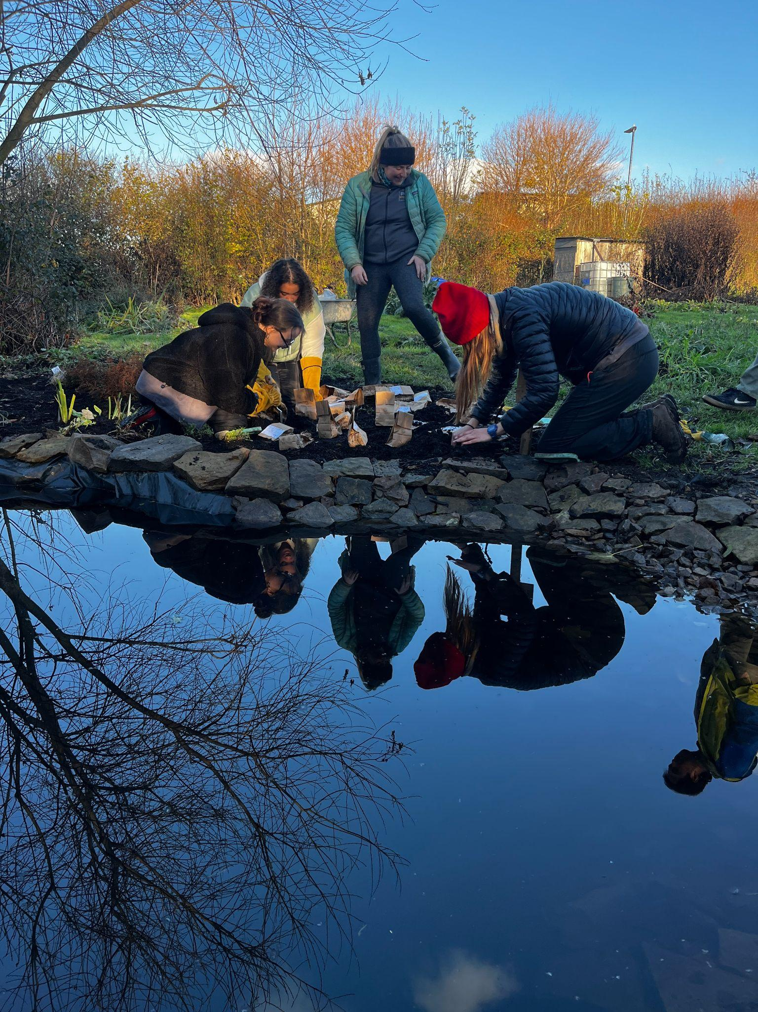
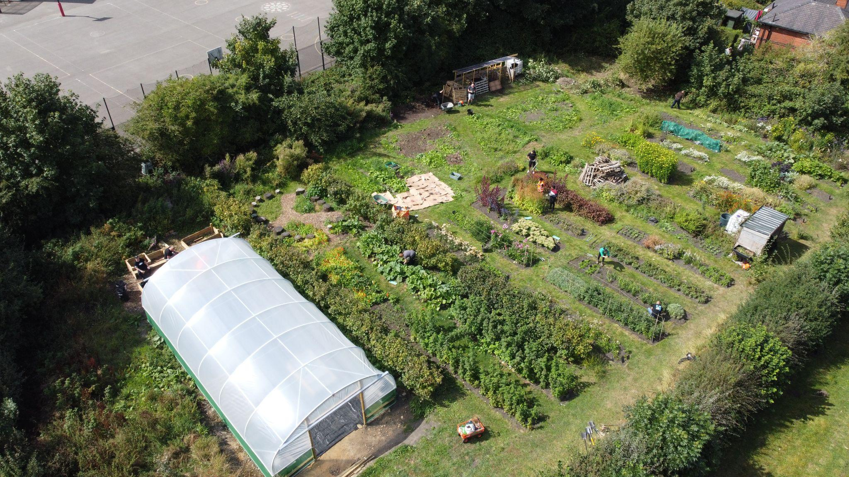
Grow Programme - Manor Park
Mondays, Tuesdays and Wednesdays 1-3:30pm
Next programme begins Monday 9 February

Slide 6
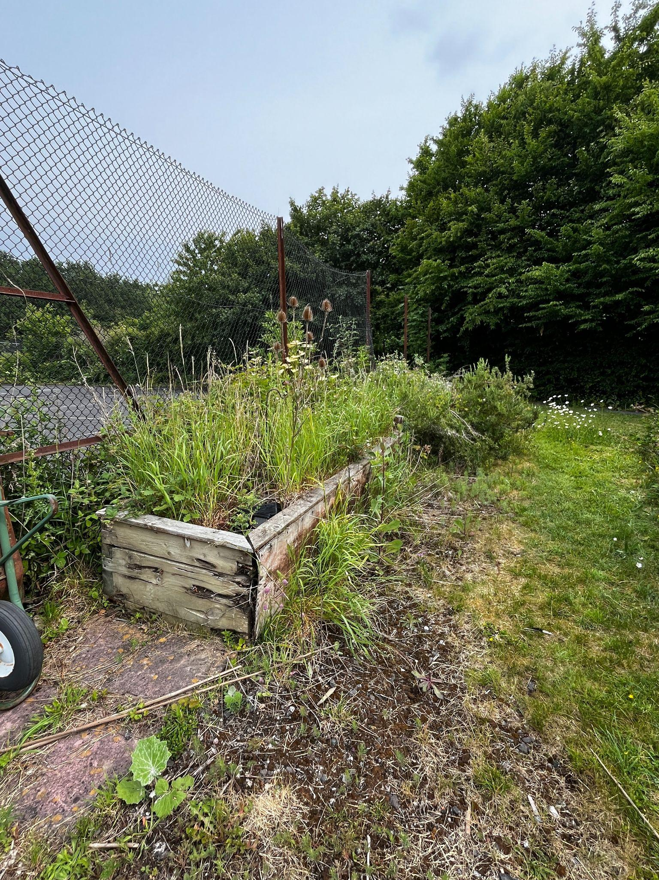
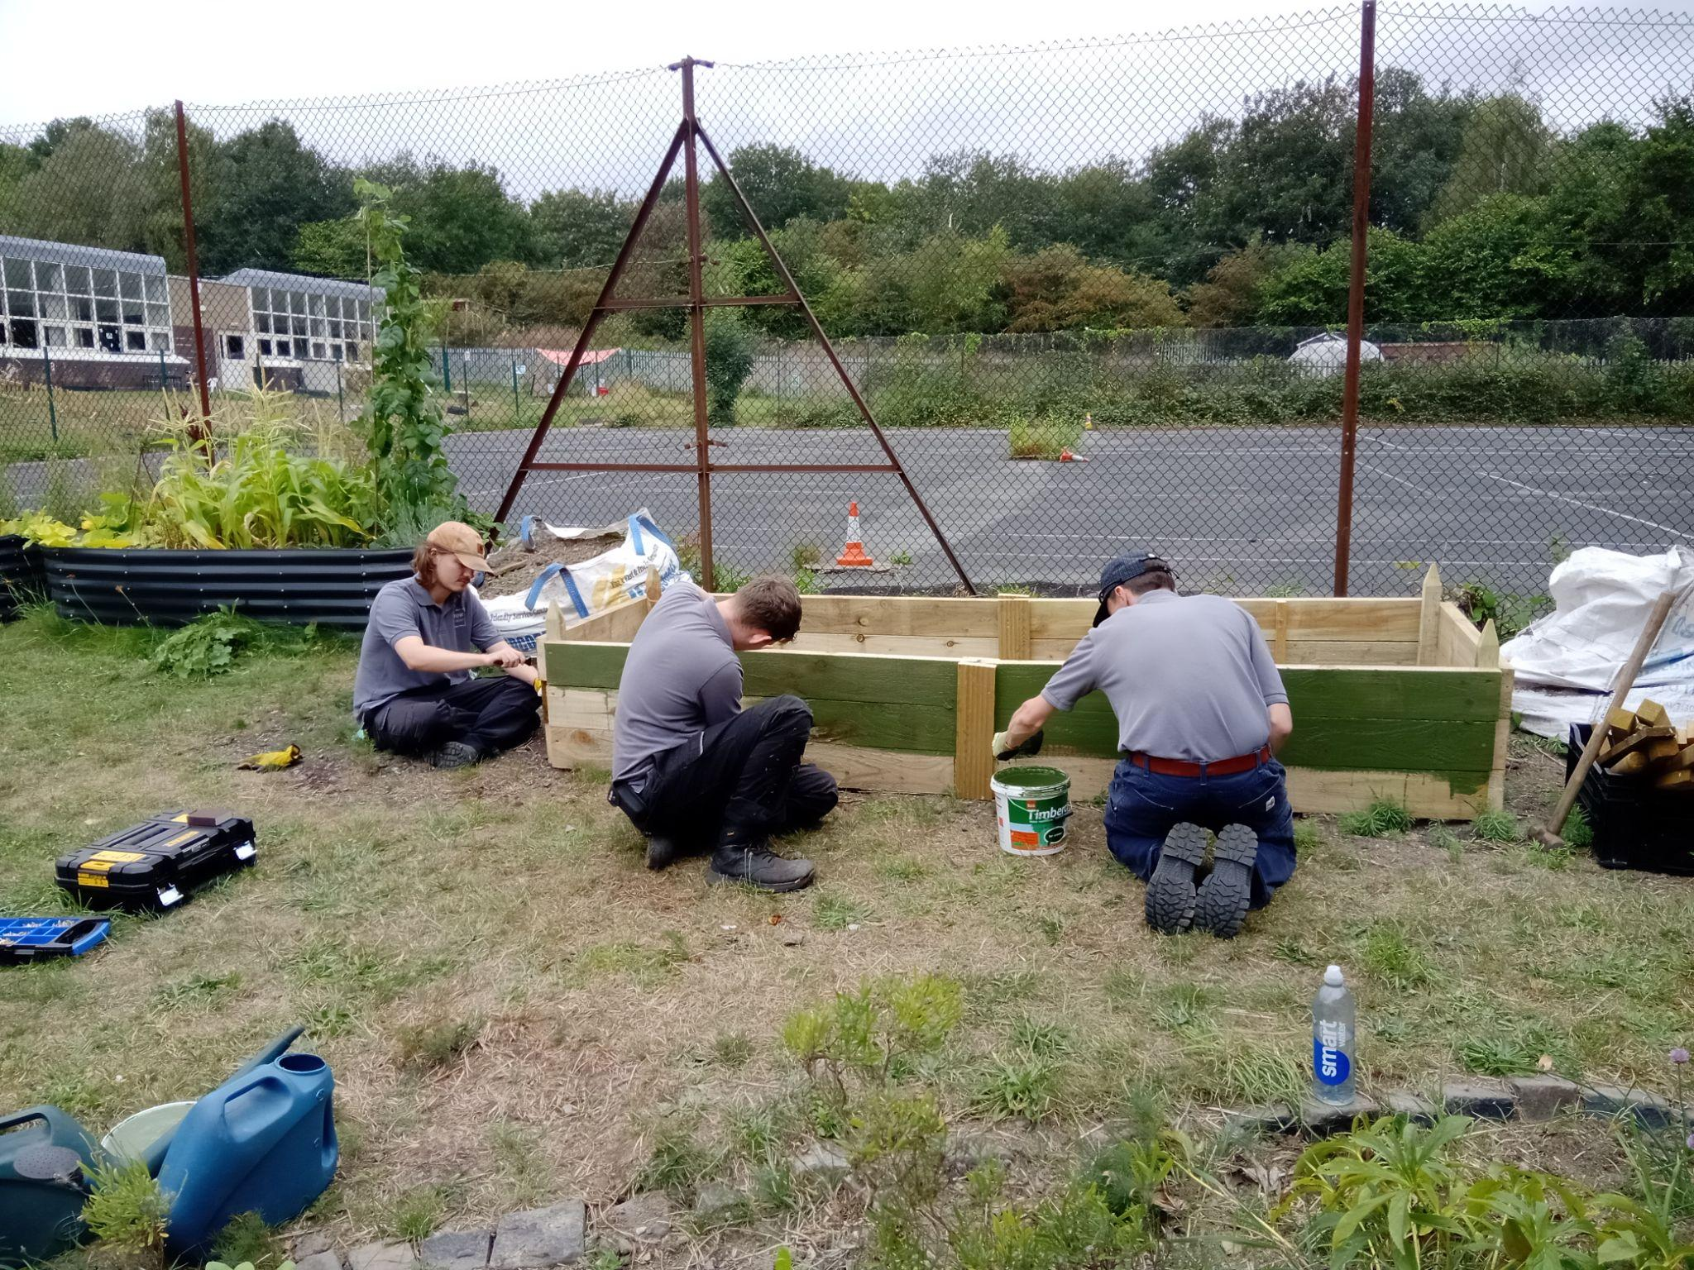
Grow Programme - High Green Development Trust
Successful pilot delivered in 2025
Watch this space for 2026!
Notes:
https://photos.app.goo.gl/xN2HU1G8Uu8q9Vey8

Slide 7
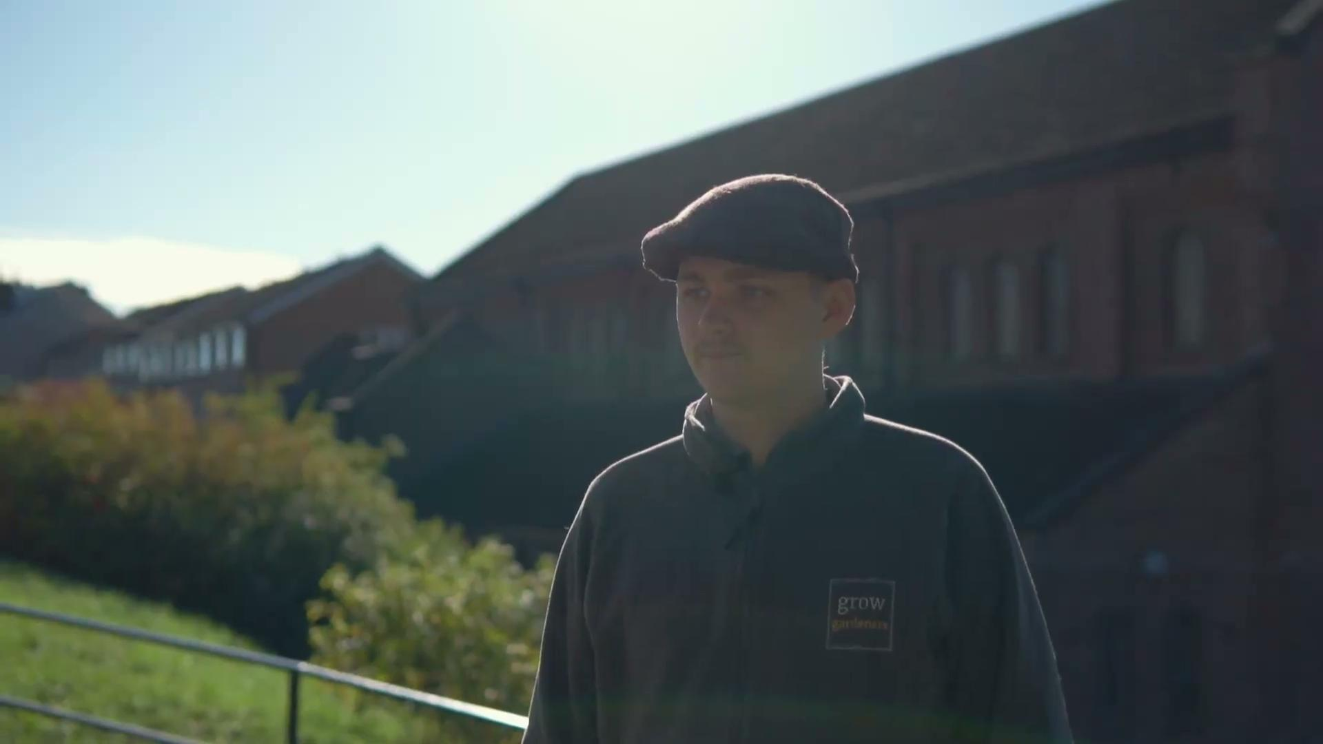

Slide 8
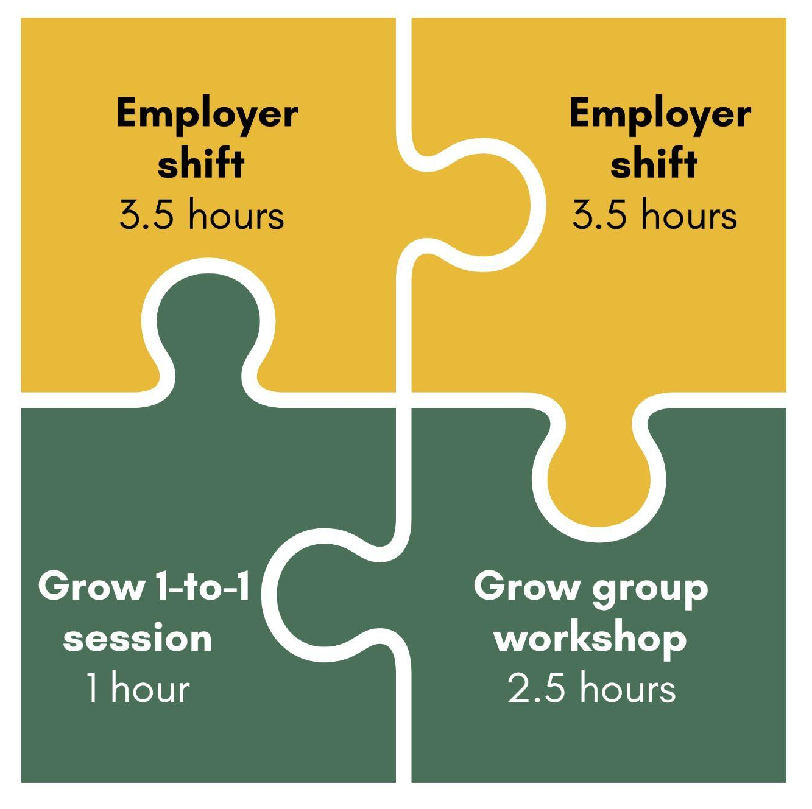
Grow Employment
10 week paid work experience programme
10 hours a per week
2 hour Grow Group Workshop
1 hour 1-to-1 coaching session
7 hours with one of Grow’s Partner Employers
Support towards the end of the programme to find work or continue with our partner.
Notes:
£12.71ph

Slide 9




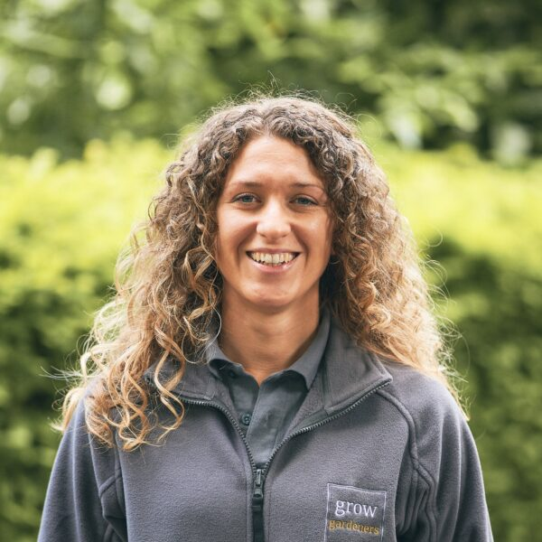





Grows Employment Partners
Sarah Coe Gardening
Birley Moor Gardens and Aquatic Centre
City Centre Horticulture Team
Foodworks

Slide 10
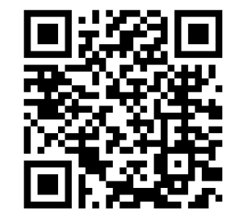
How to refer
Manor Park Grow Training (9 February)
Or email: signup@growuk.org

Slide 11
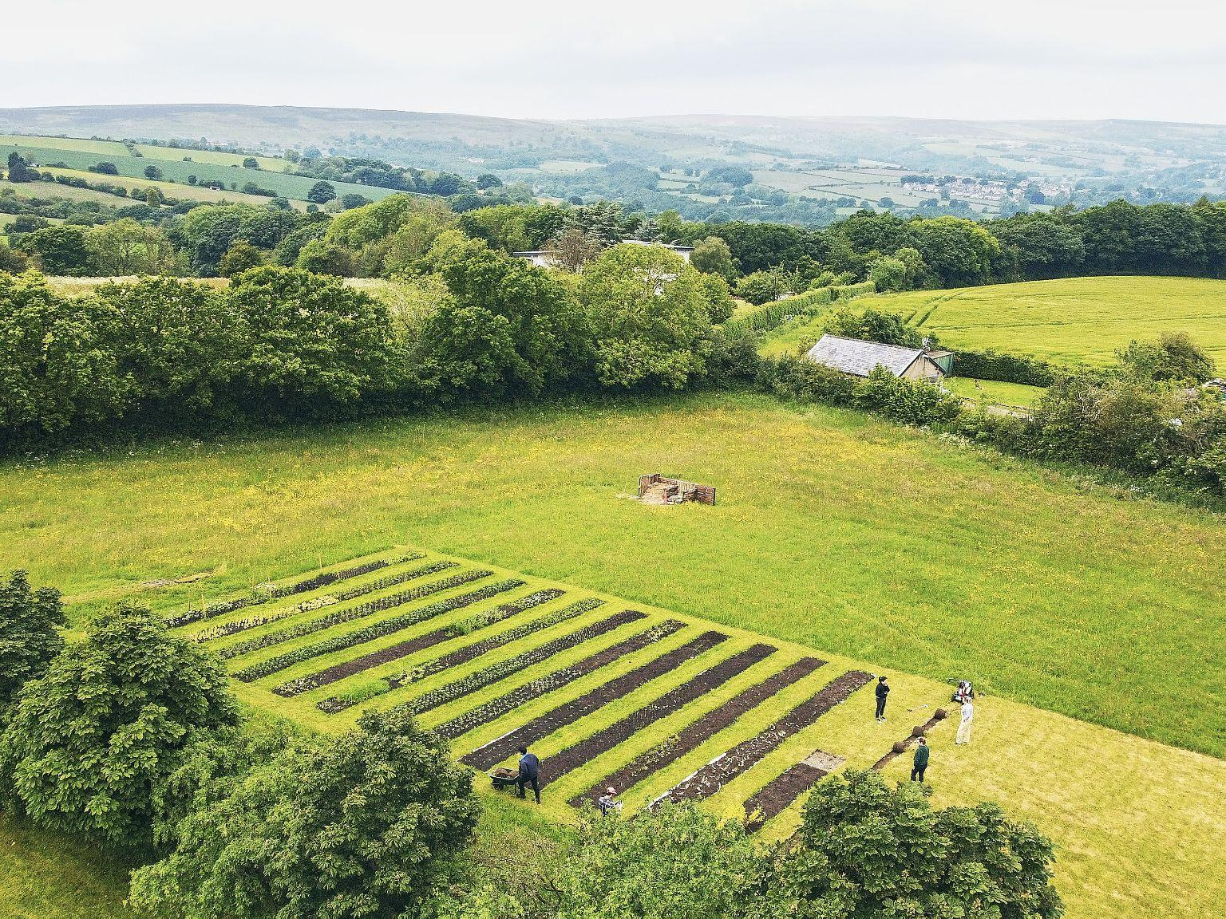
Thank you
Any questions?

