Slide 1


New to Sheffield
January 2026 Update

Slide 2
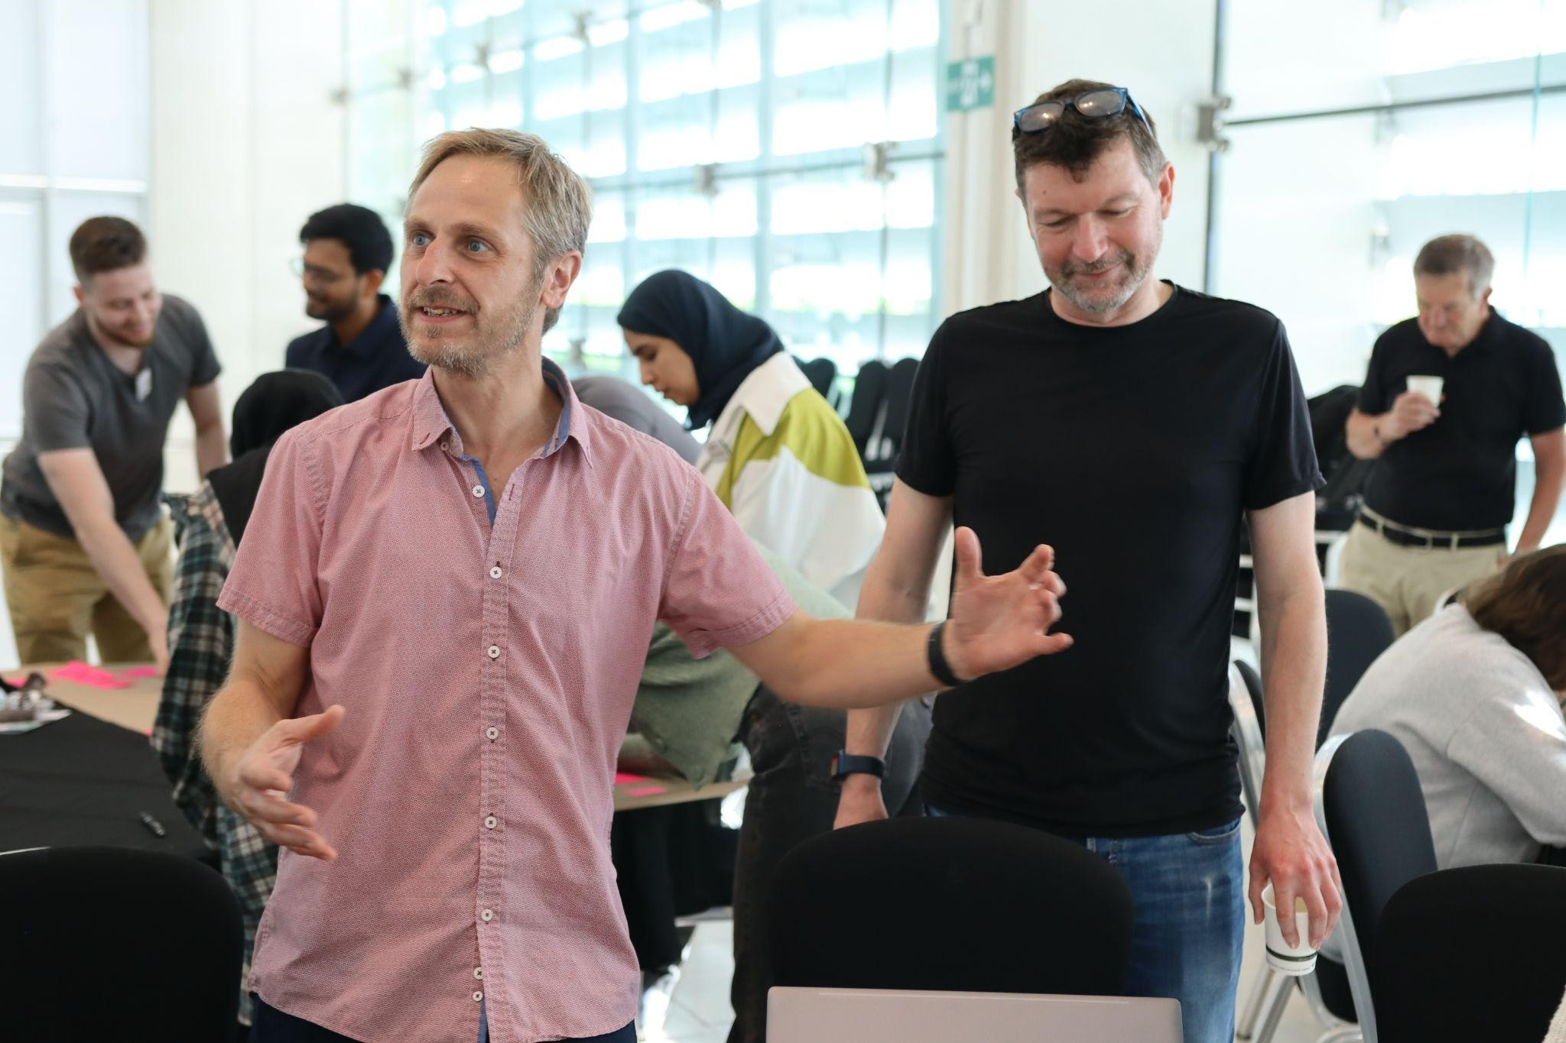
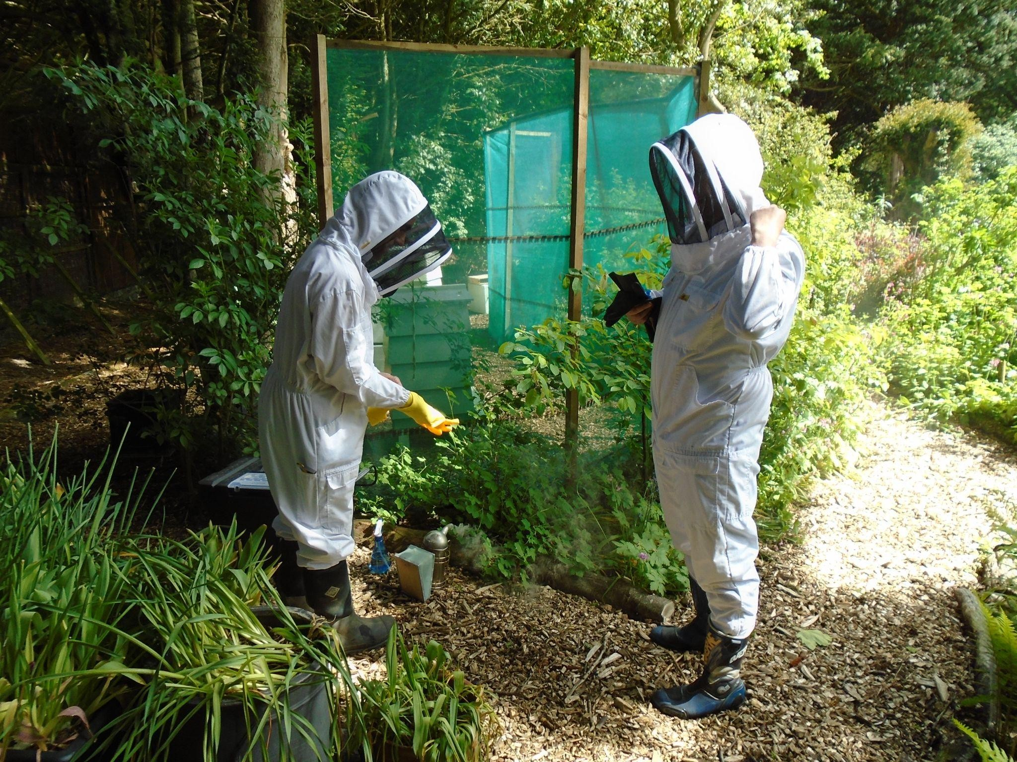
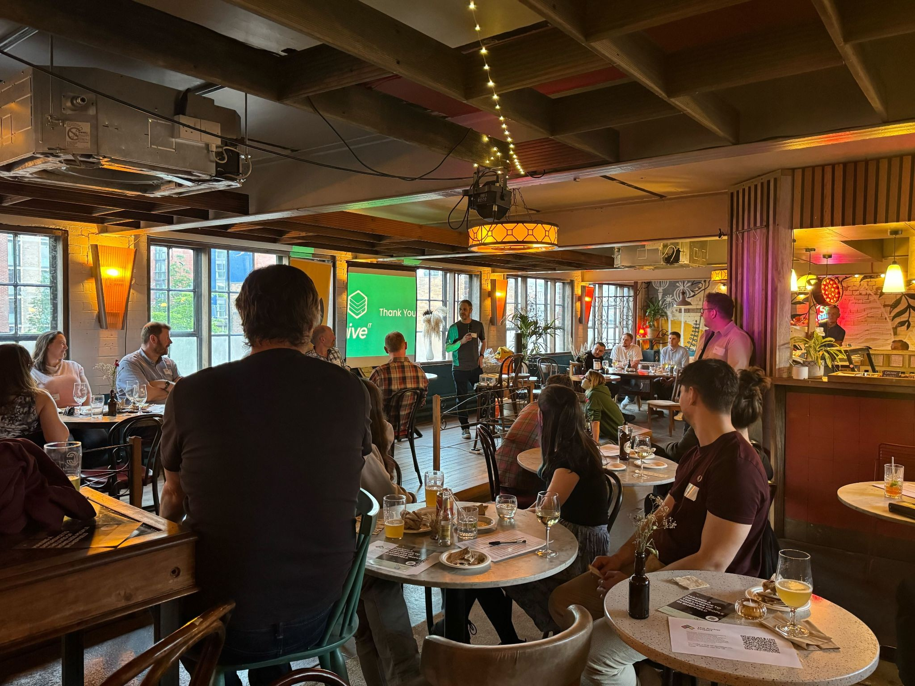
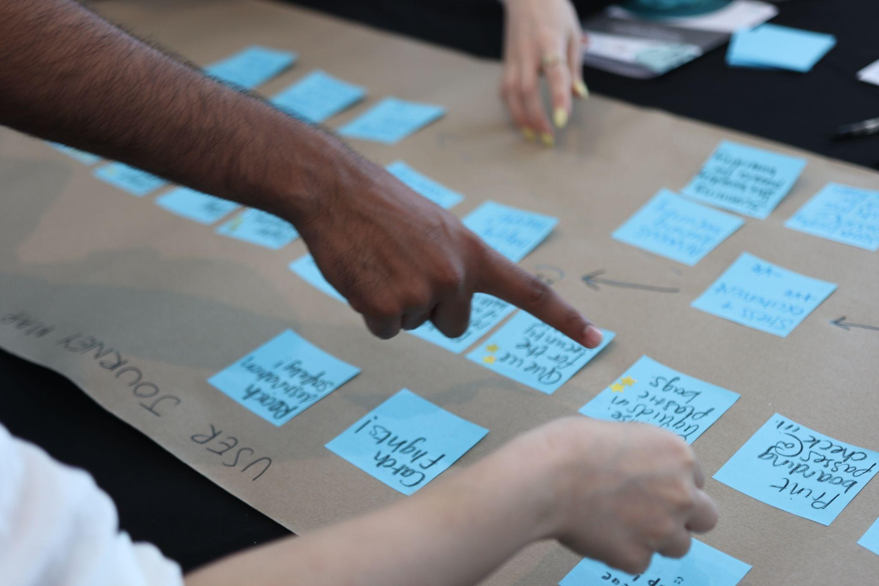

Founded in 2014 by 3 ex colleagues, now an organisation of 26
Sheffield Based
Full Service Agency: UR, UX, Design, Development, Quality Assurance
Accessibility Champions, we’re passionate about designing and building things in the right way for ALL users
Design Thinking at our core, offering training and consultancy and utilising within projects
Completing this project as part of our Tech4Good work
About Hive IT

Slide 3
How did the project come about?
Originally the ‘Asylum Journey’ website- aimed at people helping end users to seek support along their journey
Built during a ‘hackathon’
Very content heavy- difficult to maintain
City of Sanctuary handed it over to Learn for Life
Learn for Life approached Hive about redeveloping
Over 12 months later, here we are…!

Slide 4
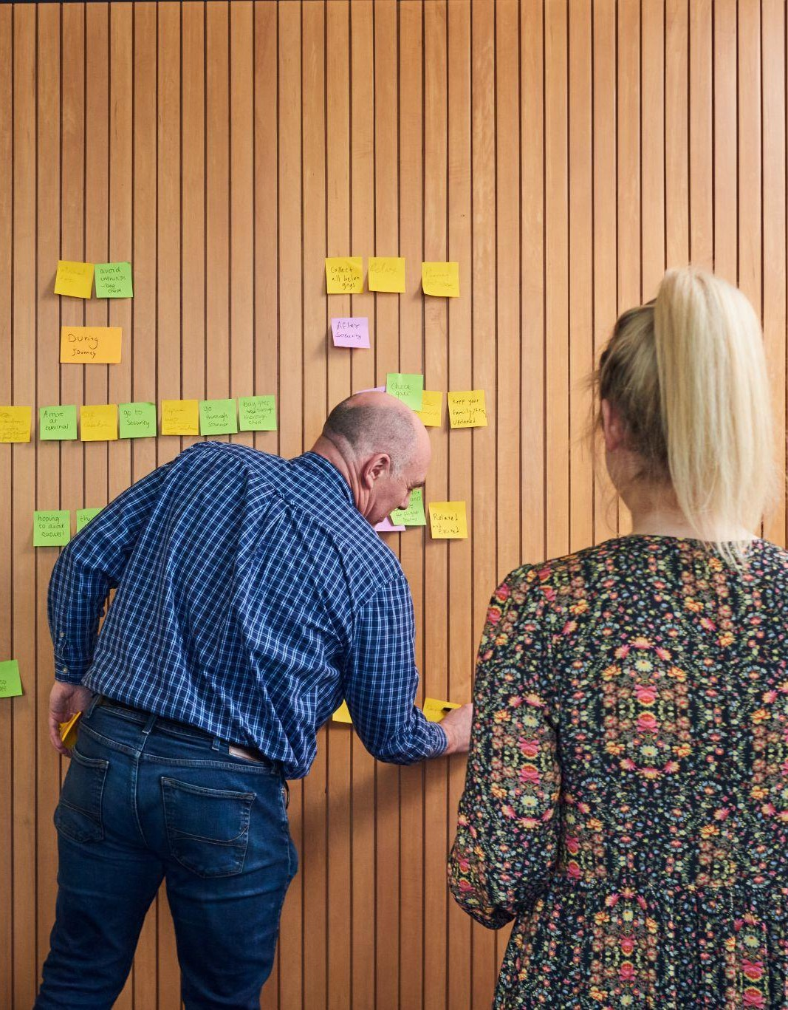
Discovery Phase
Completed a mini discovery phase of the project.
  Understand the problem
  Explore solutions
  Define the scope
  Create a plan for the build
During this phase, we all agreed that we wanted to create a platform which would help anyone who is new to Sheffield.

Slide 5
What problem are we trying to solve?
How might we help individuals who are new to Sheffield feel welcomed by providing them with accessible
Individuals seeking asylum
Migrants
Refugees
resources and reliable information
enabling them to navigate their new
International Students
environment with confidence and comfort?
Visa Holders
People with weak/ no social ties

Slide 6
What have we done so far?
Ran workshops at Learn for Life
  Individuals attending English classes
  Sheffield Hallam students
Written activity
Branding/ Naming Exercise
Card Sorting Exercise with the students
Service gathering exercise with the students
Branding workshop with Hive and Learn for Life
Attended 2 of the ‘Refugee Asylum and Migration Strategic Partnership Group’ calls (facilitated by the council) to gather support for content
Asked people what information they needed when first coming to Sheffield and their expectations…

Slide 7
What have we done so far?
Engaged with around 120 people.
Discussions with the Burngreave women’s group from the Maan Somali mental health service
Discussions with an individual on their experience of being a refugee with neurodiverse needs
Accessibility considerations
Investigating options for technology- Content management systems, translation tools, search functionality
Icon collaboration exercise- uni students facilitated some of the L4L students

Slide 8
What have we found out?
High Level Information people need:
Education
  Knowledge
  Skills
Jobs (and volunteering)
Schools, Children & Young People
Accomodation
Legal Help
Community and Networks
Health Care
Basic Needs
Staying Safe
Transport
Seeking sanctuary

Slide 9
A bit about the build
Mobile responsive website
Built using ‘Webflow’- an easy to use content management system therefore very easy to edit and update
Using Webflow inbuilt search for launch- seems decent, but we’ll see once we’ve done some user testing
Translatable into 100’s of languages- using Google Translate. Best option at this point due to limited budget. We’re writing all content using Level 1 English to avoid as much translation error as possible!
Iterative… this is just the ‘MVP- minimum viable prototype’. We will iterate based on user feedback.

Slide 10
Next Steps…
Finish the MVP build (mid Feb)
Organise and carry out a launch event (end of March)
Start to create a user testing plan for post launch, including
  Local libraries
  Disability Sheffield
  Students
  Learn for Life volunteers and students
  Zest Community Centre- This Community Can

Slide 11
How can you support us?
Help us with additional content
Flag any errors in the content
Help us to identify user groups to facilitate focus groups or interviews to test the site is working properly/what else it might need
Spread the word!

Slide 12
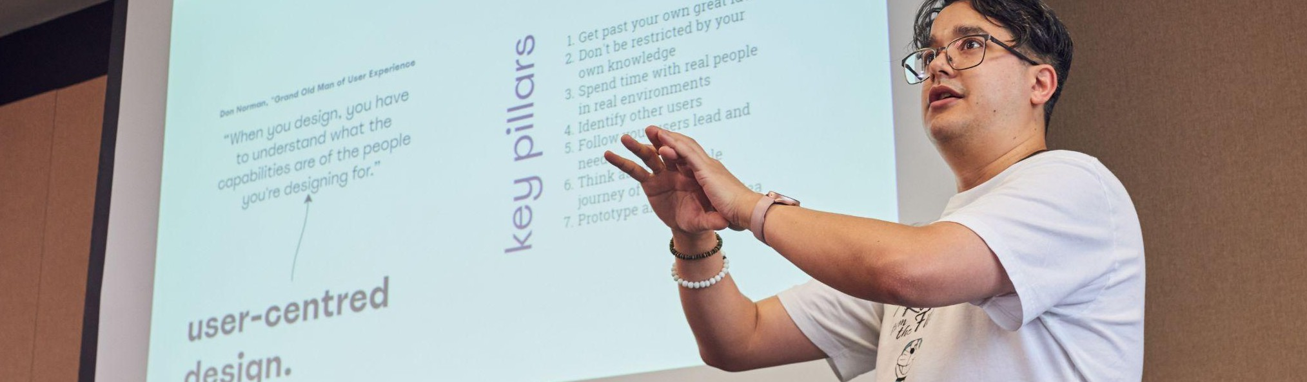

Any questions?

