Slide 1

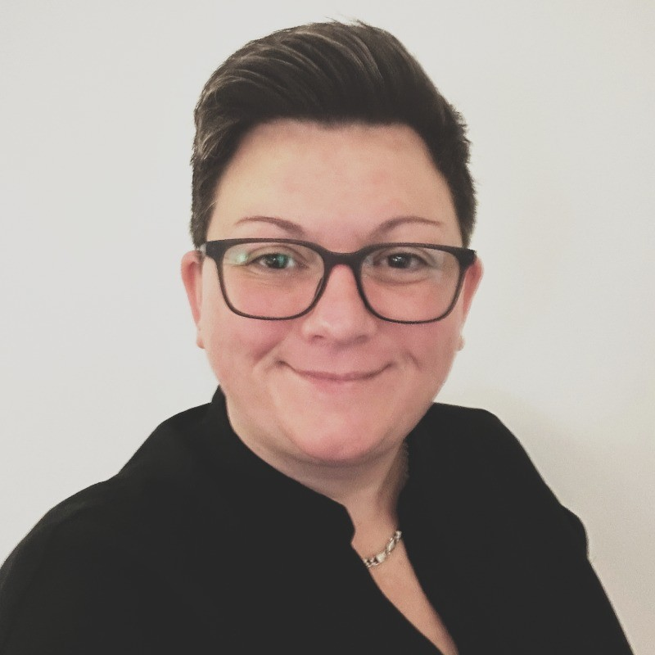
Membership Unwrapped
Riza Aparici, MAIEP
Partnership Manager
Shelley Nelson, FIEP
Learning and Quality Manager

Slide 2




Who We Are
The Institute of Employability Professionals (IEP) is the only professional membership institute for the employability profession.
Established in 2012
Over 12,000 IEP Members worldwide
Over 120 UK Capability Partners
Operating Globally, across Canada, Sweden, Australia and The Gulf
350 Fellows worldwide

Slide 3

Who We Are
The IEP is dedicated to supporting the people who support others gain work, progress in work and retain work.
Employability professionals everywhere are the best they can be.​

Slide 4

Who in the room is an
IEP member?

Slide 5






What We Offer
Professional Qualifications and Accredited Learning
Endorsed By: Endorse your organisation Learning
IEP Talks Online: Presented by Subject Matter Experts
IEP Podcasts: Bimonthly 10-minute episodes offer practical tips and strategies to enhance professional practice
IEP Satellite Centre: Licensed Partners who deliver IEP Qualifications
Mentorship Programme: Monthly mentoring for career development

Slide 6





What We Offer
Updates: Employability Professional Newsletter
Learning: Access to e-learning courses
Networking: Invitations to Events
CPD: IEP Journal, Member Resources & Opportunities
Postnominals: AIEP, MIEP, MAIEP & FIEP

Slide 7



Membership Learning
Employability Essentials
e-Learning
Supporting over 50’s in Employability
Mental Health in Employability
Employability Essentials Workshops
Employability
Podcasts

Slide 8





Accredited Awards
Award in Employability and IPS Integration
Award in Complex Needs
Award in
Artificial
Intelligence for Employability
Award in Employer Solutions
Award in
Coaching for Growth
www.myiep.uk

Slide 9


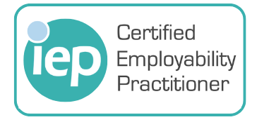
Accredited Certificate
Certificate in Employability Practice
Level 3 Accredited Certificate
www.myiep.uk

Slide 10
How This Benefits Front-Line Practitioners
Strengthens confidence and competence
Improves quality and enables practitioners to apply evidence-based techniques
Enhances engagement
Equips participants with immediate tools
Encourages reflective practise
Promotes consistency across the sector
Supports career progression
Connects practitioners across the sector
Notes:
10 Minutes: How This Benefits Front-Line Practitioners
Points to cover:
Strengthens confidence and competence when supporting a wide range of participants, including those with complex or multiple needs.
Improves the quality of day-to-day practice, enabling practitioners to apply evidence-based techniques consistently.
Enhances participant engagement, helping practitioners build trust, rapport, and motivation more effectively.
Supports better outcomes, including sustained employment, improved wellbeing, and higher participant satisfaction.
Equips practitioners with tools they can use immediately, such as coaching frameworks, conversation models, employment engagement strategies, and structured planning tools.
Builds professional resilience by offering strategies for managing challenging situations, boundaries, and workload.
Improves employer engagement skills, enabling practitioners to create stronger partnerships and better job matches.
Boosts problem-solving and critical thinking, helping practitioners navigate barriers more confidently.
Encourages reflective practice, supporting continuous improvement and professional growth.
Promotes consistency across services, ensuring all practitioners use shared frameworks and good-practice approaches.
Supports career progression, giving practitioners qualifications and CPD that strengthen their professional identity.
Connects practitioners with a learning community, reducing isolation and increasing sector knowledge and peer support.
Aligns practice with sector standards, including IPS principles, employability best practice, and IEP professional frameworks.
Builds adaptability, helping practitioners respond confidently to change, contract requirements, and evolving participant needs.

Slide 11
Thank you!
Please contact us:
Riza - riza.aparici@iemploybility.org
Shelley – shelley.nelson@iemployability.org

