Slide 1



OWN YOUR FUTURE
SUPPORTING YOUNG PEOPLE ACROSS THE UK TO OWN THEIR FUTURE
www.streetleague.co.uk
@StreetLeagueUK

Slide 2

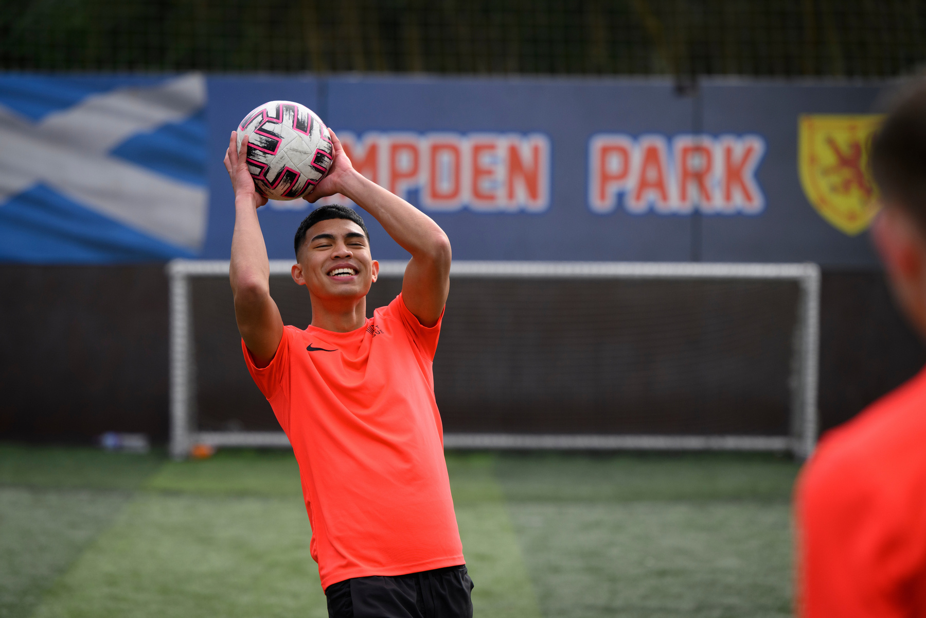

OUR MISSION
USING SPORT AND EDUCATION, WE HELP YOUNG PEOPLE INTO WORK.
OUR VISION
A SOCIETY IN WHICH ALL YOUNG PEOPLE HAVE THE OPPORTUNITY OF SECURE EMPLOYMENT AND A BRIGHTER FUTURE.

Slide 3







WHERE
WE WORK
WE WORK IN URBAN AND RURAL COMMUNITIES ACROSS THE UK IN:
SCOTLAND
ENGLAND
“STREET LEAGUE HELPED ME MAKE NEW FRIENDS, BOOSTED MY CONFIDENCE AND HELPED ME FIND A JOB. I LOVE THAT THEY DIDN’T GIVE UP ON ME LIKE SCHOOL AND THAT THEY BELIEVED IN ME.“
LAURA / MIDLOTHIAN
  Ayrshire
  Tayside
  East Region
  Greater Glasgow
  West Region
  West Midlands
  West Yorkshire
  South Yorkshire
  Merseyside
  London
  Greater Manchester

Slide 4



OUR 2024-25
IMPACT
3,079
1,765
989
783
unemployed young people engaged in programmes
employment, apprenticeship, education or training outcomes achieved.
63% of participants in sustained employment for 6 months
Participants were female
A RECORD BREAKING YEAR!
Notes:
Speak about local impact in Sheffield over last 3 years. Street League 2000.

Slide 5


THE NEED
AN ESTIMATED 948,000 YOUNG PEOPLE AGED 16–24 ARE NOT IN EDUCATION, EMPLOYMENT, OR TRAINING (NEET) - (ONS, AUGUST 2025)
YOUTH UNEMPLOYMENT IS THREE TIMES THE NATIONAL AVERAGE (ONS, APRIL 2025)
Notes:
Introduce Brandon and his story.

Slide 6
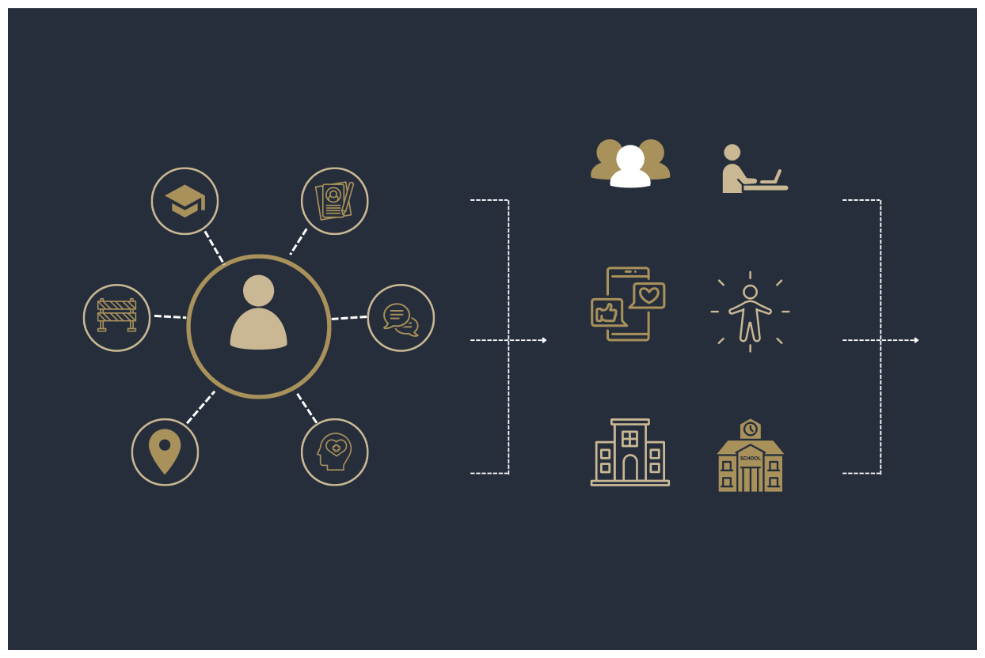
WHO WE SUPPORT
SUPPORTING
REFERRAL ROUTES
SCHOOL LEAVERS
UNEMPLOYED
THIRD SECTOR
TRAINING AND SKILLS ORGS
OVERCOMING BARRIERS
16 - 30
CONFIDENCE BUILDING
SOCIAL MEDIA
SELF-REFERRAL
LOCAL COMMUNITIES
IMPROVED WELLBEING
JOB CENTRES
SCHOOLS

Slide 7






THE STREET LEAGUE MODEL
OUR SERVICES
PROGRESSIONS
LONG-TERM
SUSTAINED EMPLOYMENT OUTCOMES
EMPLOYMENT
ACADEMY
STREET SPORTS
EDUCATION
AFTERCARE SERVICES
TRAINING
NEW OR HIGHER LEVEL QUALIFICATIONS
JOB CLUB
APPRENTICESHIPS
IMPROVED HEALTH AND WELLBEING

Slide 8
www.streetleague.co.uk
@StreetLeagueUK
OWN YOUR FUTURE
SHEFFIELD CONTACT DETAILS:
Matthew Cox – matthew.cox@streetleague.co.uk
Adam Greenwood – adam.greenwood@streetleague.co.uk
Graeme Severn – graeme.severn@streetleague.co.uk

