Slide 1


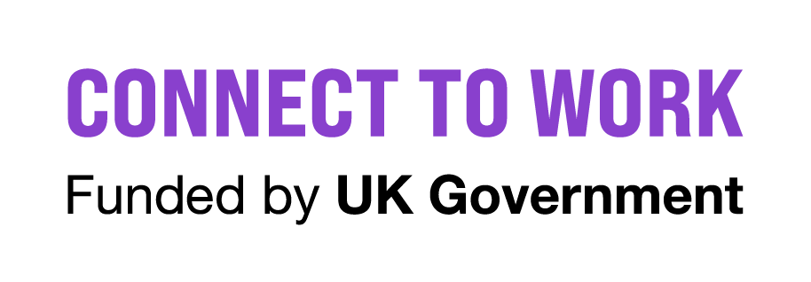


Sheffield Supported Employment
Peter Slack
Joao Bento Galinha

Slide 2
Sheffield Supported Employment
👥 Personalised Support: Tailored 1:1 job coaching, confidence building, CVs & interview prep
🏢 Real Jobs, Real Pay: Placements with local employers
🧩 Inclusive Employers: Support for businesses to be truly inclusive and access untapped talent
💬 On-the-Job Support:We stay with our clients every step of the way – even after they get the job
🌍 Changing Mindsets: We challenge stereotypes and the programme also complements the wider council mission to create a fairer, more inclusive city.
✔️ 138 people supported
✔️ 41 secured employment

Slide 3
Sheffield Supported Employment
Sheffield City Council has secured a contract to deliver the Government’s five-year Connect to Work programme
Supported Employment is part of Connect to Work programme and launched in Sheffield in September 2025, providing tailored employment support for residents with Autism and/or learning disabilities or neurodiversity.

Slide 4
Sheffield Supported Employment
5 Stages of Support
Stage 1: Participant Engagement
1
2
Stage 2: Vocational Profiling
Stage 3: Engaging Employers
3
4
Stage 4: Job Matching
Stage 5: In-Work Support & Career Development
5

Slide 5

Sheffield Supported Employment
Referrals
Triage service
opportunity@sheffield.gov.uk
0114 229 6188

