Slide 1


Teacake Club
Autumn
2026

Slide 2
Welcome !

Slide 3

Scott & Rachel

Slide 4

WELCOME TO THE SHEFFIELD COLLEGE

Slide 5


.

Slide 6



Slide 7
Who is The Sheffield College?
One of the largest further education colleges in South Yorkshire.
Delivers academic, vocational, technical qualifications, apprenticeship and higher education programmes.
Supports thousands of learners and employers annually.
Mission: Transforming Lives Through Learning

Slide 8
Formation of The Sheffield College (1992-1993) - A Landmark Merger
The College was formed through the merger of six tertiary colleges:
Castle College
Loxley College
Norton College
Parkwood College
Parson Cross College
Stradbroke College
Outcome: A single institution serving communities across Sheffield
The Origins (1980s) The Foundation for Change
Sheffield introduced a tertiary education system in 1988.
Post-16 education shifted from schools to specialist colleges.
A new approach aimed to increase educational opportunities across the city.
Created the conditions for a major college merger

Slide 9
Becoming Britain's Largest College (1995)
Rapid Growth and Expansion
More than 33,000 students enrolled.
Nearly 7,000 full-time learners.
Recognised as Britain's largest college.
Significant contribution to skills development across the region.

Slide 10
Campus Development and Investment
Modern Facilities for Modern Learning
Development of key campuses across Sheffield.
Expansion of vocational and technical training facilities.
Hillsborough Campus became a major learning centre.
Continued investment in student experience and industry-standard environments
Innovation and Employer Engagement
Responding to Workforce Needs
Strong focus on employability and skills.
Development of employer-responsive training programmes.
Launch of pioneering customer service training for taxi drivers in 2012.
Growing apprenticeship provision supporting regional economic growth.

Slide 11
Recognition and Cultural Impact
A College Embedded in the Community
Former Norton Campus featured in This Is England '90.
Continued role as a key educational institution within Sheffield.
Strong partnerships with employers, universities and community organisations.
The College Today
Leading Further Education in South Yorkshire
Approximately 13,500 learners.
More than 2,500 apprentices.
Wide-ranging curriculum from entry level to higher education.
Driving social mobility, skills development and economic prosperity.

Slide 12
Over Three Decades of Success
Created through the merger of six colleges
Became Britain's largest college
Expanded technical and vocational excellence
Developed strong employer partnerships
Supported thousands of learners into employment and higher education
Continues to transform lives through learning

Slide 13
Looking Forward
"From its beginnings as a bold educational reform, The Sheffield College has evolved into a cornerstone of learning, skills and opportunity for Sheffield and South Yorkshire."
30+ years of transforming lives, strengthening communities, and shaping future careers

Slide 14

Then the Employment Services Agency was Born

Slide 15




Why the Employment Services Agency?

Slide 16
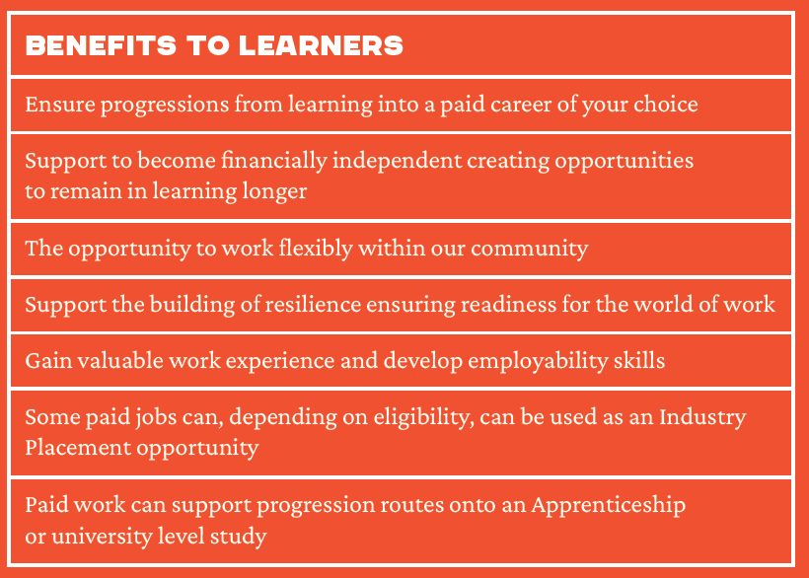
For the students…
Searching for the right job can be time-consuming and stressful. Whether you are looking for a temporary, fixed-term, part-time or a permanent job.
The Sheffield College’s Employment Services Agency is here to help you find your perfect opportunity.
Our team of experts are here to support you through our employer’s
Part time and seasonal work and possible progression onto a full-time job.

Slide 17
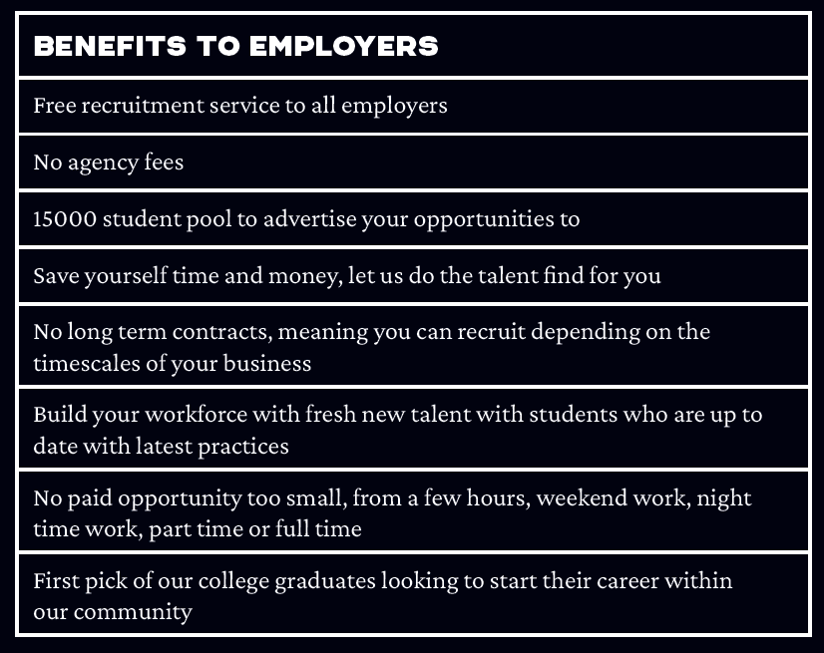
For employers…
Recruiting new staff members can be an expensive and time-consuming activity that can often yield little return.
The Employment Services Agency is here to take the stress out of recruitment. Our expert team are on hand to match your vacancies with the perfect candidate from our vast pool of talented learners. No opportunity is too small, from a few hours, weekend work, evening time work, part time or full time, there are no restrictions as to what positions can be advertised with us.

Slide 18
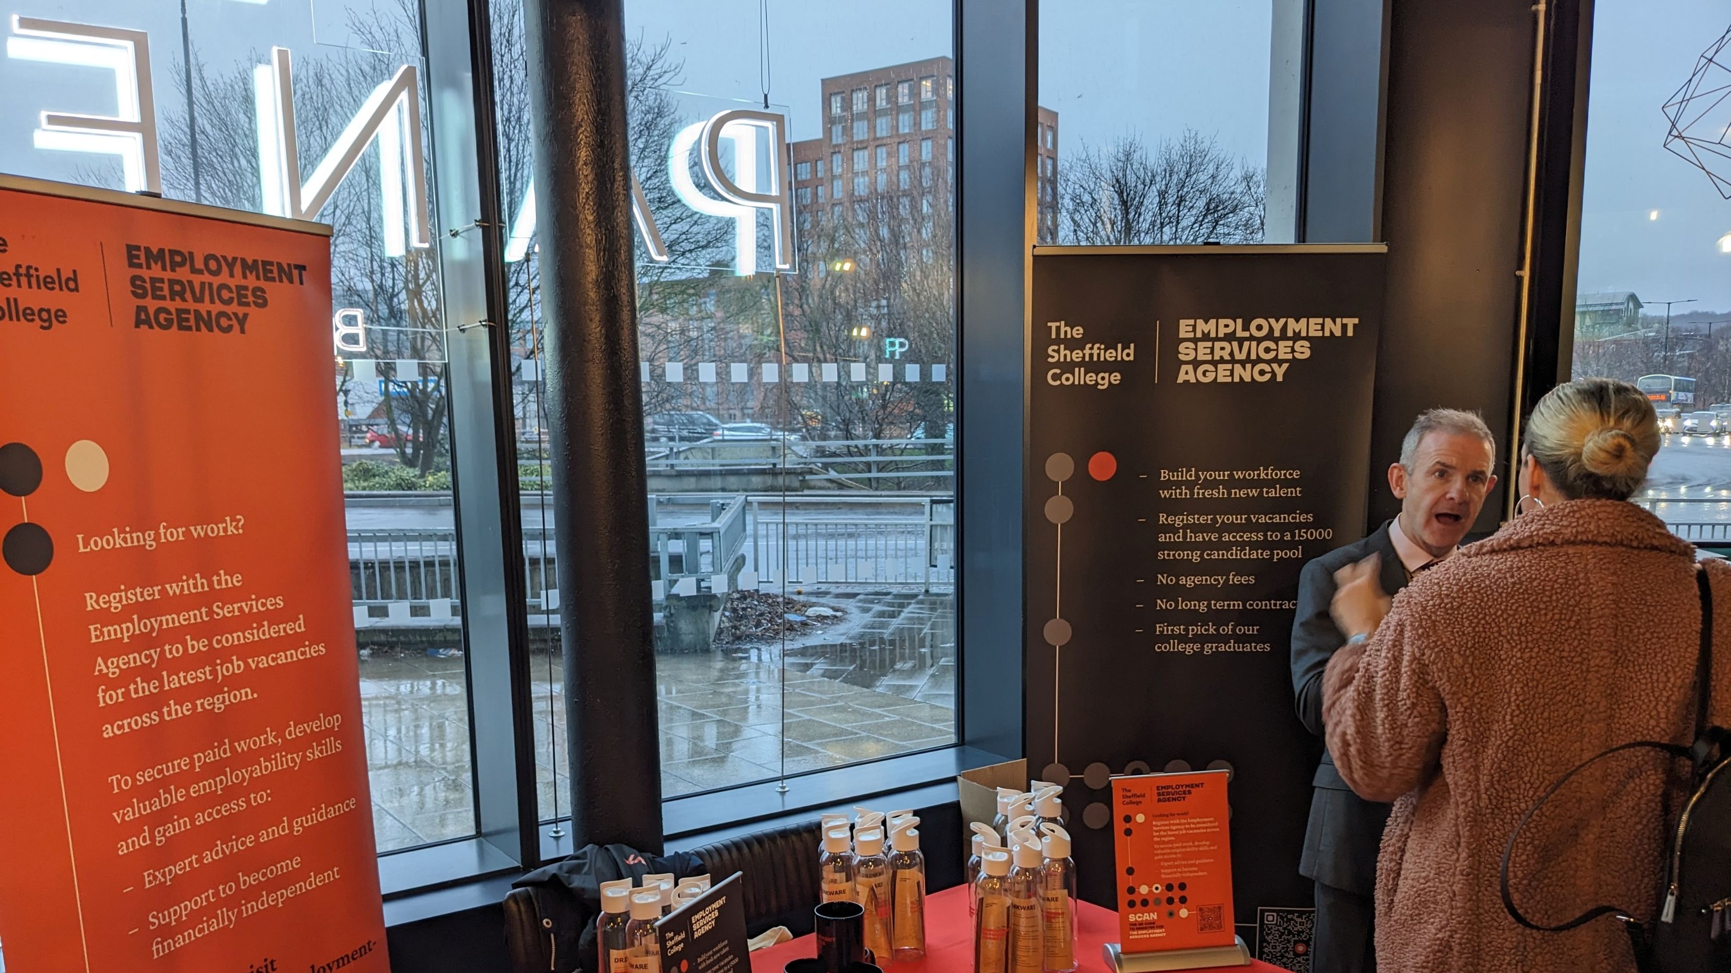
Notes:
We took the initiative to get involved with networking events around the Sheffield region to gain a quick win promotion to business to introduce the agency and explain what we were doing and how this could benefit the organisation. We sponsored the events so we were KEY speakers and this went down a storm!!

Slide 19
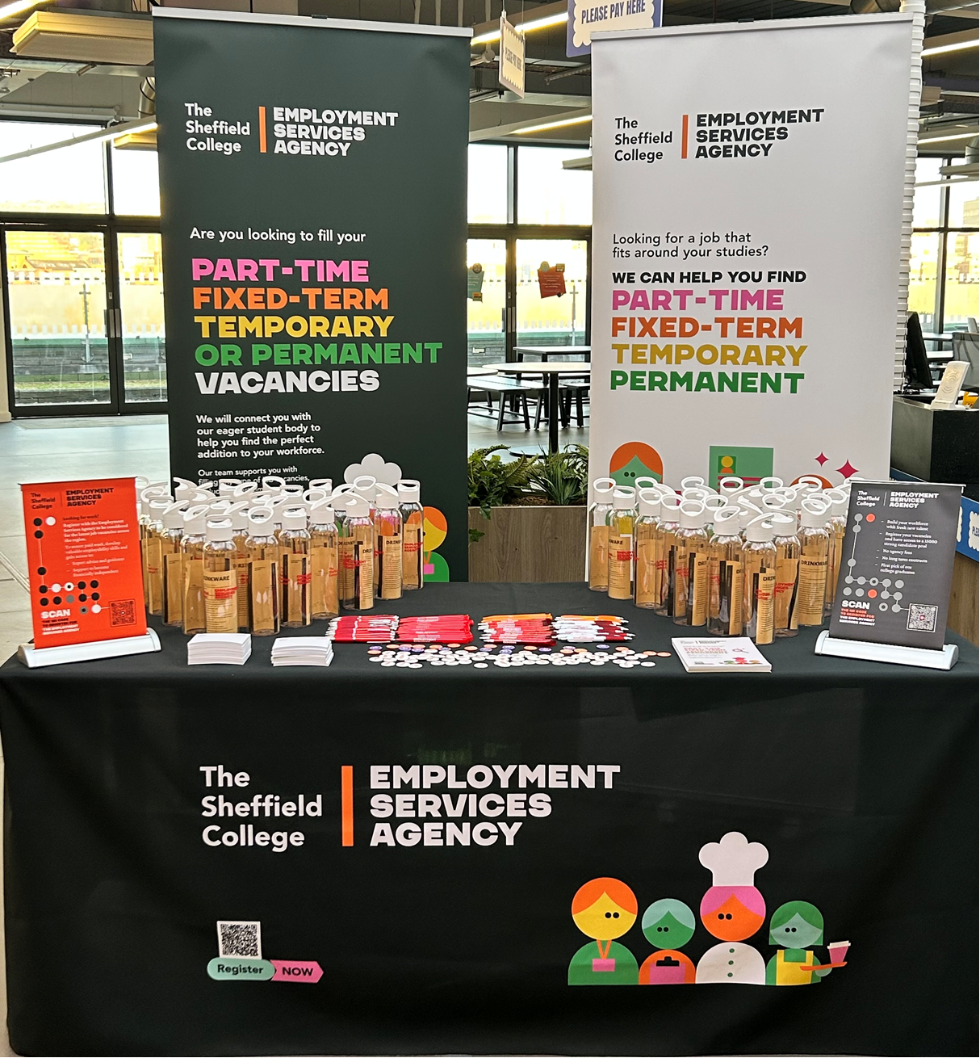
Notes:
We also host regular “pop-up” information stands within the college to raise awareness of the Employment Services Agency and ensure students know that support is readily available. These events provide an opportunity for students to learn about the services we offer, access guidance on employment opportunities, and receive practical resources and promotional materials designed to support their journey into work.
Our staff wear Employment Services Agency branded uniforms, which help to increase the visibility of the service and make it easy for students to identify and approach team members. This encourages informal conversations, allows students to access valuable information and advice, and provides a straightforward route to arranging a one-to-one appointment for more tailored employment support.

Slide 20









Businesses we are Collaborating with

Slide 21



Removing Barriers, Raising Aspirations
A Collaborative Employment‑Focused
Approach to Widening Participation
&
Pathways to Work Participants
Notes:
Quick Intro

Slide 22
Thank you
The Sheffield College

Slide 23

Katy Pugh

Slide 24
Money Guidance
Teacake club – 29th October 2026

Slide 25







Guess the bank

Slide 26


Money Guidance
Money Guidance is based on the Money Guiders Framework created by the Money and Pensions Service which cover 12 areas including budgeting and cashflow, insurance, saving and planning for later life.

Slide 27


Slide 28


Why is this important for employment advice?
If a client has money worries, these need to be acknowledged. These worries will have an impact on the ability to engage and make good decisions.

Slide 29
Why is this important for employment advice?
Do you know how to read your payslip – is the tax right?
What are the benefits of having a pension and how much will be taken out of your salary?
Preparation for work
How are you going to manage if you don’t get paid until the end of the month?
What impact will having a job have on other bills (eg council tax reductions)
Shall we do a budget?

Slide 30

What is Money Guidance?
What it is?
It’s not debt advice
What it’s not
It’s not applying for benefits and crisis loans
It’s not financial investment advice

Slide 31
It could be…
….to encourage people to talk about money and feeling comfortable about having money conversations.
…. to help people take control of their finances before it becomes out of control.
…to provide the tools to keyworkers or volunteers do they feel confident about giving money guidance.

Slide 32


Next steps
Money Guidance Training
Money Helper website
Get in touch:
Katy.pugh@sycb.co.uk
07731 936388

Slide 33

Liam Rogerson

Slide 34
Coffee Break

Slide 35
In Brief

Slide 36

Smaira Sadique
smaira.sadique@sheffield.gov.uk
07789 868191

Slide 37

Jane Williamson

Slide 38


Migrant worker update
Opportunity Sheffield - Teacake Club 29/10/26 jane.williamson@migrationyorkshire.org.uk

Slide 39
Who has the right to work
UK and Irish citizens.
People with valid work visas.
People with indefinite leave to remain.
EU citizens with settled or pre-settled status.
People who have relocated here from Hong Kong and Ukraine.
People with refugee status.
Dependent family members.
Students can work up to 20 hours per week.
Some asylum seekers have the right to work in specific job roles if their claim is outstanding for 12 months.

Slide 40
Illegal working
83% increase in raids since Labour came into power.
In 2025, almost through 13,000 visits, 9,000 arrests were made and over 1000 people removed from the UK.
Fine for employers range from £45,000 to 5 years imprisonment.
Rules tightened (again) from 1st October 2026.

Slide 41
Exploitation
People without secure immigration status, or who are tied to a particular employer, can be particularly vulnerable to exploitation. Some employers take advantage of workers’ concerns about immigration status, making it difficult for them to challenge poor or unlawful working conditions.
Common forms of exploitation include:
Underpayment
Excessive working hours
Debt and illegal fees
Coercion and control

Slide 42
International work visas
There are many different types of work visa, however most employers use the Skilled Worker route. Employers using this route must apply to become a Home Office licensed sponsor and follow strict compliance regulations. The job must have a minimum salary of £41,700. (Increased from £25,600 in 2020)
Workers on the Skilled Worker route:
  Must have a job offer from a licensed sponsor which is on the list of eligible occupations.
  The job offer must be at the required skill level – since 2025 must be graduate level or above.
  They must speak English to the required standard.
  Their right to remain in the UK is linked to their sponsorship.

Slide 43
Sponsorship issues
Migrant workers on Skilled Worker Visa can only work for the employer who has sponsored them. The employer must be licensed by the home office.
If a skilled worker loses their job (for whatever reason) they have only 60 days to find another sponsor.
This includes cases where a sponsor has their license revoked by the Home Office following investigation, which can affect hundreds of workers at a time.

Slide 44
Health and Social Care Visas
In 2022, 158,000 H&SC visa (77,000 + 81,000 dependents) were issued making up 54% of all skilled worker visas. In 2023 that number rose to 350,000 (146,000 + 203,000 dependents) making up 75% of all skilled worker visas.
The main sponsorship countries are Nigeria, Zimbabwe, India and Pakistan.
More than half of all international students (26,200) who switched directly from study visas to skilled worker visas in the year ending June 2023 went into care work
In England, there are 14,000 residential care home providers and 8,900 domiciliary care providers with a combined workforce of around 1.5 million people.
The number of businesses licensed to sponsor skilled migrants rose from 30,000 in 2020 to 84,000 in 2023.

Slide 45
Health and Care Visa Timeline
August 2020 - Health & Care Visa introduced (care workers excluded)
February 2022 - Care workers added to Skilled Worker visa
August 2023 – The Home Office tightens processes for visa and sponsorship applications amid widespread reports of worker exploitation, modern slavery, and illegal recruitment fees.
March 2024 - Dependant restrictions introduced. Care providers in England wishing to sponsor workers must now be registered with the Care Quality Commission (CQC).
April 2024 - Immigration Salary List introduced; salary thresholds rise
July 2025 - Overseas recruitment for care workers ends
Autumn 2026? - New Earned Settlement Rules come into effect
July 2028 - Care Worker visa route closes to new entrants (but existing visa holders can continue to work, and to change jobs)

Slide 46
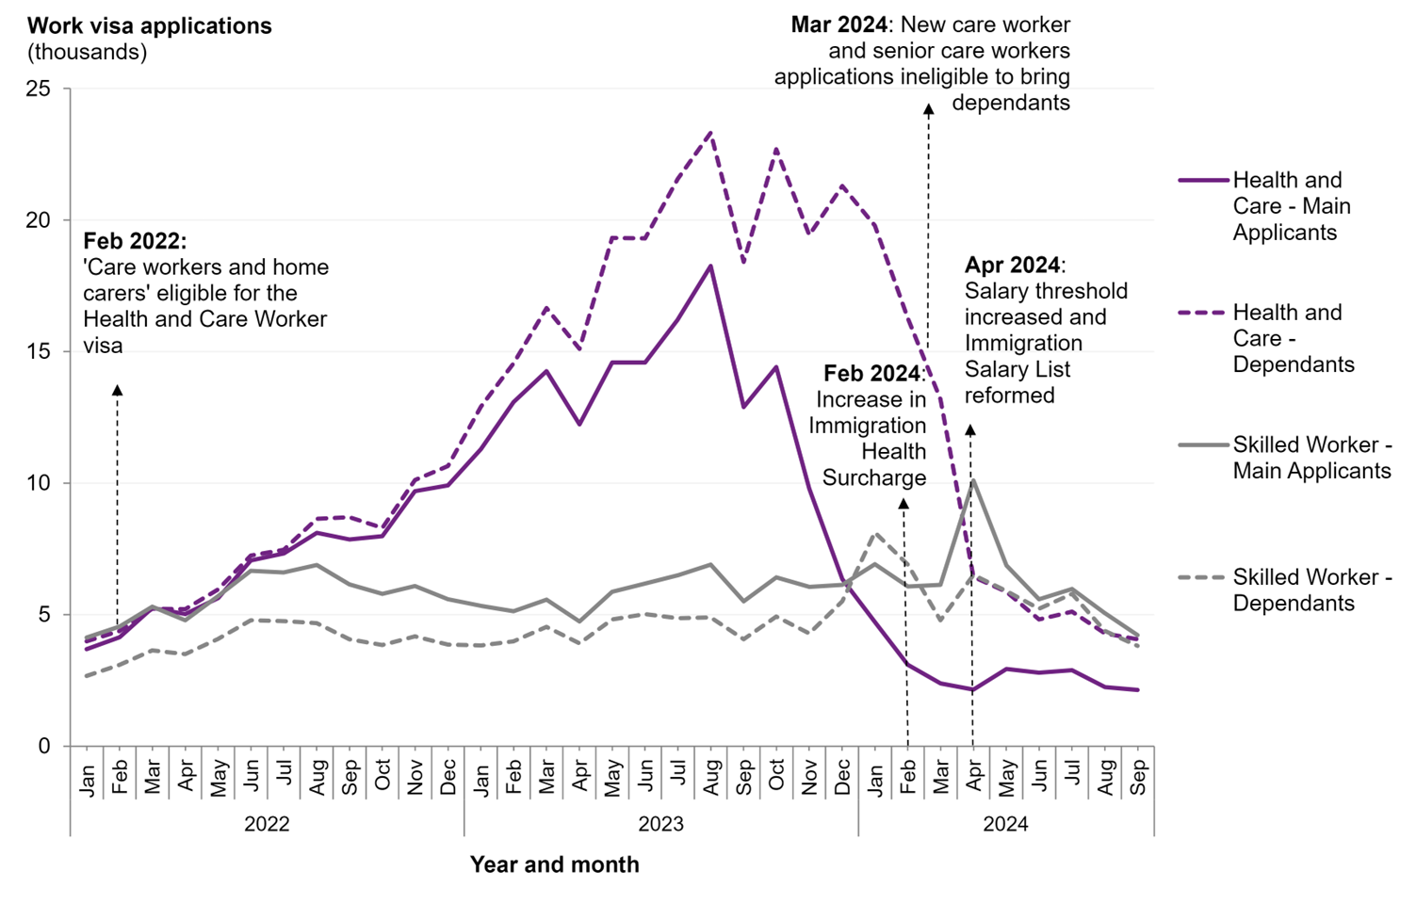
Source: Home Office

Slide 47
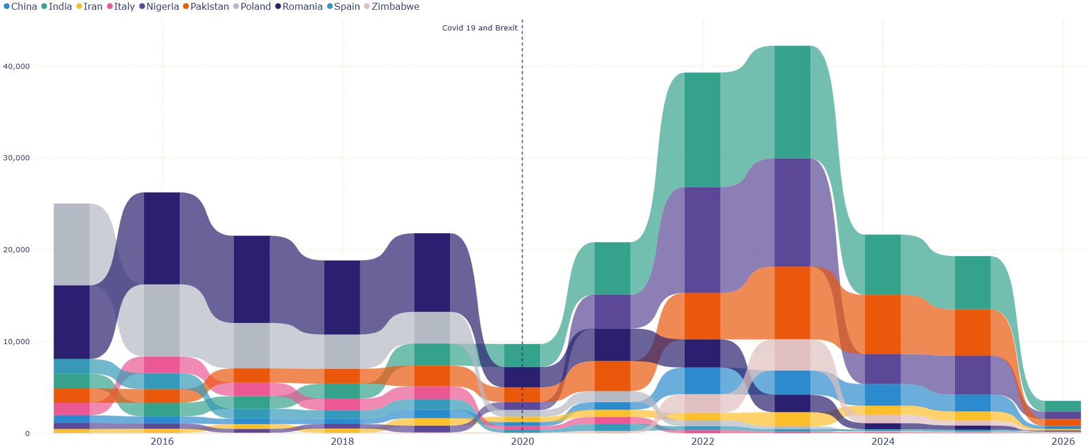
What is the picture in Yorkshire and Humber

Slide 48
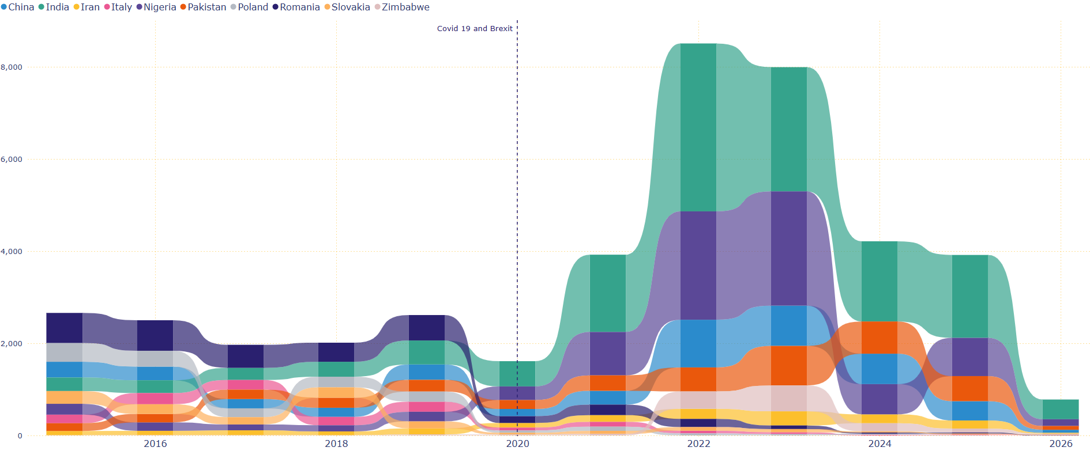
What is the picture in Sheffield?

Slide 49
In Yorkshire and Humber
Almost 7,000 workers have been contacted by UKVI after their employer lost their sponsorship license. Of these, just over 50% contacted the International Recruitment Hub for support and 934 people have found new employment through this route.
However, exploitation is rife within the sector and with the underlying threat of deportation, it’s impossible to know how many people are working in unsafe conditions.
It’s also impossible to know how many people have returned to their country of origin after exhausting all other options.

Slide 50

Migration Yorkshire
Regional Migrant Care Worker Forum - The forum brings together key stakeholders to share intelligence, identify gaps in support, promote safeguarding, and develop evidence-based recommendations, while centring the experiences of migrant workers.
Yorkshire and Humber data dashboards – Newcomers, EU Settlement, Ukraine, Refugee and asylum seekers
‘Migrant Talent Yorkshire’ – an online platform to provide practical information and resources for employers who are considering employing people from migrant and refugee backgrounds.

Slide 51
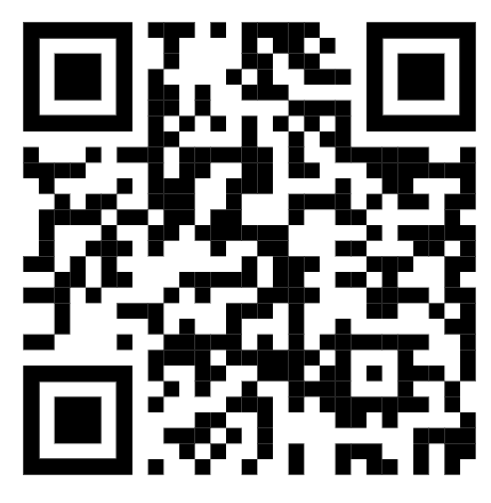


Home - Migrant Talent Yorkshire

Slide 52
THANK YOU

Slide 53
RAFFLE!

